Slide 1
STAC and CEOS ARD
Matthias Mohr
Agenda Item 7.2
WGISS-57
4-7 March 2024
Sydney, Australia

Slide 2
The Past: STAC CARD4L Extension
Complex
Only SR, ST, NRB, POL
Has many “card4l:” fields that should live in separate STAC extensions
Outdated name

Slide 3
Tasks
Create new CEOS ARD STAC extension
Deprecate STAC CARD4L extension
Create specific STAC extensions for missing fields
Work with CEOS on clarifications and template(s)
Make (example) data available
Check how this relates to and can benefit the ISO/OGC ARD work

Slide 4
CEOS ARD STAC Extension
Simplify
may not include all desired requirements
Additional PFS make it more complex again
Create “profiles” for Optical and Radar
Extend to cater for (1) AR, NLSR and (2) ORB, GLSC
Update naming scheme
Create JSON Schema
Create examples

Slide 5
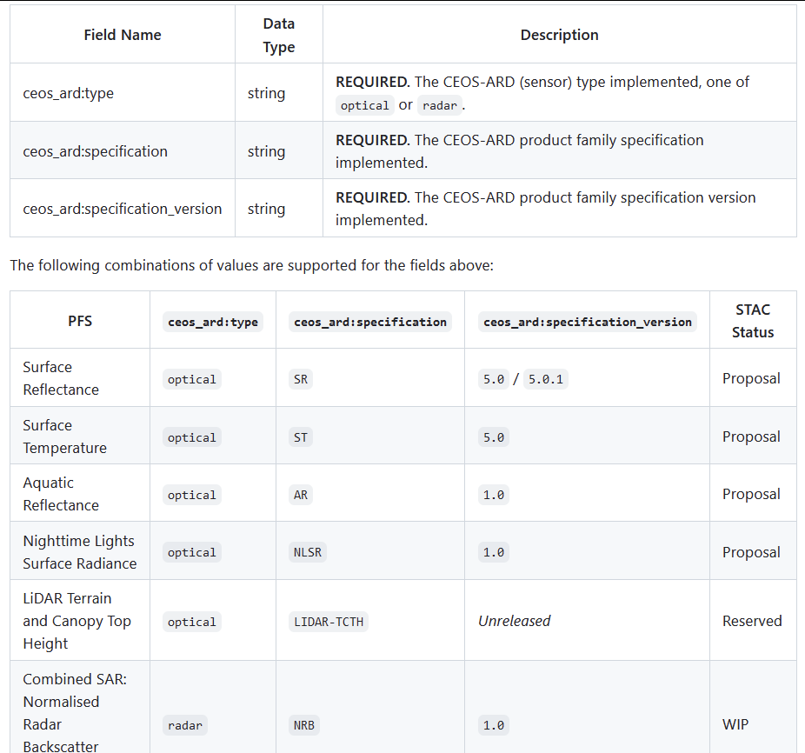

Slide 6
Optical
Draft is available
Waiting for a couple of clarifications (meeting next week)
May need updates if Optical PFS get merged
Wish for a review by CEOS
Example dataset will be created (likely Sentinel-2, hosted on Source.coop)

Slide 7
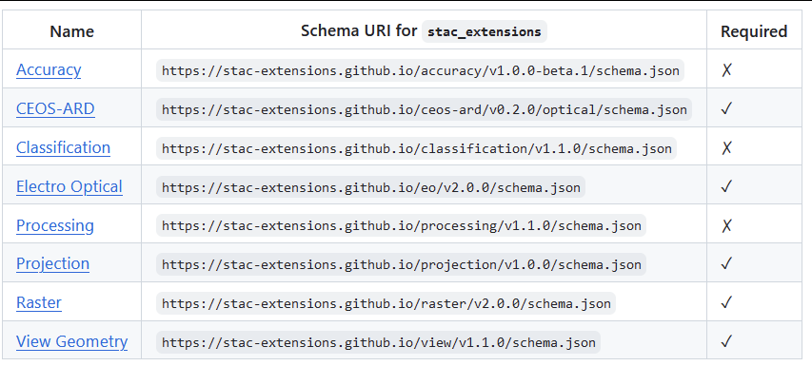
STAC Extensions for Optical
Difficult: Per-pixel metadata and “DOI documentation”

Slide 8
Radar
Planned for 2024 (or 2025)
Needs a lot of discussions for new STAC extensions
Help wanted - I have no clue about SAR!

Slide 9
Missing radar fields
mean_faraday_rotation_angle
ionosphere_indicator
speckle_filtering
pixel_coordinate_convention
measurement_type
measurement_convention
conversion_eq
relative_radiometric_accuracy
absolute_radiometric_accuracy
resampling_method
dem_resampling_method
egm_resampling_method
geometric_accuracy_type
gridding_convention
beam_id
orbit_data_source
orbit_mean_altitude
source_processing_parameters
source_geometry
incidence_angle_near_range
incidence_angle_far_range
resolution_azimuth
resolution_range
noise_equivalent_intensity
noise_equivalent_intensity_type
peak_sidelobe_ratio
integrated_sidelobe_ratio
noise_removal_applied

Slide 10
Profiles
Similar to STAC extensions: work on small groups of related information => a profile
PFS can cherry-pick from those profiles
No inconsistencies between PFS
Easier to create new PFS

