Slide 1
International Directory Network (IDN) Report
CEOS WGISS-57
Hosted by Geoscience Australia
Sydney, Australia, March 5-7, 2024
Michael Morahan (KBR)
IDN Coordinator
Michael.P.Morahan@nasa.gov
WGISS-0324-MM
Notes:
CEOS: Committee on Earth Observation Satellites
WGISS: Working Group on Information Systems and Services
CNES: National Centre for Space Studies
KBR: Kellogg Brown & Root ltd

Slide 2
Table of Contents
CEOS/IDN/CWIC Collaborations
CEOS WGISS ceos.org Updates
UMM Updates
GCMD Keyword
IDN Metrics
WGISS-0324-MM
Notes:
CEOS: Committee on Earth Observation Satellites
IDN: International Directory Network
CWIC: CEOS WGISS Integrated Catalog
WGISS: Working Group on Information Systems and Services
UMM: Unified Metadata Models
GCMD: Global Change Master Directory

Slide 3
CEOS/IDN/CWIC Collaborations
IDN Search and CWIC Portals, IDN/CWIC Metrics, CEOS/IDN/CWIC Collaborations
WGISS-0324-MM

Slide 4
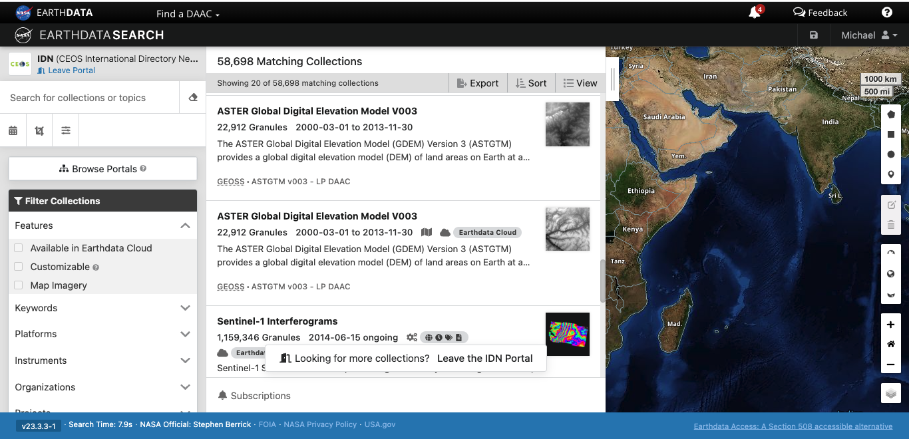
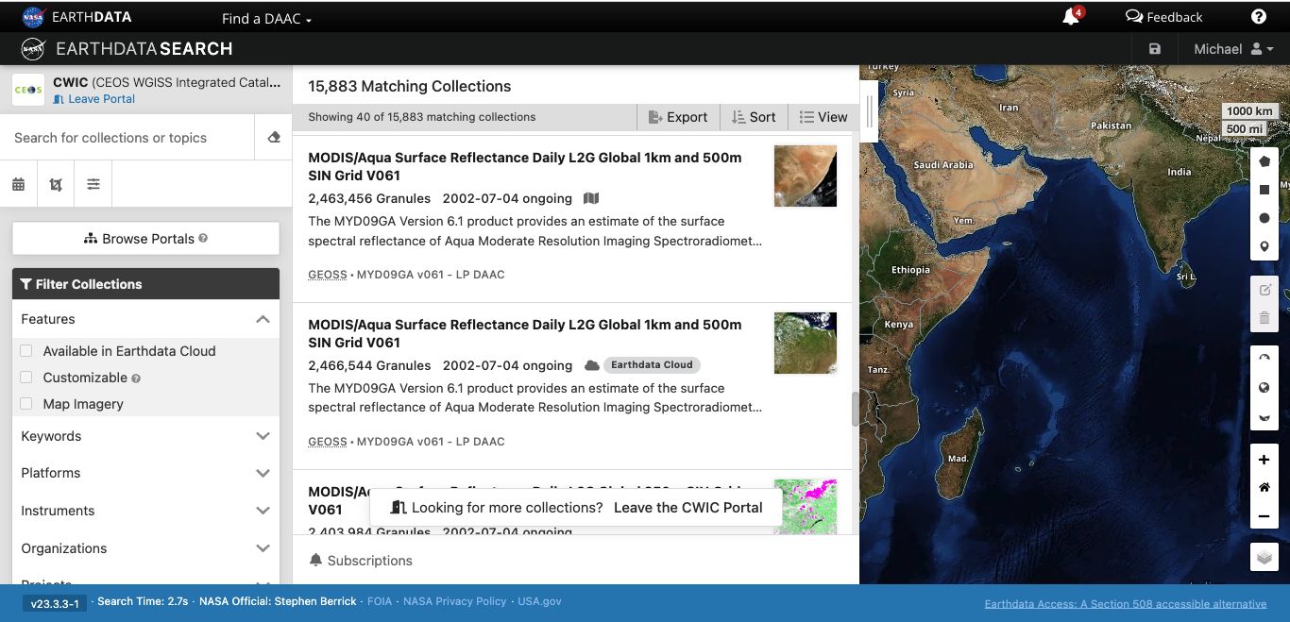
IDN Search and CWIC Portals
IDN Search Portal
CWIC Portal
Scope: All dataset metadata entries in the CMR
https://search.earthdata.nasa.gov/portal/idn/search
Scope: All CWIC dataset metadata entries in the CMR
https://search.earthdata.nasa.gov/portal/cwic/search
WGISS-0324-MM
Notes:
IDN: International Directory Network
CWIC: CEOS WGISS Integrated Catalog

Slide 5
IDN/CWIC Metrics
Total Collections and Granules offered by the CWIC and FedEO:
CEOS Interfaces | Total Collections | Total Granules
CWIC | ~369 | ~17,811,018
FedEO | ~510 | ~60,846,230
JAXA/FedEO | 1017 | ~13,740,118
Total Collections and Granules offered by the IDN:
IDN Search Portal | Total Collections | Total Granules
IDN | ~52,985 | ~1,401,651,712
WGISS-0324-MM
Notes:
FedEO: Federated Earth Observation
JAXA: Japan Aerospace Exploration Agency

Slide 6
CEOS/IDN/CWIC Collaborations
ESA/FedEO
Tested FedEO test server for ingest of ESA, ESA CCI, VITO, DLR collections, granule discovery and download.
Updated VITO collections in the CMR for the IDN
Updated or added new platforms keywords.
JAXA
Tested FedEO test server for ingest JAXA collections, granule discovery and download.
NOAA NCEI
Ingest test of NOAA/NCEI collections
Total number of records 37,335
24,873 ingested into CMR
12,462 failed ingest
Continually, reviewing CMR ISO mapping for MetadataAssociation and RelatedURL
ISRO
Updated existing collection metadata records.
Review download links for CEOS 2-step collection-granule discovery and download thru OpenSearch APIs.
INPE
IDN to review INPE STAC API and clients
CEOS Tools
Search for CEOS tools by ShortName or Keyword examples:
ShortName: https://cmr.earthdata.nasa.gov/search/tools.umm_json?name=Proba-V%20MEP&pretty=true
Keywords: https://cmr.earthdata.nasa.gov/search/tools?keyword=Sentinel%20satellites
WGISS-0324-MM
Notes:
NOAA: National Oceanic and Atmospheric Administration
NCEI: National Centers for Environmental Information
ISRO: Indian Space Research Organisation
INPE: National Institute for Space Research (Brazil)

Slide 7
CEOS WGISS ceos.org and idn.ceos.org Updates
Updates to CEOS WGISS IDN page, Replace CWIC with CEOS Providers contribution page, Replace idn.ceos.org site with earthdata.nasa.gov/idn site
WGISS-0324-MM

Slide 8
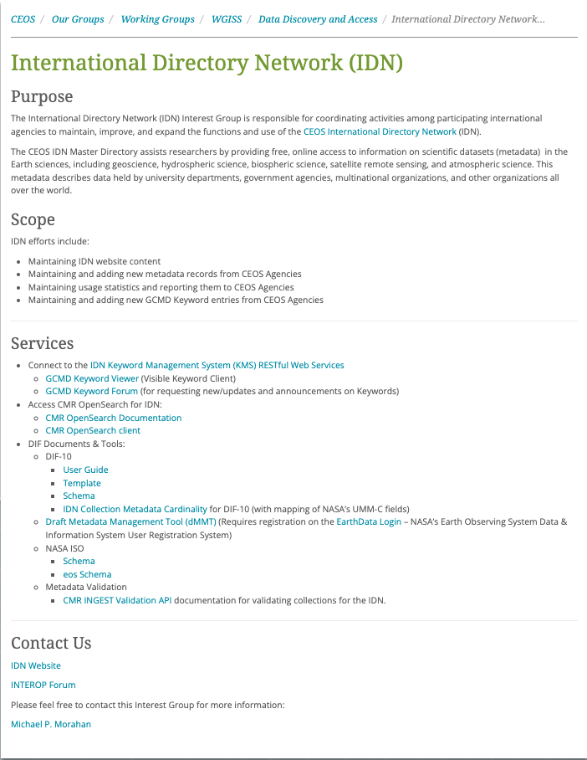
CEOS.ORG IDN Description Page
Changed CEOS International Directory Network link from https://idn.ceos.org/ to new site: https://www.earthdata.nasa.gov/learn/find-data/idn
Due to the retirement of the URL
Added IDN Search Portal link: https://search.earthdata.nasa.gov/portal/idn
Re-organized Services section:
Changed first bullet to “Connect to the GCMD Keyword Management”
Added sub-bullet “Keyword Management System (KMS) RESTful Web Services”.
Updated DIF links
Changed Michael.P.Morahan to “Contact the IDN” with email link to “support@earthdata.nasa.gov”.
WGISS-0324-MM

Slide 9
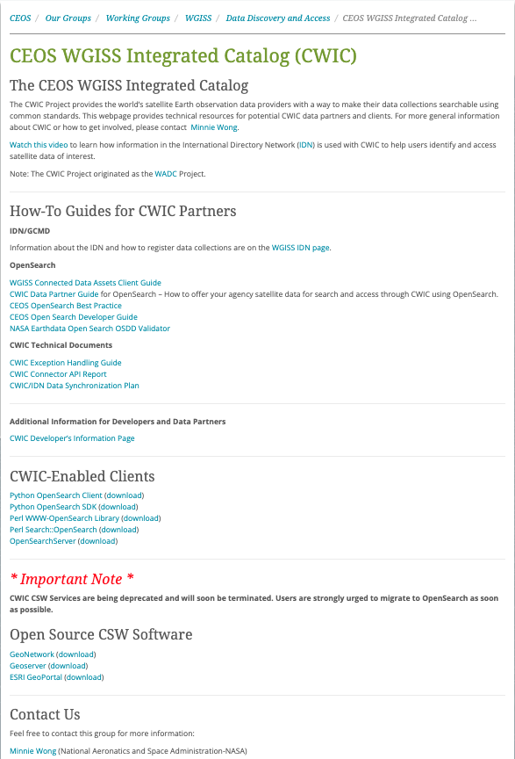
CEOS.ORG CWIC Description Page
Updates:
Change Main Title on page
Description paragraph removing CWIC references to CMR references.
Change section title “CWIC-Enabled Clients” to “OpenSearch enabled Clients”.
Change Minnie Wong contact to “support@earthdata.nasa.gov”
Replace:
CWIC references in sub-titles with CMR.
Title “CWIC Technical Documents” with “CMR Documents” and CWIC links to CMR links.
Remove:
CWIC video.
“Additional Information for Developers and Data Partners” section.
CSW deprecation notice.
Open Source CSW Software
WGISS-0324-MM
Notes:
CMR: Common Metadata Repository
CSW: Catalogue Service for the Web

Slide 10
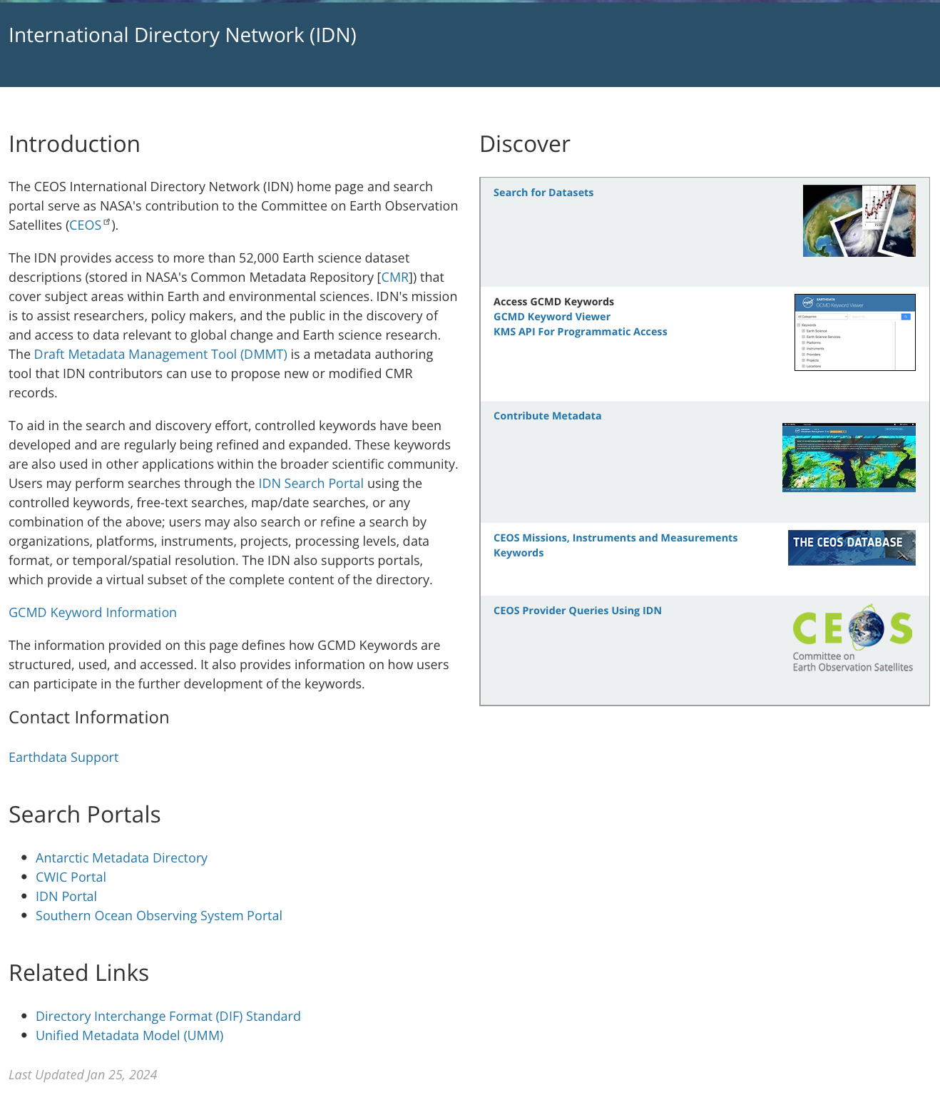
New IDN Homepage
Added missing features:
Links to CEOS specific queries on the IDN Search Portal.
Searches on CEOS MIM Keywords
Searches for specific CEOS Provider collections
Links to important sites
Unified Metadata Model (UMM)
Directory Interchange Format (DIF) Standard
Global Change Master Directory (GCMD)Keywords site.
WGISS-0324-MM
Notes:
MIM: Missions, Instruments, and Measurements

Slide 11
UMM Updates
Updates to UMM Collection
WGISS-0324-MM

Slide 12
Unified Metadata Model for Collections (UMM-C) To Support Unified Dataset Landing Pages/Web unification effort.
Existing fields under review for updates:
AssociatedDOIs > Type: used to inform users about what kind or type of DOI association is related to the element value.
New Enumeration: “Other”
AssociatedDOIs > DescriptionOfOtherType: describes what is the Other value populated in the type field of the Associated DOI.
SpatialCoverageType: describes the type of spatial (geographic or selenographic) coverage of the data in the collections.
New Enumerations: “Earth/Global” and “LUNAR”
WGISS-0324-MM
Notes:
UMM-C: Unified Metadata Models-Collection
DOI: DIGITAL OBJECT IDENTIFIER

Slide 13
Unified Metadata Model for Collections (UMM-C) To Support Unified Dataset Landing Pages/Web unification effort.
New fields under review:
DataMaturity: is used to inform users on where the collection is in a collection's life cycle.
Enumerations: “Beta”, “Provisional”, and “Validated”.
DOI > PreviousVersion: provides a record of every time that a DOI was updated and links to the DOI landing page for the previous version.
Sub-fields: Version(String), Description(String), DOI(DOI value), and Published(Date).
OtherIdentifiers: provides secondary or additional Identifiers of the collection.
Sub-fields: Identifier(String), Type(Enumeration), and OtherDescription (String).
FileNamingConvention: refers to the naming convention of the granule file along with a description of the granule file construction.
Sub-fields: Convention (String) and Description(String).
StrengthsLimitations: used to describe the usefulness, effectiveness, shortcomings of, or reservations about the data or model outputs in the collection and related publications. The Strengths and Limitations field uses the existing UMM-C OnlineResourceType to define the strengths and limitations documentation links.
TemporalResolution: describes the amount of time needed to revisit and acquire data for the exact same location.
Sub-fields: Value(Number) and Unit(Enumeration)
WGISS-0324-MM

Slide 14
GCMD Keywords
GCMD Keyword Releases, GCMD Keyword Forum, GCMD Keyword Interfaces
WGISS-0324-MM
Notes:
GCMD: Global Change Master Directory

Slide 15
GCMD Keywords
GCMD Keyword Releases:
All Keyword releases: https://wiki.earthdata.nasa.gov/display/ED/Release+Information+for+EOSDIS+Applications#tab-GCMD+Keywords
8 Keyword releases (Version 16.9 to 17.6) since WGISS-56 with various additions to Science Keywords, Platforms, Instruments, Providers, Projects, Data Format, and Product Level ID
GCMD Keyword Forum: https://forum.earthdata.nasa.gov/app.php/tag/GCMD+Keyword
Forum lets GCMD metadata providers request new or updates to the GCMD Keywords and allows users to provide feedback and comments.
Forums User Guide: https://forum.earthdata.nasa.gov/docs/assets/sitedocs/userguide.pdf
GCMD Keyword Interfaces:
All public GCMD Keywords can reviewed using Keyword Viewer or KMS API:
Keyword Viewer: https://gcmd.earthdata.nasa.gov/KeywordViewer
KMS API: https://gcmd.earthdata.nasa.gov/kms/
Example: https://gcmd.earthdata.nasa.gov/kms/concepts/concept_scheme/instruments?format=rdf
WGISS-0324-MM
Notes:
KMS: Keyword Management System
API: Application Programming Interface

Slide 16
New GCMD Keywords
Keyword Type | Keyword Details
Data Center | BU/ES > Earth and Environment, Boston University
Data Center | UMD/GEOG > Department of Geographical Sciences, University of Maryland
Data Format | obs_seq > Observation sequence file format
Data Format | XDMF > eXtensible Data Model and Format
Instrument | Mako > Mako Airborne Thermal Infrared Imaging Spectrometer
Instruments | eMAS > Enhanced MODIS Airborne Simulato
Instruments | TP-LIF > Two Photon - Laser Induced Fluorescence
Instruments | Airmar Weather Station > Airmar Weather Station
WGISS-0324-MM

Slide 17
New GCMD Keywords (continue)
Keyword Type | Keyword Details
Platform | Electro-L
Platform | Feng-Yun-4 > FY-4
Platform | Hai Yang 2
Platform | Lemur-2 > Low Earth Multi-Use Receiver - 2
Platform | Meteor-M > Meteor-M-1 Mission
Platform | Metop-SG > MetOp-Second Generation Program
Platform | MicroCarb > Carbon Dioxide Monitoring Mission
Platform | MTG > Meteosat Third Generation
Platform | SAC-C > Satélite de Aplicaciones Científicas-C
Platform | RCM-1
Platform | RCM-2
Platform | RCM-3
Platform | LPJ-PROSAIL > LPJ-PROSAIL Model
Platform | Noah-MP-LSM > Noah-MP Land Surface Model
WGISS-0324-MM

Slide 18
New GCMD Keywords (continue)
Keyword Type | Keyword Details
Project | NCAR/DART
Project | GEMx > Geological Earth Mapping Experiment
Project | CARTA-2005> Costa Rica Airborne Research and Technology Applications 2005
Project | MISST > Multi-Sensor Improved Sea Surface Temperature Project
Project | TESViS > Terrestrial Ecology Subsetting & Visualization Services
Project | MAS_eMAS > MODIS Airborne Simulator (MAS/eMAS)
Project | TRACE-A > Transport and Atmospheric Chemistry near the Equator-Atlantic
Project | TRACE-P > Transport and Chemical Evolution over the Pacific
Project | ABLE-3 > Arctic Boundary Layer Expedition-3
Project | CITE-3 > Chemical Instrumentation Test and Evaluation-3
Project | PEM-West > Pacific Exploratory Mission-West
Project | PEM-Tropics > Pacific Exploratory Mission-Tropics
Project | BlueFlux > Blue Carbon Prototype Products for Mangrove Methane and Carbon Dioxide Fluxes
Project | BioSCAPe > Biodiversity Survey of the Cape (Updated Definition)
Project | LPJ > LPJ Project
Project | FOCI > Fisheries-Oceanography Coordinated Investigations
WGISS-0324-MM

Slide 19
New GCMD Keywords (continue)
Keyword Type | Keyword Details
Provider | CU-Boulder/ECEE > Electrical, Computer & Energy Engineering, University of Colorado, Boulder
Provider | NASA/GSFC/SED/ESD/BSL > Biospheric Sciences Laboratory, Earth Sciences Division, Science and Exploration Directorate, Goddard Space Flight Center, NASA
Provider | CA/EC/CCB > Climate Change Branch, Environment Canada
Related URL | PublicationURL > VIEW RELATED INFORMATION > DATA PRODUCT SPECIFICATION (Added Definition)
Related URL | PublicationURL > VIEW RELATED INFORMATION > RELATED ARTICLES
Science Keyword | CRYOSPHERE > SEA ICE > MELT POND
Science Keyword | OCEANS > SEA ICE > MELT POND
Science Keyword | EARTH SCIENCE > LAND SURFACE > GEOMORPHIC LANDFORMS/PROCESSES > FLUVIAL PROCESSES > SEDIMENTATION > SEDIMENTARY TEXTURES
Science Keyword | EARTH SCIENCE > LAND SURFACE > GEOMORPHIC LANDFORMS/PROCESSES > FLUVIAL PROCESSES > SEDIMENTATION > SEDIMENT THICKNESS
Science Keyword | EARTH SCIENCE > OCEANS > MARINE SEDIMENTS > SEDIMENT THICKNESS
Science Keyword | EARTH SCIENCE > LAND SURFACE > GEOMORPHIC LANDFORMS/PROCESSES > FLUVIAL PROCESSES > SEDIMENTATION > SEDIMENTARY STRUCTURES
WGISS-0324-MM

Slide 20
IDN Metrics
IDN Homepage Usage, IDN Search Portal Usage
WGISS-0324-MM

Slide 21
IDN Homepage Usage (Monthly)
(January 1, 2023 to January 15, 2024)
(https://idn.ceos.org/ - URL will move to https://www.earthdata.nasa.gov/idn)
January 2023
January 2024
Users | Sessions | Pageviews
4,559 | 6,782 | 9,185
User: An individual person browsing the website.
Sessions: A single visit to the website, consisting of one or more pageviews.
Page Views: A pageview is reported when a page has been viewed by a user on the website.
WGISS-0324-MM

Slide 22
IDN Search Portal Usage (Daily)
(January 1, 2023 to January 15, 2024)
(https://search.earthdata.nasa.gov/portal/idn/search)
Sessions | Users | Views
11,208 | 7,712 | 111,216
User: An individual person browsing the website.
Sessions: A single visit to the website, consisting of one or more pageviews.
Page Views: A pageview is reported when a page has been viewed by a user on the website.
WGISS-0324-MM

Slide 23
IDN Search Portal Usage (continue)
(January 1, 2023 to January 15, 2024)
(https://search.earthdata.nasa.gov/portal/idn/search)
Page | Sessions | Views | Users
/portal/idn/search | 8286 | 34786 | 7214
/portal/idn/search/granules | 2671 | 69869 | 697
/portal/idn/projects | 45 | 3939 | 34
/portal/idn/search/granules/collection-details | 73 | 863 | 51
/portal/idn/search/granules/granule-details | 10 | 681 | 9
/portal/idn/downloads | 143 | 983 | 1042
/portal/idn/preferences | 4 | 20 | 4
/portal/idn/contact_info | 2 | 24 | 2
/portal/idn/subscriptions | 10 | 10 | 11
/portal/idn/search/granules/subscriptions | 7 | 32 | 7
WGISS-0324-MM

Slide 24
Draft MMT Usage
(August 15, 2023 to January 31, 2023)
(https://draftmmt.earthdata.nasa.gov)
MMT Usage from August 15, 2023 to January 21, 2024.
User | Unique Login | Total Logins
Metadata Authors | 6 | 47
Break down of Drafts created, submitted, and approved.
 | Created | Submitted | Approved
New Draft Proposals | 86 | 79 | 77
Update Collections | 26 | 26 | 11
Draft MMT will only save unsubmitted collection metadata for 30 days.
WGISS-0324-MM
Notes:
MMT: Metadata Management Tool

Slide 25
Thank You
Any Questions?
Email Addresses:
michael.p.morahan@nasa.gov (KBR)
valerie.dixon@nasa.gov (NASA)
support@earthdata.nasa.gov
Websites:
https://www.earthdata.nasa.gov/idn
https://search.earthdata.nasa.gov/search?portal=idn
https://gcmd.earthdata.nasa.gov/KeywordViewer
WGISS-0324-MM

Slide 26
Acronyms
API | Application Programming Interface
CEOS | Committee on Earth Observation Satellites
CMR | Common Metadata Repository
CNES | National Centre for Space Studies
CWIC | CEOS WGISS Integrated Catalog
EDSC | Earthdata Search Client
ESA | European Space Agency
FedEO | Federated Earth Observation
GCMD | Global Change Master Directory
GCOM-W1 | Global Change Observation Mission 1st-Water
JAXA | Japan Aerospace Exploration Agency
KMS | Keyword Management System
MMT | Metadata Management Tool
NCEI | National Centers for Environmental Information
NOAA | National Oceanic and Atmospheric Administration
NASA | National Aeronautics and Space Administration
UMM | Unified Metadata Models
WGISS | Working Group on Information Systems and Services
WGISS-0324-MM

Slide 27
Background Slides
WGISS-0324-MM

Slide 28
Useful Links
International Directory Network (IDN)
https://idn.ceos.org/
International Directory Network (IDN) Search Portal
https://search.earthdata.nasa.gov/portal/idn/search
EarthData Login
https://urs.earthdata.nasa.gov/home
Draft MMT
https://draftmmt.earthdata.nasa.gov/
Draft Metadata Management Tool (dMMT) User's Guide
https://wiki.earthdata.nasa.gov/display/CMR/Draft+Metadata+Management+Tool+%28dMMT%29+User%27s+Guide
WGISS-0324-MM

Slide 29
Useful Links (continue)
GCMD Keywords
https://earthdata.nasa.gov/earth-observation-data/find-data/gcmd/gcmd-keywords
GCMD Keyword Viewer
https://gcmd.earthdata.nasa.gov/KeywordViewer/
New KMS URLs
GET Capabilities
https://gcmd.earthdata.nasa.gov/kms/
All Science Keyword in CSV format
https://gcmd.earthdata.nasa.gov/kms/concepts/concept_scheme/sciencekeywords?case=native&format=csv
WGISS-0324-MM

Slide 30
Useful Links (continue)
UMM-C, UMM-G, UMM-S, UMM-T, UMM-V Documents
https://wiki.earthdata.nasa.gov/display/CMR/CMR+Documents
CMR Collection Metadata Schemas
https://git.earthdata.nasa.gov/projects/EMFD
CMR Search API
https://cmr.earthdata.nasa.gov/search/site/docs/search/api.html
CMR OpenSearch Documentation
https://cmr.earthdata.nasa.gov/opensearch/home/docs
WGISS-0324-MM

Slide 31
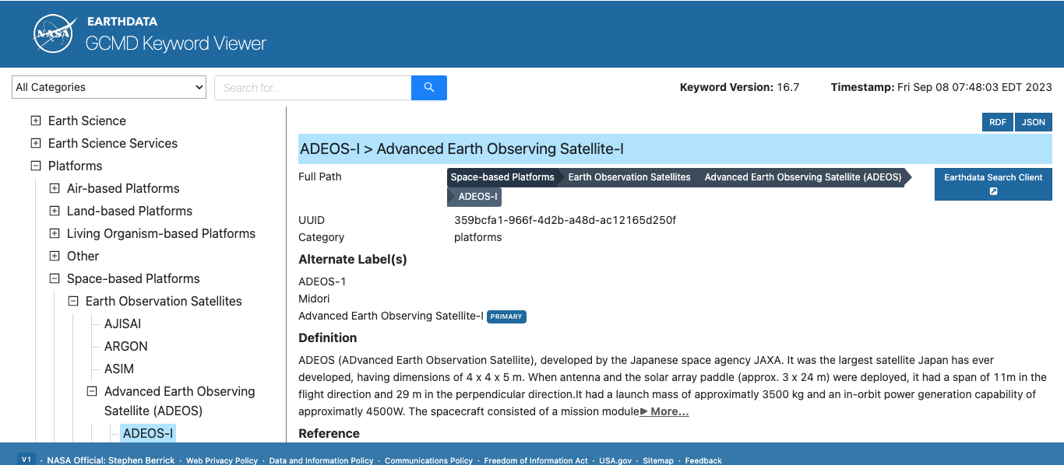
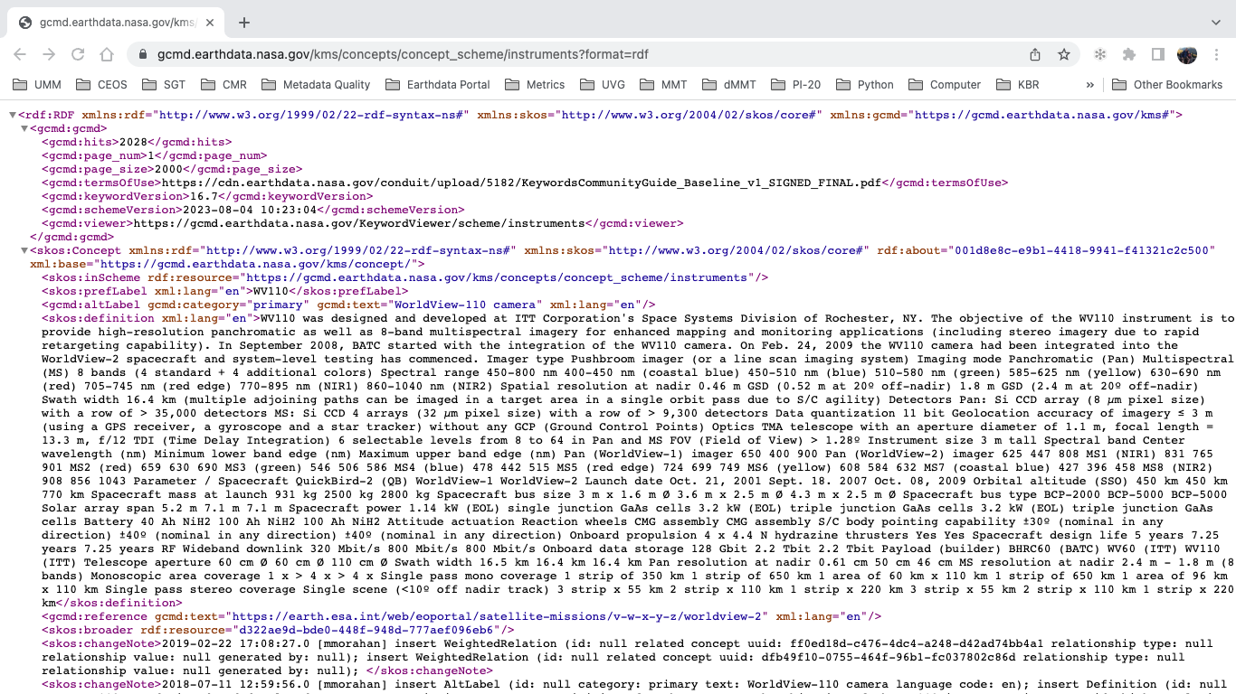
All public GCMD Keywords can reviewed using Keyword Viewer or KMS API:
Keyword Viewer: https://gcmd.earthdata.nasa.gov/KeywordViewer
KMS API: https://gcmd.earthdata.nasa.gov/kms/
Example: https://gcmd.earthdata.nasa.gov/kms/concepts/concept_scheme/instruments?format=rdf
WGISS-0324-MM

Slide 32
This work was supported by NASA/GSFC under Raytheon Technologies contract number 80GSFC21CA001.
WGISS-0324-MM

