Slide 1
WGISS Data Preservation and Stewardship Interest Group (DSIG) Overview and CEOS Workplan
Mirko Albani, ESA
Agenda Item 9.1
WGISS-57
4-7 March 2024
Sydney, Australia

Slide 2
WGISS Interest Groups
https://ceos.org/ourwork/workinggroups/wgiss/

Slide 3
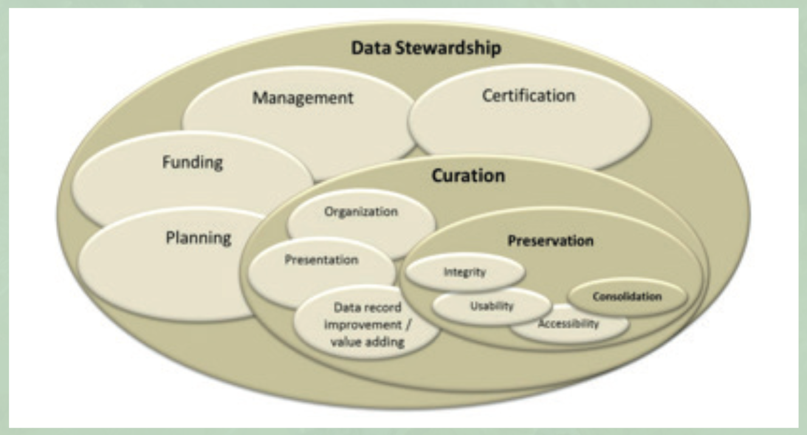
Background
WGISS accomplishes its Data Preservation and Curation efforts through the Data Stewardship Interest Group (DSIG)
Purpose of the activities:
Enable the sharing of agency investigations, developments, experiences and lessons learned relating to EO data stewardship
Issue common cross-agency best practices or guidelines of data stewardship for possible adoption by CEOS/WGISS members
Sponsor technical exchanges and the conduction of Joint Activities and/or Pilot Projects on specific data stewardship topics
Establish and maintain a CEOS “Data Purge Alert” service
Contributing to GEO and Standardization activities

Slide 4
DSIG Achievements
Not exhaustive list of achievements:
Raised awareness on EO data stewardship
Shared investigations, developments, experiences, and lessons learned relating to EO data preservation approaches and technologies
Several documents (White Papers, Best Practices, Guidelines, and recommendations) produced and accessible on the WGISS website
CEOS “Data Purge Alert” and “New Agency Dataset Availability” service
Addressed recovery of Historical Data and started AVHRR project

Slide 5
DSIG Information
https://ceos.org/ourwork/workinggroups/wgiss/preservation/

Slide 6
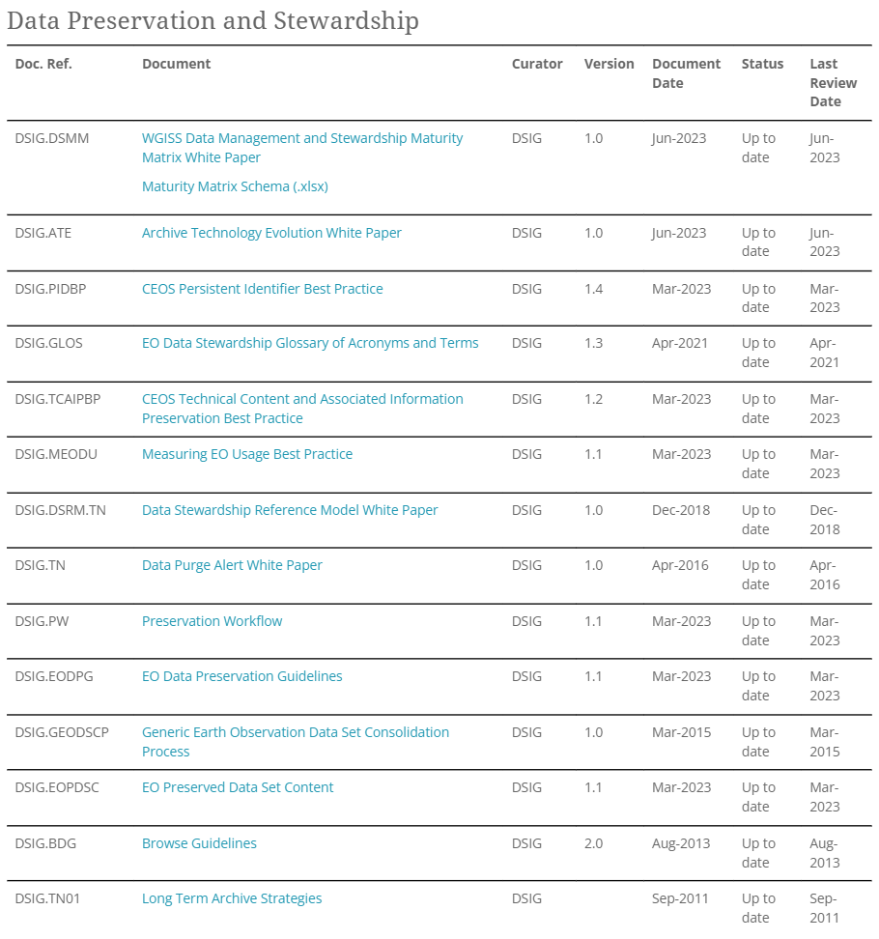
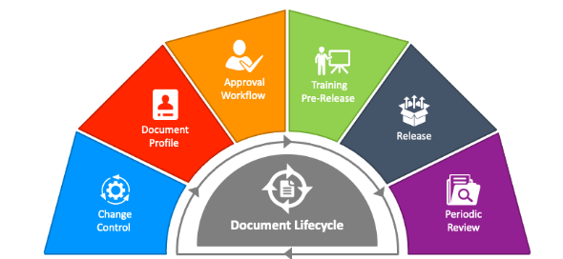
DSIG Best Practices and White Papers
Document review lifecycle
DEDICATED PRESENTATION AT WGISS#57

Slide 7
Data Stewardship Reference Model
The Reference Model assists data owners and data managers in Earth observation (EO) data centres in the task of implementing and improving data stewardship. The Data Stewardship Reference model describes a series of WGISS assets to be applied and used, before, during, and/or after the end of an Earth observation mission, in order to ensure Earth observation space data sets are preserved and valorised.

Slide 8
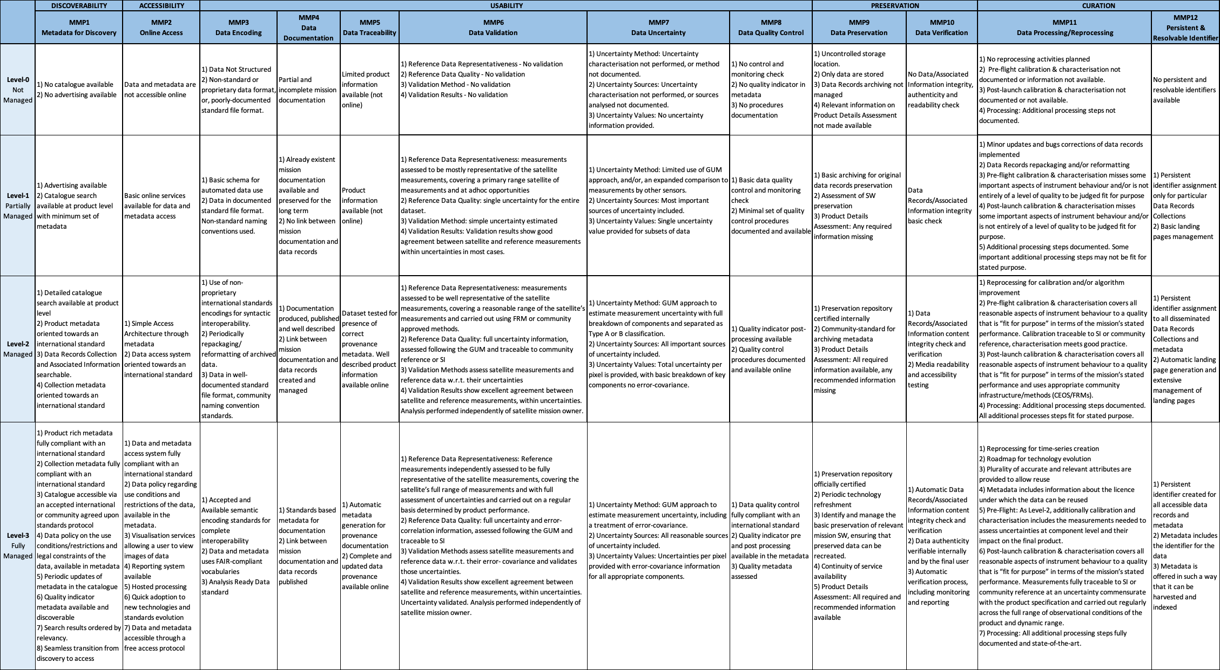
Data Management and Stewardship Maturity Matrix
DMSMM defines all activities needed to preserve and improve the information content, quality, accessibility, and usability of data and metadata.
Tangible example of a Joint Activity on specific data preservation topics
DEDICATED PRESENTATION AT WGISS#57

Slide 9
Archive Technology Trends and Evolution
Archived data volume at CEOS space agencies is growing exponentially. At the same time archiving technology is changing very rapidly. Objective of the survey, workshops and dedicated sessions was to present the status of CEOS agencies archives in terms of content, technology and future evolutions/trends. The result of this activity is the CEOS Archive Technology Evolution White Paper.
The white paper (CEOS workplan deliverable) is the result of dedicated sessions extended to the wider CEOS WGISS context. The starting point was an ESA study for the evolution of the ESRIN Archive to the next technology step in order to assure seamless preservation of the always increasing volume and variety of data records.
The paper describes the functionalities and architecture of the ESRIN archive and of other solutions implemented at WGISS Agencies. It collects some of the main challenges faced today by EO data archives and provides (not exhaustive) information about archiving and preservation solutions available on the market with recommendations for evolution.
DEDICATED PRESENTATION AT WGISS#57

Slide 10
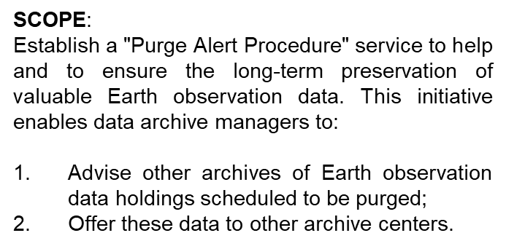
Purge Alert Service White Paper

Slide 11
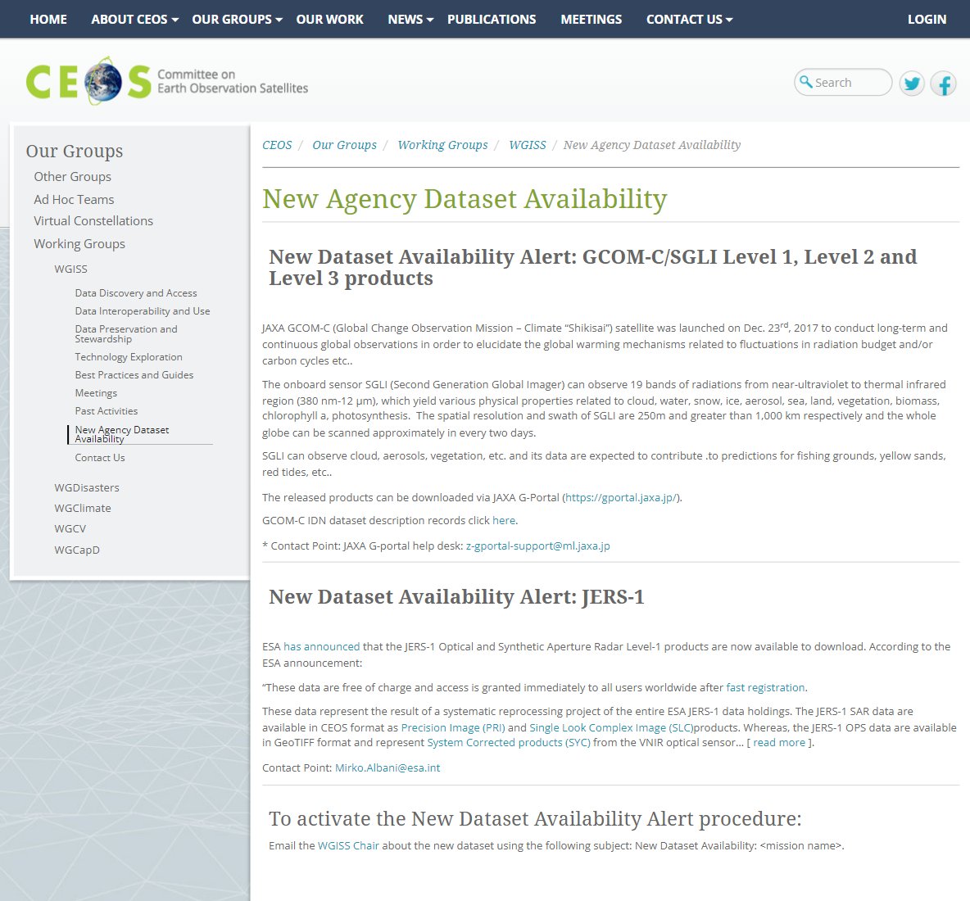
New Agency Dataset Availability

Slide 12
Heritage Data Recovery
Climate related applications are requiring more and more to extend critical long-term science observations back in time through recovery and use of heritage (historical) datasets. Objective of the sessions is to identify historical/heritage datasets currently not accessible to users (e.g. because on old media, not kept online, etc.) and trigger potential joint recovery actions.
Need: identify historical/heritage datasets currently not accessible to users (e.g. because on old media, not kept online, etc.) and trigger potential joint recovery actions. The sessions are consisting of WGISS members presentations with information on heritage datasets to be recovered in terms of:
Dataset description and scientific relevance
Dataset location and status of accessibility
Dataset format, volume, etc.
Availability of dataset related documentation, software, information
Indication of priority based on uniqueness, applications, needs, impact
DEDICATED SESSION AT WGISS#57

Slide 13
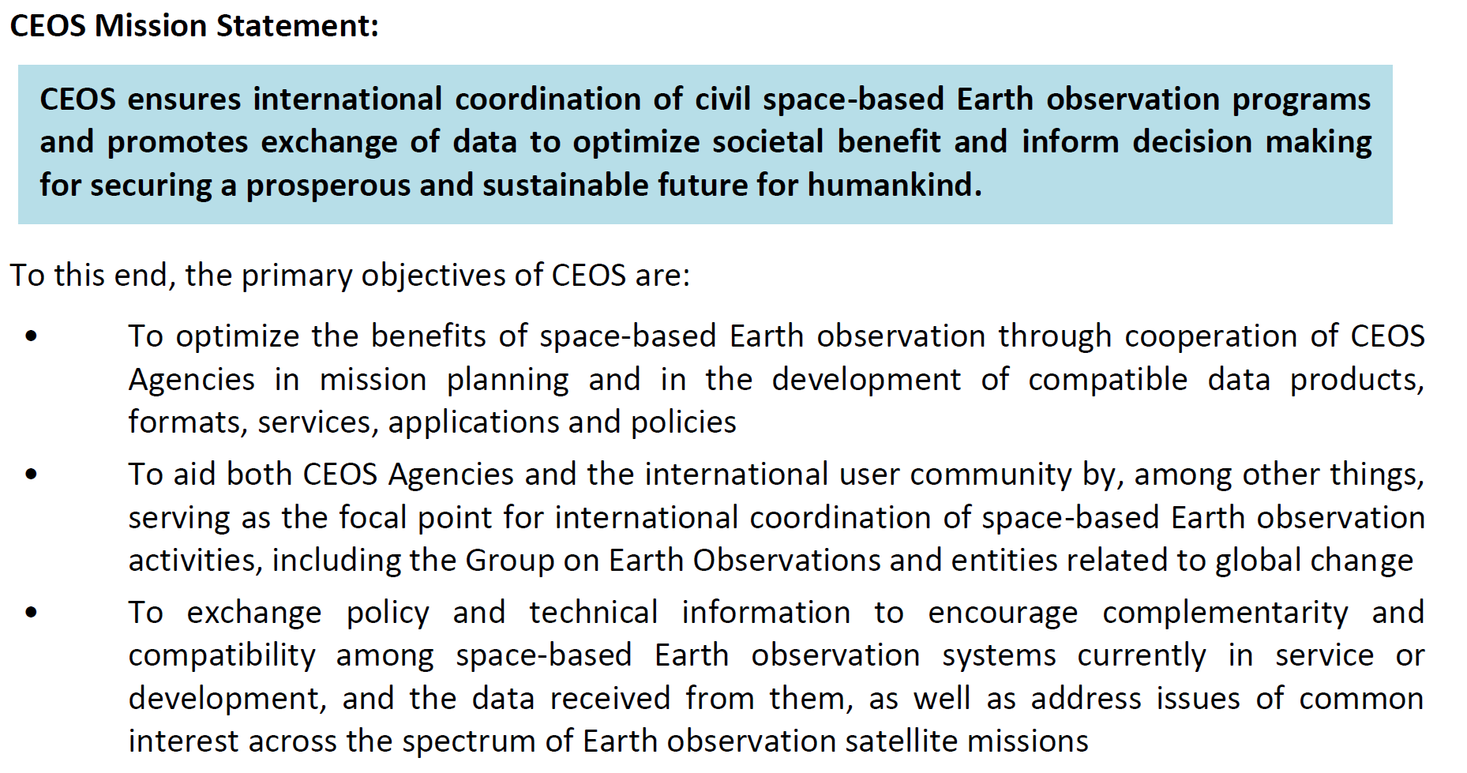
CEOS Work Plan Objectives

Slide 14
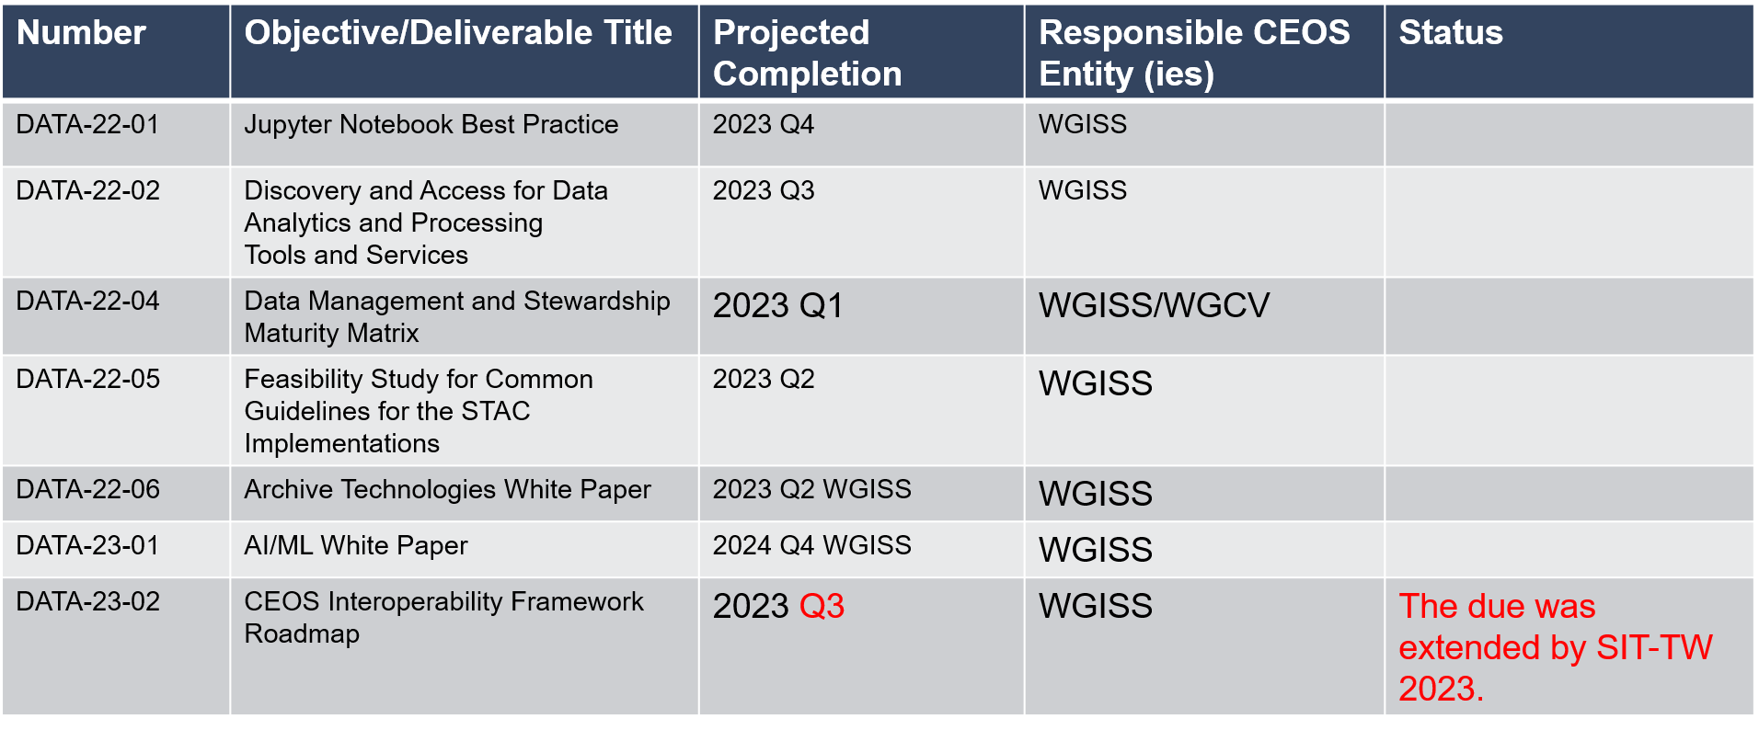
WGISS 2023-2025 Work Plan (v1.1)

Slide 15
WGISS 2024-2026 Work Plan - DSIG
Proposed deliverables for the Data Stewardship Interest Group:
White Paper on EO Data collections management and governance: this would be produced as outcome of discussions to be held at WGISS starting from WGISS#57 and would address topics like management of data collections in the Cloud, Preservation of "MASTER" collections, reproducibility of previous collections versions (algorithm availability), cross-collection validation, and general Interoperability and Governance approaches. This deliverable could be produced by Q4 2024/Q1 2025.
White paper on Software preservation: this deliverable would address and recommend techniques to ensure preservation and reusability of software tools related to EO missions (e.g. processors, exploitation and visualization tools). It could be produced by Q3 2025.

