Slide 1
WGISS-57 Long Term Archive Workshop Summary

Slide 2
Executive summary
The main challenge of archives is the sheer volume of data, the copious number of files, the diversity of formats and the yearly increase of data produced.
The archives are constantly enhanced to facilitate the archival process by using technological innovation and practices. To save energy, thus making the archive and its hardware environmentally friendly, green computing technologies are often favorable.
This presentation summarizes the LTA workshop held at ESA/ESRIN on the 23rd of November 2023.

Slide 3
LTA Workshop flyer

Slide 4
LTA Workshop Agenda
OUTLINE for AGENCY
Archive Infrastructure and technology
Monitoring tools
Archive volume, missions, coverage
Archiving flows and processes
Data format/packaging for long term archive
Management of the relevant associated information, documentation, software and knowledge (if managed)
Trends and Future Plans, Main Issues and Challenges
OUTLINE for VENDORS
Corruptions (OS, firmware issues)
Undetected bit flips (data transmission, within storage device)
Media wear out and breakage: disk head crashes, snapping tapes
Hardware or media obsolescence
Environmental elements (humidity, temperature, dust)
Disasters such as fire, earthquakes, accidents etc.
Preserving data at the Exa-scale

Slide 5
DAP WG AGENCIES SESSION

Slide 6
CNES
A system overview of STAF infrastructure was presented, highlighting the storage systems. The OAIS-based multi-purpose/multi-mission long-term archive (LTA) in CNES was presented, including REGARDS, the STAF API, and catalogue. Performance details of the LTA are shared, highlighting the use of disk and tape storage with ~3 PB on STAF v3, with a volume ramp up to >30 PB by 2030. It was confirmed that the system is entirely on-premises, hence, a similar situation to ESRIN with the same challenges, particularly relating to metadata.

Slide 7
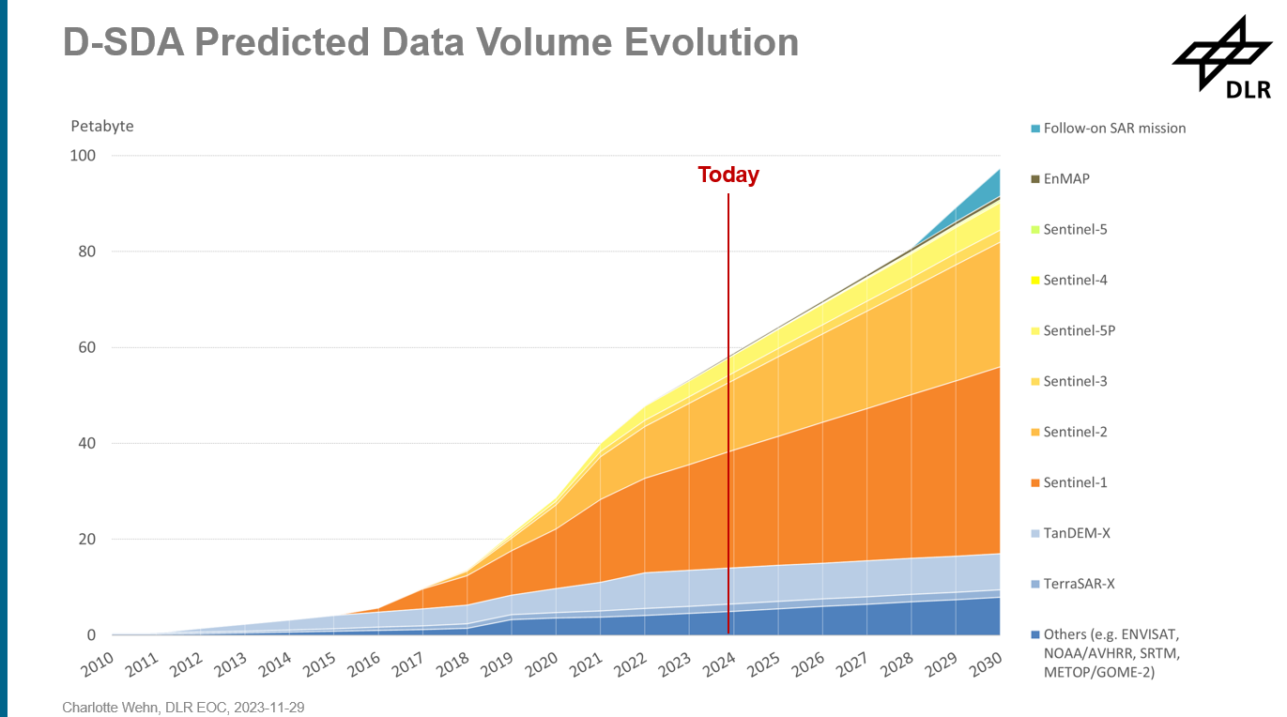
DLR
Archive technology at DLR was described, including components (hardware, media, software, etc.) and data flows/processes. Challenges and plans were outlined, with the predicted volume evolution from 50-60 PB now to ~100 PB by 2030. The current activity is the acquisition of new HSM software due to the obsolescence of Oracle HSM.
The archive format in DLR is different from usual due to the large number of small files associated with satellite data which are not ideal for archive management.

Slide 8
UKRI / CEDA
Specific details of CEDA (Centre for Environmental Data Analysis) were provided: more than 26 PB of data comprising 8,500 datasets and ~345 million files, with ~42,000 users in a 5-year span. The archive services, JASMIN, and future challenges were also discussed.

Slide 9
AIRBUS
Details of the archive infrastructure and technology were provided, including data management and monitoring tools. The archive has a maximum capacity of 90 PB (with minimal environmental impact) and is scalable to 150+ PB, however, the ESA TRUTHS mission (planned launch in 2030) is expected to produce over 170 PB of data and potentially much more.

Slide 10
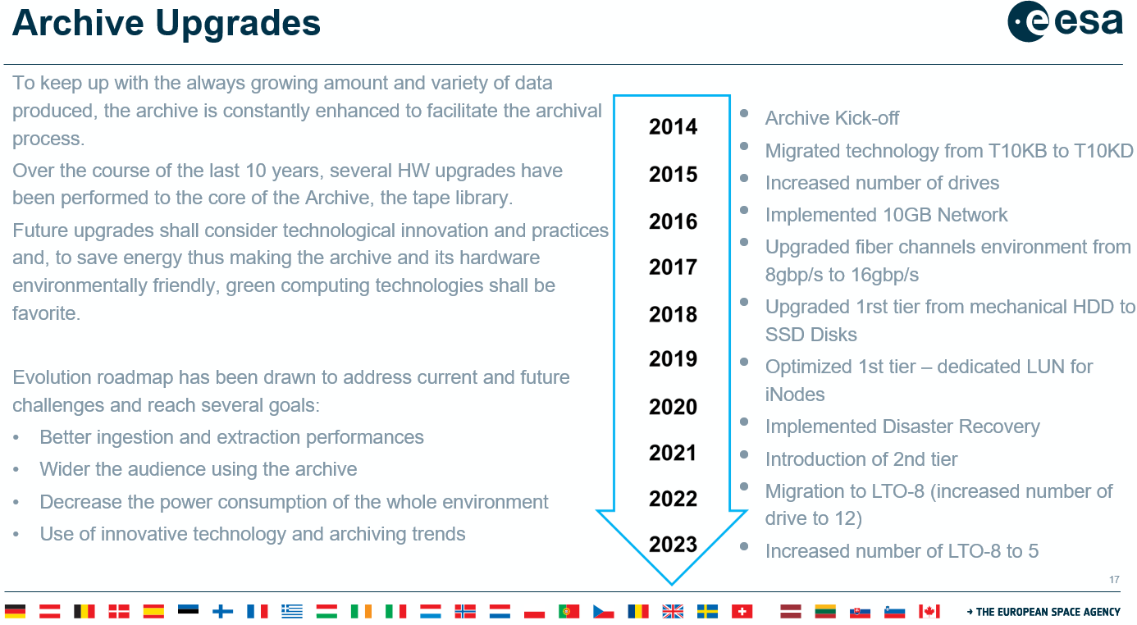
ESA
The ESA Earth Observation (EO) archives and infrastructure were presented, highlighting a total volume of ~18 PB and ~231 million files. Several challenges have been identified, including poor performance for small files, media failures, vendor-locked solutions, and longevity/obsolescence.

Slide 11
SOLUTION PROVIDERS SESSION

Slide 12
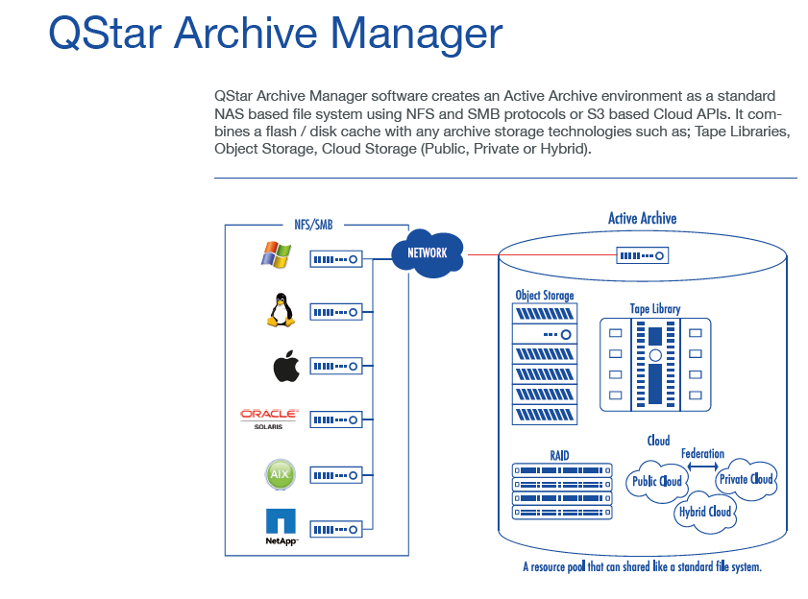
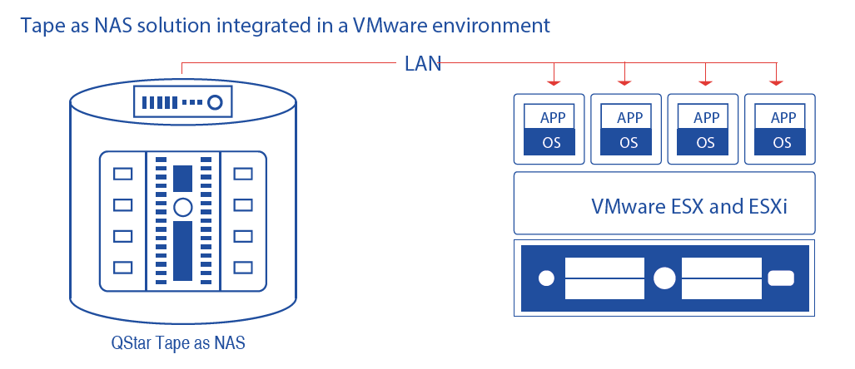
Q-STAR
Qstar’s portfolio was presented highlighting their support for cloud, object, tape, disk, and optical storage; API and web service based. The available archive manager presents a “tape-as-NAS” or “tape-as-cloud” solution. Global ArchiveSpace (GAS) is multi-node based and scalable up to the exabyte level. Technology migration is built into the architecture for ease of use; easy interface with the major libraries present in the market.

Slide 13
PURE STORAGE
The concept of flash for long-term storage was presented along with use cases. Currently available as 75 TB in a single drive with a roadmap to 300 TB in a single drive within 3 years. 10+ PB all-flash storage currently offered, with power requirements of less than 1 kW/PB and read and write speeds of 12 GB/s and 5 GB/s, respectively. Pure storage started working with SSD (Solid State Drives); low environmental impact even using disk instead of tapes.

Slide 14
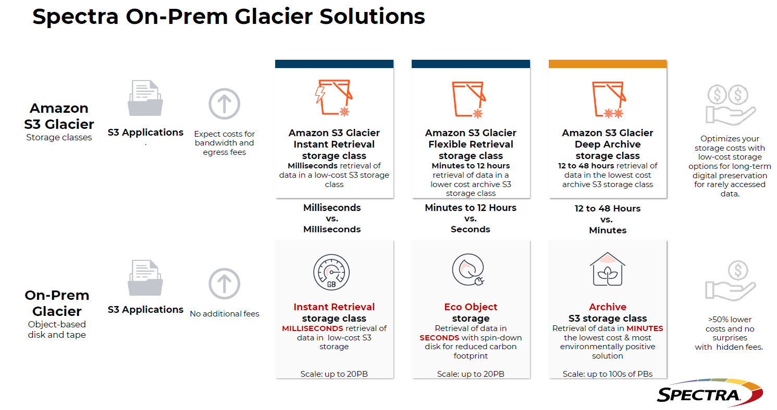
SPECTRA LOGIC
ExaScale TFinity is currently the largest storage system available globally and is an open system with media lifecycle tracking/reporting. Details of the available on-premises glacier storage were also provided. They are the leader in Robotic Libraries area.

Slide 15
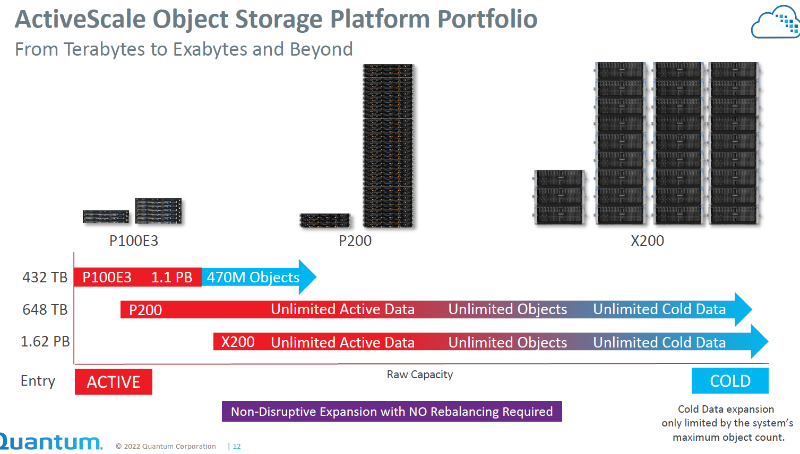
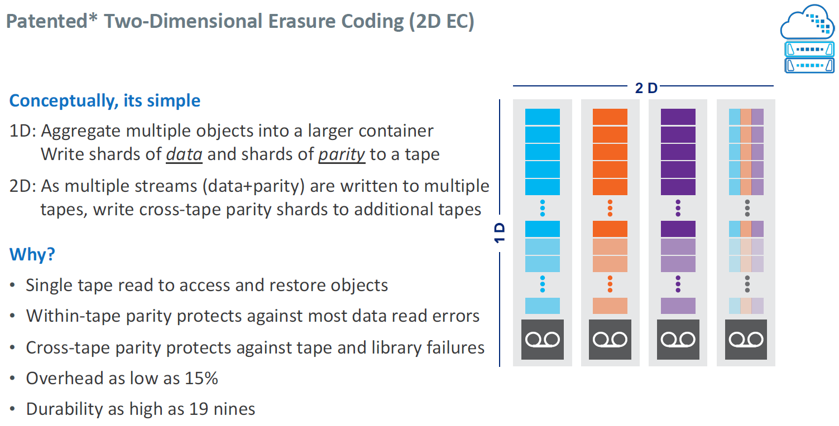
QUANTUM
The portfolio of object and tape storage solutions was presented along with the 2-dimension Erasure Coding offered. Erasure Coding splits files onto different tapes to boost performance with no real limit on file size and files are aggregated into single objects. Splitting across three sites avoids disruption due to a potential node failure while also improving latency.

Slide 16
PIQL
The range of storage technologies offered was presented, including permanent storage solutions. PiqlDisc is a permanent storage solution targeting < €3/TB with 1 TB per disc with random access capabilities. In terms of software, Piql offers a microservices-based cloud-like platform and a hybrid information management system.

Slide 17
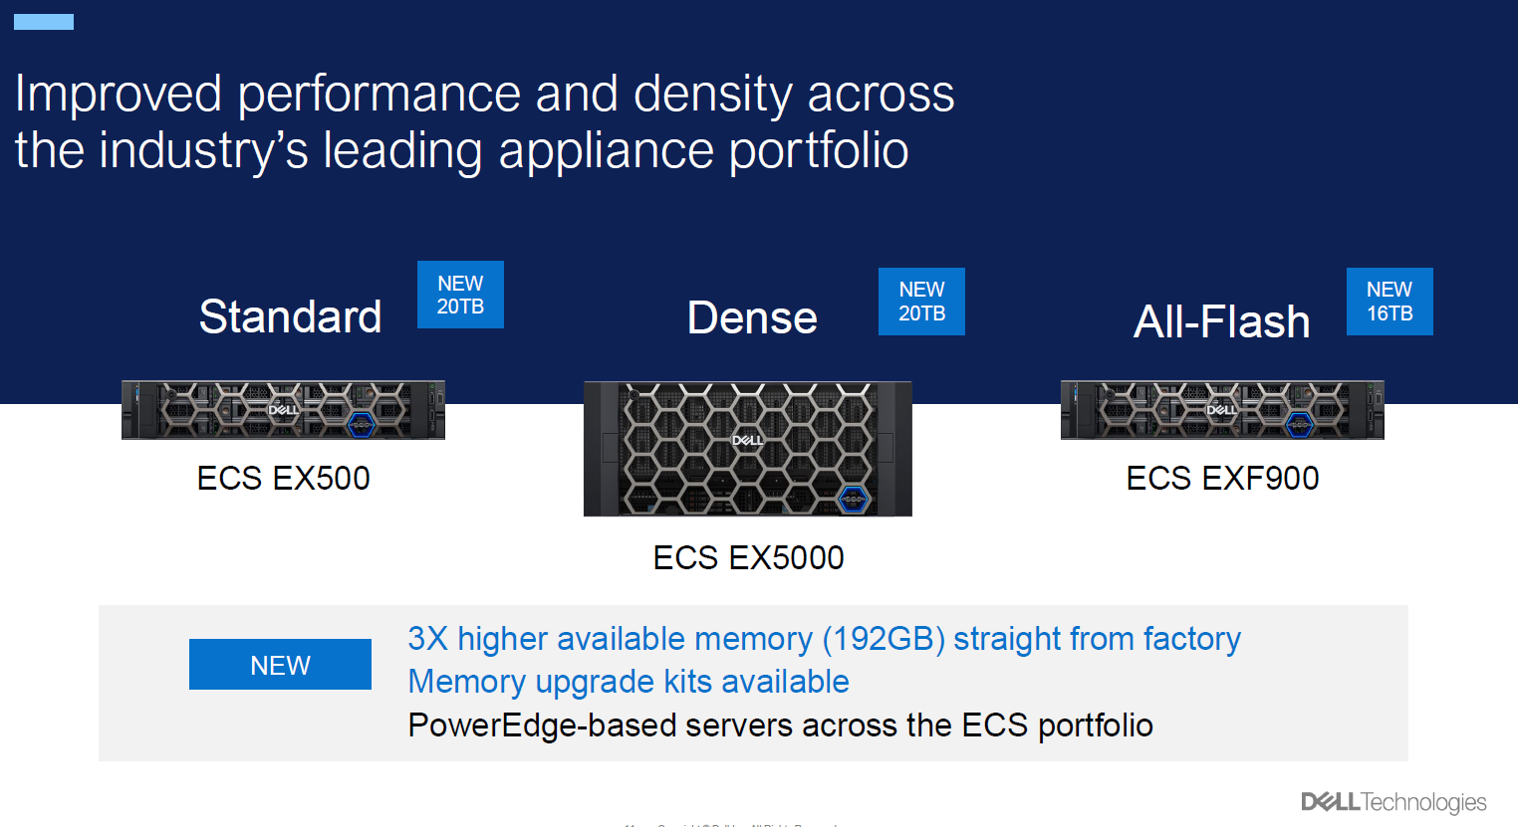
DELL
The portfolio of storage solutions was presented. ECS features and capabilities were covered, along with security and encryption details. An example of metadata search was also provided.

Slide 18
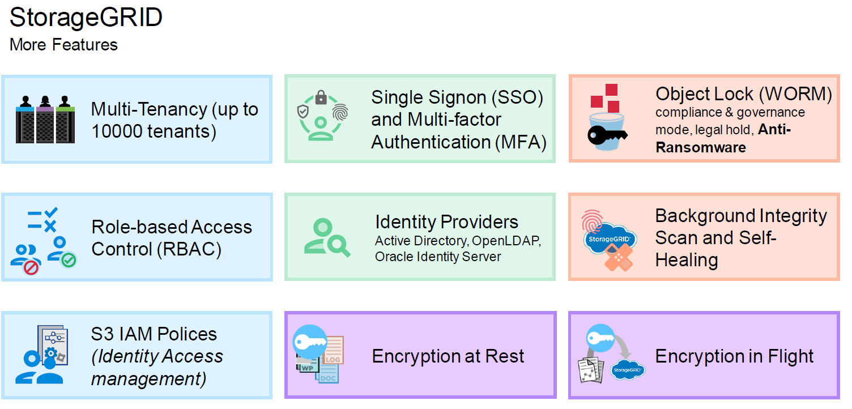
NetApp
The product portfolio was presented, including StorageGRID, with a focus on data integrity and protection. Following discussion, it was confirmed that there is no direct route from the cluster to StorageGRID, it is only via Trident for now.

Slide 19
OPEN DISCUSSION (1/2)
The reasoning for using tape storage on-premises was discussed, highlighting that generally no external access is required. EO data records are the main asset of the ESA EOP department, having a copy on-premises is very important. The choice of using tapes is also based on the fact that tapes have been used for years and have proven to be reliable and have advantages (e.g. cost, security, environmental) when storing multiple copies of the data.
The need is to evolve into a “warmer” storage solution in the future, perhaps by following the example of what DLR has done, where they went from a cold archive to an archive that fits an HPC. So, the data is exploited in the layer on top of the archives.
HPC’s are under consideration. There is a desire to adapt the current storage approach to take advantage of the HPC’s (and vice versa) as the current approach is that the archive is for storage only.
The difference between the dissemination systems and storage was raised. These are separate environments, but an approach is needed to optimise which data is stored and which is on the dissemination systems. Not all data is wanted equally, and different “tiers” of storage may be the best approach.
Regarding metadata enrichment, details of the EO-SIP format were provided. In an EO-SIP the metadata is packaged with the imagery, and the metadata, which is also used for search parameters, conforms to an internationally agreed/recognised standardised format.

Slide 20
OPEN DISCUSSION (2/2)
NetApp highlighted the approach of organising storage such that the infrastructure is divided into a faster layer for ingest and retrieval; something that can yield improved performance. Then, based on policies or, on-request, move the data to larger object storage before taking the decision to write to tape. The system, on the other side, can, as required, put the object that is needed in the high-performance layer. The other providers also confirmed their ability to provide similar systems.
The issue of data duplication and integrity was raised, highlighting that copies may be spread everywhere on the cloud, and how to ensure that a user gets the original data not manipulated. Vendors detailed their solutions to this, particularly with object storage where each object has a unique ID, and copies of the object have different IDs that are linked to the original, allowing the persistent identification of the original version.
The vendors enquired about the official policy about data dissemination to the public. With ESA data being open and free anyone can, in principle, make a copy of it. The main priority for ESA is to ensure dissemination of data to worldwide users with infrastructure provided by European providers. How agencies disseminate data stored on tapes was clarified. Generally, ESA data for dissemination, which is typically of a higher processing level, are held on the dedicated systems, while the lower-level products are stored on tape and accessed when needed for activities such as reprocessing campaigns.

Slide 21
OPEN DISCUSSION (2/2)
Following a question from Spectra Logic, ESA’s policy towards open source was clarified. ESA strives for open source when e.g. developing software through contracts, however in most cases where ESA engages an outside company for the provision of a service there is no hard requirement for open source technologies to be used.
For DLR, there is a similar effort towards open/standardised data, but some data is still restricted. In general, data is free and open where possible, and software is open, where possible. Airbus on the other hand, as a commercial provider, is impacted much more by licencing, feasibility studies, geo-restrictions, export control, etc.
The merits of using a hybrid system of proprietary and open storage from a security point of view were discussed. In many cases, clients will employ a double copy of data, with one utilising proprietary technology (e.g. for enhanced security, or improved performance) and the other with an open standard (e.g. LTFS, to ensure persistence of access in the future). For example, an Italian television broadcaster tendered a contract for converting 3.2 million video media to digital, for this they used tapes in LTFS for storage, but inside the library, they decided to use a proprietary format for the improved performance.
It is agreed to organise another workshop in a couple of years time.

