Slide 1
Data Preservation & Stewardship Interest Group (DSIG) Work Plan
Mirko Albani, ESA
Agenda Item 1.2
WGISS-58
16-17 October 2024
Sioux Falls, South Dakota, USA

Slide 2
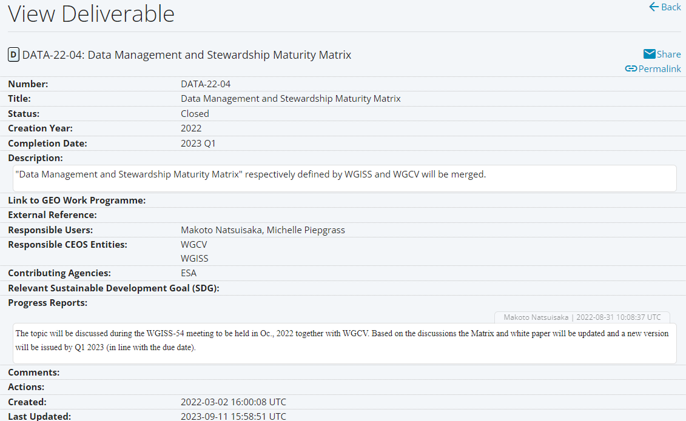
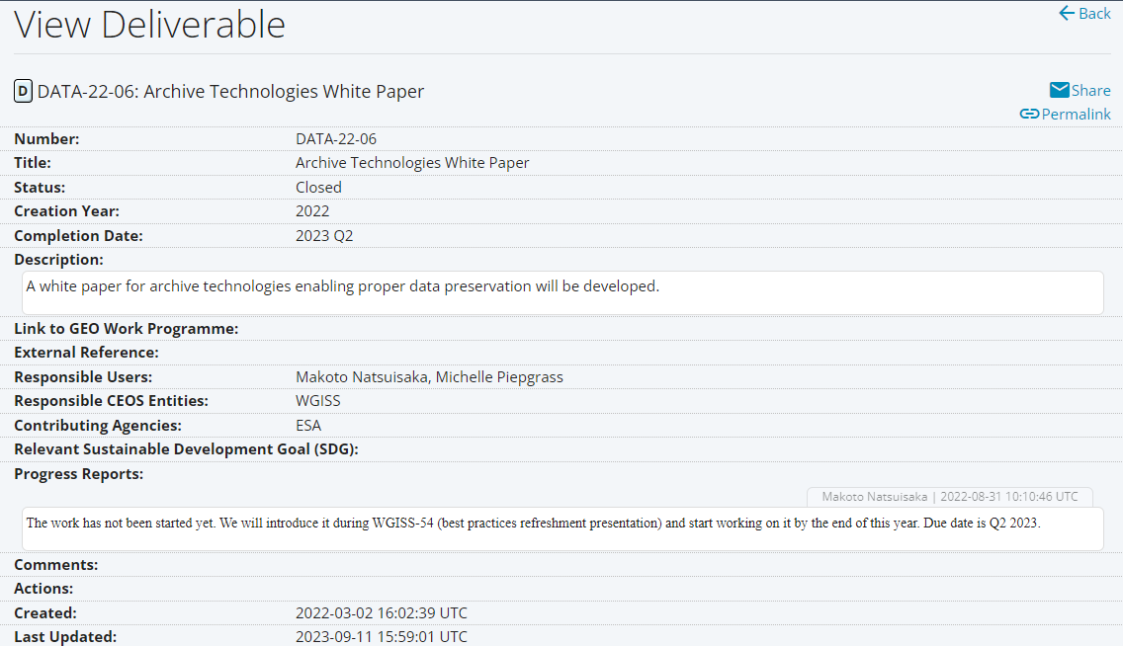
CEOS Deliverables 2021 - 2023

Slide 3
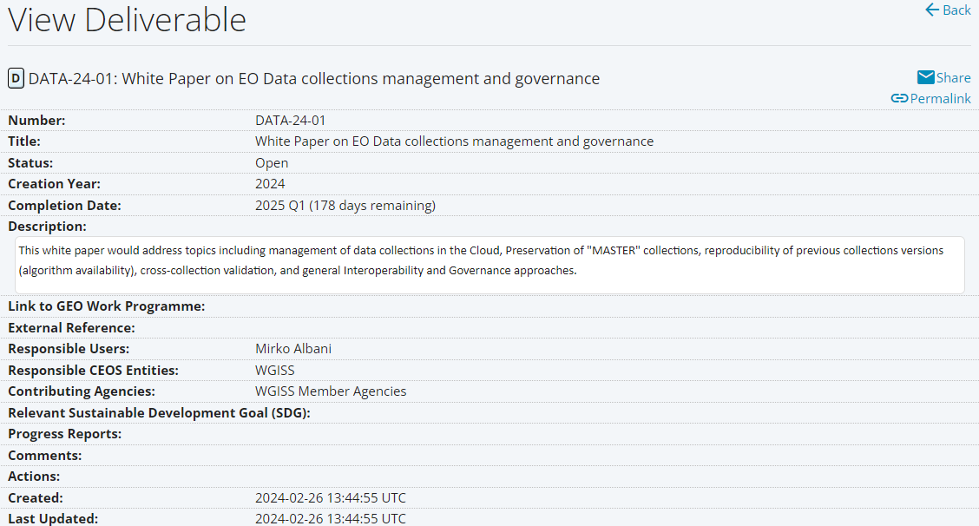
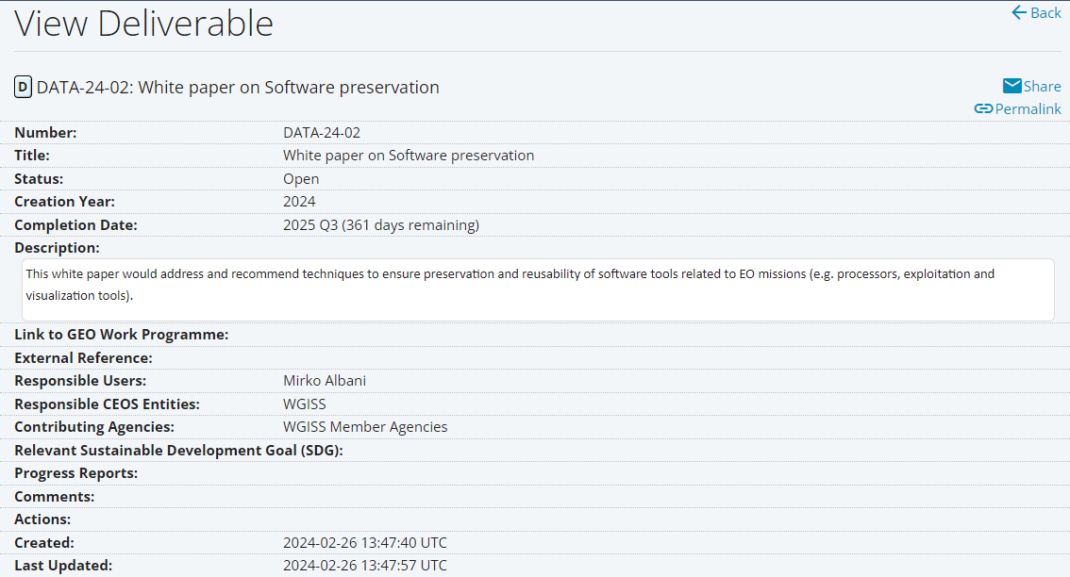
CEOS Deliverables 2023 - 2025
Completion Date: CONFIRMED

Slide 4
CEOS Deliverable DSIG Vision
Long-term accessibility and exploitability of Earth Science data requires
that not only sensed data, but also technical content and associated information needs to be properly preserved and made accessible.
The following topic with relevant outline is proposed:
Long Term Content and Information Preservation
Long Term Data Preservation processes
Data Provenance

