Slide 1
Technology Exploration Interest Group (TEIG) Work Plan
Yousuke Ikehata, JAXA
Agenda Item 1.5
WGISS-58
16-17 October 2024
Sioux Falls, South Dakota, USA

Slide 2
2024-2026 work plan
CEOS Deliverables
We are looking for technology topics related “Federation”.
Distributed data centers
API and use of standards
Number | Title | Completion date
DATA-23-01 | AI/ML White Paper | 2024 Q4
DATA-22-01 | Jupyter Notebook Best Practice | 2024 Q4

Slide 3
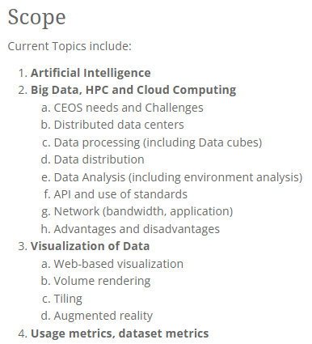
Short term plan
We’re recruiting new lead member and call for new tech. topics.
We need to update our scope.
Cloud computing and its infrastructures has been already “general”.
Visualization of Data is still “current and trending software technologies”?

