Slide 1
ESA Earth Observation Space and Ground Data Archiving Policy
Mirko Albani, ESA
Agenda Item 2.2
WGISS-58
16-17 October 2024
Sioux Falls, South Dakota, USA

Slide 2
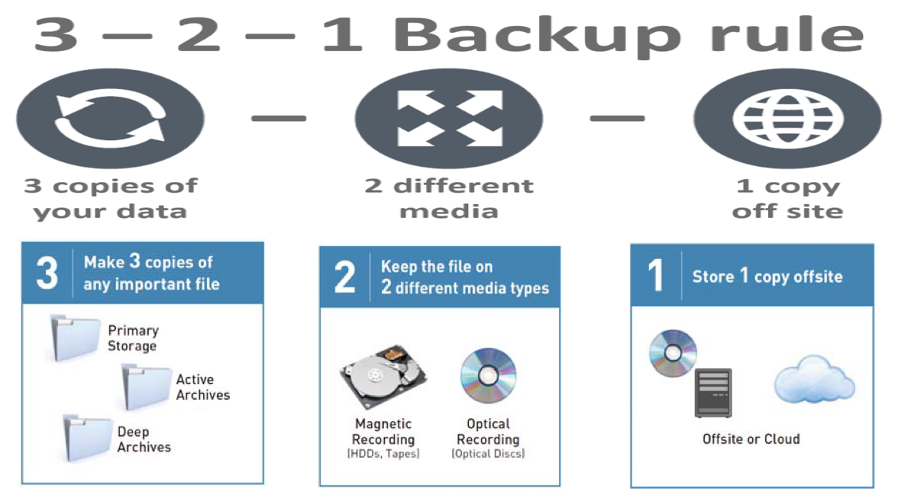
Archiving Policy
According to CEOS preservation guidelines, “At least three data copies should be kept on different technology media and in different locations”. This approach will be used as reference starting point and tailored for the ESA Archiving Policy.

Slide 3
The challenge
Increasing volume of data (e.g. from new missions) 🡪 might not be sustainable to archive everything
How to ensure that the correct (and minimum) set of data and information is preserved ?
What risks are acceptable ?

Slide 4
ESA EO Space and Ground Data Archiving Policy
Addresses the archiving of Space and Ground Datasets Packages.
Applicable to Earth Observation missions (Sentinels excluded) archived at ESA.
Applied and implemented during EO missions operational and post-operational phases (Phase E and Phase F1), and during the Heritage Phase (Phase F2).
Compliance of a mission wrt the policy is assessed by the relevant Ground Segment Operations Manager in coordination with the Mission Manager.

Slide 5
Space and Ground Datasets Packages
Space and Ground Datasets Packages consist of the following elements:
Space-borne and ground segments datasets (SGD): Payload instrument datasets, spacecraft housekeeping telemetry data, auxiliary and ancillary data about satellites/instruments/vehicles, higher-level derived/processed data, campaign data, calibration, simulation, experimental and validation data;
Software, analysis tools and services data including relevant documentation (e.g. catalogue databases, orchestrator & processors, quality control tools) related to the SGD data and necessary or useful for their analysis and usability;
Technical and Scientific Information related to the SGD data necessary or useful for their intelligibility, usability and exploitation;
Metadata describing the context, content and structure of the above defined digital objects composing Space and Ground Datasets Packages and their management through time.

Slide 6
Space-borne and ground segments datasets (SGD)
EO satellites space and ground segments datasets (SGD) are grouped based on their processing level using the following categories:
Payload RAW data: EO payload instrument data as down-streamed from the satellite and acquired inside the relevant mission Ground Segment using the original acquisition system.
Native Format Data: EO payload instrument data as acquired and generated inside the relevant mission Ground Segment using the original processing chains, spacecraft telemetry data, auxiliary and ancillary data.
Reformatted Data: EO payload instrument data reformatted, archived and distributed to users in other formats still preserving the scientific content of the original products with different types of layout and coding; spacecraft telemetry data, auxiliary and ancillary data reformatted for different purposes or needs.
Repackaged Data: EO payload instrument data repackaged to store additional information together with the data itself in a single package (e.g. in EO-SIP package containing together with the data, also associated metadata, browse images, browse metadata and quality report); spacecraft telemetry data, auxiliary and ancillary data repackaged for different purposes or needs.
Notes:
Dataset Collection of homogeneous data, part of the Data Offer

Slide 7
Archiving Policy (1/2)
Payload Raw Data
Payload raw data shall be archived in 2 (two) copies in 2 (two) physical locations distant at least 200 Km, using 2 (two) different archiving technologies.
Native Format Data: Payload L0, spacecraft telemetry, auxiliary and ancillary
Current Baseline of Master datasets shall be archived in 3 (three) copies in 3 (three) physical locations distant at least 200 Km among them, and using 2 (two) different archiving technologies. If a corresponding repackaged dataset is available, the current baseline of Master datasets shall be archived in 2 (two) copies in 2 (two) physical locations distant at least 200 Km, using 2 (two) different archiving technologies.
Previous Baseline of Master datasets, if existing, shall be archived in 2 (two) copies in 1 (one) or more physical locations, using 2 (two) different archiving technologies.
Reformatted and/or Repackaged Data: Payload L0, spacecraft telemetry, auxiliary and ancillary
Current Baseline of bulk reformatted datasets, if existing, shall be archived in 2 (two) copies in 1 (one) or more physical locations, using 2 (two) different archiving technologies.

Slide 8
Archiving Policy (2/2)
Native Format Payload Higher-level data (e.g. Level-1/Level-2 bulk reprocessed)
Current Baseline of bulk processed/reprocessed and quality approved datasets shall be archived in 3 (three) copies in 3 (three) different physical locations, distant at least 200 Km among them using at least 2 (two) different archiving technologies, if reprocessing from previous level (e.g. Level-0) is not achievable anymore for technical or cost reasons. If a repackaged corresponding dataset is available, the Current Baseline of bulk processed/reprocessed datasets shall be archived in 2 (two) copies in 2 (two) physical locations distant at least 200 Km, using 2 (two) different archiving technologies.
Current Baseline of bulk processed/reprocessed and quality approved datasets shall be archived in 2 (two) copies in 1 (one) or more physical locations using 2 (two) different archiving technologies if reprocessing from previous level (e.g. Level-0) is demonstrated to be still achievable both at technical and cost level
Previous Baseline of bulk processed/reprocessed and quality approved datasets shall be archived in 2 (two) copies in 1 (one) or more physical locations using 2 (two) different archiving technologies.
Higher-level products generated on-demand shall not be permanently archived (e.g. on-the-fly production).
Reformatted and/or Repackaged Payload Higher-level Data
Current Baseline of bulk reformatted and/or repackaged and quality controlled datasets, if existing, shall be archived in 2 (two) copies in 1 (one) or more physical locations, using 2 (two) different archiving technologies.

Slide 9
Software, analysis tools, data services, technical and scientific information and metadata
Software, analysis tools and services data including relevant documentation related to EO Space and Ground Segments Datasets shall be archived in at least 3 (three) copies in 2 (two) different locations distant at least 200 Km using 2 (two) different technologies.
Archived SGD related software and data analytics tools shall contain all elements needed to properly run them. As an example, instrument processing facilities shall contain processors, orchestrators and any required software and configuration file (e.g., Task Tables) to properly set up the processing environment. Ready to run preconfigured processing environment (e.g., based on containerized SW) is to be preferred.
Technical and Scientific Information related to EO Space and Ground Segments Datasets shall be archived in at least 3 (three) copies in 2 (two) different locations distant at least 200 Km using 2 (two) different technologies.
Metadata describing the context, content and structure of the digital objects composing Space and Ground Datasets Packages shall be archived in at least 3 (three) copies in 2 (two) different locations distant at least 200 Km using 2 (two) different technologies.

