Slide 1
USGS EROS Archiving Policy
Ryan Longhenry, USGS
Agenda Item 2.6
WGISS-58
16-17 October 2024
Sioux Falls, South Dakota, USA

Slide 2
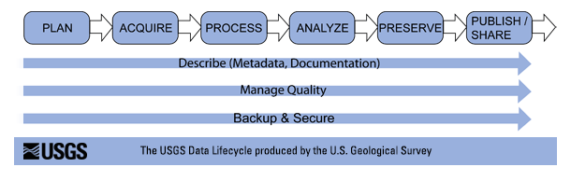
Key Data Management Initiatives
Provide data management, access, archive, and distribution for all data sets within the USGS Historical Archives that have long term relevance to science and support the USGS mission
Improve access to the land archive
Utilize consistent data management approaches across all data sets.

Slide 3
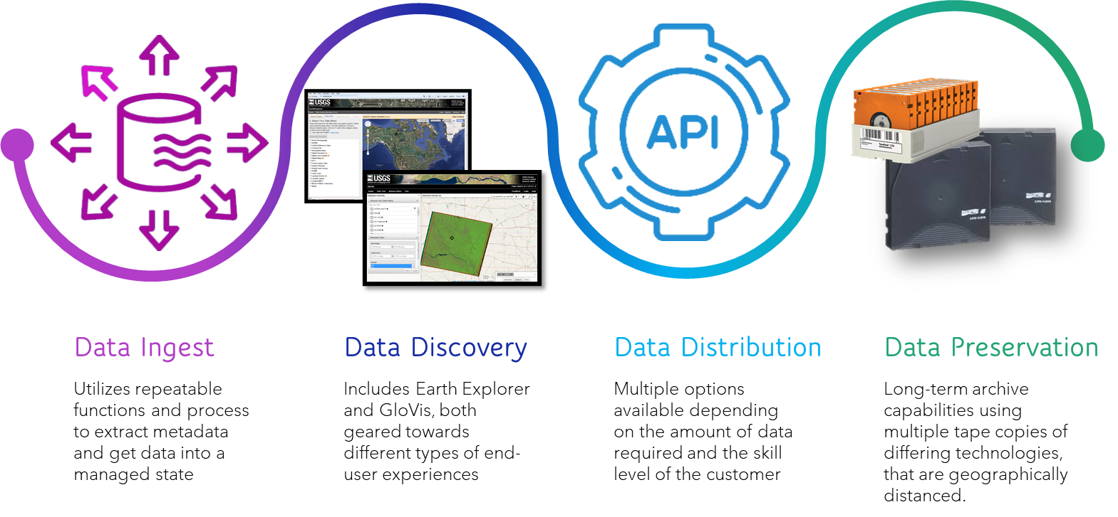
Data Management Practices

Slide 4
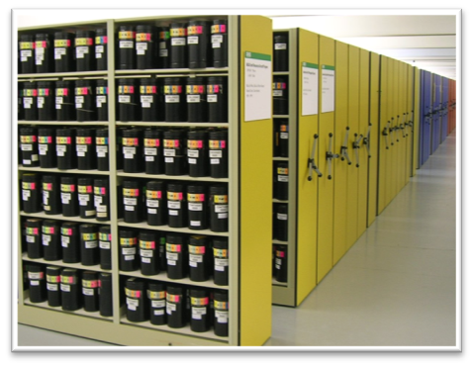
Data Management Policies
Land Remote Sensing Policy Act of 1992
"SEC. 502. ARCHIVING OF DATA.
(a) PUBLIC INTEREST.—
It is in the public interest for the United States Government to—
(1) maintain an archive of land remote sensing data for historical, scientific, and technical purposes, including long-term global environmental monitoring;
(2) control the content and scope of the archive; and
(3) assure the quality, integrity, and continuity of the archive .
(b) ARCHIVING PRACTICES.—The Secretary of the Interior, in consultation with the Landsat Program Management, shall provide for long-term storage , maintenance, and upgrading of a basic, global, land remote sensing data set (hereinafter referred to as the "basic data set") and shall follow reasonable archival practices to assure proper storage and preservation of the basic data set and timely access for parties requesting data."

Slide 5
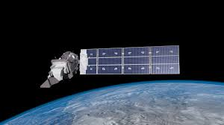
Data Management Policies
National Satellite Land Remote Sensing Archive (NSLRSDA)
The National Satellite Land Remote Sensing Data Archive (NSLRSDA) was created to identify, collect, preserve, and make available land-based, remotely sensed imagery.
The collection policy is based on the concept of maintaining imagery collections that serve environmental, agricultural, mapping, energy, economics, and global change research communities in addition to the general public.
Once collections are formally accepted by the USGS for inclusion into the NSLRSDA, the records become the responsibility and property of the USGS. Accepted NSLRSDA collections may ultimately be transferred to other entities such as the National Archives and Records Administration (NARA), when deemed appropriate by the USGS.

Slide 6
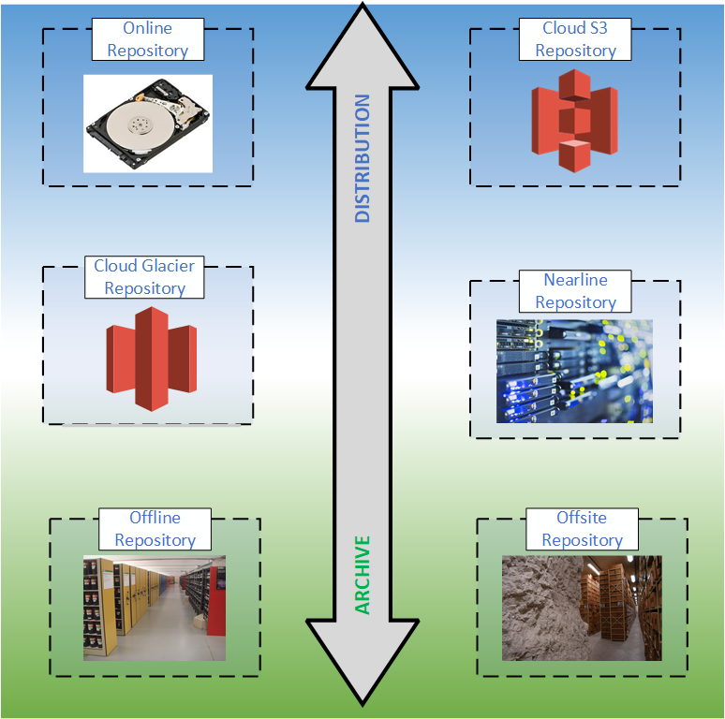
Data Repositories
Different technology is used to store data depending on utilization intent
“Distributed” and “Archived” holdings vary depending dataset
  Example: Landsat Mission data is archived while the L1/L2 derived products are distributed. For the high-resolution orthoimagery dataset, the distributed and archived products are the same
Nearline systems are utilized to distribute data from the archive
  Cloud nearline systems are being reviewed for utilization in the same way

Slide 7
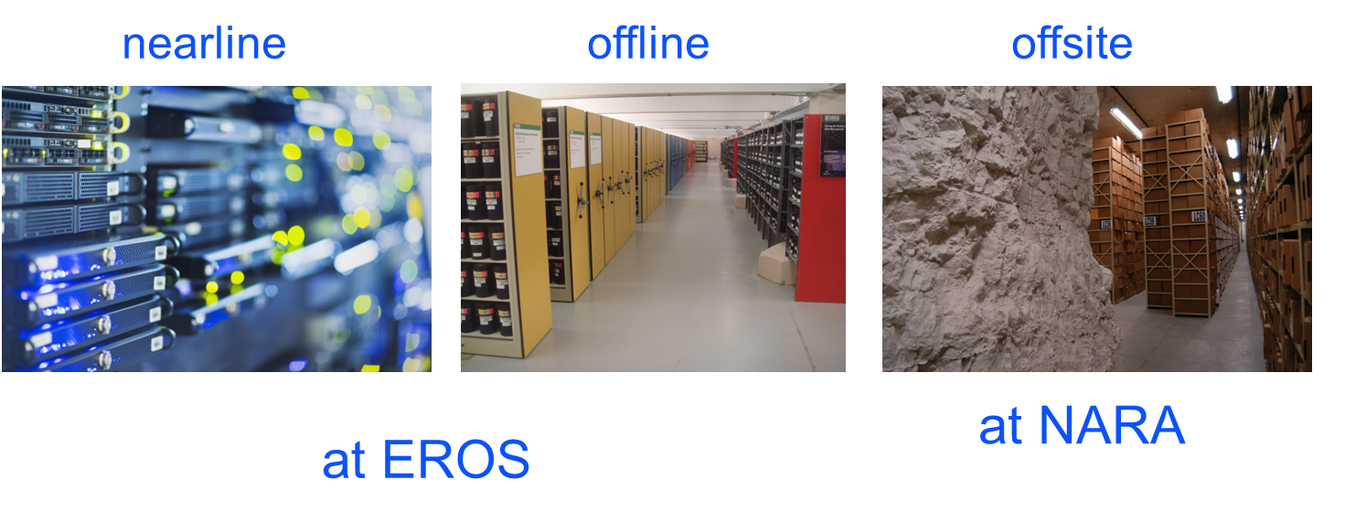

Data Archiving Procedures
Data is preserved using 3 copies: nearline, offline, and offsite
  The most “native” level is deemed as the archival version in active missions. Upon decommissioning of mission, archival decisions adjustments are made on a case by case basis.
Nearline data stored in a Spectralogic Tfinity robotic tape library system
Offsite copies are stored at the National Archive
Record Administration (NARA) Kansas City facility
Multiple media types are utilized to ensure long term readability
  Currently using LTO-9 and
  IBM TS1160 tapes
Media are periodically updated
as tapes technology advances.
Records management schedules
are worked with NARA

Slide 8
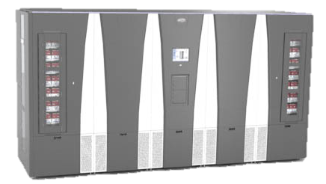
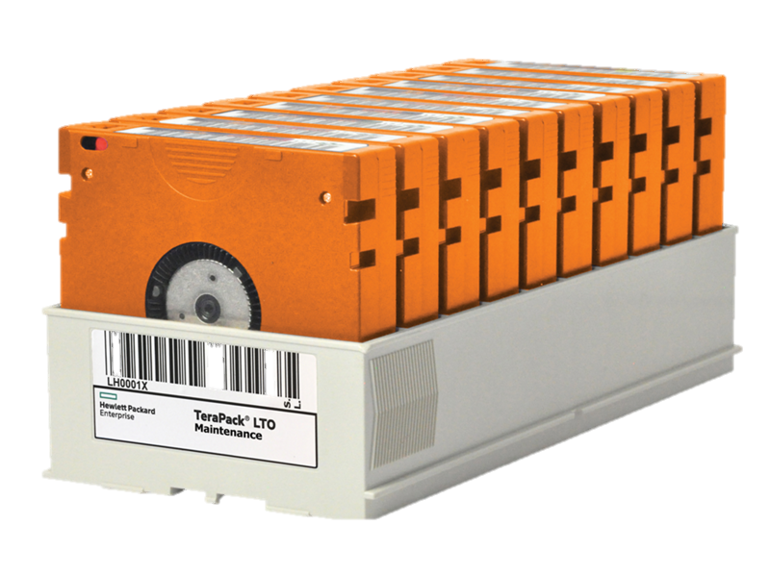
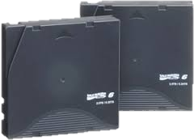
Archive Media Studies
Biennial archive media trade studies
  Compares offline digital archive storage technology options for:
    working copies not maintained in the robotic tape library
    master copies
    offsite copies
Recommendations from latest (2023) study
  Stay the course with use of LTO9
  Continue storing datasets on multiple technologies to mitigate risks associated with each technology

Slide 9
Dataset Appraisal Process
Collecting Scope, Priorities, and Limitations
The USGS EROS Data Archive focuses on collections that best support land research activities for the Nation. Acquisition priorities, in order, include publicly available:
Long-term, consistent, and/or repetitive coverage collected systematically over U.S. land surfaces from multiple sources.
Long-term, consistent, and/or repetitive coverage collected systematically over land surfaces of various locations worldwide from multiple sources.
Additionally, land remote sensing collections meeting the following criteria may be acquired by the USGS.
Those that:
Provide a historical record of the land surface
Can be accepted within funding limitations and processing
capabilities.
Are of important informational or intrinsic value.
Limitations:
No classified imagery collections are accepted.
No oceanic or atmospheric collections beyond those utilized
for land applications are accepted.
Appraisals and Dispositions
Appraisals are a standard part of USGS work processes
and are conducted on every collection considered or offered. Collections to be disposed of may be transferred
to NARA, donated to another acceptable organization, or destroyed.

Slide 10
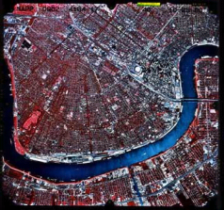
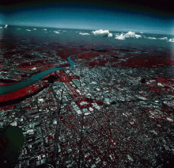
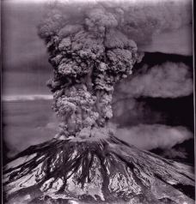
Aerial Photography Dataset Collections
U.S. Geological Survey Photography 1937 - 1995
National High-Altitude Photography 1980 - 1989
National Aerial Photography Program 1987 - 2004
Space Acquired Photography 1969 - 1984
Other U.S. Federal Aerial Photography 1937 - 1999
Side-Looking Airborne Radar 1980 - 1994
High Resolution Orthoimagery 2003 - Present
Unmanned Aircraft Systems (UAS) 2008 - Present

Slide 11
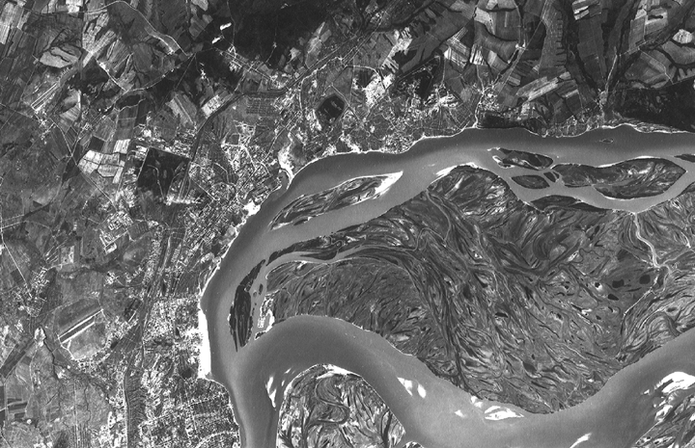
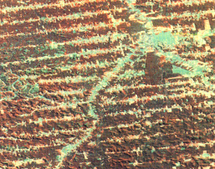
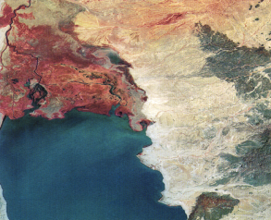
Satellite Dataset Collections
Declass 1 (Corona)
Declass 2 (KH-7, KH-9)
Declass 3 (KH-9)
SPOT Pan/Multispectral
SPOT Data Buy
Landsat MSS
Landsat Thematic Mapper
Landsat 7 ETM+
Landsat 8 OLI
Landsat 9 OLI/TIRS
AVHRR LAC/HRPT
EO-1
SIR-C
Commercial Data Purchases
Orbview
ResourceSat-2
Notes:
The Antarctic Flight Line Maps feature hand-drawn flight lines along with the frame numbers of aerial photographs taken during the flight. The flight lines are labeled with TMA numbers, which is a reference to the trimetrogon aerial (TMA) photography acquired by the U.S. Navy for use in topographic mapping. TMA photography is a system of cameras positioned to take left oblique, vertical, and right oblique images simultaneously. The images are taken along a single flight line with the oblique cameras pointed at a depression angle of 30°. Each of the three cameras has an angular field of view of 60°, which provides 180° horizon to horizon coverage when the images are placed side-by-side. Not all flights were equipped with oblique cameras, and equipment malfunctions limited the availability of complete sets of photography. Flight lines continue to be cataloged by TMA number even though missions flown after January 1975 acquired images with a single vertical camera.

Slide 12
Thank you!
QUESTIONS?
Ryan Longhenry
rlonghenry@usgs.gov
Reference Information
Dataset Overview
    https://www.usgs.gov/centers/eros/science/usgs-eros-archive-products-overview
  Data Access
    GloVis https://glovis.usgs.gov/
    Earth Explorer https://earthexplorer.usgs.gov/

