Slide 1
Software preservation White Paper
I.Maggio, Starion for ESA
Agenda Item 5.3
WGISS-58
16-17 October 2024
Sioux Falls, South Dakota, USA

Slide 2
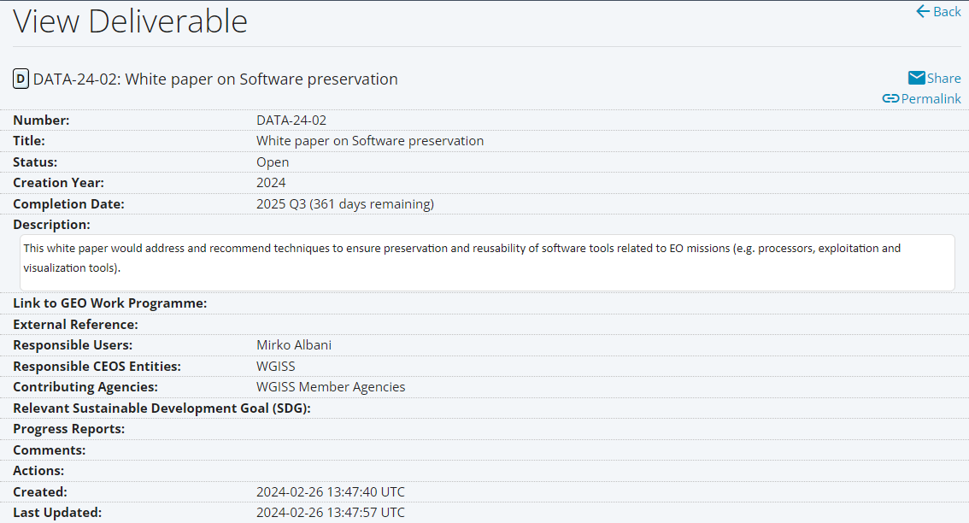
CEOS DELIVERABLE FROM DSIG
This presentation provides a starting point for the discussion and for a dedicated session to be organised at WGISS#59

Slide 3
SOFTWARE PRESERVATION - SCOPE
The white paper should be intended to assist data/software managers in the field of Earth observation (EO) with the task of ensuring the long-term preservation of EO missions and data related software, thus improving data accessibility and usability for current and potential future users.
The intended audience should comprise data and software providers, decision makers and scientists, and data managers/stewards for data centres and repositories.
It will introduce the concept of software preservation, outlining its importance and justifying the importance of expending to effort to ensure effective preservation of EO software.
Details of the main principles of software preservation will be provided, as well as brief descriptions of the primary strategies that may be implemented by data managers.
Consideration should be also given to the typical challenges that may present throughout the preservation process.

Slide 4
SOFTWARE PRESERVATION – INTRODUCTION
Long term digital preservation is the act of managing, maintaining, and preserving digital objects (information, documentation, data, etc.) so that they may be accessed and used by potential future users.
Without the necessary associated software, interaction with preserved data might not be possible, thus rendering it meaningless.
Compared with other types of digital object, software has many characteristics which make preservation significantly more challenging (e.g. specific hardware requirements, large number of software libraries/dependencies, particular operating system requirements and licence agreements).
Despite the associated difficulties with preservation, software is often a vital resource for the exploitation of data, and it is imperative that software is preserved to avoid obsolescence-related issues in the future.
Preserving any and all associated dependencies to ensure that they can be met in the future is also of importance, in addition to ensuring that adequate documentation is maintained for running the software and interpreting results.

Slide 5
WHY TO PRESERVE SOFTWARE
There are several reasons that justify expending the effort required to preserve software, foremost of which is the simple fact that since data is being preserved, any associated software should be preserved alongside it to maintain the data’s maximum value.
Having access to the original software is crucial for any potential reanalysis/reproduction of earlier work, ensuring that researchers can understand how data was processed in the past, thus enabling meaningful comparisons with modern data analysis.
Data processing software provides valuable historical context for scientific data as it reflects the analysis methods and technologies used over time.
Software may possess some degree of cultural significance if it contributed in some way to a notable event/research/discovery and should therefore be preserved for posterity.

Slide 6
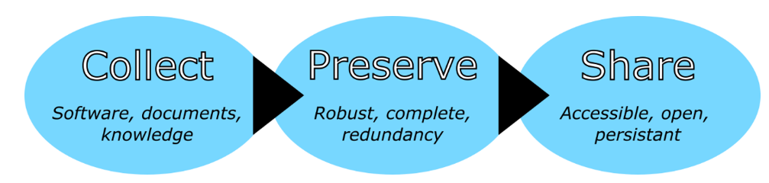
PRINCIPLES OF SOFTWARE PRESERVATION
These three principles, which correspond to the different phases of the software preservation process, help to guarantee the robust preservation of software while maximising benefit to, and usage by, potential future users of the software.

Slide 7
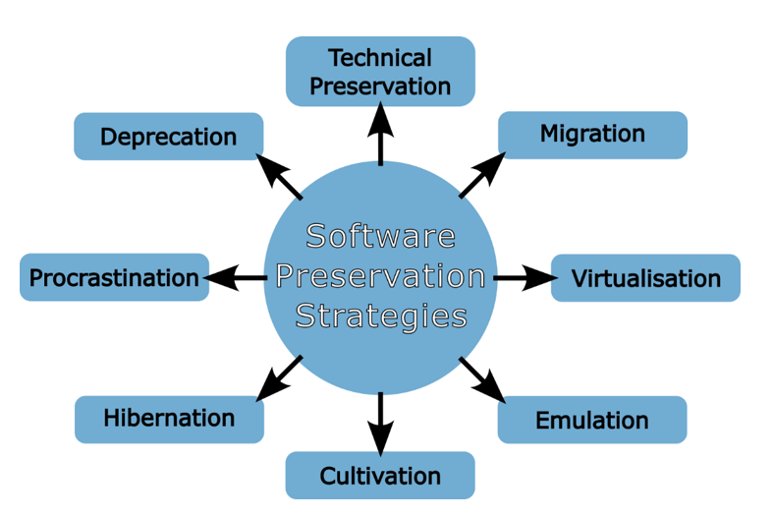
SOFTWARE PRESERVATION STRATEGIES

Slide 8
CHALLENGES AND COMPLICATIONS (1/2)
A wide array of challenges face software preservation, from technical complications to legal issues and resource availability.
A well planned and proactive approach to software preservation may help to avoid some of the most encountered challenges, particularly for larger, well-resourced organisations.
shortage of documentation and expert knowledge can significantly hamper the preservation process (mitigated by early adoption of a preservation strategy that ensures an adequate documentation and expert knowledge collection).
lack of expert knowledge may have a particular impact on the preservation of software (mitigated by early adoption of a preservation strategy that ensures an adequate documentation and expert knowledge collection).
preserving the full functionality of the software may be difficult as data managers/preservationists may not be familiar enough with the entire software to accurately assess whether all aspects are functioning as designed.
risk of partial or full obsolescence prior to beginning the preservation process poses a critical treat that is particularly pronounced for software that depends on any specialised hardware (mitigated by a good preservation planning).
The need to avert these risks further reinforces the importance of planning the preservation activities as soon as possible so that software and hardware may be preserved while they are still available.

Slide 9
CHALLENGES AND COMPLICATIONS (2/2)
intellectual property (IP) rights which may prevent the distribution of the software without first receiving explicit permission from the rights holder.
software preservation often requires the manipulation of the software in a manner which may not be permitted by the licence agreements.
simply preserving the software for personal use might not be permitted.
resource availability, both in terms of personnel and finances.
software preservation activities can involve sizable expenses, particular if employing a strategy of technical preservation for software that relies on specialist hardware that must be purchased and preserved.
Even if all the required expertise are available, preservation is still a time-consuming process that requires significant effort and commitment from the personnel involved.

Slide 10
LECTURES ON THE TOPIC (Not Exhaustive)
N. C. Hong, “Digital Preservation and Curation: The Danger of Overlooking Software”, in The Preservation of Complex Objects, Vol. 1, Visualisations and simulations, pp. 25–35 (2012). ISBN 978-1-86137-6305
R. A. Lorie, “Long Term Preservation of Digital Information”, JCDL ’01: Proceedings of the 1st ACM/IEEE-CS joint conference on Digital libraries, USA, pp. 346–352 (2001). https://doi.org/10.1145/379437.379726
S. M. Morrissey, “Preserving Software: Motivations, Challenges and Approaches”, Digital Preservation Coalition, (2020). https://doi.org/10.7207/twgn20-02
E. M. Corrado, “Software Preservation: An Introduction to Issues and Challenges”, Tech. Serv. Q., 36(2), pp. 177–189 (2019). https://doi.org/10.1080/07317131.2019.1584983
B. Matthews, A. Shaon, J. Bicarregui, C. Jones, J. Woodcock, and E. Conway, “Towards a Methodology for Software Preservation”, iPRES 2009: Proceedings of the 6th international conference on the preservation of digital objects, USA, pp. 132–140 (2009). https://escholarship.org/uc/item/8089m1v1

Slide 11

WAY FORWARD
A dedicated session will be organized at WGISS#59 to share experiences and technical information to be used to draft the White Paper

