Slide 1
Digital Earth and Challenges with Data in the Cloud
Alex Leith, Auspatious
Agenda Item 9.3
WGISS-58

Slide 2
What is the talk about
I’m Alex Leith and I have around 6 years experience in EO
My background is geospatial, but I have spent a lot of time supporting open source software and open data
I worked on the development of STAC specifications that are required to load data efficiently, which were adopted by E-84, MSPC, USGS and others
This talk is about how Digital Earth and Challenges of Working in the Cloud.

Slide 3
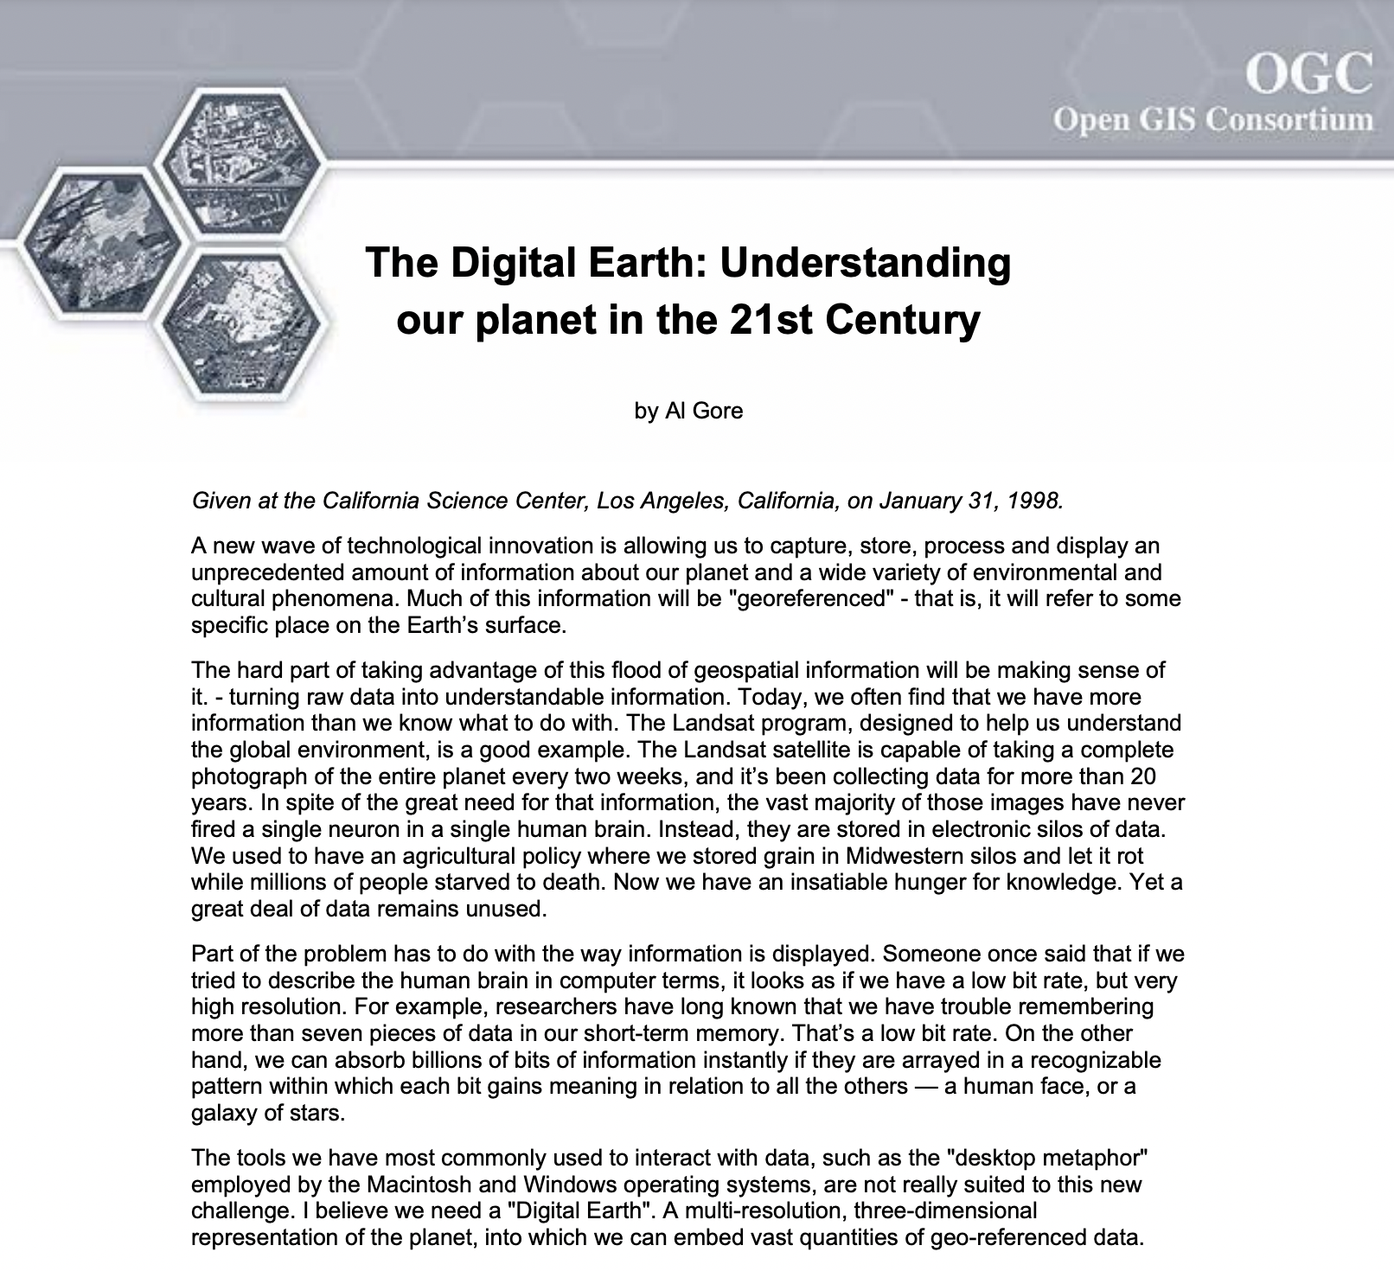
The Digital Earth
“We have an unparalleled opportunity to turn a flood of raw data into understandable information about our society and our planet.”
“In the first stage, we should focus on integrating the data from multiple sources that we already have.”
“In the long run, we should seek to put the full range of data about our planet and our history at our fingertips.”
- Al Gore, 1998

Slide 4
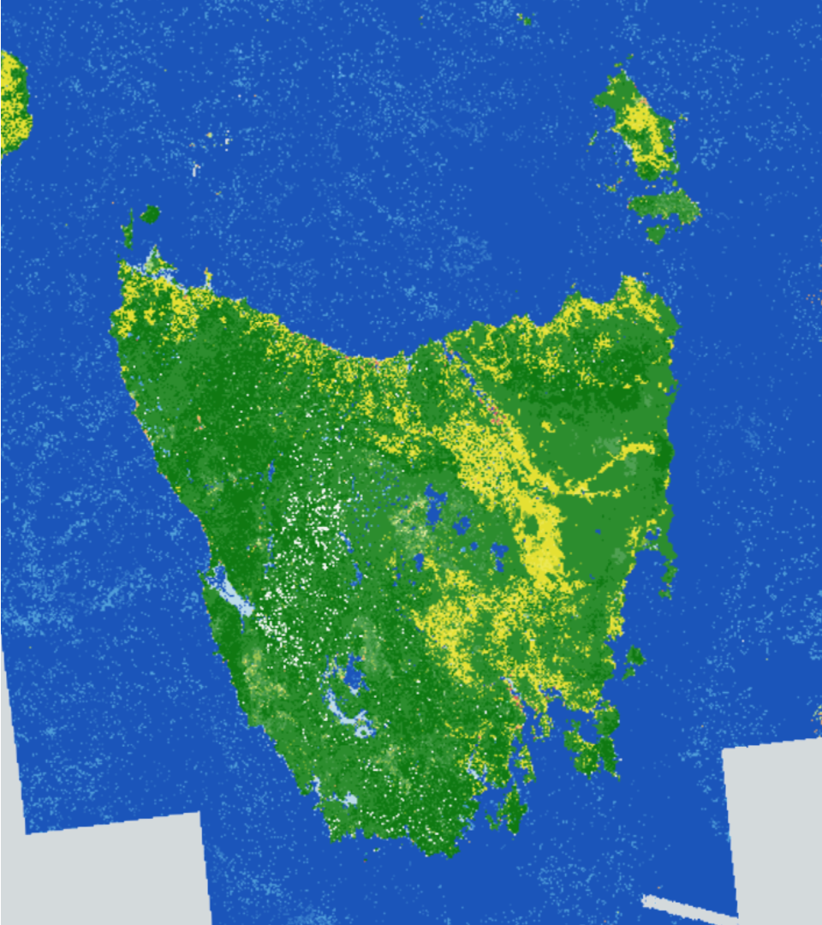
Digital Earth Australia (2010)
Funded by the Australian Government
Australia used to be a downlink for Landsat
Raw data was stored on tapes
Data eventually was digitized in Unlocking the Landsat Archive project
The Australian Geoscience Data Cube (AGDC) was developed
It was improved and consequently renamed to “the Open Data Cube”
Today Digital Earth Australia supports government and industry by making EO data accessible

Slide 5
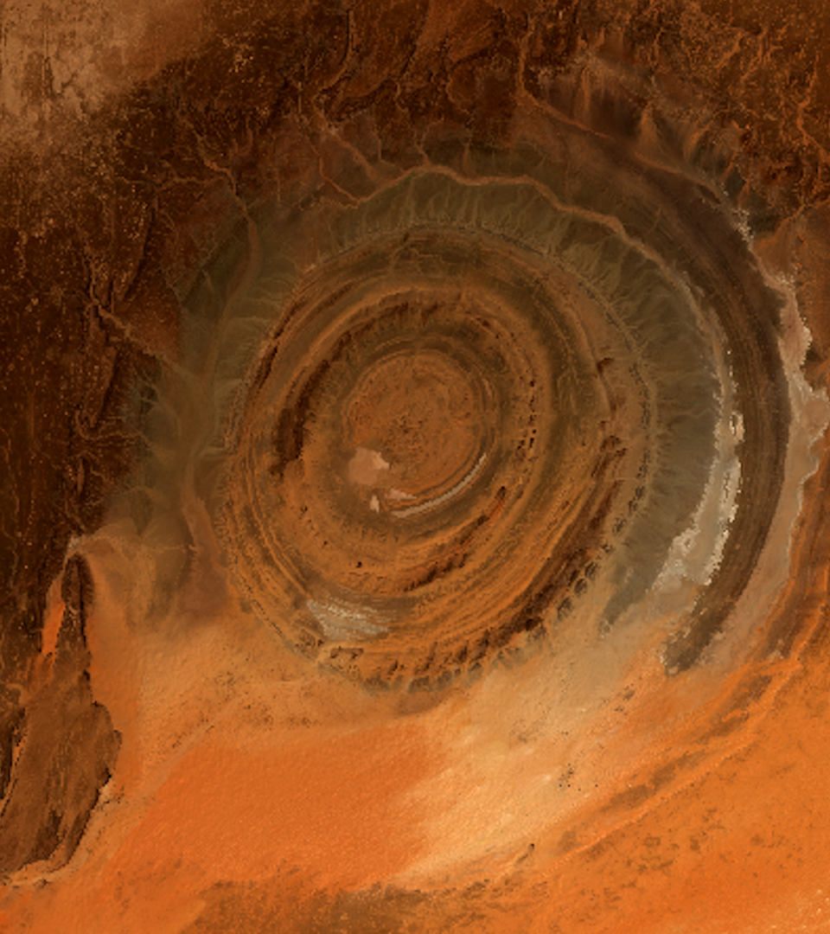
Digital Earth Africa (2020)
Funded by US-based Philanthropic organization and Australian Government
Broad goals around making data more easily accessible across the African continent
The mission
DE Africa will process openly accessible and freely available data to produce decision-ready products. Working closely with the AfriGEO community, DE Africa will be responsive to the information needs, challenges and priorities of the African continent. DE Africa will leverage and build on existing capacity to enable the use of Earth observations to address key challenges across the continent.

Slide 6
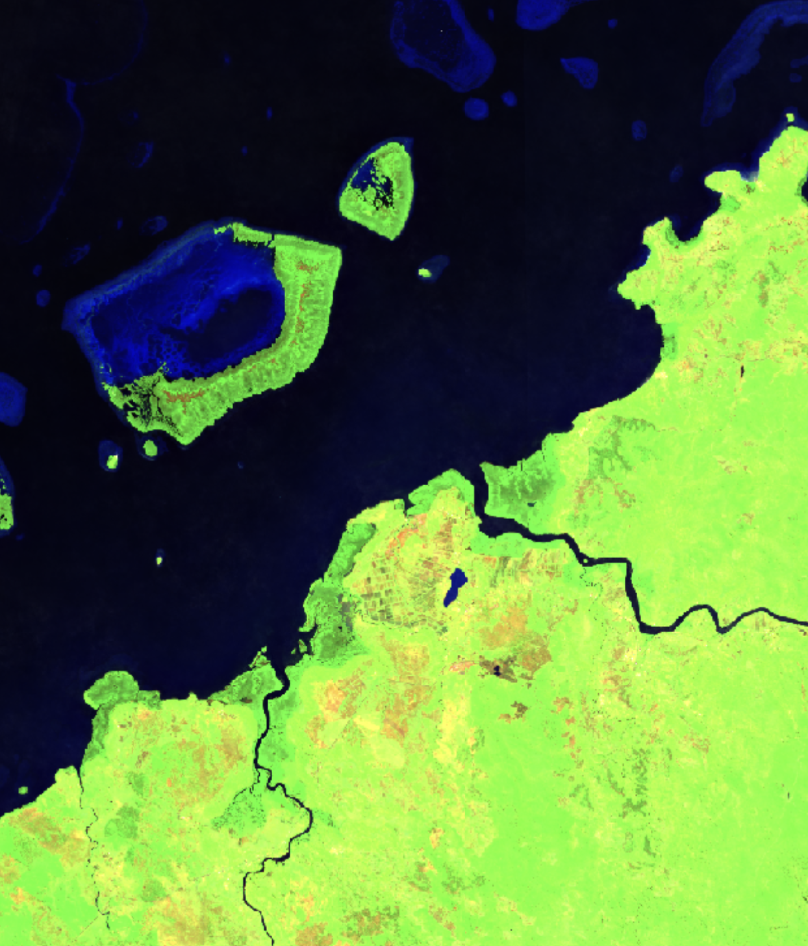
Digital Earth Pacific (2023)
Empower more people from the Pacific to access and analyse data. Chart a course towards a culture of scientific collaboration that is self-sustaining and meaningful.
Simplify access to Earth and Ocean Observation data. Deliver a technology infrastructure that enables people to access, visualise and analyse data.
Deliver new products specific to the needs of the Pacific. Research and develop new and adapt existing derived data products and deliver them routinely and reliably.

Slide 7
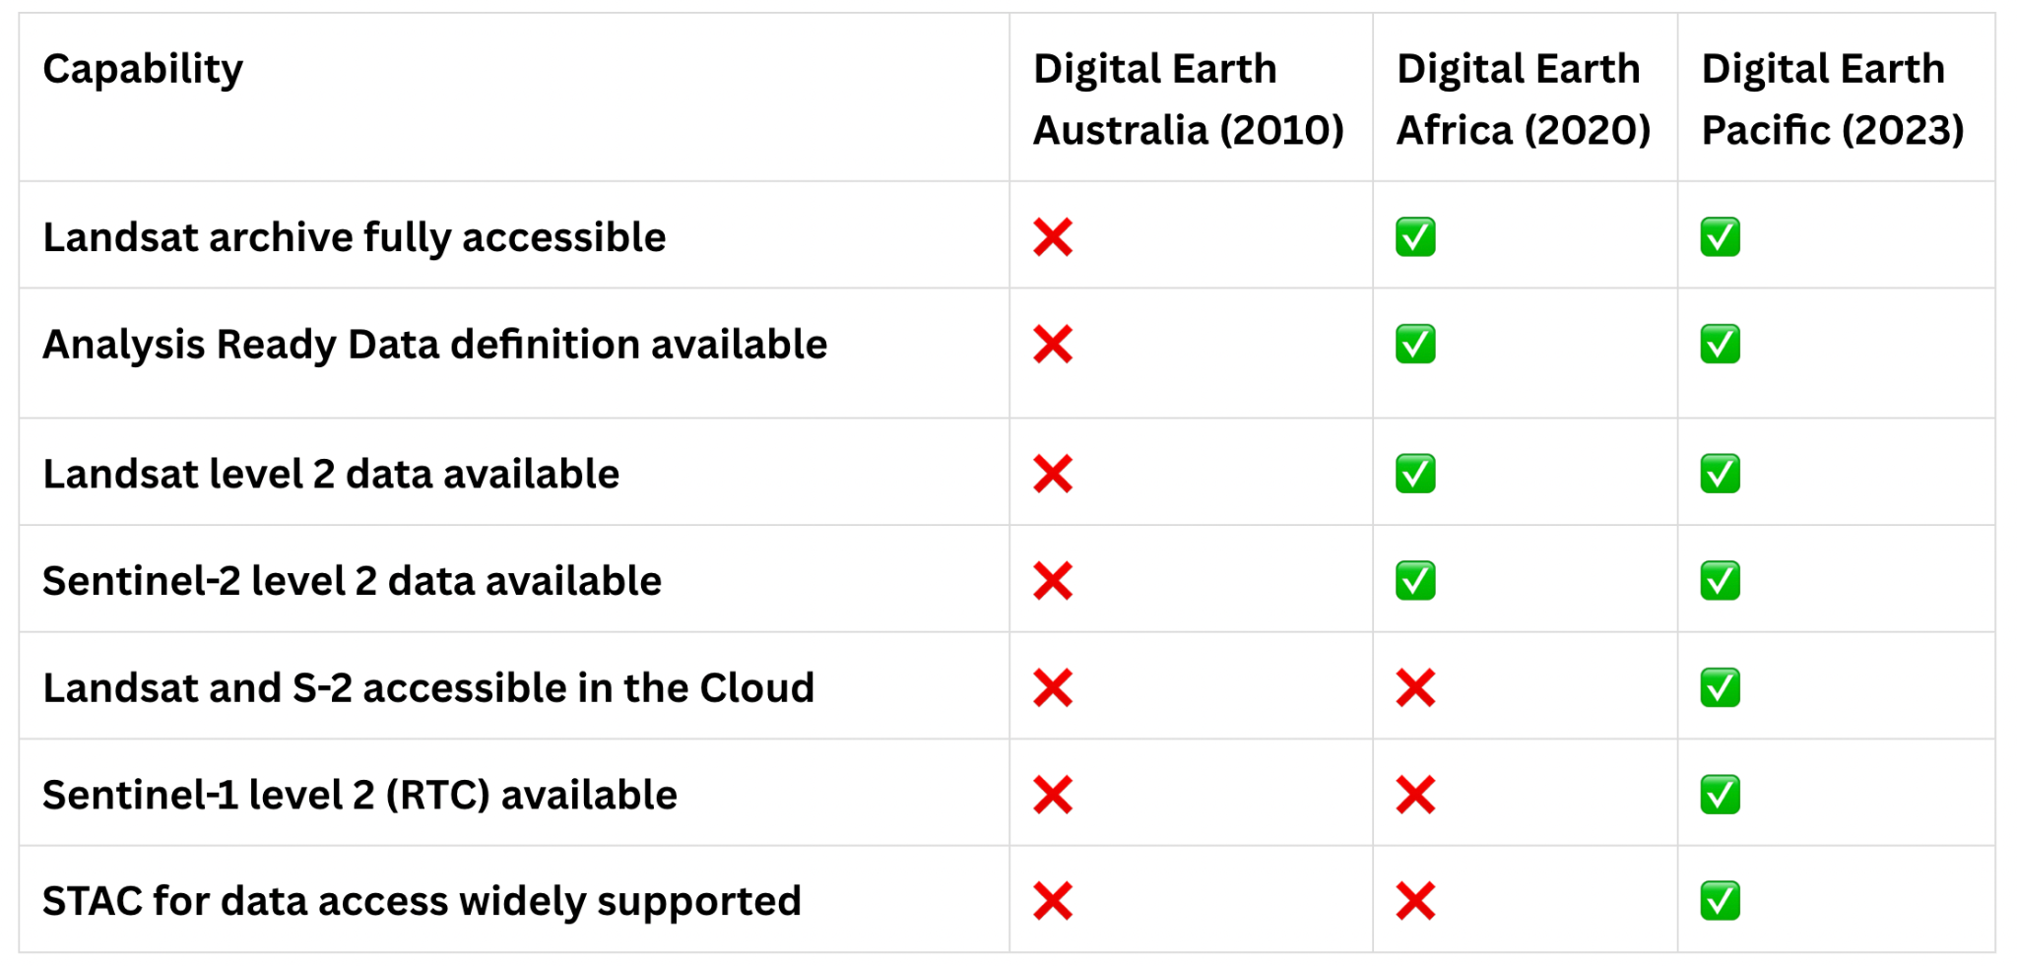
What capabilities were available

Slide 8
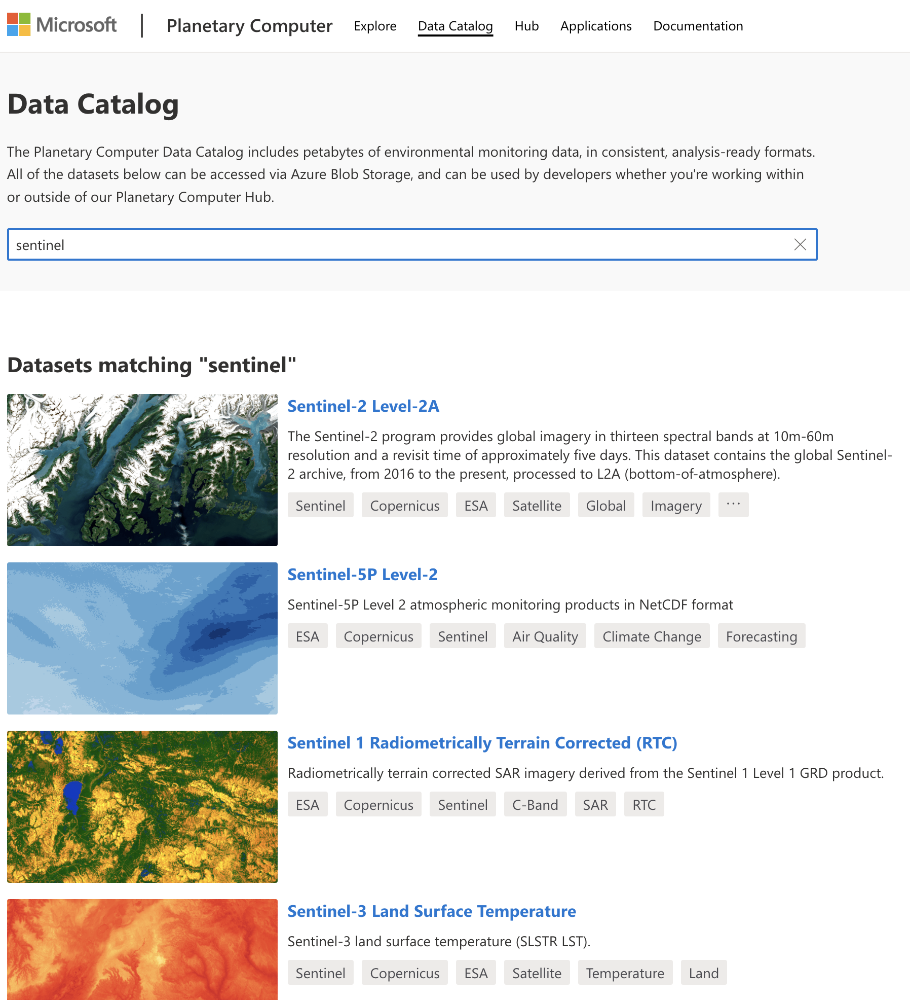
The Present Future of Digital Earth Platforms
Global analysis ready data is accessible with low to no barriers
Petabytes of open data, including:
Landsat 4, 5, 7, 8 and 9 from early 80s to yesterday
Sentinel-2 (A and B) from 2016 to yesterday
Sentinel-1 (A and not B any more) from 2014 to yesterday
New commercial satellites practically every week!

Slide 9
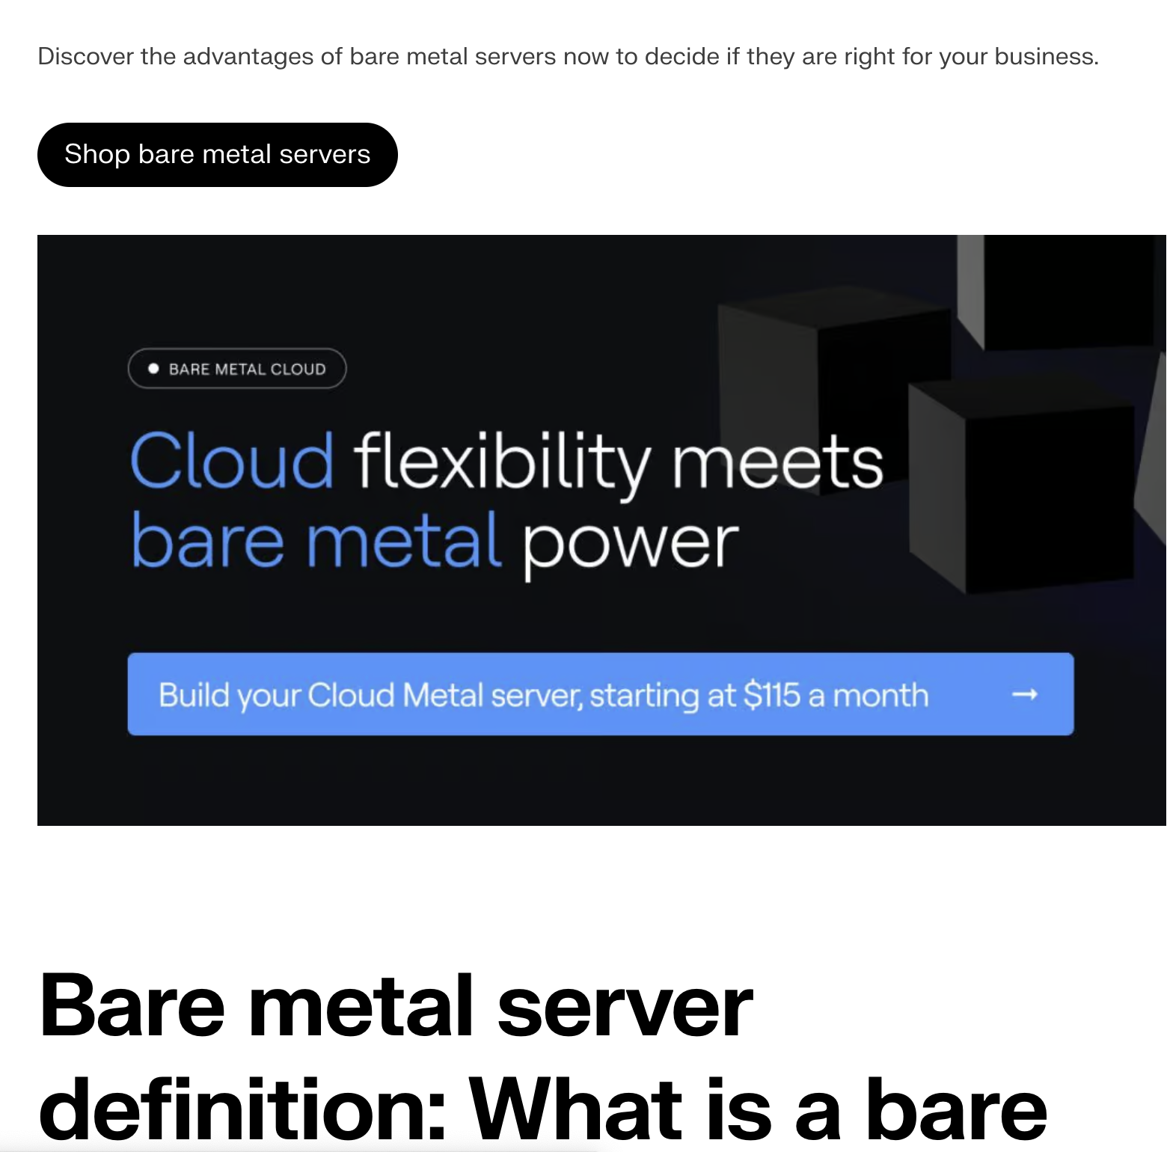
What is Cloud Native
In the beginning, there was lift and shift
Next came all the as-a-services
Later came containerisation and container orchestration
Now we’re using Kubernetes and infrastructure-as-code
Perhaps we’re moving back again to simpler things…

Slide 10
Cloud Native Geospatial

Slide 11
Case Study: Global Coastlines
The original process was developed for a supercomputer and filesystems
On the cloud, writing to disk slows things down a lot
The process was re-developed to load data from S3 directly into memory, and write direct back to object storage
Result is simpler process with less infrastructure and shorter run time, but more memory usage

Slide 12
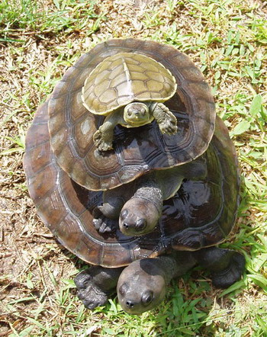
Major Challenges with Cloud
There’s a lot of abstraction going on:
Hardware to virtualisation
Virtualisation to Kubernetes
Kubernetes to workflow app
And for files, a shift from thinking about file storage to thinking about objects
But when things don’t work, there’s a lot you need to know
Learning all of this is hard and takes a long time
Cloud engineers are expensive
(Mistakes can be expensive too!)

Slide 13
Mistake 1: infinite serverless
A process was developed to transfer data from the US to Africa
Once transferred, a Lambda (serverless function) was to run for JSON files to update a field in them
JSON landing in the destination bucket triggered the update that write the result to the destination bucket
Cost was…. A lot…

Slide 14
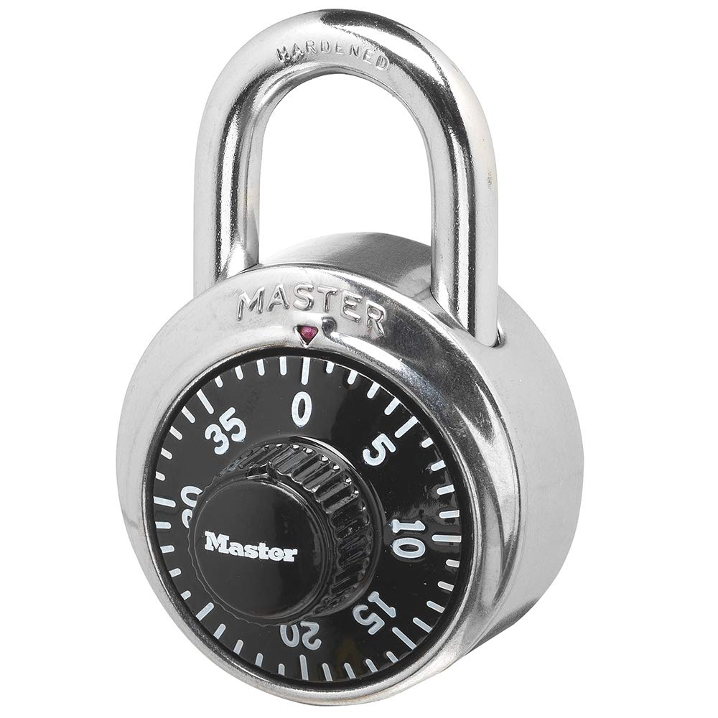
Mistake 2: expensively secure
We run things in virtual private networks
To access the internet, you need a NAT gateway
Traffic across this costs $0.057 per GB
There’s a special direct connection to S3 (VPC Endpoint)
We turned this off due to an issue
And then ran 400 TB of data processing
(Cost was 400,000 * $0.057 = $22,000 USD

Slide 15
The cloud is essential
Even for USGS, there’s no alternative
The scale for the cost is incredible
The complexity in the abstraction is essential
I’m doing some processing without using Kubernetes currently, and it’s harder to scale, but simpler
Work smarter not harder

Slide 16
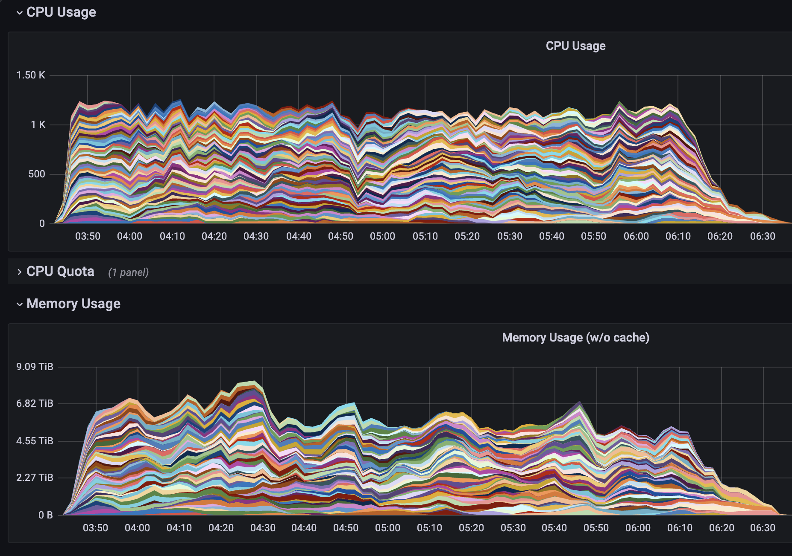

Slide 17
