Slide 1
GitHub & Modular Approach to CEOS-ARD PFS
Chris Barnes, USGS/KBR
LSI-VC co-lead
Agenda Item D.2
WGISS / WGCV Joint Meeting
15 & 18 October 2024
Sioux Falls, South Dakota, USA

Slide 2
Outline
GitHub Outcomes from LSI-VC-16
- Approach & Timeline
GitHub Training

Slide 3
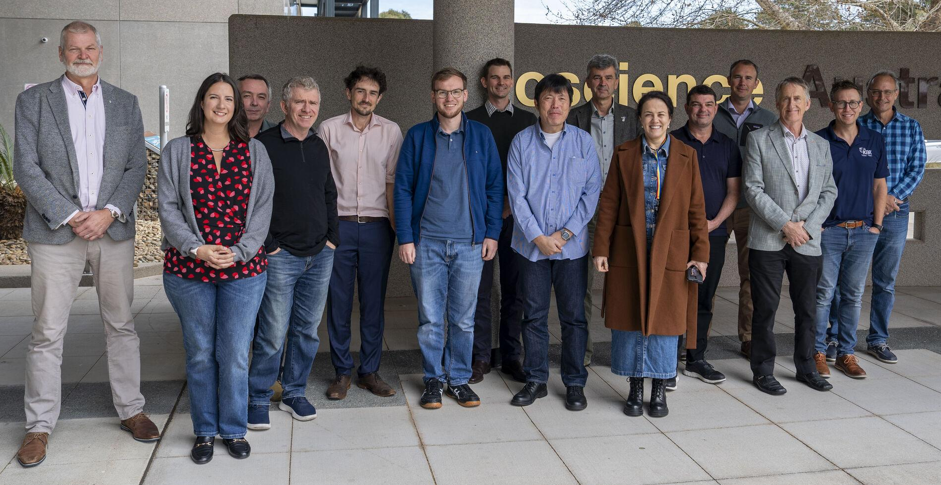
GitHub Outcomes from LSI-VC-16 - Approach & Timeline
Unanimous agreement at LSI-VC-16 that the best way forward to further develop, transparency, version control and consistency across CEOS-ARD PFSs is via GitHub
… and increase community engagement and alignment with STAC.
A notional roadmap and timeline for this activity as well as an initial set of implementation practices/ guidelines was discussed.

Slide 4
GitHub Outcomes from LSI-VC-16 - Approach & Timeline
CEOS-ARD PFS/GitHub Governance - Establish PFS/GitHub roles and responsibilities (i.e., admins/ moderators) - Description of workflow, process and GitHub tools (e.g. building blocks) - How to implement version control? Handling of historical PFS compliance. - What is our approach to beta PFS versions? - What is our “Pull request” review process? - …?
Quickly discerned we have a lot more questions than answers, so to ensure everyone understands the rules of engagement, especially as we seek broader community participation, a CEOS ARD Governance Framework needs to be established
LSI-VC Secretariat and co-leads to define a roadmap/ next steps that covers the next 6 mths using LSI-VC-17 (April 2025) as a check in
Will share with the CEOS-ARD Oversight Group
Matt Paget (CSIRO) to support Matthias Mohr (Ind. Consultant) to setup GitHub
SAR PFS will be used as the “building blocks” and then Optical PFS
Not exactly sure how long the initial transition to GitHub and establishing the building blocks is going to take, just yet…

Slide 5
GitHub Training
YES there will be!
Any suggestions/recommendations can be directed to the LSI-VC co-leads:
Ake Rosenqvist - (JAXA/ soloEO)
Christopher Barnes – (USGS/KBR)
Peter Strobl - (EC/JRC)
Takeo Tadono – (JAXA)
But first, CEOS SEO (Dave Borges) will arrange for GitHub training for LSI-VC
How will GitHub and tools be used to migrate CEOS-ARD PFSs from Word docs into a modular approach.
Then align the CEOS SEO training with what is defined in the CEOS ARD Governance Framework to roll out across the rest of CEOS
Welcome WGISS and WGCV input/ guidance
Likely 12 mths out from fully transitioning to into GitHub environment for external feedback

Slide 6
Resources
CEOS-ARD
CEOS-ARD Newsletter
CEOS-ARD Framework
Guide to CEOS-ARD Self-Assessments
THANK YOU!
Chris Barnes: barnes@contractor.usgs.gov

