Slide 1
WGCV-54/WGISS-58
Consistency in Quality of Surface Reflectance Measurements
Simon Oliver
Medhavy Thankappan
Geoscience Australia
Agenda Item D.3
WGCV-54/WGISS-58 Joint Meeting
15 & 18 October 2024
Sioux Falls, South Dakota, USA

Slide 2
Issue
The CEOS-ARD Surface Reflectance Product Family Specification (PFS) provides a strong basis for interoperability.
However, it tolerates different approaches for deriving the ARD—Surface Reflectance. This affects the harmonisation of multi-sensor products, limiting their utility for applications requiring time-series data from several sources.
There is a need to continue building on the CEOS-ARD effort and developing approaches to achieve better harmonisation of multi-sensor data.
This proposal is about taking the next steps to support better harmonisation of CEOS-ARD Surface Reflectance products from multiple sources.
Notes:
CEOS ARD PFS provides a great basis for interoperability, though if you follow the PFS it may result in differences in the representation of measurements. This is because CEOS ARD is not prescriptive and allows adopted to have a variety of approaches to products, which may commonly be termed surface reflectance, but vary quite significantly in what physical quantity they actually represent. The Surface Reflectance Consistency project that we are talking about today aims to address elements of that variability, and could be seen as a next step in the evolution of the ARD concept to better support harmonisation of CEOS ARD Surface Reflectance products from multiple sources.

Slide 3
Issue
Correction and Inputs | ESA S2 L2A Sen2Cor | USGS L2 LASRC | GA Lambertian | GA NBAR |  | GA NBART
BRDF Model | - | - | - | Ross Thick, Li Sparse
BRDF Parameters | - | - | - | MCD43A1 / VNP43
BRDF: solar angle | - | - | - | ✓ |  | ✓
BRDF: view angle | - | - | - | ✓ |  | ✓
Atmospheric: solar angle view angle | - | ✓ ✓ | ✓ ✓ | ✓ ✓ |  | ✓ ✓
Terrain illumination (slope/aspect/shadowing) | ✓ | - | - | - |  | ✓
Adjacency | ✓ | - | - | - |  | -
Pressure | default | Internal based on DEM | MODTRAN default atmospheric profile - DEM altitude adjusted
Air Temperature | default | MODIS/VIIRS CMG | MODTRAN default atmospheric profile - DEM altitude adjusted
Aerosol Optical Thickness | DDV / CAMS | Internal algorithm | AATSR Climatology
Water Vapor | Atmospheric Pre-corrected Differential Absorption | MODIS/VIIRS CMG | NOAA NCEP – DEM altitude adjusted
Ozone | ECMWF | MODIS/VIIRS CMG | OMI/TOMS
Atmospheric Correction | LibRadTran LUT | Internal algorithm/6S | MODTRAN 6
Sun and Sky glint correction | - | - | - |  | - | -
DEM | Planet DEM COP DEM since 3.01 | ETOPO5 (CMGDEM) | - |  | - | SRTM 1 sec (modified)
The CEOS-ARD Surface Reflectance PFS provides a good starting point for interoperability of multi-sensor SR products but there are some differences among CEOS-ARD SR products.
Notes:
This table represents just a few examples of the different approaches that are currently taken in the production of surface reflectance products.

Slide 4
Why do we care?
Inconsistency in surface reflectance products from different providers limits combined use of multi-sensor data, performing impactful analyses and gaining deeper insights.
CEOS agencies' efforts in producing NASA HLS and ESA Sen2Like demonstrate the need to improve the compatibility of SR measurements across providers.
Planned major Collection upgrades (e.g. USGS – Landsat C3) provide an opportunity for input in support of better alignment and harmonisation of SR products.
CEOS-ARD is only the first step in the ‘interoperability continuum’, we need to plan the next steps to advance CEOS interoperability objectives.

Slide 5
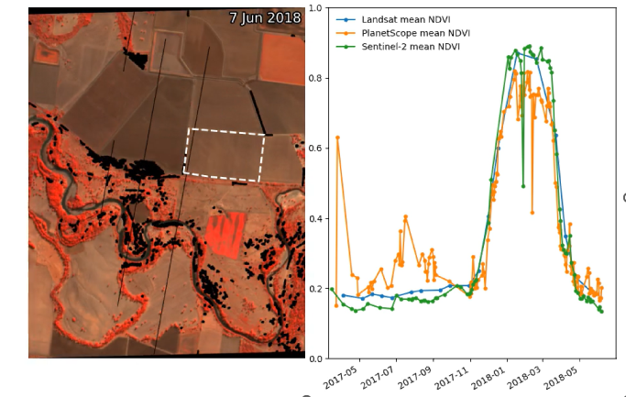
Data inconsistency
Noise in Normalised Difference Vegetation Index time-series profiles for the same area derived from Landsat, Sentinel-2 and PlanetScope data
Credit: Robbi-Bishop Taylor, Geoscience Australia

Slide 6
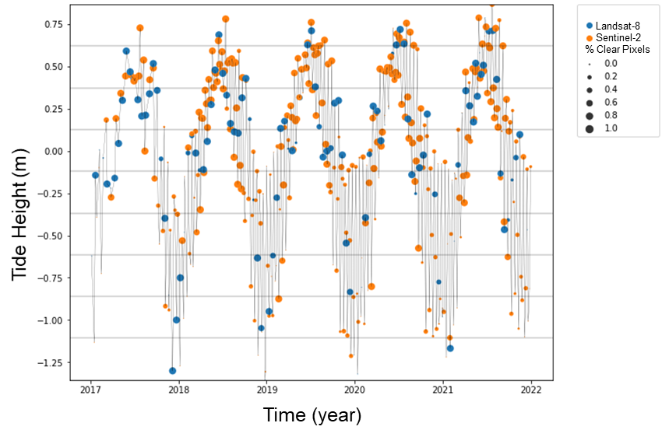
Harmonisation: Synergies
By combining Landsat (blue) and Sentinel-2 (orange) data processed through the same workflow, a set of observations that best represent the tidal range in coastal northern Australia was achieved. It would take much longer to achieve the same result if data from only one sensor were used.
Credit: Robbi-Bishop Taylor, Geoscience Australia
Notes:
Harmonisation of surface reflectance quantities can allow data from different platforms to be used together. The data here is produced from geoscience australia's ARD processor which applies a common correction across both Landsat and Sentinel-2. This example coincides Landsat (in blue) and Sentinel-2 (in yellow) observations with low and high tide peaks over a five year period with the aim of characterising the tidal dynamics. The size of the dot represents the percentage of clear pixels and it is interesting to note that during the low tide phase (in the bottom half of the chart) we see a lot of not so clear Sentinel-2 observations, when compared with the Landsat observations (which tend to be clearer). The use of the two data streams here means we can get a clearer picture of the tidal dynamics that we would with a single sensor. This work is only possible because the observations from Landsat and Sentinel-2 are effectively harmonised and represent the same surface reflectance quantity.

Slide 7
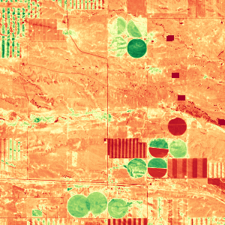
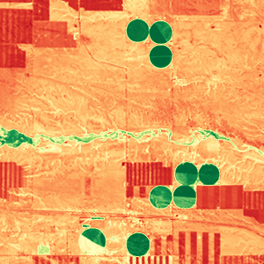
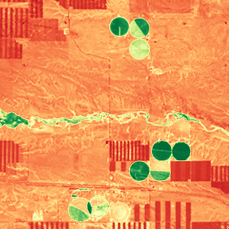
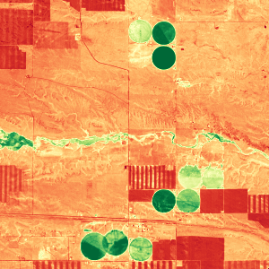
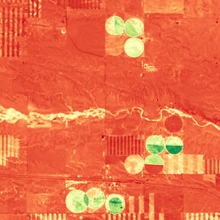
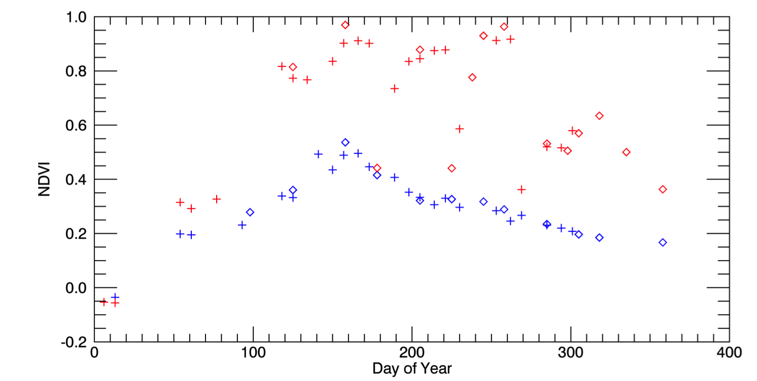
Harmonisation: Better insights
Better insights into seasonal phenology could be achieved from Harmonised Landsat / Sentinel-2 data with high temporal density of observations. Transient phenomena would be missed if data from only a single sensor were used.
May 4, 2016 (S2)
Aug 8 (L8)
Aug 17 (L8)
Sep 1 (S2)
Oct 20 (L8)
3km
0.1 NDVI 0.9
Example from the US: Seasonal phenology (greening) for natural grassland (blue line) and irrigated alfalfa fields (red line) near Cheyenne Wyoming observed from Harmonized Landsat/Sentinel-2 data products. The high temporal density of observations allows individual mowing events to be detected within alfalfa fields. HLS Products available from https://hls.gsfc.nasa.gov
Credit: Jeff Masek, NASA
Sentinel-2 Landsat-8
+
Alfalfa
NDVI
mowing
Grassland
Notes:
This example comes from Jeff Masek at NASA and represents the insights that can be gained through the use of Harmonized Landsat and Sentinel-2 for gaining better insights into seasonal phenology. The red line in the chart at bottom represents the change in NDVI of an irrigated alfalfa crop over a year, with harvesting events shown as dashed vertical lines. The diamond shapes represent Sentinel-2 measured NDVI and the plus signs represent Landsat. We can see that the higher temporal frequency afforded by these homogenised observations in the HLS dataset allows the detection of the individual harvesting events and deeper insights.

Slide 8
Proposal
Build on CEOS-ARD achievements so far, take next steps to achieve multi-sensor harmonisation.
Unambiguously characterise the SR quantity in the context of CEOS-ARD products.
Identify a set of inputs, corrections, associated parameters and tolerances for achieving consistency in SR measurements in support of harmonising CEOS-ARD SR products.

Slide 9
Benefits
Consistent time-series across sensors, steps towards enhanced harmonisation amongst CEOS-ARD SR products.
Focused effort on value-adding with a common foundational measurand and improve the results from multi-sensor analyses, gain better insights.
Reduced duplication of effort, cost savings, increased global applicability of algorithms, higher return on investment.

Slide 10
Key objective
Describe a surface reflectance (Passive Satellite Viewed Bottom of Atmosphere Surface Reflectance) quantity, the applicable steps, model parameters and their tolerance, required for generating SR products of consistent quality using like-bands from different sensors.

Slide 11
ACIX vs SR Quality Consistency
Atmospheric Correction Intercomparison Exercise (ACIX):
Evaluated and compared the performance of several atmospheric correction processors.
For understanding strengths and weaknesses of algorithms for a reduction of error sources for atmospheric correction.
SR Quality Consistency:
Not an intercomparison exercise, allows for difference in approaches.
About defining the surface reflectance quantity that enables measurement harmonisation.

Slide 12
Conceptual model (current)
A
Datasets A and B
B
Illumination conditions
Reflectance
A B
A
Atmospheric correction
BRDF correction
Terrain Illumination correction
Adjacency correction
Solar angle normalization
B
Time
Surface Reflectance Profiles
Target characteristics

Slide 13
Conceptual model (current)
A+B
Harmonised datasets
A B
Reflectance
Atmospheric correction
BRDF correction
Terrain Illumination correction
Adjacency correction
Solar angle normalisation
Time
Surface Reflectance Profiles
Notes:
The absolute calibration of A & B (Geometry and Radiometry) are assumed to be the same.

Slide 14
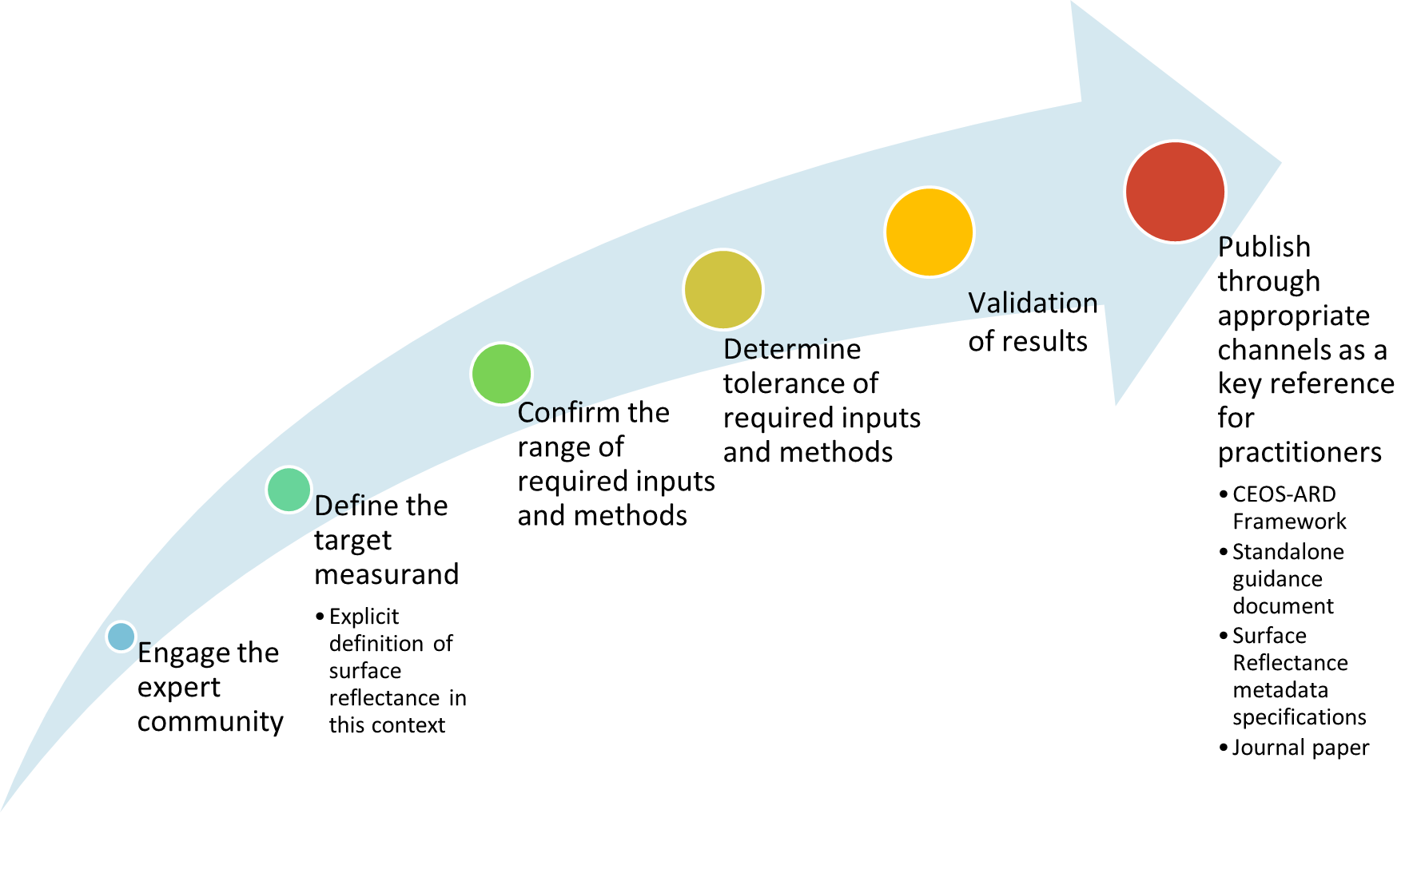
Plan of action

Slide 15
Progress so far
Original concept first presented at ARD23 Workshop, exposure document of the concept presented at WGCV-52 in June 2023, then at LSI-VC 14 in October 2023
A revised concept paper presented at WGCV-53 in March 2024.
Following feedback, engaged the expert community after a call for ‘Expressions of Interest’ to participate in the Surface Reflectance Quality Consistency initiative.
Fortnightly meetings of the expert group continue, initial discussions focussed on terminology to enable shared understanding of objectives for the work.
Subsequent effort to document the discussions that could support interoperability initiatives within CEOS (Interoperability Framework, Handbook 2.0, led by WGISS).
A guidance document on the SR Quality Consistency initiative is in development with contributions from the expert group.

Slide 16
Document purpose
Serve as a reference for organisations considering reprocessing of Earth observation Collections of moderate resolution (1m - 100m) passive optical satellite data (300-2500 nm) with an aim of contributing to a virtual constellation of interoperable surface reflectance measurements.

Slide 17
Title
“Achieving consistent quality for harmonising land surface reflectance measurements across like-sensor bands in the solar reflective region”

Slide 18
Document structure
Background
1 Introduction
1.1 Purpose
1.2 Contributors
1.3 Definition : Consistency two surface reflectance measurements
1.4 Scope
2 Steps/corrections needed to achieve consistency
2.1 General Steps
2.2 Harmonisation Steps
2.3 Homogenisation Steps
3 Surface Reflectance Quantity
3.1 Description of the surface reflectance quantity
4 Applicable Parameter Thresholds
4.1 Atmospheric Correction
4.1.1 Atmospheric parameters
4.1.2 Comparability of Radiative Transfer Codes
4.2 BRDF correction
4.3 Terrain Illumination
4.4 Parameter Tolerance Summary

Slide 19
Defining the term
Surface reflectance measurements from different (satellite)s or sensors can be considered consistent when if, for an invariant target and within a predefined range of conditions, they produce comparable results which fall within their measurement uncertainties for the same target under predefined conditions.

Slide 20
Steps to Quality Consistency
General Steps | 1. Radiometric calibration
 | 2. Atmospheric correction
 | 3. Validation against reference
 | 4. Consistency checks
 | 5. Traceable to SI units
Harmonisation | 6. Geometric correction
 | 7. BRDF correction
Homogenisation | 8. Spectral band adjustment
 | 9. Spatial resolution harmonisation
 | 10. Polarisation harmonisation correction (optional)
Validation Steps | 11. Validation
Consistency

Slide 21
Harmonisation Steps
A harmonised satellite series is one where all the calibrations of the sensors have been done consistently relative to reference datasets which can be traced back to known reference sources, ideally to SI.
https://research.reading.ac.uk/fiduceo/glossary/
Harmonisation | 6. Geometric correction
 | 7. BRDF correction

Slide 22
Homogenisation Steps
Unlike harmonisation, homogenisation is where measurements from satellites are forced to produce a similar result such that simultaneous observations over the same location would (in theory) yield the same output. In reality, the signals from different sensors would be different and homogenisation is adding in corrective terms to each satellite to make them look the same.
https://research.reading.ac.uk/fiduceo/glossary/
Homogenisation | 8. Spectral band adjustment
 | 9. Spatial resolution harmonization
 | 10. Polarization harmonization correction (optional)
Notes:
2.3 Homogenisation Steps
Unlike harmonization, homogenization is where all satellites are forced to look the same such that when looking at the same location simultaneously they would (in theory) give the same signal. In reality the signals from different sensors would be different and homogenisation is adding in corrective terms to each satellite to make them look the same. It is likely that these corrective terms will not be 100% effective and that the process of homogenisation will add in scene dependent errors to the uncertainty budget which may be difficult to assess. [9] Homogenization assumes a reference dataset, and therefore is not considered in the generation of equivalent measures within this guidance.
Spectral band adjustment: Account for differences in spectral response functions between sensors (if possible) for various landcovers by applying appropriate corrections or band-pass adjustments.
Spatial resolution harmonization: Account for GSD and spatial resolution differences (e.g. point spread function) if a spatially homogeneous data set is desired.
Polarization harmonization correction (optional): Account for sensor and scene polarization effects.

Slide 23
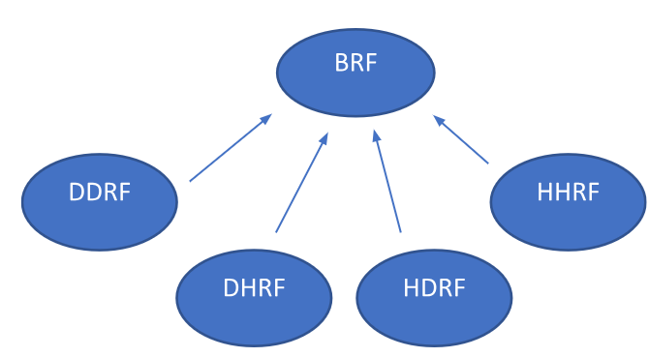
SR Measurand Definition
WORK IN PROGRESS
The idealised surface reflectance measure may be termed BRF – Directional incident and Directional excitant light and not hemispherical, nor conical in either direction.
Schaepman-Strub 2006
Notes:
The Top-of-Canopy Bidirectional Reflectance Factor (TOC BRF), which is solely dependent on illumination and viewing angles, cannot be directly observed in the field due to the inherent influence of sky radiation.

Slide 24
Parameter Tolerances
WORK IN PROGRESS
To achieve surface reflectance consistency, inputs to the radiative transfer model must be within defined tolerances and enable improved harmonisation of surface reflectance quantities.
For example:
aerosol, water vapor, ozone, pressure
elevation model

Slide 25
Contributors
Contributor | Organisation
Eric Vermote | NASA
Martin Bachmann | DLR
Peter Strobl | EC
Robert (Bob) Ryan | I2R
Mary Pagnutti | I2R
Raquel delos Reyes | DLR
Simon Oliver | GA
Medhavy Thankappan | GA
Dani Schläpfer | ReSe
Rudolf Richter | DLR
Fuqin Li | GA
David Jupp | CSIRO
Cody Anderson | USGS
Sebastien Saunier | Telespazio
Steve Covington | USGS
Sabrina Pinori | Serco
Danika Wellington | USGS
Symbios facilitating fortnightly meetings
USGS considerations for Landsat Collection 3 – 2028/29
Current working draft

Slide 26
CEOS Objectives
CEOS Terms of Reference
"To optimise the benefits of space-based Earth observation through cooperation of CEOS Agencies in mission planning and in the development of compatible data products, formats, services, applications and policies"
Mission specific consistency exists, but significant opportunity exists for all of mission approaches.

Slide 27
Discussion
How could this work complement the CEOS Interoperability Framework/Handbook?

