Slide 1
Radiometry and Spatial Matchup Database
Cody Anderson, USGS
CEOS WGCV Vice-Chair
Agenda Item F.2
WGISS / WGCV Joint Meeting
15 & 18 October 2024
Sioux Falls, South Dakota, USA

Slide 2
JACIE/VH-RODA Cal Site Actions
Joint Agency Commercial Imagery Evaluation (JACIE)
Very high-resolution Radar and Optical Data Assessment (VH-RODA)
Common Cal/Val Evaluation Sites
Common data pool for commercial imagery over evaluation sites
Database of high-res Ground Control Points (GCPs) and Digital Elevation Models (DEMs)
GCPIX: a Proposal to Orchestrate GCP Collection
JACIE Partner Agencies
VH-RODA

Slide 3
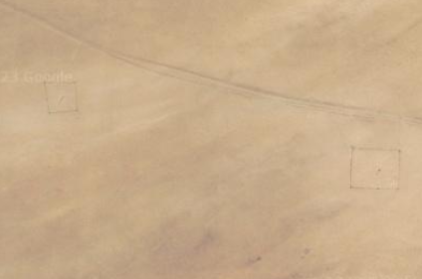
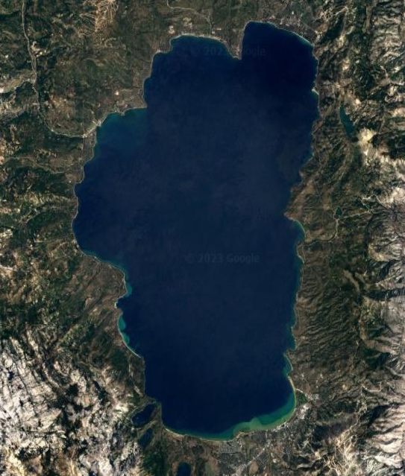
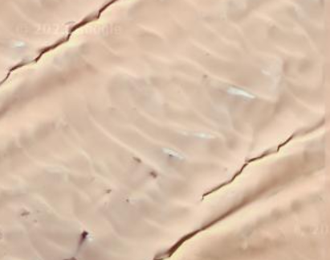
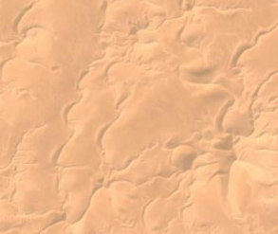
Radiometric Sites
Railroad Valley
Gobabeb
Lake Tahoe
Libya 4
Libya 1
Algeria 3

Slide 4
Radiometric Sites
Site Name | Center Latitude | Center Longitude
Instrumented Sites
Railroad Valley Playa | +38.50 | -115.69
Gobabeb, Namibia | -23.60 | +15.12
Lake Tahoe (Thermal) | +39.10 | -120.03
Pseudo-Invariant Calibration Sites (PICS)
Libya 4 | +28.55 | +23.39
Libya 1 | +24.42 | +13.35
Algeria 3 | +30.32 | +7.66

Slide 5
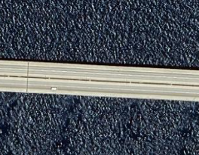
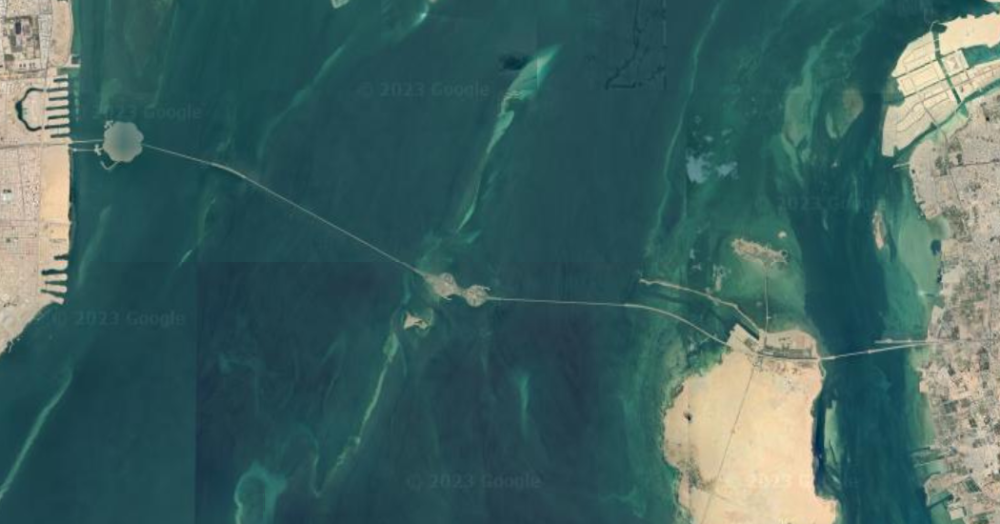
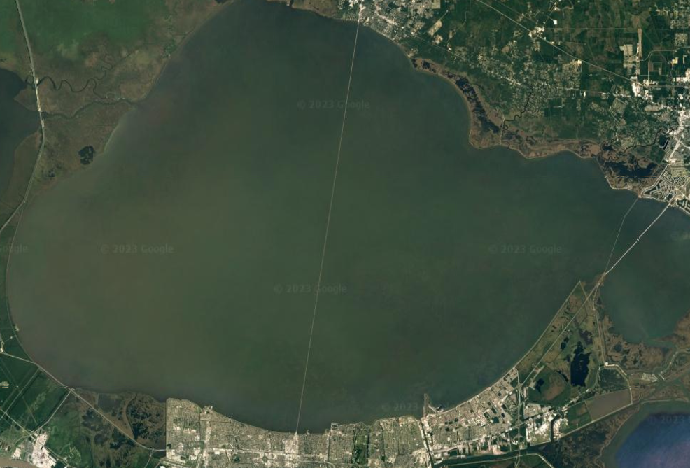
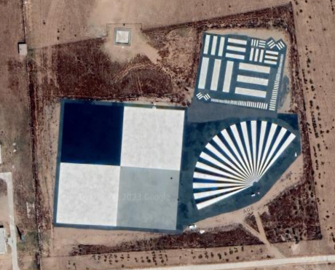
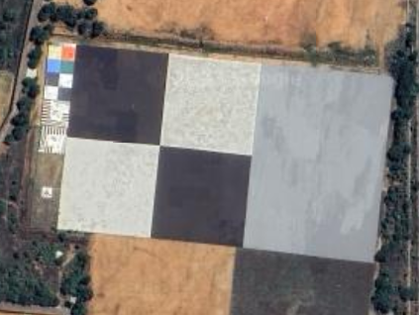
Spatial Sites
King Fahd Causeway
Lake Pontchartrain Causeway
Baotou Target
ISRO NRSC Target

Slide 6
Spatial Sites
Site Name | Center Latitude | Center Longitude
Medium Resolution Sensor
King Fahd Causeway | +26.20 | +50.34
Lake Pontchartrain Causeway | +30.21 | -90.12
High Resolution Sensor
Baotou Target, China | +40.85 | +109.63
ISRO NRSC India | +17.03 | +78.18

Slide 7
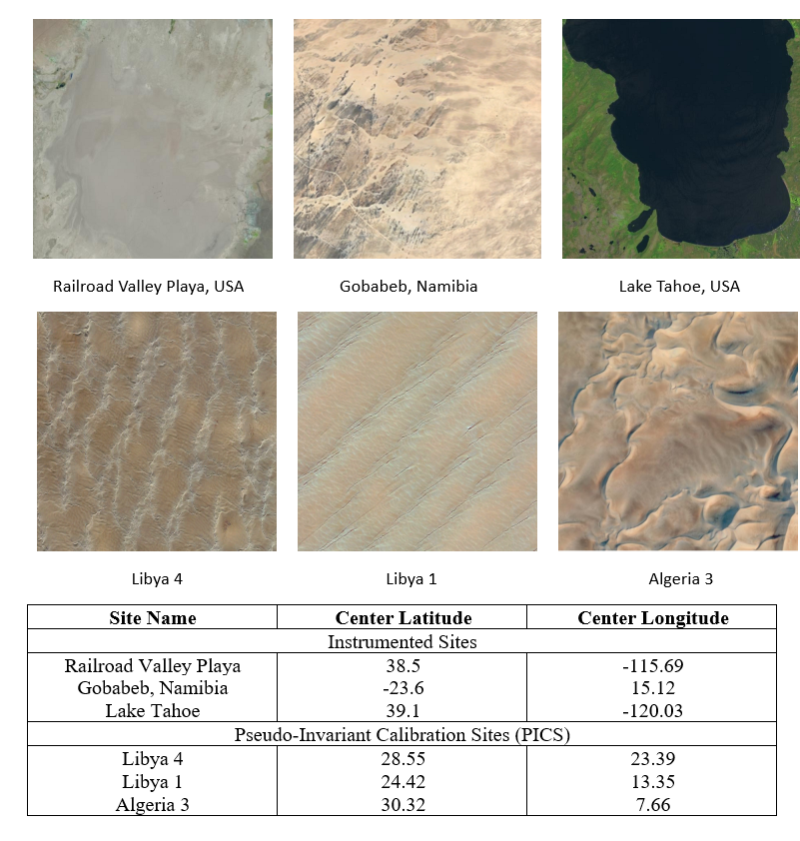
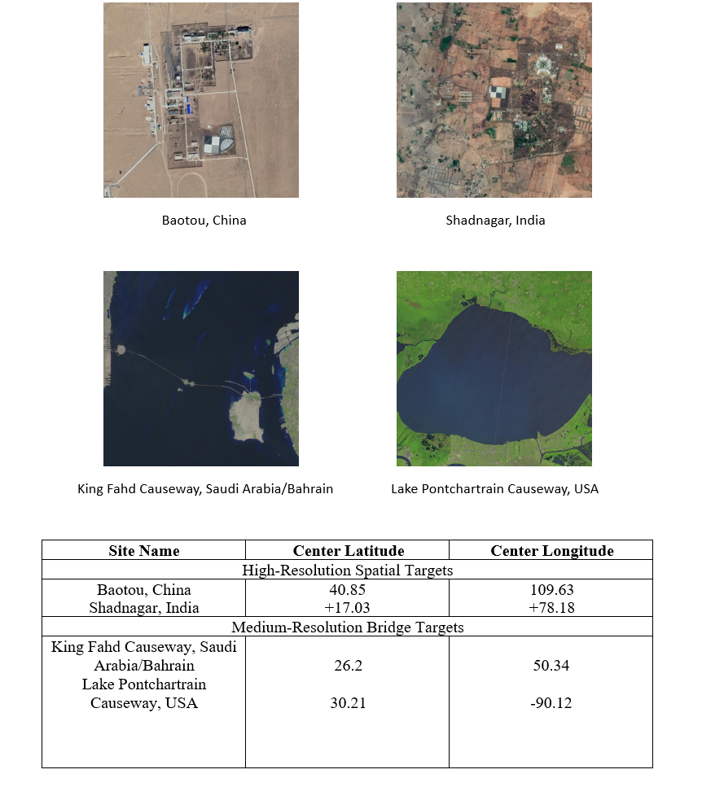
Recommendation
CEOS WGCV Recommendation: Facilitating interoperable global satellite imagery: agency & newspace
To
To facilitate a consistent understanding of the relative radiometric and spatial performance characteristics of passive optical satellite Level 1 imagery CEOS recommends that member agencies regularly collect and provide free access to imagery and associated metadata against a common ‘CEOS reference’ from their own missions as well as encourage/request any commercial data provider they can influence to do the same. The imagery can be made available for collection by API or deposited to a dedicated CEOS archive held in the UK Earth Observation Data Hub (EODH). CEOS will provide feedback on relative performance for QA purposes for both satellite operators and data users via a tool/web app developed by NPL (UKSA).
The CEOS reference has been chosen to be derived from a minimal set of locations together with the minimal required metadata. The reference in practice consists of a few sites for radiometric and spatial evaluation for solar reflective and thermal emissive missions.

