Slide 1

WGISS/WGCVSI-Traceable Satellite (SITSat) Task Group
Nigel Fox, NPL/UKSA
Yolanda Shea, NASA
Agenda Item: G1
WGISS / WGCV Joint Meeting
15 & 18 October 2024
Sioux Falls, South Dakota, USA

Slide 2

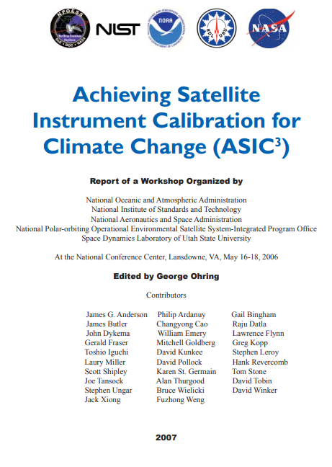

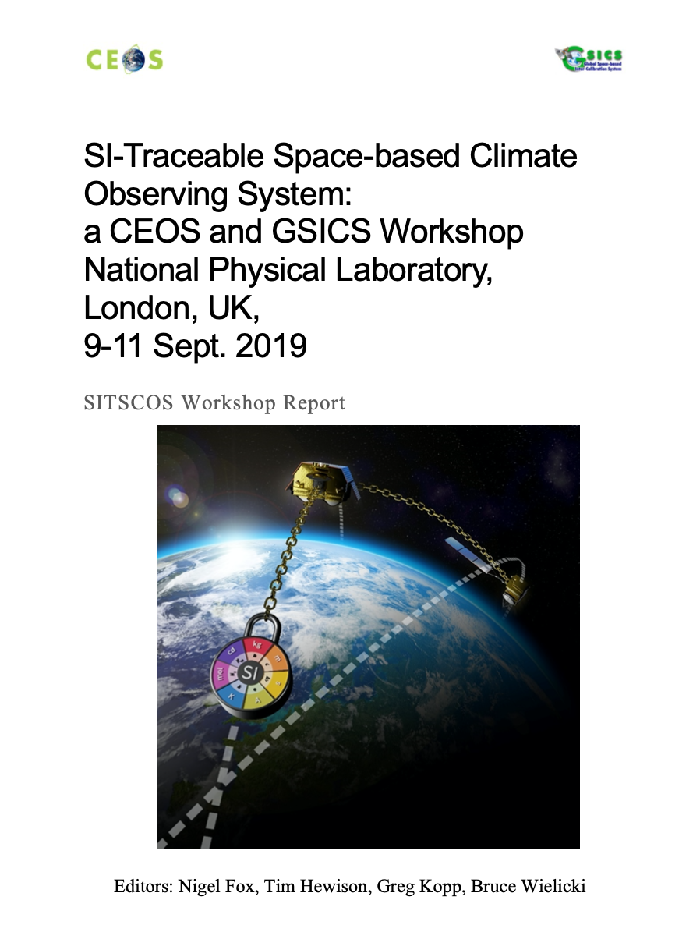

Background
Action B1-5
International activities around SI-Traceable data for Climate Monitoring from Space, including plans to launch SITSats

Slide 3
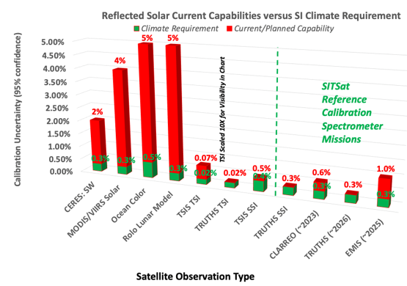
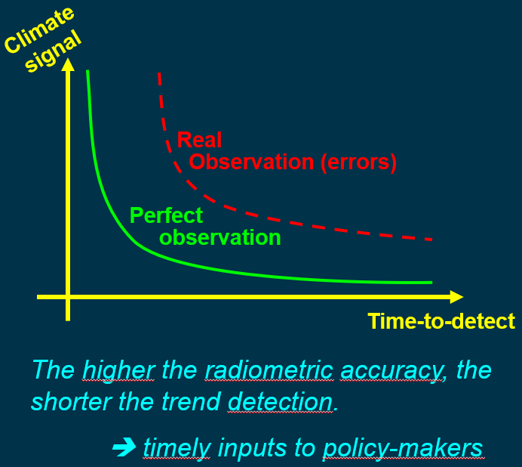
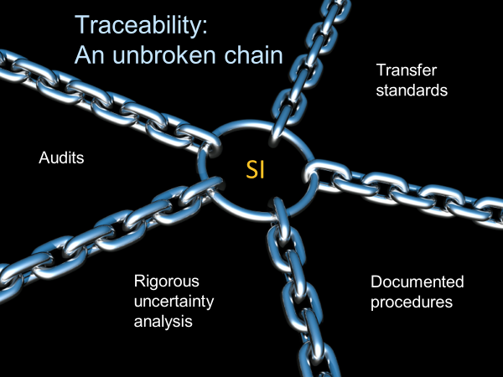
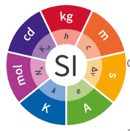
What is a SITSat?: simple definition
A SITSat is a space-based instrument making measurements of the Earth that can transparently evidence their metrological traceability to international system of units (SI) with an uncertainty commensurate with the most demanding needs of climate https://doi.org/10.47120/npl.9319
When used as a ‘reference to calibrate other satellites its uncertainty should be at least half that of the satellite under test.

Slide 4
What is a SITSat ?: Full definition
A SITSat is a satellite-based sensor which can provide and verifiably evidence, in a fully open and transparent manner, all significant contributions to the uncertainty of its measurements, metrologically traceable to the international system of units, SI, at the location and time from where they are made. In addition, this uncertainty must be at a level that is considered by the community to be of ‘Fiducial reference’ quality, i.e., that for a defined spectral domain/application it can be considered ‘state-of-the-art’ and able to unequivocally serve as a reference for similar measurements from other sensors. The uncertainty of a SITSat should be expected to reach or at least approach that required for key climate science objectives such as those identified in the “SI-Traceable Space-based Climate Observing System: a CEOS and GCICS Workshop” ( https://doi.org/10.47120/npl.9319 ). When used as a reference a SITSat would be expected to have a measurement uncertainty of <0.5 compared to that of its non-SITSat peers.
Note:
1/ If used as a reference, the method used to compare with other sensors and its associated uncertainty to SI, should also be fully documented and evidenced.
2/ The nominal threshold uncertainty to be considered a SITSat for a particular type of measurement/application may increase or reduce over time commensurate with scientific consensus, currently this requires 2-10x improvement over current sensors. Although desirable in the long-term, it is not essential to have a SITSat for all applications and sensor domains and thus the assignment of the classification to a sensor should only be made when the maturity and technology of a particular domain justifies it.
3/ A SITSat peer group would constitute ALL sensors making similar measurements (e.g., spatial and spectral range)

Slide 5
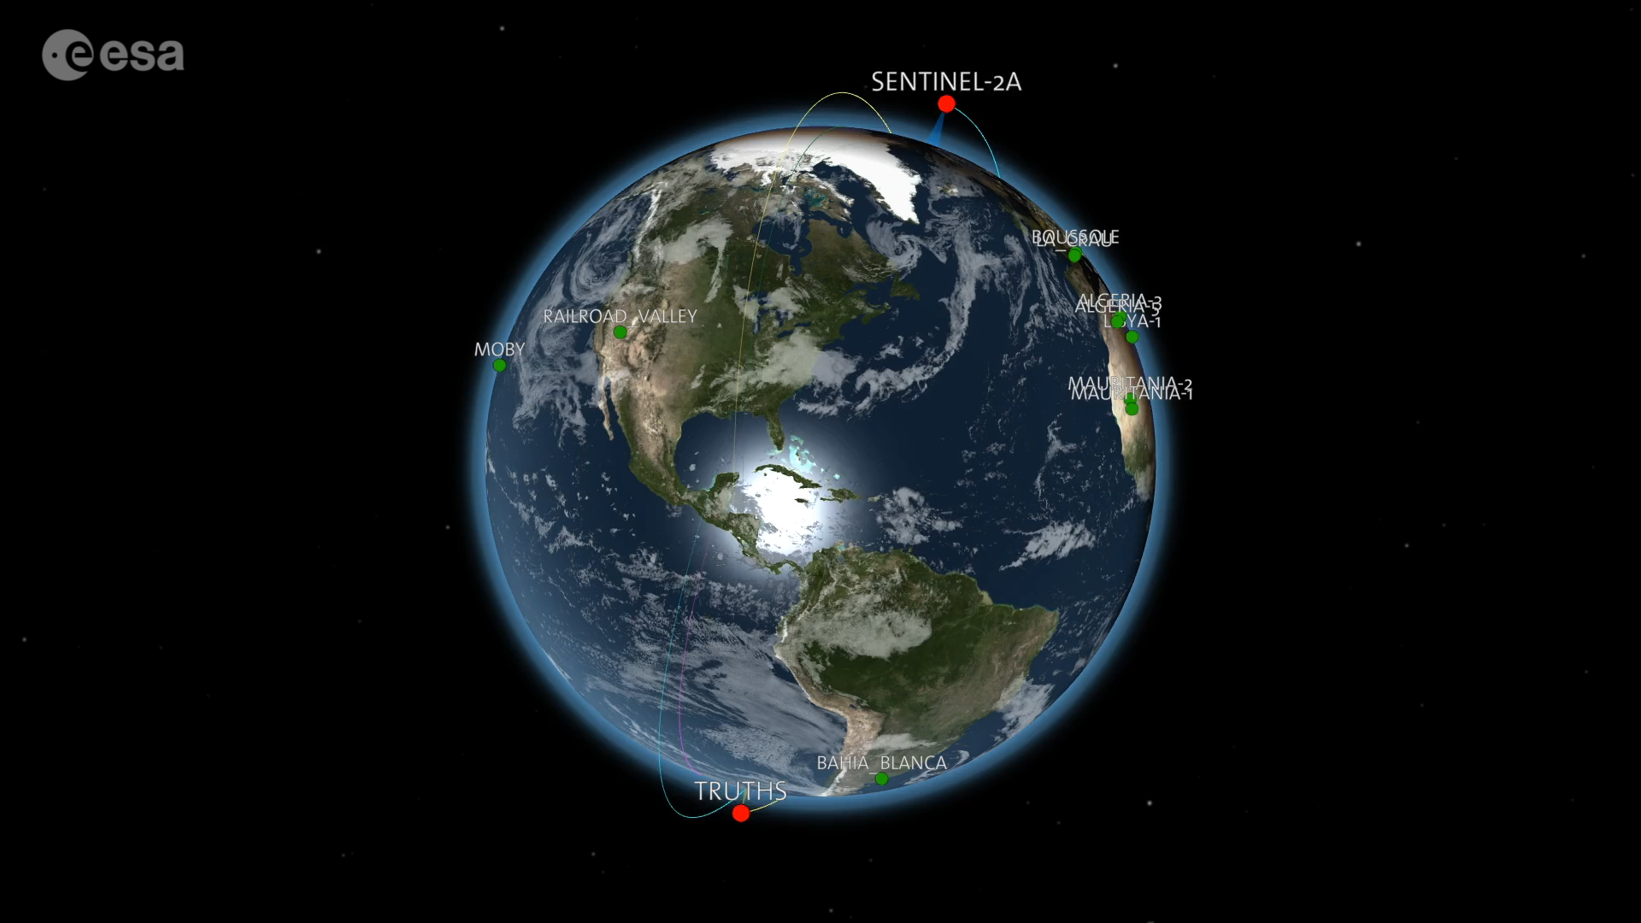
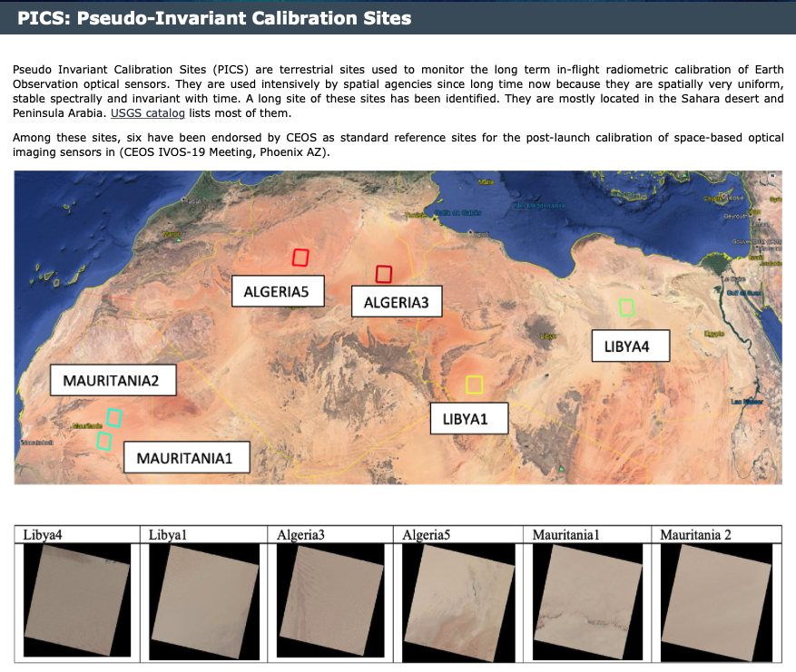
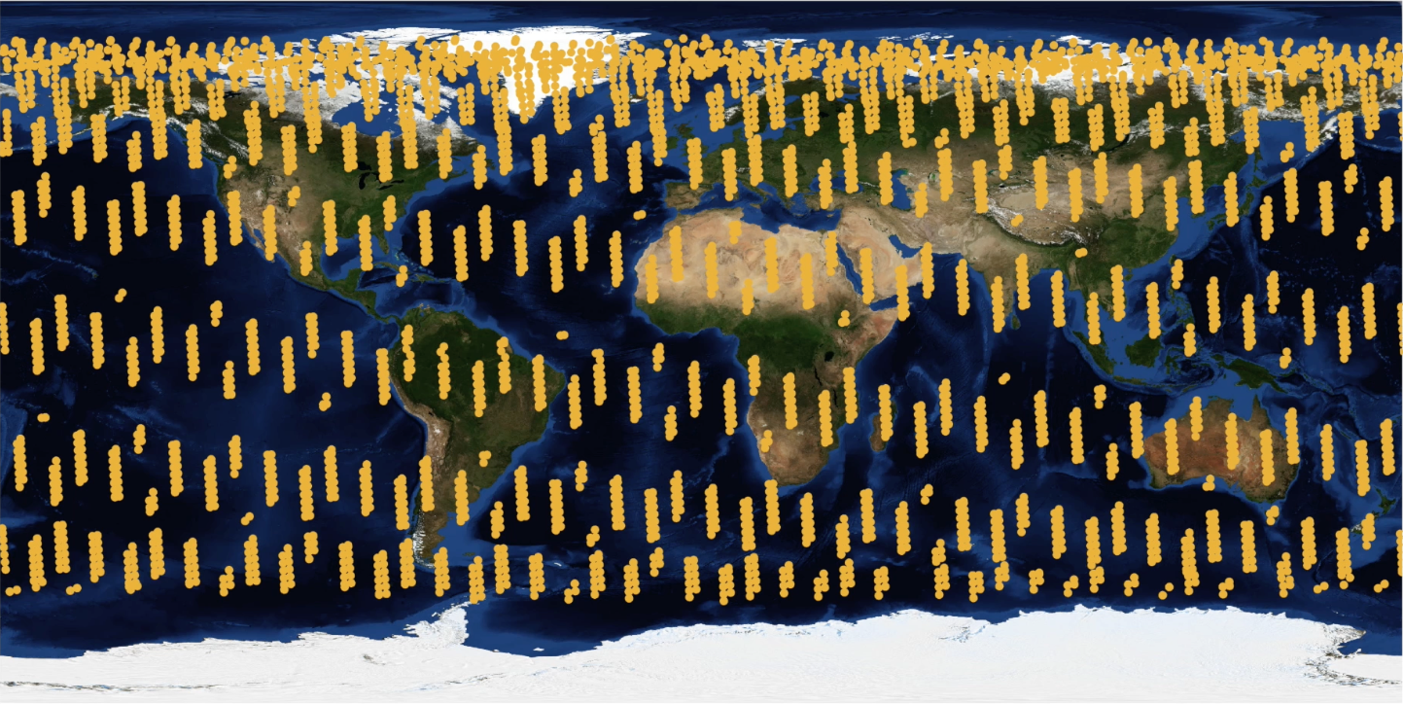
Calibration SNO example
CEOS/GSICS Cal/Val architecture
1 yr of SNO for Sentinel 2
CLARREO-PF similar methodology but ISS orbit & increased pointing agility

Slide 6


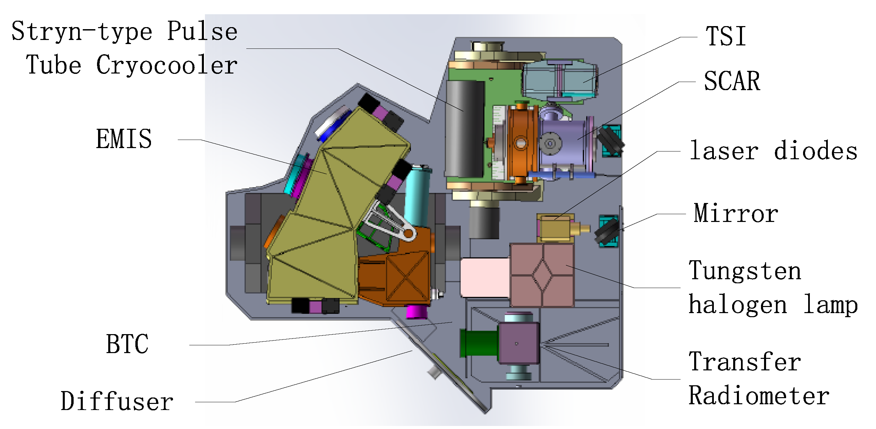
SITSats in Development: Solar Reflective
CLARREO PATHFINDER - NASA
TRUTHS - ESA
LIBRA - CMA
2027
2030

Slide 7
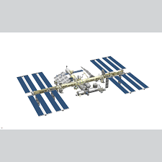
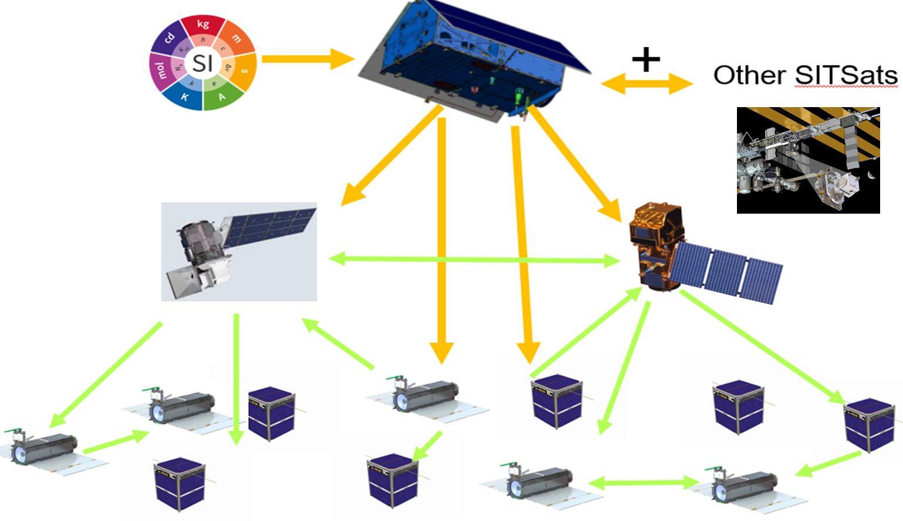
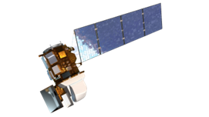
Motivation for SITSats
Desire for ‘Reference/Fiducial’ data that enable unequivocal change detection in relatively short time-scales and mitigate ‘data gaps’ (particularly for climate)
    - Robust, transparent quantified evidence of traceability to a reference (ideally SI) - ‘QA4EO’
    - Small comprehensively evaluated uncertainties
    - Allowing ‘stability’ criteria for climate to be robustly tied to invariant reference (SI)
‘System of systems’ Integrated EO data, interoperable/harmonised
knowledge of/removal of biases
- ARD
- SI-Traceability provides unambiguous trust, space agency agnostic, longevity
New space – reliance on post-launch calibration, no on-board calibration
  - Reduced cost, complementary observations (temporal/spatial coverage)
  - Level playing field, maximal utilisation of investments and assets
CEOS/GSICS initiatives to establish international references and SI-Traceability
- Coherent, comprehensive/flexible, reliable anchor to well-established methods
- Mimics calibration methodologies of all terrestrial ‘industries’
- Provides a clear label of a specific sensor property but generic to ‘application’
Space-based Intercalibration

Slide 8
Rationale for Task Group
Recognition, visibility of the new class of Instrument to senior levels in space agencies & EO community
- Noting at least 3 SITSats are currently under-development from different continents
- Case studies demonstrating benefit (quantitative) of improved accuracy
Similar to CEOS-VCs – coordinate, where appropriate, to facilitate commonality of purpose (shared vision)
- Maximal utilisation of resources
- Continuity of ‘service’ (data, coordination of launches)
- Internationally integrated ‘users’, data source agnostic tools
- Advocacy from an international ‘multi-agency’ perspective
- Lessons learnt – enabling new missions/agencies
- Value > sum of parts
Establish an agreed minimal set of definitions and principles to distinguish SITSats and their utilisation
- Independent of application domain or technology
Seek to build a common user/customer base, transcending individual missions
  - Value/necessity for achieving GEOSS ‘fit for purpose’ solutions to needs of climate & society

Slide 9
Task Group Objectives
Establish clear definitions of what constitutes a SITSat and the minimal requirements needed to evidence this status
Serve as a forum for agencies developing/planning SITSat missions to share experiences and knowledge
    - Create common messaging, Communication of benefit to all stakeholders, (website)
Discuss collaboration opportunities, joint Cal/Val activities, campaigns, and data sharing
Provide an opportunity for mission coordination, gap analyses, efficient tasking, and acquisition planning
Facilitate coordination on technical topics, reporting of uncertainty and traceability information, interoperability, and methods of dissemination
Aim for a systems-based approach along the lines of a CEOS Virtual Constellation, rather than missions being developed and operated in isolation

Slide 10
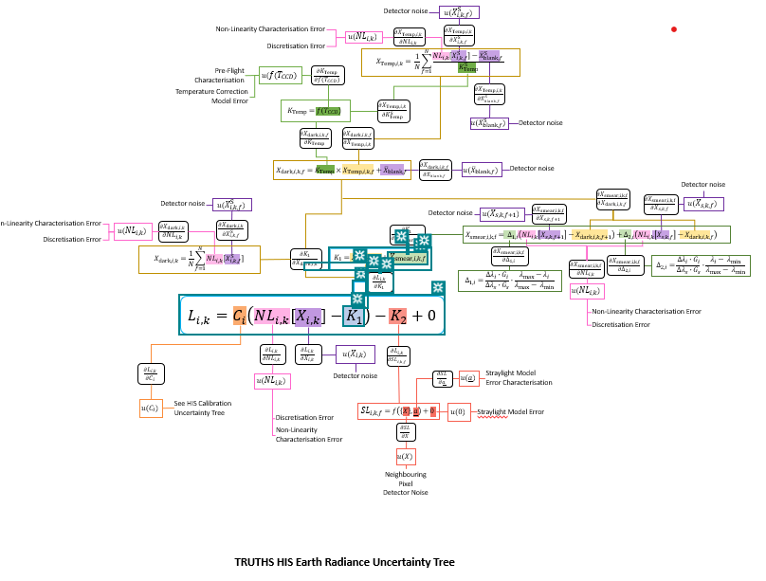
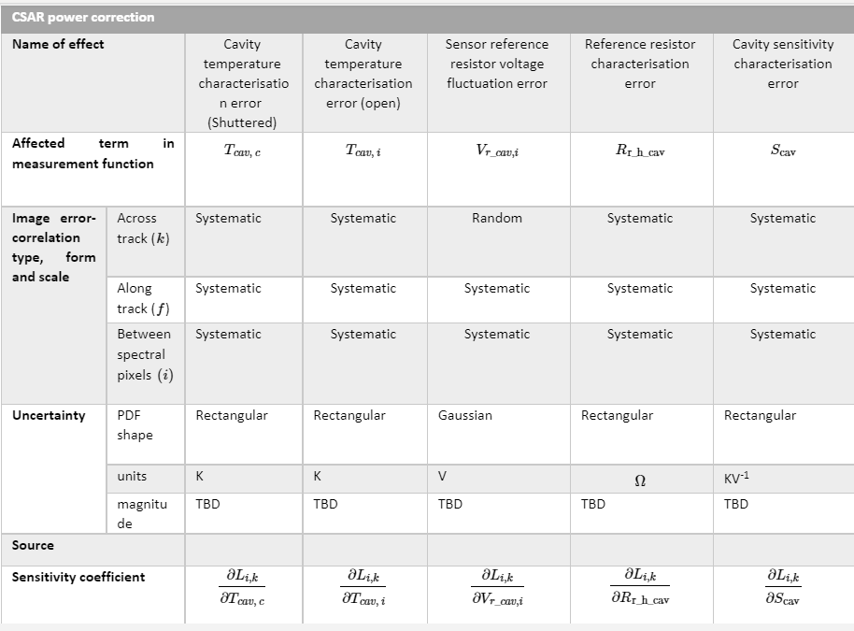
Evidencing Traceability/Uncertainty
FIDUCEO-like – As an example
Fiduceo like analysis of end to end traceability and uncertainties – A potential example
‘effects table’ for each error source
How to optimally present/store and/or deliver to user
– Increased size of data product

Slide 11
Task Group Deliverables
Establish a clear definition of what constitutes a SITSat and minimal requirements needed to evidence this status
    - How and what to present as Uncertainty/SI-traceability evidence (standardized content and/or format)
Develop a roadmap (whitepaper) of what a SITSat enabled observing system looks like
Data sharing based on a systems approach
- Common (interoperable?) reporting/archive grid for climate? (Spectral/spatial)
- Common Grid for S2S calibration?
- Format – what info to report and how? (note volume of information when including uncertainties)
- Mirrored data stores/access?
- Minimal set of common ‘targets’ (comparison/gap filling etc)
Communications strategy for awareness raising / key messages / utility for observing system / integrated multi-SITSat observing system

Slide 12
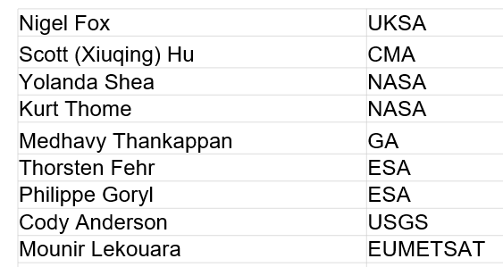
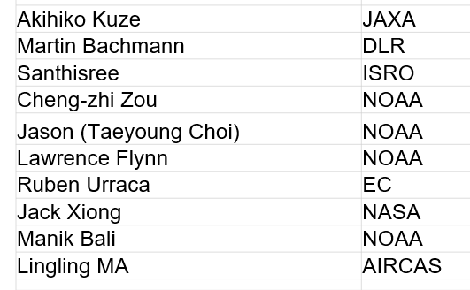
Task Group Members

Slide 13
Communications:
CEOS Cal/Val portal SITSat group page
Potential Content
  Define SITSats and why they are important for global climate observing system
    How to evidence it is a SITSat – Traceability & Uncertainty
    How they can transfer calibrations – Link to full cal val architecture – expected performance improvement - utilize COVE tool to illustrate Cal opportunities
    What they don’t do i.e. cannot correct without assumptions of sensor under test
  Purpose of the SITSat group
  SITSat group members & how to contact the group
  Overview of SITSats in development/planned & expected operational timeframes
  Future: Past and upcoming group activities (meetings, etc)
  Future: Relevant Documentation (To be created by this group)
General
  Key simple common messages for end of a talk or opportune meeting
  Poster for common useage

Slide 14
Next steps
Approx 3 Virtual 0.5 day meetings a year + 1 in person (tied to other event if possible)
      (Friday 3 pm)
Establish CalVal portal page and wiki for common development by team
Membership (CEOS/GSICS agencies or representatives of)
No critical urgency to deliver objectives but Communication strategy relatively high priority
    - clarity on what a SITSat is! and what differentiates it from other satellites
    - common simple key messages
    - Identify existing ‘product’ uncertainties of example missions & potential benefits
    a SITSat might bring
    - maximise short term opportunity to coordinate (CPF & TRUTHS in particular)
    -CEOS Cal/Val infrastructure, Priority missions, Comparison
    - Develop white paper on what a SITSat enabled observing system looks like

Slide 15
Agenda for Friday meeting: all welcome!
1. Welcome
2. Review of Prior action Items Status
3. Create a strategy/schedule for this WG to achieve the objectives summarized in the ToR
4. SITSats demonstration in COVE: Our specific ask to the SEO team.
5. Plan out content for the website – Clarify what we want to communicate
6. [If Time] Create list of relevant documentation that this group needs to generate (e.g. SITSat classification requirements, calibration data product recommendations)
7. Collate Actions
8. Closing

