Slide 1
Committee on
Earth
Observation
Satellites
Viewing Earth
    Serving Society
Steven Ramage, CEO Update
WGISS-59. March 2025
Bangkok, Thailand

Slide 2
CEOS Executive Officer Report
CEOS Chair Activities Work Plan Activities CEOS Working Groups, Virtual Constellations and other CEOS entities SIT-40 (quick insight) GEO Activities

Slide 3
CEOS Chair Themes
UK Space Agency 2024/5 – Unlocking EO for Society
1. Unlocking EO for public service
2. Unlocking EO for UNFCCC global stocktakes
3. Unlocking EO for the Global Methane Pledge
4. CEOS in Schools and the Youth Summit
Notes:
CEOS Plenary 2025 – 14, 15, 16 YO pre university age

Slide 4

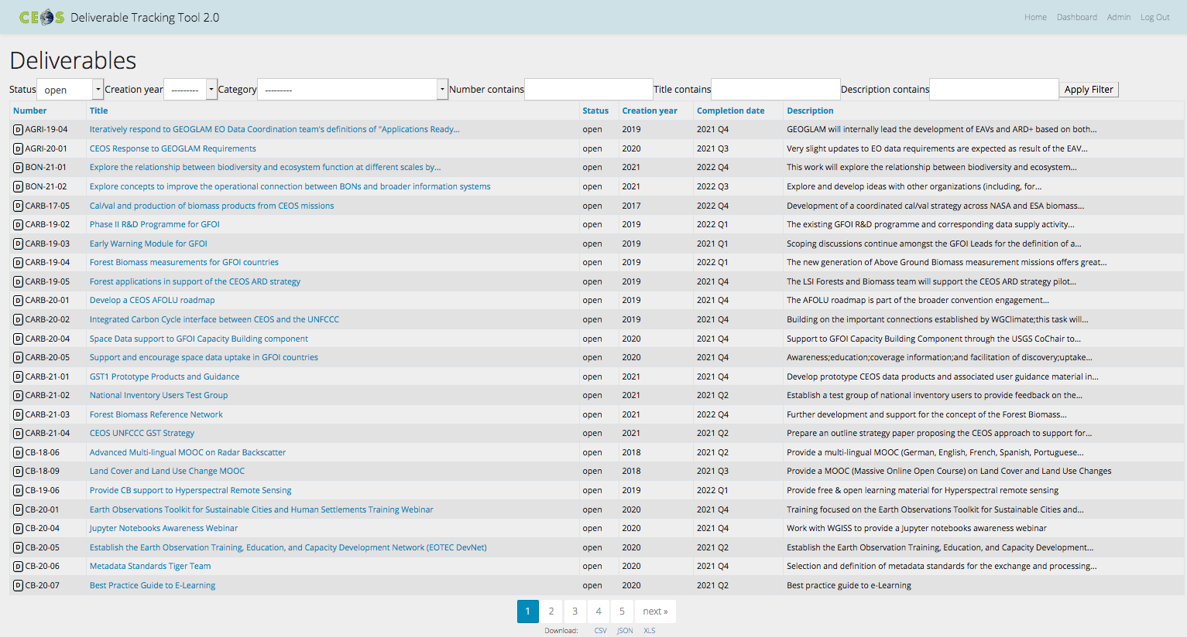
CEOS Work Plan
3-year plan re-evaluated and updated annually by all CEOS entities and presented for formal endorsement in Q1 of each calendar year.
CEOS undertakes rigorous work planning, monitoring and implementation of its activities, all of which ensure CEOS internal accountability and external credibility.
The Work Plan informs the spectrum of deliverables that CEOS membership agree to undertake.
CEOS deliverables are reconciled and tracked with a dedicated CEOS deliverable tracking tool.
The CEOS 2025-2027 Work Plan defines 100+ deliverables.
http://deliverables.ceos.org/

Slide 5
CEOS Work Plan
Started planning in November 2024
Fewer activities than previous Work Plan
First draft for review shared 5th March 2025
  Feedback for more time to review before sharing with Principals
Final review and virtual endorsement after SIT-40
Notes:
CEOS Plenary 2025 – 14, 15, 16 YO pre university age

Slide 6
CEOS Work Plan – WGISS
Number | Objective/Deliverable Title | Projected Completion | Responsible CEOS Entity(ies)
DATA-24-01 | White Paper on EO Data collections management and governance | 2025 Q1 | WGISS
DATA-24-02 | White paper on Software preservation | 2025 Q2 | WGISS
DATA-24-03 | CEOS Interoperability Handbook 2.0 | 2025 Q4 | WGISS
DATA-25-01 | White paper on federated access | 2026 Q3 | WGISS
DATA-25-02 | CEOS Interoperability Maturity Matrix | 2026 Q4 | WGISS
DATA-25-03 | White Paper on EO for Digital Twins | 2026 Q2 | WGISS
DATA-25-04 | EO Data Citation Guidelines | 2026 Q4 | WGISS
Notes:
DATA-22-05 has expired and DATA-22-01 and DATA-23-01 are due at the end of Q4 2025

Slide 7
WGISS CEO Team Action
SIT-TW-2024-03 | CEOS Executive Officer will support the WGISS Interoperability team in securing the appropriate engagement from across CEOS, as well as identify potential approaches and opportunities for CEOS to consider for engagement with the means and opportunities for commercial sector engagement. WGISS is to report on progress regularly at CEOS Secretariat meetings. | SIT-40
 | The Interoperability Handbook in development should have engagement from across CEOS and beyond, as it is an issue that affects all aspects of EO. The CEOS Secretariat is the appropriate forum to discuss if well placed to ensure the proposed engagement is advised before suggesting it to the broader CEOS community work has the correct engagement.

Slide 8
CEOS Work Plan – New Space
Number | Objective/Deliverable Title | Projected Completion | Responsible CEOS Entity(ies)
OUT-24-01 | CEOS and the ‘New Space’ Agenda | 2026 Q4 | CEOS Chair SIT Chair
OUT-24-02 | Increase engagement with the commercial sector on CEOS-ARD | 2026 Q4 | CEOS-ARD OG
OUT-24-03 | Unify CEOS engagement with the commercial sector at key meetings with respect to ARD and Cal/Val | 2026 Q4 | CEOS-ARD OG
OUT-25-01 | LSI-VC & CEOS-ARD commercial engagement workshops and conferences | 2026 Q4 | LSI-VC, CEOS-ARD OG
OUT-25-02 | Framework for commercial archive data catalogue and buyout opportunities for the public good. | 2026 Q4 | LSI-VC
Notes:
LSI VC in Japan, VH-RODA Very High-resolution Radar & Optical Data Assessment (VH-RODA) 2024 early Dec in ESA, ARD

Slide 9
CEOS Biodiversity Study Team
38th CEOS Plenary - specific focus on biodiversity for 2025 to:
  Explore a post-2024 Strategy for CEOS and Biodiversity and
  Increase Policy Footing and Linkages to the Biodiversity Community
Team leads
  Gary Geller, NASA; Marc Paganini, ESA; Shaun Levick, CSIRO
  Topic leads
  Jason Duffe, ECCC – CBD and GEO BON (with Geller + GEO Atlas); Sandra Luque, INRAE – IPBES; Marc Paganini, ESA - UN SEEA and Ramsar Convention; Neil Sims, CSIRO – UNCCD; [Ramage with COAST VC] – IOC/UNESCO; Swaroop Tulsidas, CSIRO - TNFD
  Completing engagement tables with background and requirements
  Also assessing links to other areas of CEOS, e.g. climate and disasters
Notes:
CEOS Study Team

Slide 10
SIT-40, Fukuoka, Japan
40th CEOS Strategic Implementation Team Meeting (SIT-40)
8 – 10 April 2025 | Chaired and Hosted by JAXA
Daimyo Conference, Fukuoka Daimyo Garden City Tower, Fourth Floor
2-6-50 Daimyo, Chuo-ku, Fukuoka, 810-0041, Japan
HYBRID MEETING

Slide 11
EO Data Impact
  Global Stocktake Lessons Learned paper coordinated by the CEOS Working Group on Climate (WGClimate).
    CEOS country engagement activities in support of national inventories and reporting, including feedback from the WGClimate-22 meeting with national inventory compilers.
    Revise the CEOS Global Stocktake Strategy and reach consensus on the fundamental substance of the revision.
  Aquatic Carbon Roadmap and completion of the CEOS Carbon Roadmaps
    GHG and AFOLU Roadmaps, incl. LSI-VC Forests and Biomass Subgroup.
  CEOS engagement with the Intergovernmental Panel on Climate Change (IPCC) Technical Support Unit (TSU) for Task Force on National Greenhouse Gas Inventories (TFI) and their Emissions Factor Database (EFDB).

Slide 12
Greenhouse Gas Observations
  Discuss Best Practices for Remote Sensing-based Estimates of Facility-scale Emissions (methane best practices), including update to the Global Methane Pledge, as is being proposed by CEOS Chair and prep for UNFCCC COP-30.
  CEOS and International Methane Emissions Observatory (IMEO) cooperation in 2025, as compiled by the GHG Task Team, the SIT Chair and CEOS Chair.
  Report on the implementation status of the CEOS Greenhouse Gas (GHG) Roadmap and discuss near-term activities.
  Discuss the status of the WMO Global Greenhouse Gas Watch (G3W) and CEOS engagement.

Slide 13
Working Group topics
  Discuss the proposal from WGDisasters for a workshop between Early Warnings for All (EW4All) pillar leaders and CEOS agencies.
  Review the draft Interoperability Handbook developed by WGISS. Discuss the draft recommendations across the five factors of the Handbook: Architecture, Interface, Vocabulary, Quality, and Policy.
  Discuss and consider potential endorsement of the Space Agency Response to the 2022 Global Climate Observing System (GCOS) Implementation Plan.

Slide 14
Virtual Constellation topics
  Consider the recommendation from COAST-VC and SST-VC regarding priority coastal areas (5-6 regional masks) for extended observation coverage for new ultra-high-resolution thermal infrared instruments to capture additional sea surface temperature data up to 100 km from coastlines.
  Review the UN Ocean Decade talking points developed by COAST-VC.
  Discuss the approach to a CEOS response to the Essential Agriculture Variables (EAVs). Report on progress of the effort to bolster CEOS Agency participation in the GEOGLAM Subgroup of the Land Surface Imaging Virtual Constellation (LSI-VC) and identify CEOS agency agriculture activities and experts. Update CEOS on plans for the May 2025 EAV Workshop at the JRC.

Slide 15




CEOS Long-term Priorities
Ensure that climate observation requirements identified by the Global Climate Observing System (GCOS) – and implications of the Paris Climate Agreement – are addressed.
Ensure, in the context of the Sendai Framework for Disaster Risk Reduction 2015-2030, that CEOS Agency data are made available in support of disaster risk reduction and that CEOS continues engagement with UN agencies and authorities.
Ensure that space-based Earth observation data and products are integral to the success of the next decade of the Group on Earth Observations (GEO), and that CEOS contributions to, and engagement in, GEO governance and leadership are further enhanced.
Systematically engage in and contribute to global efforts on the critical challenges that face humanity in support of the UN 2030 Agenda for Sustainable Development.

Slide 16
Group on Earth Observations (GEO)
  Funding is the major challenge, which will dictate the size and shape of the GEO Secretariat going forward; CEOS already has no dedicated person.
  GEO Programme Board presented the review process for the 66 submissions (7 review teams) made to the Post-2025 GEO Work Programme.
  According to the GEO Secretariat CEOS is listed as a partner or as contributing to the following activities:
    GFOI (Mature Flagship), GEOGLAM (Flagship), GEO-LDN (Flagship)
    GSNL (Flagship), Digital Earth Africa (Enabling Mechanism), Digital Earth Pacific (Enabling Mechanism)
    According to the GEO Secretariat, CEOS is not listed as a partner but playing a key role in: GEO-TREES (Initiative) and EO4DRM (Initiative).

Slide 17


CEOS Membership
Now in its fourth decade,
CEOS comprises
34 Members
(Space Agencies) and
30 Associates
(UN Agencies, Phase A programmes or supporting ground facility programmes)
All of whom contribute to CEOS on a ‘best efforts’ and voluntary basis.
Discussions with Azerbaijan, Catalan, Ethiopia, Ghana, Greece, Kenya, Malaysia, Nigeria, Philippines and Rwanda regarding participation in CEOS – numerous topics of interest to all agencies. Mainly CEO team with some WG Capacity Building and Data Democracy engagement.

Slide 18
executive_officer@lists.ceos.org
@steven_ramage
Thanks for listening.

