Slide 1
WGISS Support to CEOS-ARD Strategy 2024
Matt Steventon
CEOS-ARD & LSI-VC Secretariat
WGISS-59
Item 12.1
28 March 2025

Slide 2
CEOS-ARD Strategy 2024
Update to past editions from 2019 and 2021
Reflect on the progress to date, take stock of future directions and needs, and confirm our strategy for the next few years
Lots happening – Strategy captures and organises all of these threads
Mostly covers the ‘what’ and ‘why’ (and who to some extent) – ‘when’ and ‘how’ to be decided and added to future CEOS Work Plans
A broad portfolio of CEOS-ARD that is easily discovered, accessed and utilised is the ultimate goal.
Link: CEOS-ARD Strategy 2024

Slide 3
CEOS-ARD Strategy 2024
The Strategy activities are categorised into six broad themes:
CEOS-ARD Availability, Product Diversity, and Representation
CEOS-ARD Framework and Specification Advancement
Discovery, Access, Utilisation, and Interoperability
Community Engagement
Research, Test Cases, and Pilot Activities
Commercial Engagement

Slide 4
Plan for today
WGISS support critical to discovery, access, utilisation, and interoperability aspects in particular
Will present some specific items from the Strategy for discussion
Welcome ideas from WGISS experts
Helpful if we could identify some near term collaborative tasks and actions. Low hanging fruit?
Practical actions to work us towards “A broad portfolio of CEOS-ARD that is easily discovered, accessed and utilised”
Open discussion
Looking to the future of CEOS-ARD

Slide 5
The Future of CEOS-ARD…
LSI / ARD teams recognise need for a future iteration of CEOS-ARD that introduces higher requirements for data ‘quality’, among other things
Also recognises the need to work closely with the community to understand the requirements for future evolution of CEOS-ARD
This includes WGISS and similar expert groups
2025 is very much going to be an info gathering year – taking the pulse of the community, their needs, and advancements in this space
LSI/ARD teams plan interactive sessions at ESA LPS, IGARSS, IAC and others
Gather feedback on the current state of CEOS-ARD and to consult the community on what they value in the current iteration of CEOS-ARD and what is needed in future evolutions.
Call on the community to help us understand the headline priorities for the future of CEOS-ARD and to lay the basis for a consultation paper
Next iteration of the CEOS-ARD Strategy (2026)

Slide 6
LSI-VC-17
17th Meeting of the CEOS Virtual Constellation for Land Surface Imaging (LSI-VC)
14-16 April 2025
Hosted by the Japan Aerospace Exploration Agency (JAXA)
JAXA Tsukuba Space Center, 2-1-1 Sengen, Tsukuba-shi, Ibaraki 305-8505 Japan
Yousuke Ikehata (JAXA) presenting WGISS Analysis of AI/ML readiness of CEOS-ARD and Suggestions for the CEOS-ARD PFS and Framework
All welcome!
Agenda
Webex Connection Details
Meeting link: https://ceos.my.webex.com/meet/ceoswebex1
Meeting number: 2554 498 5768
Join from a video conferencing system or application
Dial: ceoswebex1.ceos.my@webex.com
You can also dial 173.243.2.68 and enter your meeting number.
Join by phone
+1-650-479-3208 United States Toll
Access code: 2554 498 5768
Global call-in numbers
https://ceos.my.webex.com/ceos.my/globalcallin.php?MTID=mf31cbd892c421d70ad0a66143bc89fb4

Slide 7
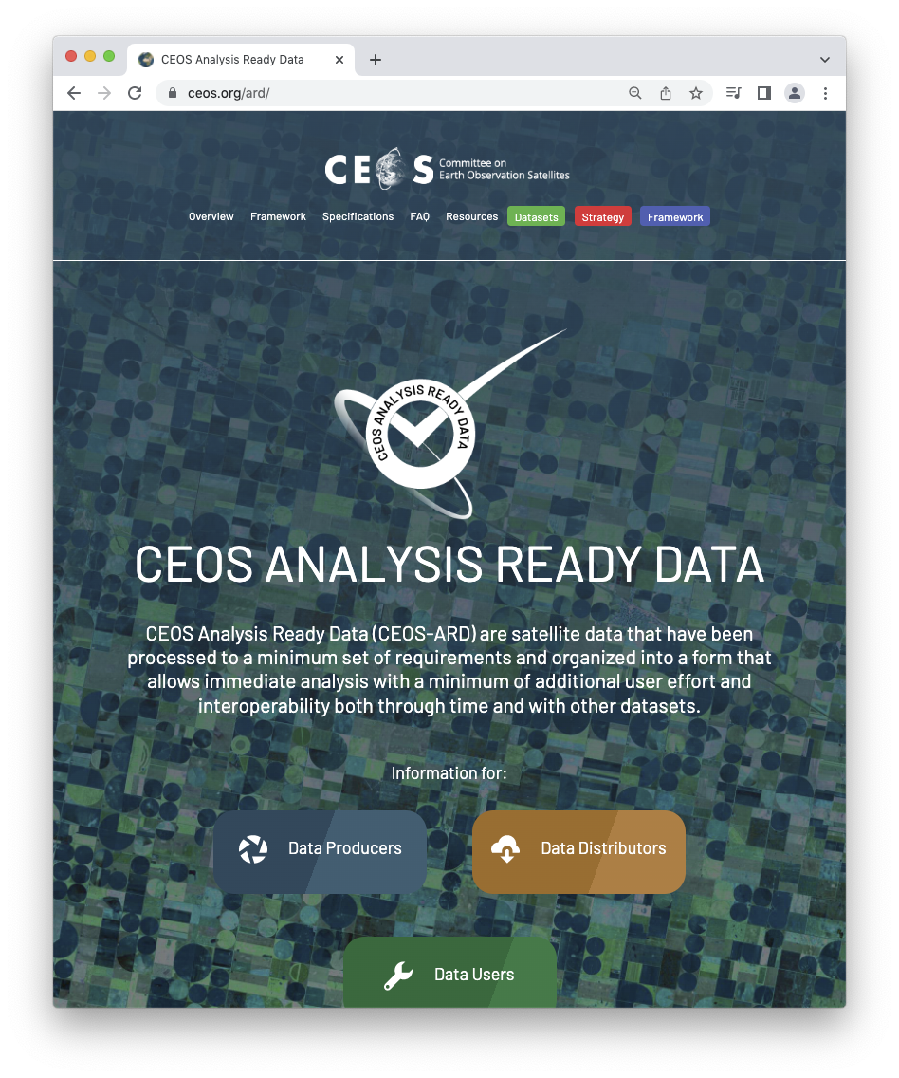
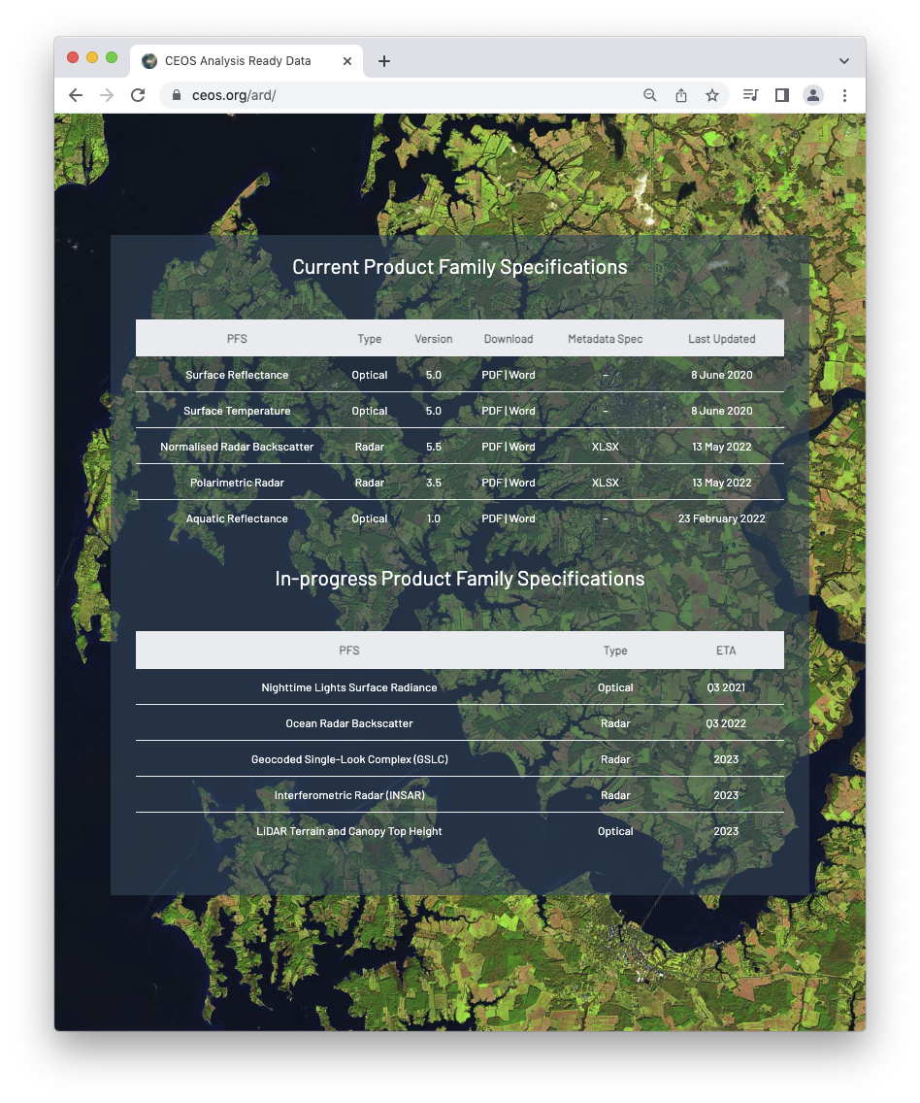
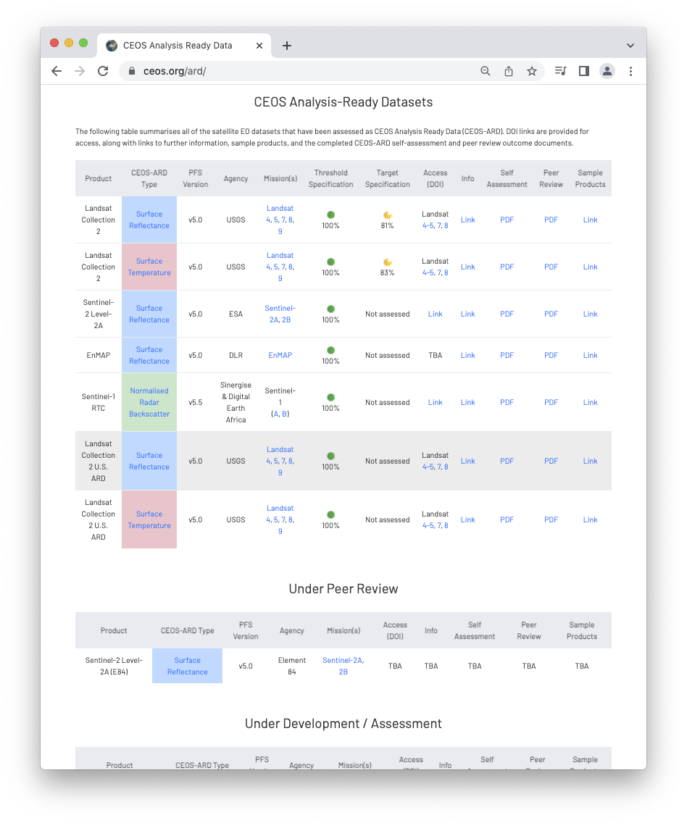
More information
ceos.org/ard
CEOS-ARD GitHub
CEOS-ARD Newsletter Sign-up
Past issues: https://ceos.org/ceos-ard-newsletter/
https://x.com/CEOSARD
Contacts:
Ferran.Gascon@esa.int
matthew@symbioscomms.com
ard-contact@lists.ceos.org

Slide 8
1.4: CEOS-ARD at mission inception and planning stages and in archive reprocessing plans
CEOS Agencies should include systematic CEOS-ARD production into their plans at mission inception and design stages
Avoid the need for costly reprocessing or retrospective adjustments.
For missions that are ongoing/ended – at major archive reprocessing opportunities.
Questions
Do WGISS participants have sway in these decisions at agency level?
Does WGISS track these reprocessing events?

Slide 9
2.4: Replica datasets, authenticity, traceability, and inherited CEOS-ARD compliance
Often replicas of CEOS-ARD datasets mirrored in multiple locations
Needs to be a mechanism for these mirrored datasets to inherit CEOS-ARD compliance
Agreed means for testing the authenticity and CEOS-ARD compliance of these copies (e.g., potentially changed formats, metadata files renamed, or content otherwise altered)
Clearly identifying the original source of the CEOS-ARD compliance
‘Cloud Service durability’, i.e. multiple copies, locations, notice periods for deletion, etc.
Questions
Somewhat related: Common mechanisms for ‘pushing’ updates / notifications to users/providers?

Slide 10
3.1: Embrace the CEOS Interoperability Framework
Looking to WGISS Interoperability Handbook v2.0 for guidance on increasing interoperability
WGISS support is needed to ensure CEOS-ARD development is aligned
Questions
What does the Interoperability Handbook look like in practice
Current findings / suggestions?
Suggestions on how best to demonstrate interoperability of CEOS-ARD endorsed datasets?

Slide 11
3.2: Alignment of CEOS-ARD and STAC
CEOS-ARD STAC extensions developed and being updated.
Move of CEOS-ARD specs to GitHub and modularisation via ‘building blocks’ so there can be more alignment
Current metadata specs provided for SAR in XML
Need to work out what is missing from the metadata on the STAC side.
Missing fields might necessitate a new STAC extension / evolution of the CEOS-ARD extension.
Natively expressing CEOS-ARD metadata in STAC unlocks existing software ecosystem.
Questions
Potential WGISS role / support to CEOS-ARD STAC extension evolution?
Anything to note from STAC best practices work?

Slide 12
3.3: Cloud native approaches and machine-to-machine access and utilization
Understanding changes to the CEOS-ARD Framework that will make CEOS-ARD datasets more suited to the cloud environments
Seek to ensure the suitability of CEOS-ARD for the machine-to-machine processes
Extends to AI/ML
LSI-VC-17 presentation from Yousuke Ikehata
Considerations should include introducing mechanisms for ‘pushing’ updates about CEOS-ARD datasets.
Questions
These considerations would not be unique to CEOS-ARD?
Notes
Prime input for any future CEOS-ARD evolution

Slide 13
3.4: CEOS-ARD discoverability and branding
Efforts to increase the visibility of and access to CEOS-ARD datasets
Consistent branding and representation across CEOS Agency data platforms, CMR, FedEO,
And shared infrastructure such as that maintained by WGISS, the CEOS MIM Database, and others across CEOS.
Better promote the availability of CEOS-ARD
Need for a multi-agency strategy to demonstrate benefits/value of CEOS-ARD endorsed datasets and the interoperability they create for the user community

Slide 14
3.5: CEOS-ARD in the commercial cloud
Engage with key cloud providers to ensure CEOS-ARD is promoted on their platforms, and demonstrate interoperability use cases
Leverage existing agency relationships with these providers, which are hosting an increasing amount of CEOS Agency data
Seek to establish dialogues with key data distributors and cloud operators to coherently promote CEOS-ARD via their platforms

Slide 15
6.1: CEOS-Industry ARD workshops alongside key CEOS meetings
Opportunities to co-locate CEOS–Industry ARD workshops alongside key CEOS meetings should be used wherever possible to engage industry, including ‘New Space’ companies, in CEOS-ARD and to follow up the recommendations from the CEOS New Space Task Team white paper
Opportunities
CEOS-ARD commercial engagement sessions alongside future WGISS meetings?
Replicate efforts seen in LSI-VC
Related: current suite of PFSs are unsuitable for VHR data, so even commercial data providers keen to adopt CEOS-ARD cannot do so before we have produced "VHR-adapted" PFSs. (a next target for the SAR team this year)

