Slide 1
An AI Initiative from Research to Operations (EOP-GE)
Hayret Abdula Keary, Sofia Marzo, Damiano Guerrucci, Francesca Cipollini

Slide 2
Inventory Insights: Data Products and Missions in Earth Observation
80 ESA & TPM Missions
205 Data Collections
40M ESA Data Products
Target Users
include scientists, researchers, and professionals across various domains.
Possess expertise in their own scientific fields but are typically unfamiliar with the services provided by ESA’s ground segment.

Slide 3
EO AI Technical Support Assistant
Enhancing User Experience by providing more engaging and dynamic interactions between users and the system
Demonstrating an innovative solution for delivering information to better meet changing user expectations
Using data from the TellUs ticketing system (52K tickets) to understand its coherence in a technical support assistant operational scenario
Summarising information from 3.7K web pages and 4.7K documents
Understanding if the output of an LLM model using RAG can provide sufficiently clear answers that can support the user community
Performing a thorough data anonymisation using LLMs combined with scripting methods
Performing sentiment analysis and classification on the TellUs ticketing system data

Slide 4
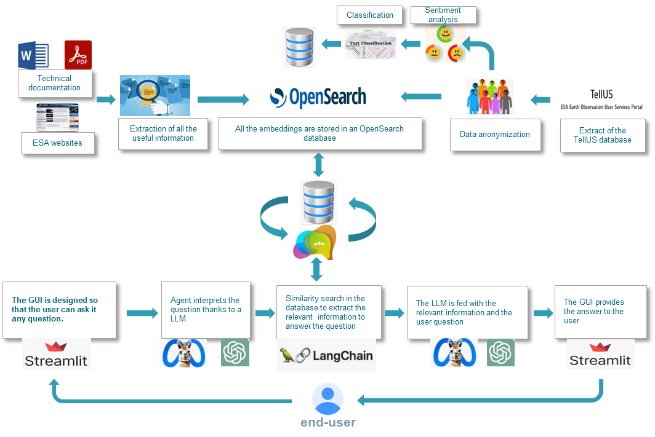
EO AI Technical Support Assistant - Workflow

Slide 5
EO AI Data Discovery Assistant
Project Objectives
Facilitation of discovery of Earth Observation data products and collections, and simplification of the process for finding optimal products.
Lowering of the barrier for entry level users with limited knowledge in Earth Observation terminology and ESA missions.
Provision of consolidated EO product proposals based on user inquiries and data requirements.
Project Innovations
Integration of LLM Agents: Leveraging the advanced capabilities of Large Language Model (LLM) agents.
Comprehensive Data Utilization: Employing not only the information from Earth Observation (EO) data collections but also the detailed metadata associated with each EO data product.
Requirement-Based Recommendations: Providing recommendations that meet the user’s temporal and spatial, and data requirements.

Slide 6
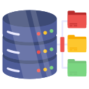
EO AI Data Discovery Assistant - Pipeline
4
5
1
Query Decomposition
Embedding Generation
Geodecoding API
User Authentication
& Login
Correction & Validation Mechanism
Query Processing
2
3
6
Hybrid Search
end-user
Vector Database
Cloud + Local
EO Collections
11
9
User Profile & History
LLM Agent
Collection Retriever
10
8
Image Fetching
Product Visualization
Data Products File
Interactive Product Map
7
Response Generation & Product Proposals
EOCAT API Mechanism
EO Products
EO Data Processing
Product Retrieval Mechanism

Slide 7
Research to Operations
EO AI Technical Support Assistant
+
EO AI Data Discovery Assistant
EO AI Advanced Assistant

Slide 8
EO AI Advanced Assistant
Simplify Access to Data and Services for both Entry-level and Experienced Users
Automate User Support
Provide Data Product Suggestions and Simple Data Visualisations
Provide technical resources and support Developers in Integrating EO Data into Applications
Establish a Flexible and Scalable Architecture that Serves as a Foundation for Integrating future AI-driven Tools and Components Seamlessly
Deliver and Deploy a Beta Version tested by Real Users
Hybrid Integration of Complex Generative AI Workflows and Traditional Data Discovery Methods
Comprehensive Utilization and AI Integration of EO Services, Data, Metadata
AI Driven Requirement-Based Service and Data Recommendations
Real-Time and Interactive Data Visualizations based on Natural Language

Slide 9
EO Advanced AI Assistant - High-Level Architecture
User Interface
General Purpose LLM
AI-Agent Orchestrator
Personalization DB
Data Discovery + Visualization
Assistant
Technical Support + Development Support Assistant
Ticketing Assistant
Vector Store

Slide 10
High-Level Architecture – AI-Agent Orchestrator
Data Discovery
Assistant
AI-Agent Orchestrator
Query Management & Routing: Perform query management, intent classification and routing of user queries to appropriate subsystems.
Structured Inter-Subsystem Communication: Enable the structured communication between different subsystems of the Assistant.
Integration of Scalable and Upgradable Tools: Enable the seamless introduction of new tools into the architecture, allowing for independent scaling of components through implemented abstraction.
Response Aggregation: Collects and synthesizes responses from multiple subsystems into a cohesive answer for the user.

Slide 11
High-Level Architecture – Data Discovery + Visualisation Assistant
Provision of consolidated and requirement-based EO product proposals based on user inquiries and data requirements.
Lowering the barrier for entry level users with limited EO background to query the EO Catalogue and navigate through ESA products.
Facilitation of the exploration of EO products through interactive visualizations.
Assess integration with ASCEND data sources for extended visualization capabilities beyond the metadata layer
Prioritize reusability by building upon the existing demo, maximizing the use of its established functionality and architecture.
Dependencies
Up-to-date Vector Store with EO Data Collections.
General Purpose Large Language Model.
EOCAT API
Personalization DB for storing previous conversations and enabling continuing previous interactions.

Slide 12
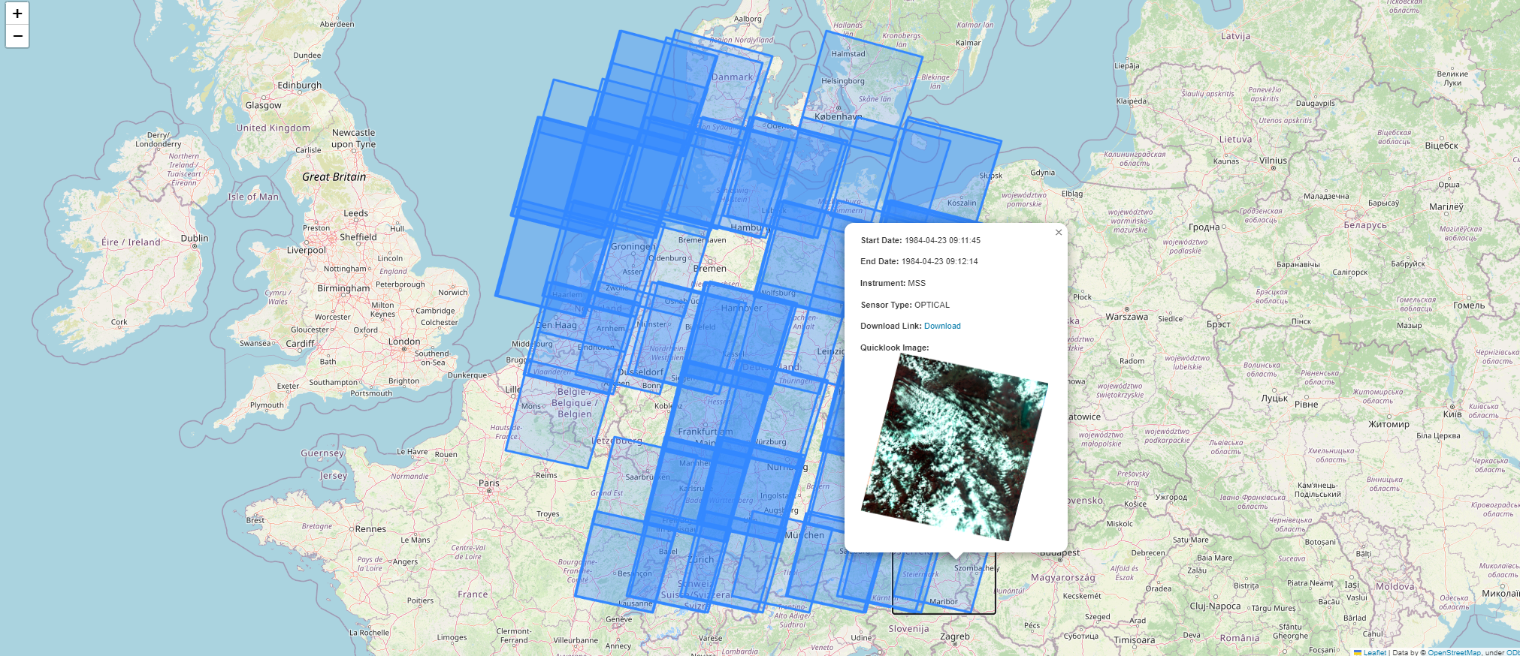
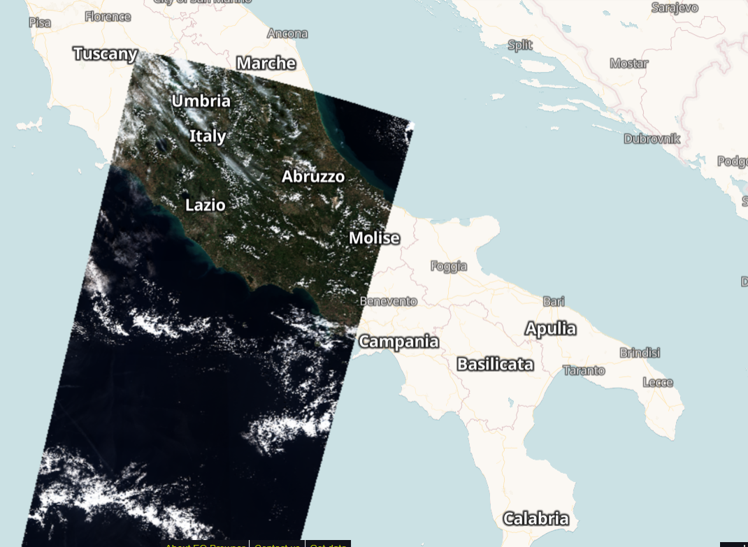
High-Level Architecture – Data Discovery + Visualization Assistant
Interactive Product Availability Map
Current Visualizations

Slide 13
High-Level Architecture – Technical Support + Development Assistant
Dependencies
Up-to-date Vector Store with sources from:
ESA Earth Online website contents
EoPortal website contents
EOCAT API Documentation, interface and coding snippets
General Purpose Large Language Model.
Personalization DB for storing previous conversations and enabling continuing previous interactions.
Simplify access to technical resources and documentation provided by open-source ESA sources.
Provide verified and up-to-date information to the users about services, data and documentation with the related URLs to original sources.
Prioritize reusability by building upon the existing demo, maximizing the use of its established functionality and architecture.

Slide 14
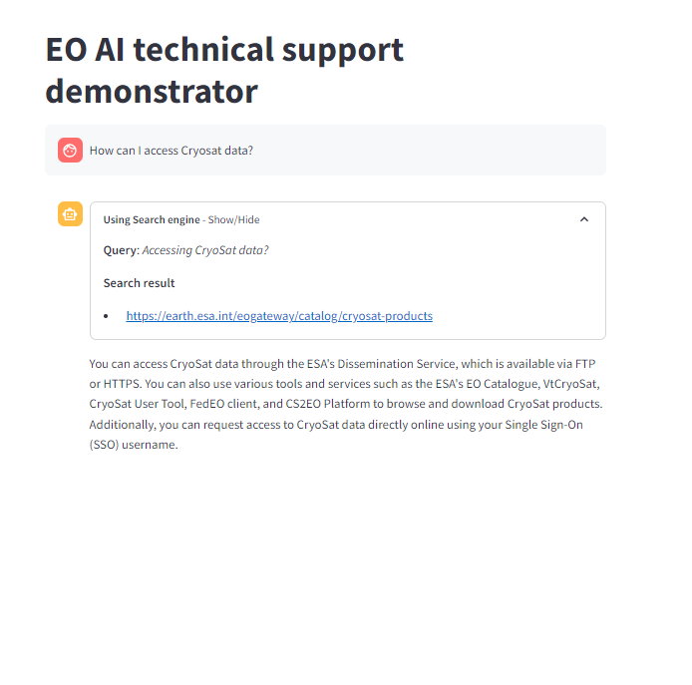
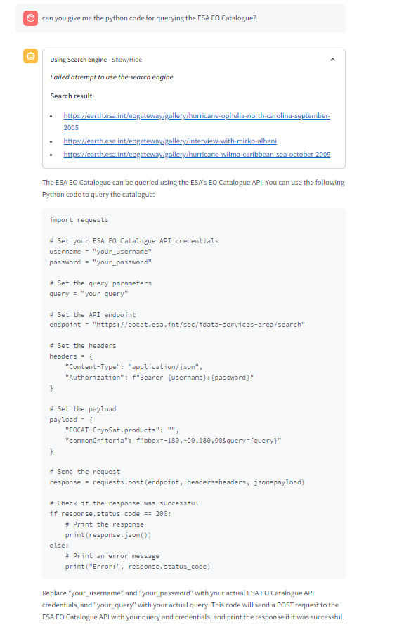
High-Level Architecture – Technical Support + Development Assistant
Query for ESA Documentation for Earth Online
Query for coding assistance from EOCAT API documentation

Slide 15
High-Level Architecture – Ticketing Assistant
Automate ticket population for technical support, and restrained data access.
Improve user efficiency in seeking support.
Centralize management of data access and resource extraction.
Enhance user satisfaction while simplifying user engagement.
Dependencies
Integration with ESA TellUs system
Integration with EO IAM

Slide 16
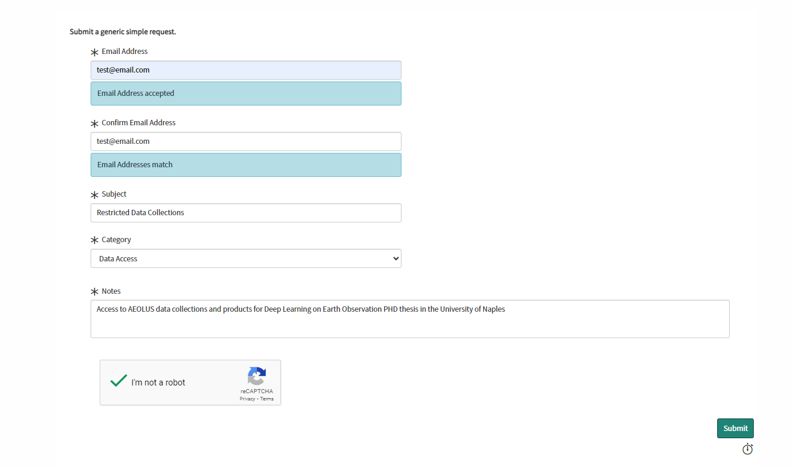
High-Level Architecture – Ticketing Assistant
Automated TellUs ticket creation

Slide 17
High-Level Architecture – Personalisation Database
Provision of personalized service and data recommendations based on user profiles and previous interactions.
Enhance User Engagement and Interaction with the EO Advanced AI Assistant.
Facilitate User Exploration.
Dependencies
Personalization DB for storing previous conversations and user preferences.
EO IAM Integration for retrieving user parameters
EO CAT API

Slide 18
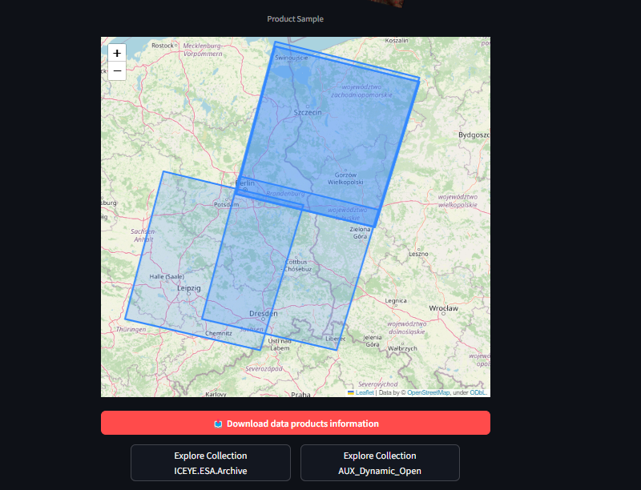
High-Level Architecture – Personalisation Database
Recommendations on additional ESA resources based on user profile and past interactions.

Slide 19
EO Advanced AI Assistant – Operations
Scalability by supporting an increasing number of parallel users
System and component-based monitoring
Integration with external operational systems
Benchmarking
Compliance with Data Protection rules
Compliance with Security rules
Confidentiality
Integrity
Availability
Accountability
+ Trustworthiness

Slide 20
Thank you
Quite some work left before the launch of full operational assistant
AI landscape changing very quickly so adaptations might be needed
Gradual scaling expected to preserve resources
Hardware plays an important role
Beneficial to meet user expectations by gradually releasing new and innovative tools

