Slide 1
LPS25 Key Takeaways for WGISS
D. Guerrucci, ESA
Agenda Item 1.10
WGISS-60
13-17 October, 2025
Oberpfaffenhofen, Germany

Slide 2
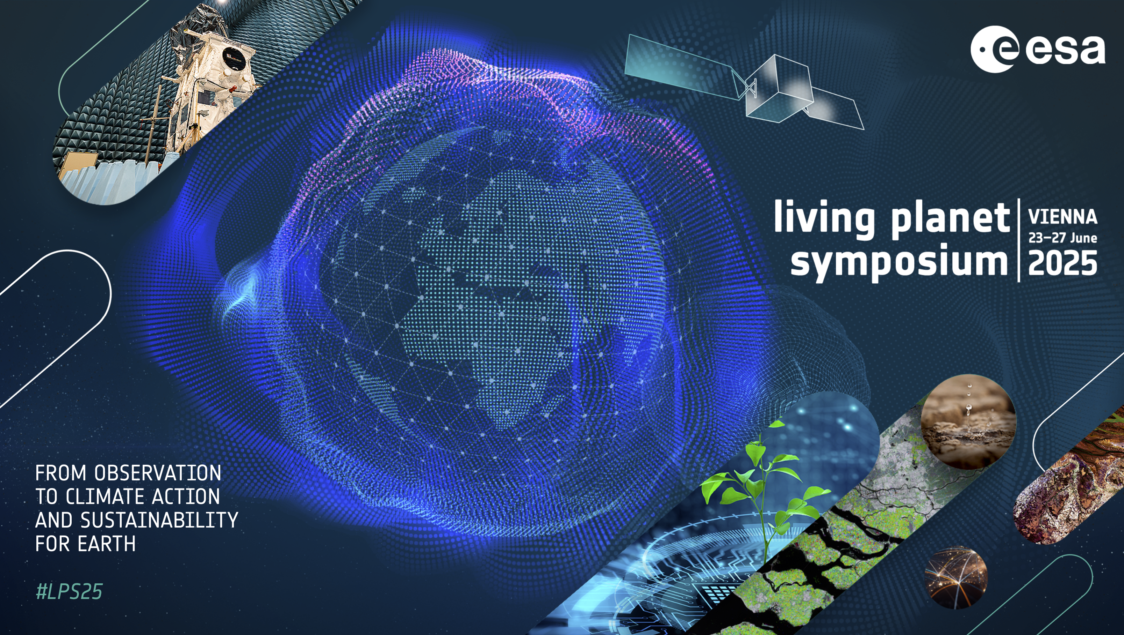
The venue and time

Slide 3
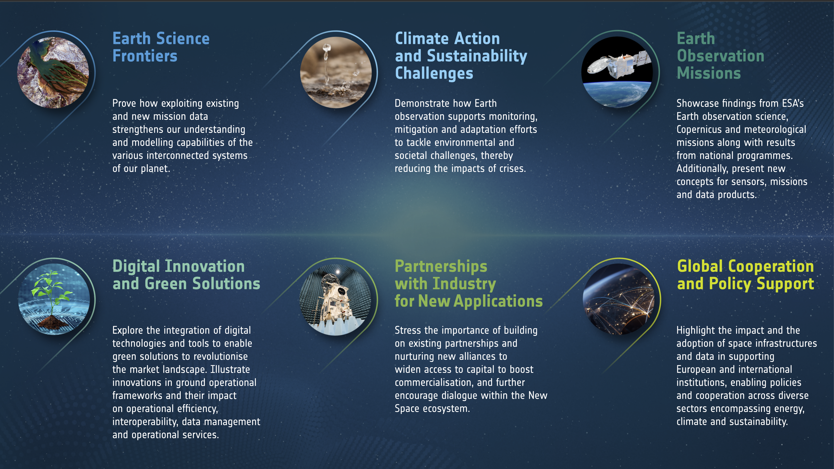
The contents

Slide 4
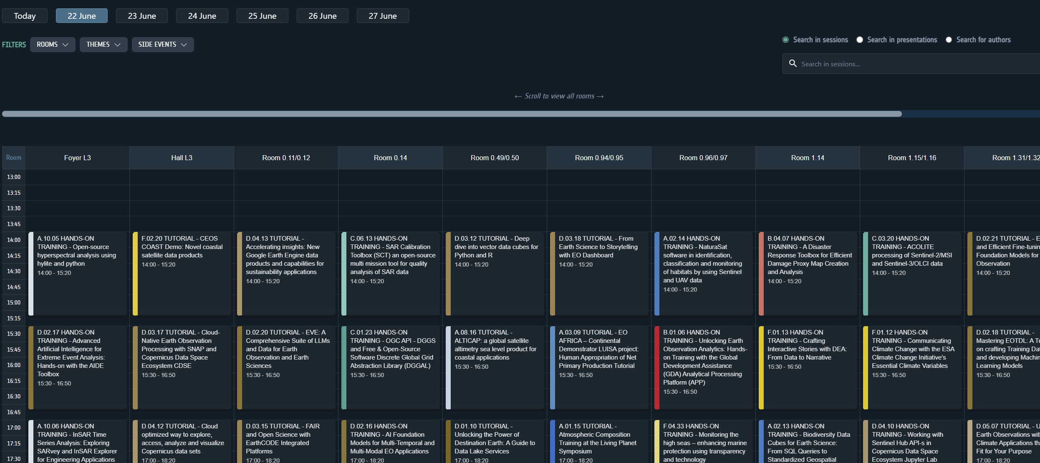
The program
6900 Participants
from 125 nationalities
250+ Sessions
60+ Agoras
150+ Capacity Building sessions
4200+ Scientific presentations and posters
800+ Members of scientific committee
55+ Exhibitors
2200 Children at the School Activities

Slide 5
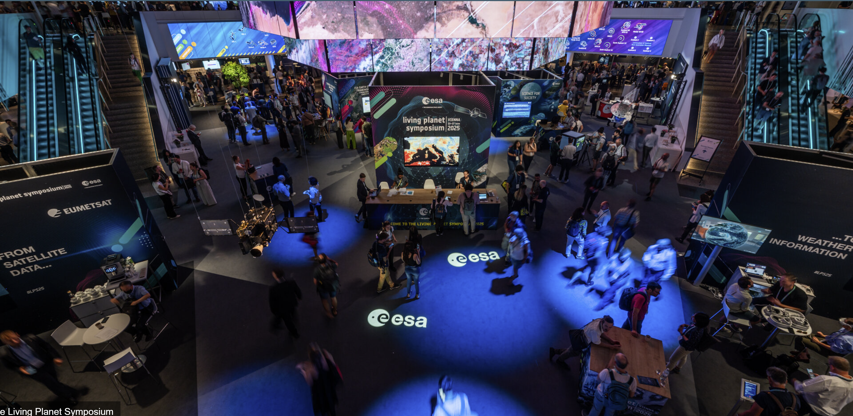
The Earth Observation Framework (EOF) Booth
Focusing on new logistics and communication:
263 interactive Demonstration sessions (guided small-group using headphones) delivered over five days, attracting over 2,000 participants, representing approximately 30% of all LPS25 attendees
62 one-on-one (1:1) sessions (44 for DestinE and DTE, and 18 for Copernicus), with tailored discussions on technical topics
Wide thematic coverage across sectors including energy, climate resilience, insurance and urban development, demonstrating practical applications of EOF-enabled services
In presence Help Desk support and User Survey assistants

Slide 6
LPS User Survey
30th May
Online collection start
23-27th June
LPS
22nd July
Online collection end
In 2025, 732 respondents
(85% received during LPS)
Notes:
The survey was collected online and in person during the Living Planet Symposium 2025 in Vienna.
During the event, five Eversis employees encouraged the symposium participants to share their feedback. The respondents could fill out the survey on tablets, which were available to them, or on their phones after scanning a QR code.
85% of responses (623 out of 732) were received in the period when LPS took place: between 23rd and 27th June.

Slide 7
The Objective
The 2025 survey focused on understanding:
User preferences regarding data access
Satisfaction from utilised EO data and services
New, emerging needs and problems that could shape the future of EO services
Notes:
The survey was collected online and in person during the Living Planet Symposium 2025 in Vienna.
During the event, five Eversis employees encouraged the symposium participants to share their feedback. The respondents could fill out the survey on tablets, which were available to them, or on their phones after scanning a QR code.
85% of responses (623 out of 732) were received in the period when LPS took place: between 23rd and 27th June.

Slide 8
Type of attendees
Notes:
The survey reached a broad range of roles and organisations, with respondents from research or academic institutions being the most represented group (69%).
And it has been the same in the previous years. The changes in proportions of these groups are minor.

Slide 9
Country of Residence
Notes:
This year, respondents from just three countries (Germany, Italy, and the United Kingdom) accounted for half of the survey participants.
Throughout the years, we can see that some countries are consistently represented by a significant number of survey respondents. In addition to Germany, Italy, and the United Kingdom, these were France, Spain, and the Netherlands.
Also, the proportion between respondents from European and non-European countries remains quite similar.

Slide 10
Application Domains
Notes:
Three application domains dominated among the responses, accounting for half of all responses: land surface, agriculture, and climate.
And these top three application domains are consistently similar across all mission categories in the survey. This is true for all programmes except Earth Explorers.

Slide 11
Time Series
Notes:
91% of repondents work with time series, and they mostly need long time series. Over half of respondents need more than 5 years, and almost 30% need 1 to 5 years.
In previous years, preferences related to time series were quite similar. Respondents always mostly needed long time series of more than 5 years.
At the same time, stable group of around 10% of respondents do not require any time series for their work.

Slide 12
Filtering Preferences
Notes:
Respondents did not indicate a strong preference for any data filtering method. Searching by area of interenst or by mission or instrument is the most popular among respondents.
What stands out is a relatively low preference for searching by application domain.

Slide 13
Data Access Methods
 | Research or Academic Institution | Private sector | International/ National Organisation | Private Individual | Non-profit Organisation/ NGO
Code/API | 47% | 48% | 41% | 30% | 27%
GUI | 30% | 29% | 30% | 35% | 31%
GIS tools | 18% | 17% | 19% | 30% | 27%
Text-based search | 5% | 6% | 10% | 5% | 15%
Notes:
Code/API integration is the preferred access method, especially among research or academic institutions and private sector.
When compared with the previous survey from 2022, we observed that API became slightly more popular while GIS tools are slighly less used among respondents.

Slide 14
Key Aspects of Data Access
Notes:
When it comes to key aspects of data access, respondents mostly value access to the full archive and older data, but they also care about data quality and reproducibility.
Updates and communication were indicated as the least important aspect.
The new option, added this year (“Accessing data from different types of missions from a unique access point”), was selected by 238 respondents, which is one-third of survey participants. However, the need for having one platform to access all data was often repeated in the comments, which brings us to the next questions - Utilised Platforms.

Slide 15
Utilised Platforms
Notes:
In this open-ended question, the respondents were asked to provide a platform which they use to access and work with the data.
The absolute winner among them is Google Earth Engine, which is used by almost half of survey participants.
The second most popular platform among respondents is Copernicus Data Space Ecosystem,
The other popular platforms, used by more than 50 respondents, are ESA MAAP and ESA Exploring Earth.
And this question is a good opportunity to present of one the key conclusions which is that respondents mostly present two opinions: one says that ESA should have their one unified platform for all data, the other says that ESA should share the data on other popular platforms (they mostly mention Google Earth Engine). This shows a tendency towards working in one environment instead of using multiple tools in parallel.

Slide 16
Additional Data and Services
Most meaningful „Other” comments:
A natural language matching service from user needs to products targeted at non-expert users of EO”
“Centralised platform like Copernicus data store with search options available with different aspects: missions, time, spatial range, etc”
“Information about delayed data & low quality”
“Status page to know the outages asap”
“Larger amounts of archive images through third-party missions.”
Notes:
In this question, respondents were asked to share additional data and services they would need ESA to provide.
And they mostly need new types of data access and search parameters. The second most selected enhancement was higher-level analysis-ready data and thematic data products.
The least popular enhancement was a personalised area with service suggestions.

Slide 17
Utilised ESA Heritage Missions Data
Notes:
Survey respondents who use ESA Heritage Missions data mainly use Envisat and ERS.

Slide 18
Utilised Third Party Heritage Missions Data
Notes:
Among 128 respondents who use Third Party Heritage Missions, 49 (38%) use Landsat 1-6 data. Other missions were selected by much fewer respondents. The only other constellation used by more than 20 respondents is SPOT 1 to 5.
In 2025, some of the TPM missions were not classified as Heritage yet, or were grouped differently. Therefore, we cannot directly compare 2025 data to previous years.

Slide 19
Utilised Third Party Missions Data
Missions selected by less than 10 respondents:
Spire 8
Unseenlabs 8
IRS-P5 / Cartosat-1 7
Odin 7
Vision-1 7
Aura 6
SCISAT-1 6
FSSCat 4
IRS-R2 / ResourceSat-2 4
TanSat 2
Notes:
Landsat 7 and 8 constellation was the most often selected group of missions, not only among Third Party Missions, but among all missions present in the survey. In total, it was selected by 276 respondents, which accounts for 38% of all survey participants. PlanetScope (143 responses) is also the second most often selected mission both among TPM and among all missions in the survey.
In 2025, some of the TPM missions were classified as Heritage Missions, or were grouped differently. Therefore, we cannot directly compare 2025 data to previous years. However, Landsat has always been the most often selected group of missions, even if under different groupings or namings like “Landsat” in 2016, “Landsat-4 to 7 and Landsat-8” inm 2019, or “Landsat-1 to 7, Landsat-8” in 2022.

Slide 20



Recommendations Related to Data and Services
Simplify and unify access
Improve discoverability and metadata
Expand volume, coverage, and continuity
Notes:
It might be worth considering further steps towards a single point of access for all ESA and Third Party Missions. Respondents frequently asked for either creating a single centralised platform or for providing data in other services.
Many respondents indicated that it is difficult to know what data exists or how to filter effectively, so clearer catalogues and handbooks could make data more findable and usable. It could be helpful to invest in richer metadata, search, and documentation tools.
Users often emphasised the value of long-time series and global coverage. Expanding these areas where feasible might strengthen ESA’s role as a provider of long-term datasets.

Slide 21



Recommendations Related to Data and Services
Invest in data interoperability and harmonisation
Address weaker aspects identified in satisfaction scores
Enhance user support and visibility
Notes:
4. Users might benefit from harmonised products development (e.g. multi-mission products, optical-SAR combinations). Respondents pointed to interoperability as a way to improve efficiency and make datasets more comparable.
5. Survey results indicate that data discovery, downloads, and ESA-provided tools were consistently weaker points. It could be worth reviewing these areas to reduce barriers for everyday users.
6. Respondents also expressed a need for clearer communication on available data across all mission categories. Increasing ESA’s visibility compared with other providers might help underline the value of ESA’s investments in Earth observation.

