Slide 1
Data Preservation & Stewardship Interest Group (DSIG) Work Plan
Mirko Albani, ESA
Agenda Item 1.5
WGISS-60
13-17 October 2025
Oberpfaffenhofen, Germany

Slide 2
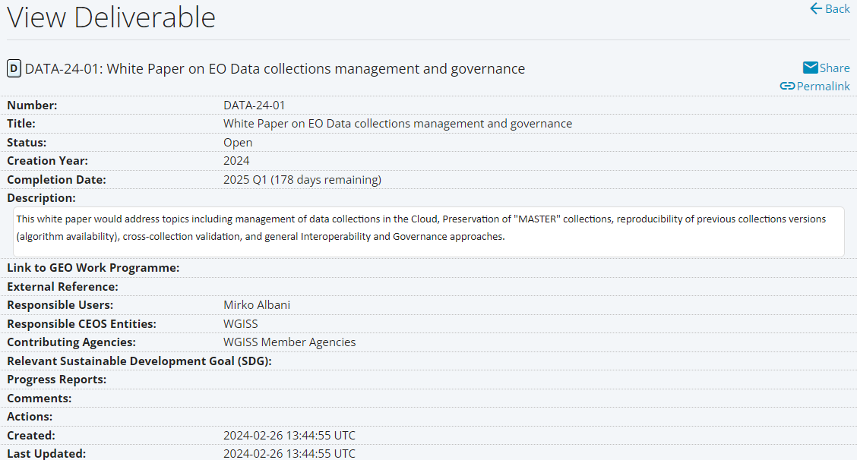
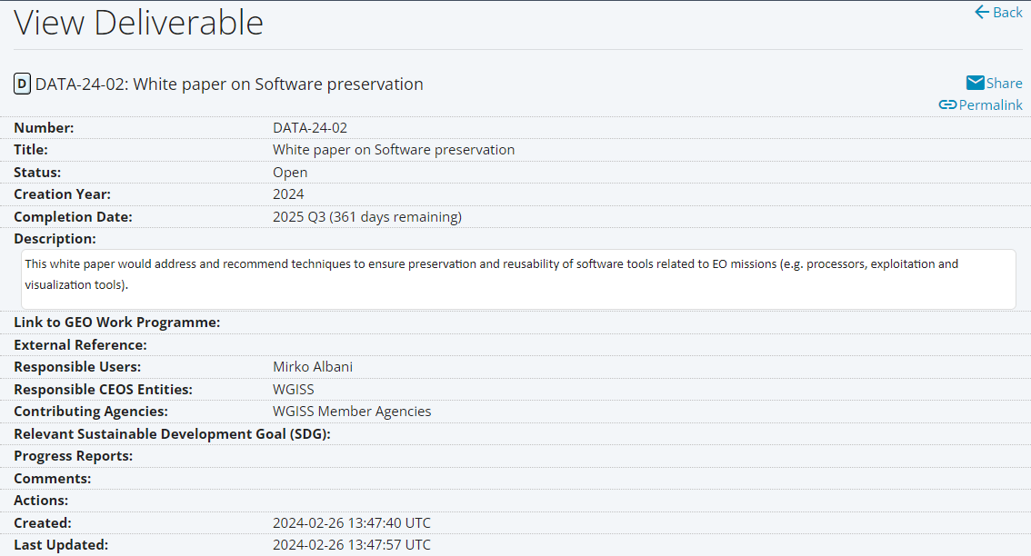
CEOS Deliverables 2023 - 2025
COMPLETED
UNDER FINALISATION
Completion Date: CONFIRMED

Slide 3
CEOS Deliverable DSIG Vision
Long-term accessibility and exploitability of Earth Science data requires that not only sensed data but also technical content and associated information needs to be properly preserved and made accessible. In addition, data provenance and data citation are key aspects to be further discussed in the CEOS framework which might benefit from shared and coordinated approaches.
Ongoing/future deliverables will address:
Data Associated Content and Information Preservation
Long Term Data Preservation processes
Data Provenance and Citation
Confirmed deliverable for 2026-28:
Dedicated Presentation in Session 3

Slide 4
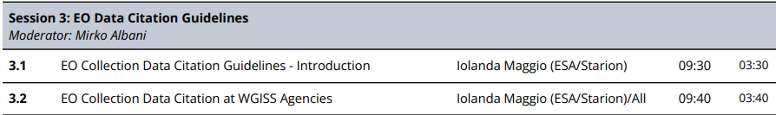
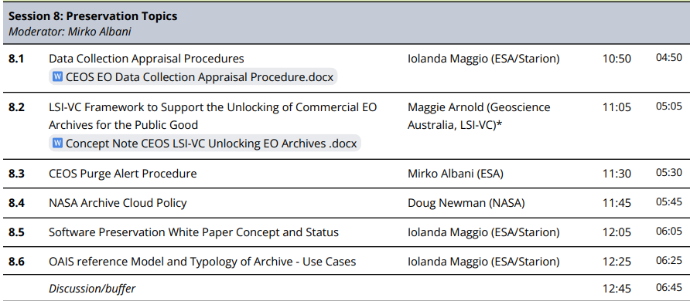
DSIG Sessions and Topics
Day 2: Tuesday, 14th October 2025
Day 3: Wednesday, 15th October 2025

Slide 5
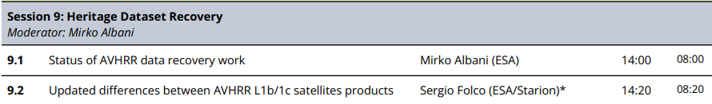
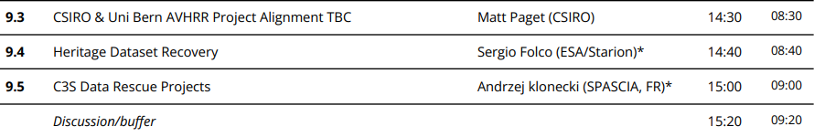
DSIG Sessions and Topics
Day 3: Wednesday, 15th October 2025

