Slide 1
Technology Exploration Interest Group (TEIG) Work Plan
Yousuke, JAXA
Maral, UKSA
Agenda Item 1.7
WGISS-60
13-17 October, 2025
Oberpfaffenhofen, Germany

Slide 2
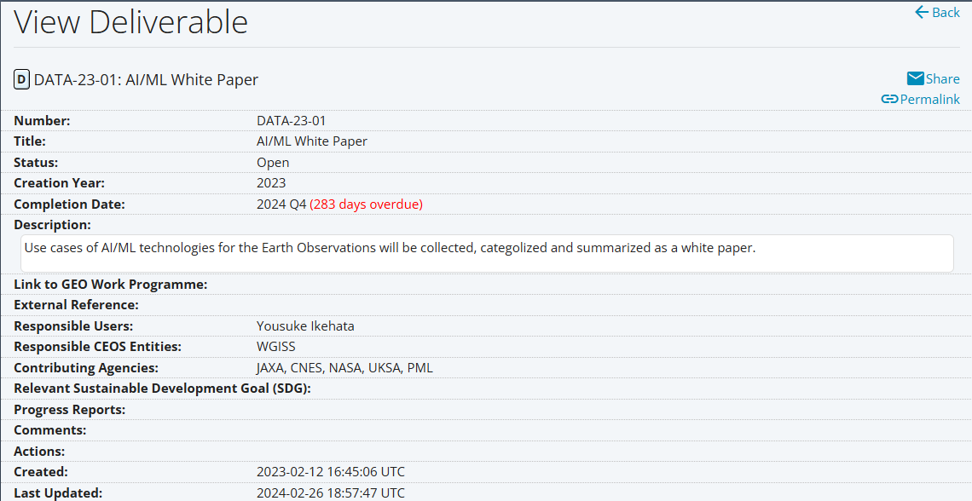
CEOS Deliverables
CLOSED

Slide 3
WGISS Action (1/4)
ON GOING
ID | WGISS-58-21
Action | TEIG to investigate with DAIG and SEO the available technologies for federated authentication, and which would fit with the objectives of CEOS.
Actionee | TEIG / DAIG / SEO
Due Date | WGISS-59
Status | In Progress
Status notes | SEO scheduling meeting with DAIG

Slide 4
WGISS Action (2/4)
ON GOING
ID | WGISS-59-11
Action | DAIG and TEIG to consider whether a separate white paper on Data Federation is needed, alongside the current work on User Federation.
Actionee | DAIG/TEIG
Due Date | WGISS-60
Status | In Progress
Status notes | Activity started for White Paper definition and possible assignment of contribution

Slide 5
WGISS Action (3/4)
Propose to CLOSE
ID | WGISS-59-15
Action | TEIG to document the scope of the AI/ML ready data definition task, and who we would be doing it for.
Actionee | TEIG
Due Date | Q2 2025
Status | In Progress
Status notes | TEIG provides information AI/ML ready data and describe ESIP's check list as one of them. And CEOS ARD will be also introduced for usefull data for AI/ML.

Slide 6
WGISS Action (4/4)
Propose to CLOSE
ID | WGISS-59-16
Action | TEIG to document the scope of the Digital Twins white paper.
Actionee | TEIG
Due Date | ASAP
Status | In Progress
Status notes | Outline for the document will be shared at WGISS-60

Slide 7
Federation
Day 2: Tuesday, 14th October, 2025
Session 4: Data Access Moderator: Damiano Guerrucci
4.1 | Federated Authentication and Authorization (AuthN/Z) White Paper status | Filippo Marchesi (Solenix/ESA) | 11:00 | 05:00

Slide 8
AI/ML white paper
Day 3: Wednesday, 15th October, 2025
Session 10: AI/ML Moderator: Yousuke Ikehata & Maral Bayaraa
10.1 | AI/ML White Paper Report Plan for endorsement by WGISS | Yousuke Ikehata (JAXA) | 15:50 | 09:50
10.2 | EO Advanced AI Assistant | Killian Perriot (ESA/Thales)*, Dorian Voydie (ESA/Thales)* | 16:05 | 10:05
10.3 | CORSA AI Compression for Terrascope Products | Bart Beusen (Terrascope)* | 16:20 | 10:20
10.4 | Supporting Weather and Climate Application Development with ML-Friendly Earth Observation Data | Jörg Schulz (EUMETSAT) | 16:35 | 10:35
 | Discussion/buffer |  | 16:50 | 10:50

Slide 9
Digital Twins
Day 5: Friday, 17th October, 2025
Session 15: Digital Twins Moderator: Yousuke Ikehata / Maral Bayaraa
15.1 | Harmonization of Mutli-Resolution Geospatial Data in GeoSpatial Digital Twin Framework | J.Narendran (ISRO/NRSC)* | 10:20 | 04:20
15.2 | Irish National Framework for Digital Twins | Alastair McKinstry (ICHEC)* | 10:40 | 04:40
15.3 | Interactive Session on EO for Digital Twins Scope of the White Paper | Maral Bayaraa (UKSA), Yousuke Ikehata (JAXA) | 11:00 | 05:00

