Slide 1
WGISS Action Review
Libby Rose
WGISS Secretariat
Agenda Item 1.9
WGISS-60
13-17 October, 2025
Oberpfaffenhofen, Germany

Slide 2
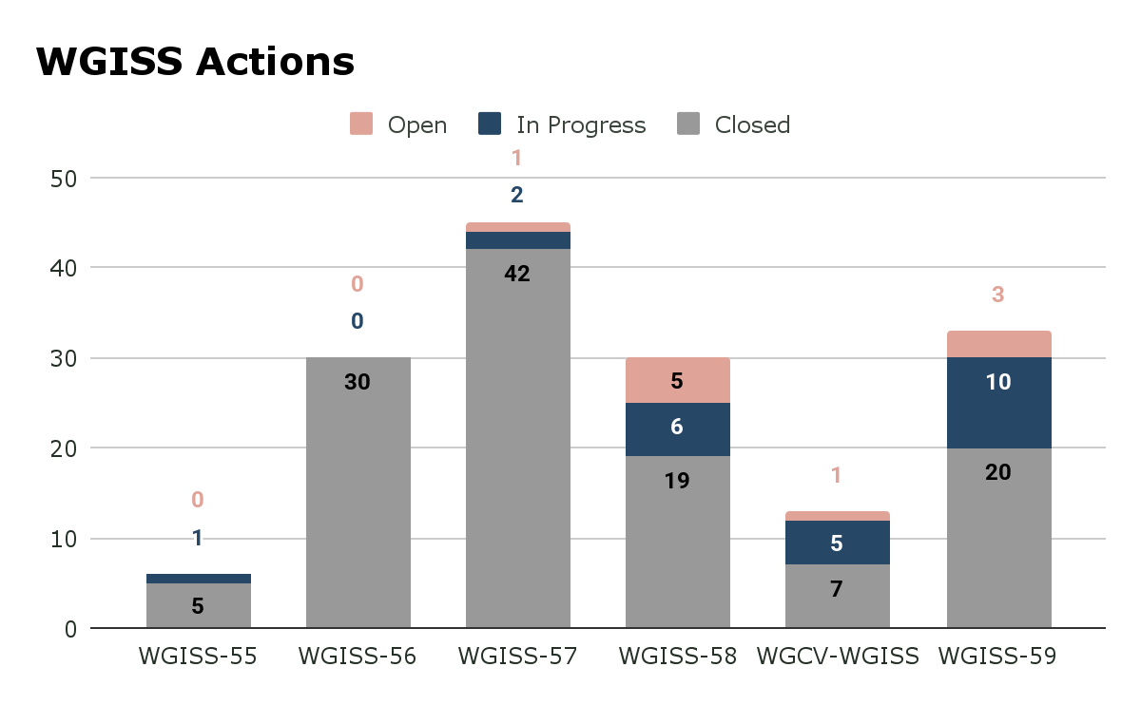
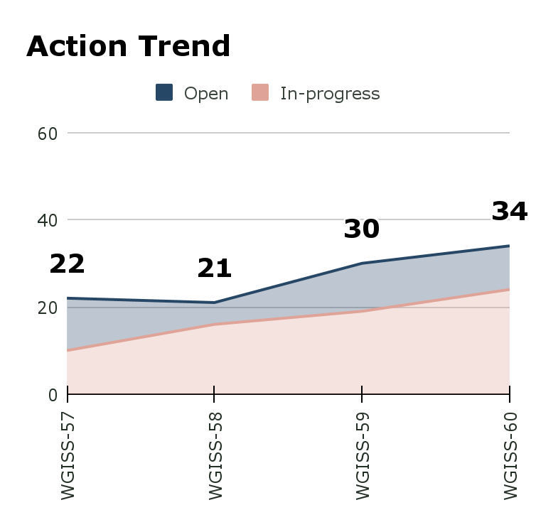
Overall Status
In progress: 25 (69%)
Open: 11 (31%)

Slide 3
WGISS-57-07
WGISS Chair to compile a table of POC for external and internal collaborations. Table should be regularly updated (revised at least annually) and may be included as part of a WGISS annual work plan.
Group | WGISS POC
ARD Oversight Group | Matt Paget (CSIRO), ++
GEO Infrastructure Development Task Team (GIDTT) | Mirko Albani
OGC | Dave Borges (SEO)
Consultative Committee for Space Data Systems (CCSDS) | Mirko/Iolanda (Data Archiving & Ingesting WG)
CGMS WGIV | ?

Slide 4
WGISS-58-10
Anyone interested in using CoMET once it becomes available to non-NOAA users should send Sarah Menassian (NOAA) an email.
Close?

Slide 5
WGISS-58-12
NOAA CoMET team to discuss whether the tool will be open source, and consider how CEOS could build on this work to make a version applicable for CEOS.
Any progress?

Slide 6
WGISS-58-18
DAIG to connect with the NCICS team developing the SuperSTAC prototype, and remain aware how this interacts with IDN & FedEO.
How is the SuperSTAC prototype developing?
Action to remain open?

Slide 7
WGISS-58-27
Ken Casey to discuss further with the NOAA team about a knowledge graph demonstration using the MIM Database. Once ready, Libby Rose can connect Ken with the MIM Database Team to discuss further.
Do we still want to pursue this? Is NOAA still working on knowledge graphs?

Slide 8
WGCV-WGISS-2024-05
SEO to develop some ‘Contributor Guidelines’ for the CEOS GitHub to help outsiders contribute to the Interoperability Handbook and other repositories.
Ready to share with WGISS?

Slide 9
WGCV-WGISS-2024-13
WGCV to provide guidance on what uncertainty information should be packaged within a dataset. WGISS should then add guidance on how this information can be provided to the user. This should be fed back to add into the CEOS-ARD specifications.
Waiting for WGCV inputs

Slide 10
WGISS-59-30
CEOS-ARD Oversight Group to work with CEOS MIM Database team and LSI-VC to identify and develop ‘CEOS-ARD’ keywords to be provided to DAIG for FedEO and IDN, to support discovery of the datasets. CEOS-ARD Oversight Group should consider how to recommend the use of these keywords to support better discovery of CEOS-ARD datasets.
Status update?

