Slide 1
EO AI Advanced Assistant
Killian PERRIOT, Dorian VOYDIE
Thales for ESA
Agenda Item 10.2
WGISS-60
13-17 October, 2025
Oberpfaffenhofen, Germany

Slide 2
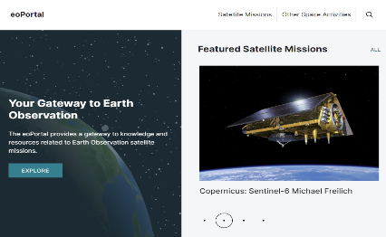
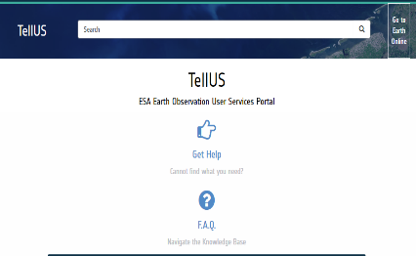
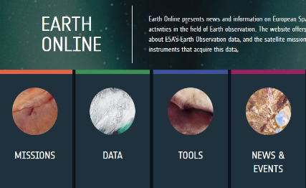

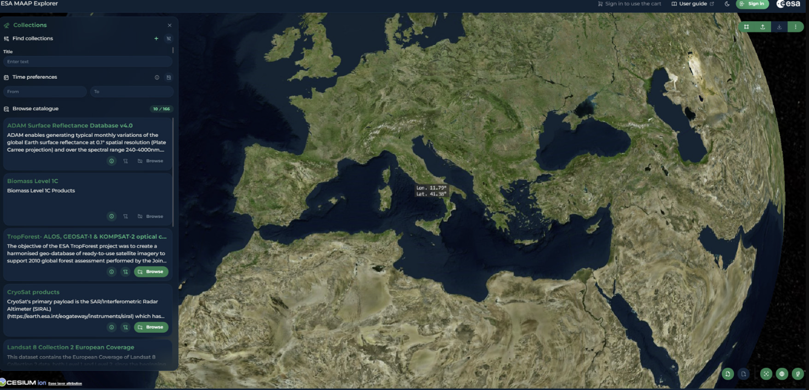
Context
Pains
Large amount of data (documentation, code, forms) spread across multiple platforms/websites and various sources.
Many tools and APIs
Non-expert users struggle to access relevant information.
Expert users underutilize the information available on other platforms.
  ⇒ Underexploited data.
EoPortal
ESA TellUS
Earth Online
EO IAM
ESA MAAP

Slide 3
High-Level Architecture
User Interface
General Purpose LLM
AI-Agent Orchestrator
Personalization DB
Data Discovery
Coding
Assistant
Ticketing Assistant
Recommendation System
Technical Assistant
Started in 2024
2025 study
Start in 2026

Slide 4
High-Level Architecture
AI-Agent Orchestrator
Query Management & Routing: Perform query management, intent classification and routing of user queries to appropriate subsystems.
Structured Inter-Subsystem Communication: Enable the structured communication between different subsystems of the Assistant.
Integration of Scalable and Upgradable Tools: Enable the seamless introduction of new tools into the architecture, allowing for independent scaling of components through implemented abstraction.
Error and Exception Management: Manages errors and exceptions within the subsystems.
Response Aggregation: Collects and synthesizes responses from multiple subsystems into a cohesive answer for the user.

Slide 5
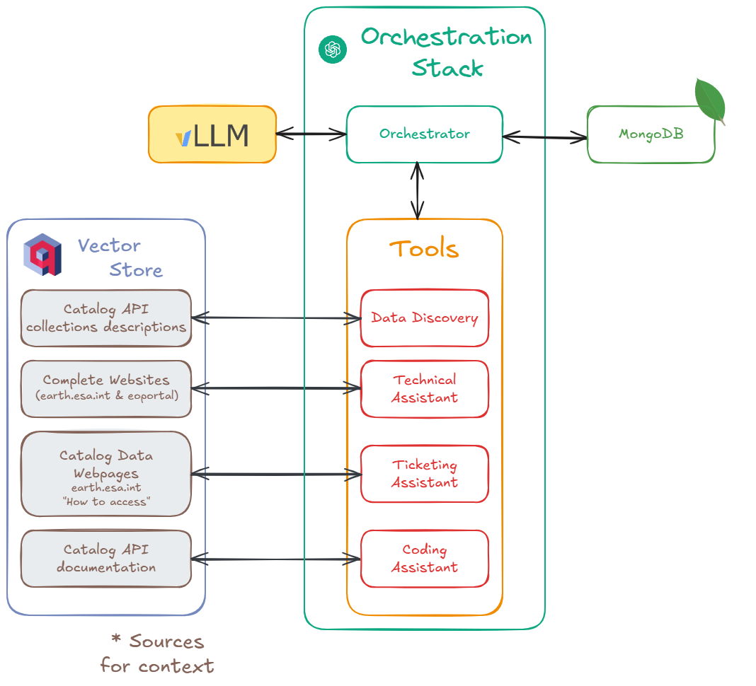
Global workflow
The orchestration stack
  Interacts with LLM(s).
  Manages personalization database for user history and preferences.
  Uses tools for task-specific queries from users (documentation, coding assistance, …).
Vector Store
  Contains all external data needed by the tools.
  Is composed of multiple “collections” of “documents”.

Slide 6
Datastore overview

Slide 7
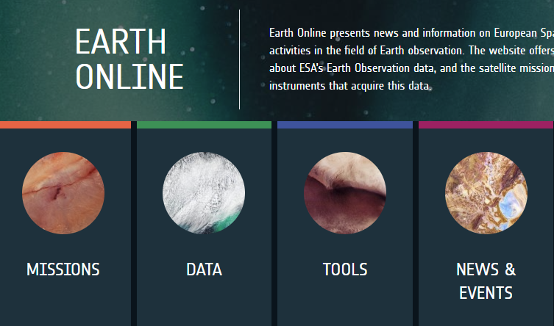
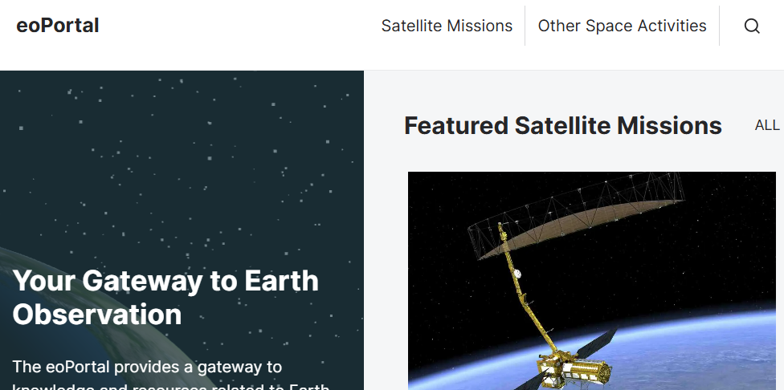
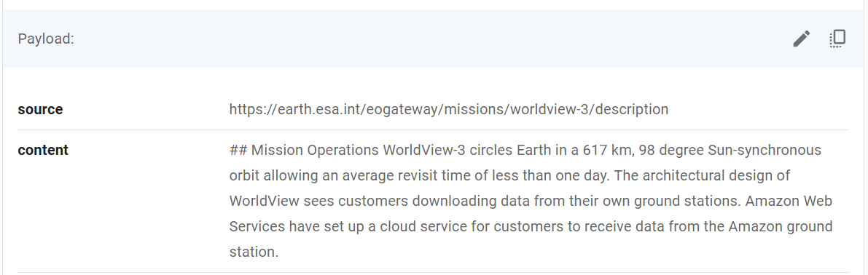
Technical Assistant
Purpose
  List of relevant documents + sources
Input data
  Earth online
  EO portal
Data processing
  Remove all the archived and outdated webpages
  Extract the relevant html content and convert to markdown
  Remove the references and figures that are too heavy for small models to process
  Clean artifacts caused by the conversion
  Ingest the data by chunks (updated)
Notes:
Keep a curated dataset of everything interesting on Earth Online and EO Portal.
Cleaning the data is a crucial part.
Currently, only the text is kept. However in the future we could image using a Multimodal LLM (MLLM) to interpret more complex document with images, videos, graphs, …

Slide 8
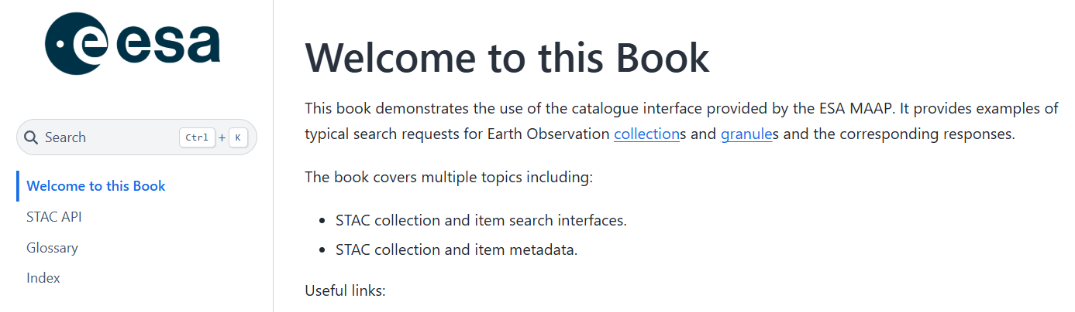
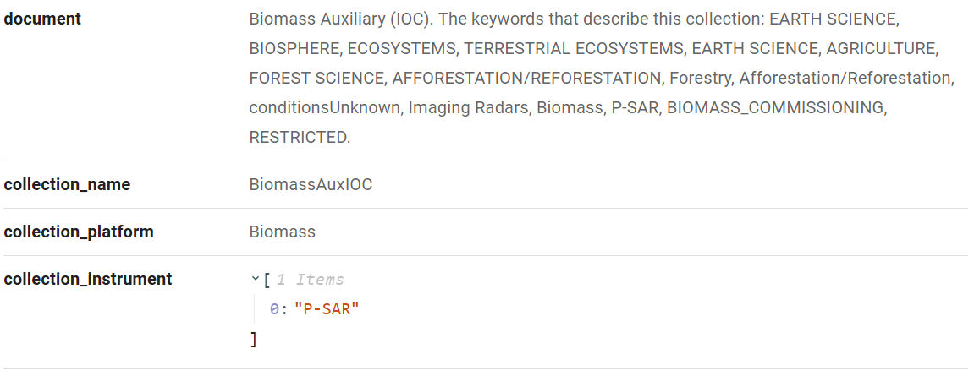
Data Discovery
Purpose
  Find the most suitable data collection for the user purpose. Provide direct access to MAAP catalog data products and visualizations from Quicklooks using automated API calls from user queries.
Input data
  MAAP Catalog API
Data Processing
  List the available collections in the catalogue
  Extract their information
    Description
    Platform
    Instruments
    …
Notes:
Very important database, as it mimics the content of the MAAP API.
We keep a set of the available ESA collections to make API calls to, locally.
As it is frequently updated, we make sure to keep a rather good “hit/miss” ratio on our api calls.
We also retrieve relevant information about data collections such as a description, the platform, the instruments, …

Slide 9
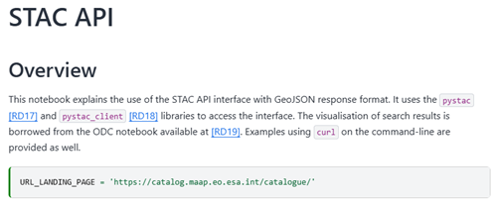
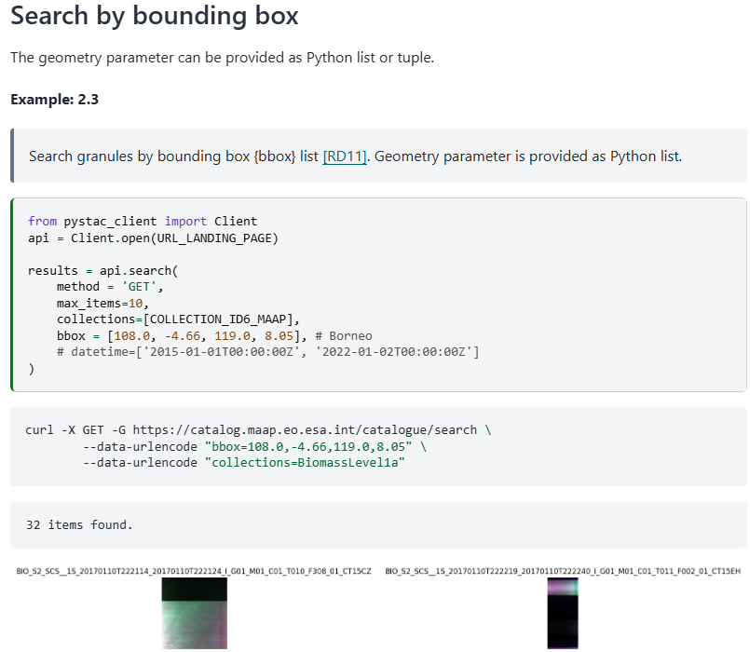
Coding Assistant
Purpose
  Find the most suitable standalone, executable code examples for API usage from the MAAP Catalogue. Each code cell becomes completely self-sufficient.
Input Data
  Notebooks from MAAP Catalog API
Data Processing
  Fetch all notebooks from the MAAP catalog
  Extract code cells and text and convert to markdown
  Reconstruct cell dependencies automatically
  Add necessary imports and definitions to each cell
  Split markdown into functional, self-contained code chunks using AI
Notes:
For now we based the process on RAG only.
The LLM will only adapt the code snippets that it is given.
The performances of such a method rely mainly on the quality of the dataset.
Frequent updates on our code database helps us having the latest version of the code available.
The next step would be to add a verification loop to asses the quality of the generated code.
And why not use a code generation LLM dedicated to challenge the originally generated code and refactor it if needed

Slide 10
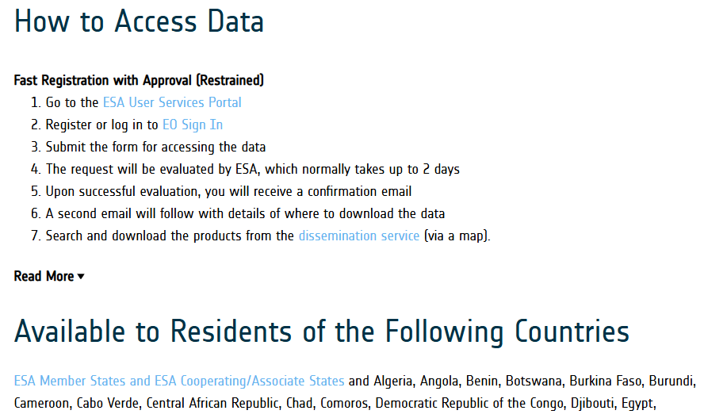
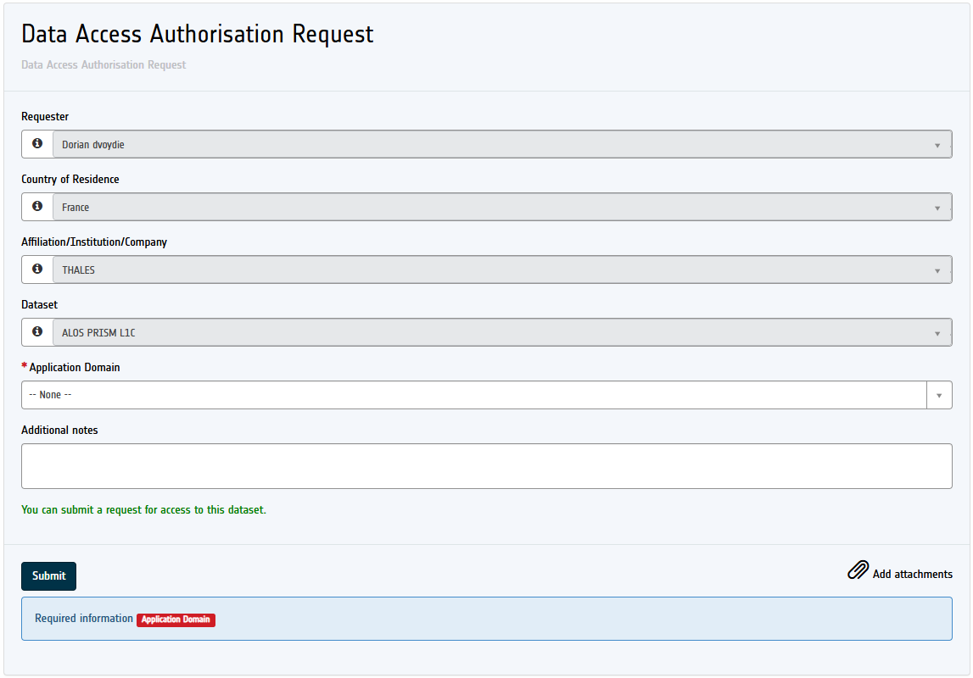
Ticketing Assistant
Purpose
  Assist users by outlining the required steps, pre-filling forms, and providing relevant links to request access to the data collections they are interested in
Input Data
  Earth online data Collection webpages
Data Processing
  Retrieve collection names, instruments, platform
  Extract the "How to Access Data" section containing access instructions
  Extract the "Available to Residents of the Following Countries" section describing country-based access restrictions
  Collect relevant links and access request forms
  Retrieve terms and conditions (policy) for using and/or accessing the data
Notes:
Information extracted from Earth Online collections’ “How to access” section.
There are multiple form formats, each of them associated to collections. Depending on the level of sensitivity of the collection

Slide 11
Demo Use Cases

Slide 12
Use case 1
Notes:
First Use Case : A User is looking for domain specific information.
-> Queries the assistant with a generic question regarding its topic of interest
Technical Assistant gathers documentation data from Earth Online and EO Portal and gives back the best answer
-> Asking for data access.
Ticketing Assistant found multiple ESA collections matching query
-> Refines query
Ticketing Assistant finds the matching collection and retrieves data access steps
-> Code integration
The Coding Assistant adapts code from MAAP API Documentation to match the users’ needs and target specific data collections.

Slide 13
Use case 2
Notes:
Second Use Case : A User knows exactly what he is looking for.
-> Directly targets ALOS PRISM L1C data with specific cloud coverage requests and spatial extent
Data Discovery makes the API call and manages to find product. Creates a visualization of a sample with detailed information.
-> The data is restricted. So user asks how he can get access to this data
Ticketing Assistant found multiple ESA collections matching query
-> Refines query with exact collection ID
Ticketing Assistant finds the matching collection and retrieves data access steps, with the matching ESA TELLUS forms already prefilled.
Once the form is filled, sent and validated, the user can now freely access the data.

Slide 14
Use case 2
CONTACT
Killian PERRIOT
Artificial Intelligence Engineer
killian.perriot@thalesgroup.com
Dorian VOYDIE
Artificial Intelligence Engineer
dorian.voydie@thalesgroup.com
Notes:
Second Use Case : A User knows exactly what he is looking for.
-> Directly targets ALOS PRISM L1C data with specific cloud coverage requests and spatial extent
Data Discovery makes the API call and manages to find product. Creates a visualization of a sample with detailed information.
-> The data is restricted. So user asks how he can get access to this data
Ticketing Assistant found multiple ESA collections matching query
-> Refines query with exact collection ID
Ticketing Assistant finds the matching collection and retrieves data access steps, with the matching ESA TELLUS forms already prefilled.
Once the form is filled, sent and validated, the user can now freely access the data.

