Slide 1
Architecture Factor
Mirko Albani, ESA
Agenda Item 11.3
WGISS-60
13-17 October 2025
Oberpfaffenhofen, Germany

Slide 2
Architecture Factor
Architecture plays a very important role in enabling interoperability. It describes the organizational structure of concepts, processes, and assets, including data and workflows. It comprises structural aspects of models and standards that govern the collection management, archiving, storage, documentation and publishing of data, and is the basis on which the interoperability of data and services is built on.
The Architecture factor has been divided into the following sections:
Preservation Architecture: the primary purpose of data archiving is to preserve data over time. Preserving data over time consists in holding data in repositories in a way that enables data to be managed and accessed now and in the future. Data archiving is a complex, long-term process, with possibly many partners, including data providers supplying data to the archive, data users willing to use the archive, archive managers organizing the archive and other archives with which interoperability may be sought. Data management and archiving should consider not just the storage of data, but also the access and usage patterns of data.
Data and Metadata Architecture: recommendations for collection management functions including data production, management, packaging and documentation.
Publishing Architecture: publishing recommendations involve the final stage in making data accessible to external organizations or individuals. These recommendations are aimed at facilitating both access to data as well as maintaining a replica of part or all of a collection of data, including to be used when managing data for interoperability on the cloud.

Slide 3
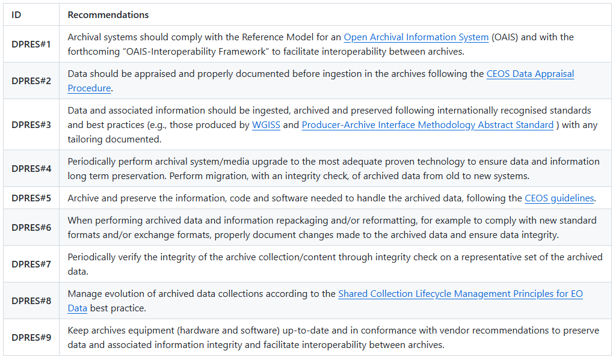
Preservation Architecture Recommendations

Slide 4
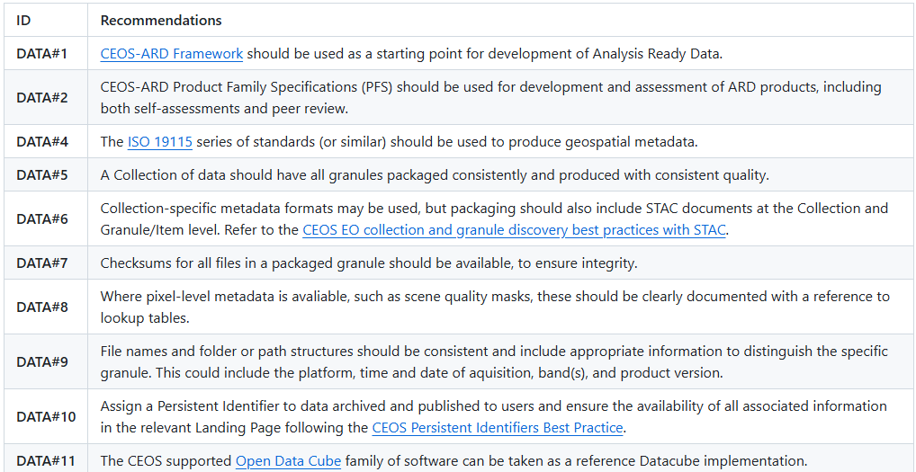
Data and Metadata Architecture Recommendations

Slide 5
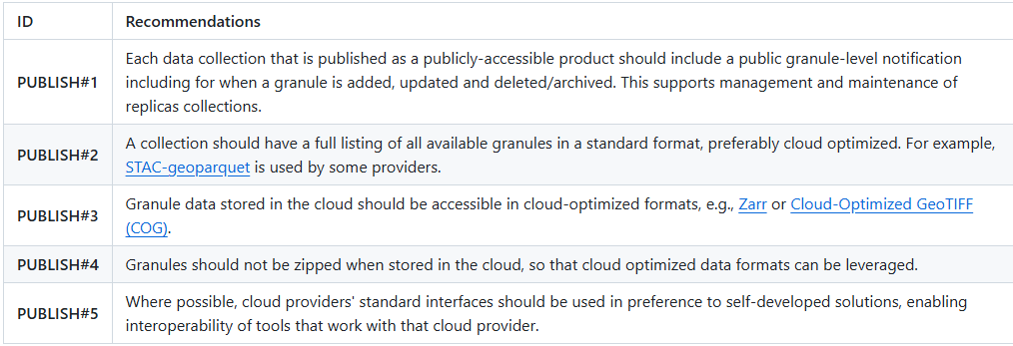
Publishing Architecture Recommendations

