Slide 1
Maturity Matrices Data Management & Stewardship, CalVal and Interoperability
I.Maggio, Starion for ESA
Agenda Item 11.6
WGISS-60
13-17 October 2025
Oberpfaffenhofen, Germany

Slide 2
Main Concepts

Slide 3
Data Management and Stewardship Maturity Matrix (DMSMM): Main concepts
DMSMM defines all activities needed to preserve and improve the information content, quality, accessibility, and usability of data and metadata.
Data stewardship “encompasses all activities that preserve and improve the information content, accessibility, and usability of data and metadata” (National Research Council 2007).
Data management includes all activities for “planning, execution and oversight of policies, practices and projects that acquire, control, protect, deliver and enhance the value of data and information assets.” (Mosely et al. 2009).

Slide 4
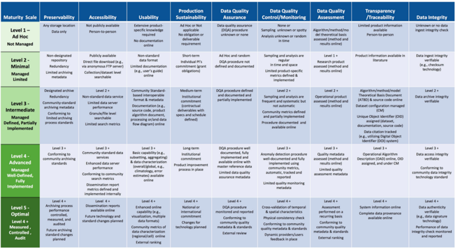
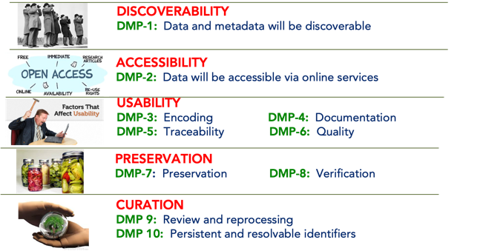

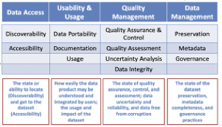
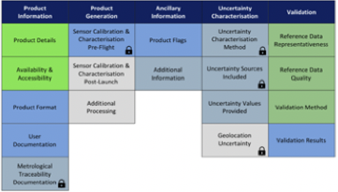
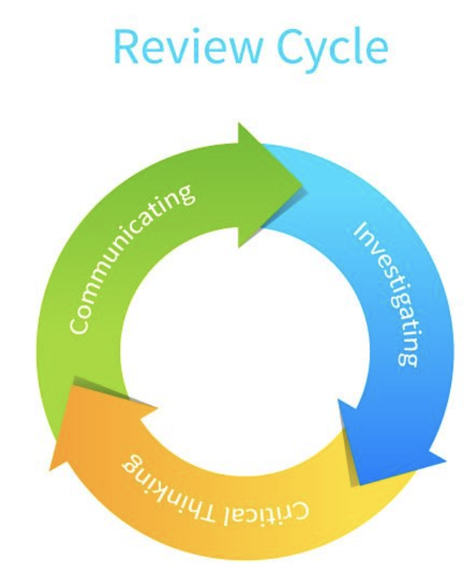
DMSMM Generation Process
CEOS WGISS DMSMM: Generation process
MM for Long-Term Scientific Data Stewardship
GEOSS Data Management Principles
RDA FAIR Data Maturity Model
WMO Stewardship MM for Climate Data
ESA Earthnet Quality Data Assessment Pilot

Slide 5
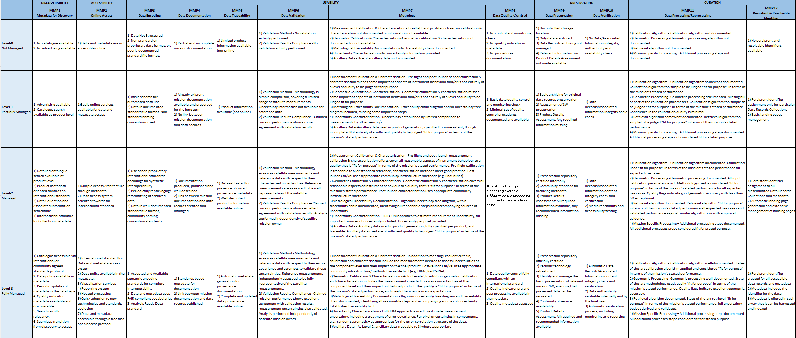
CEOS WGISS Data Management & Stewardship Maturity Matrix
https://ceos.org/document_management/Working_Groups/WGISS/Interest_Groups/Data_Stewardship/White_Papers/WGISS%20Data%20Management%20and%20Stewardship%20Maturity%20Matrix.pdf
https://ceos.org/document_management/Working_Groups/WGISS/Interest_Groups/Data_Stewardship/White_Papers/WGISS%20Data%20Management%20and%20Stewardship%20Maturity%20Matrix_Schema%20to%20be%20filled.xlsx

Slide 6
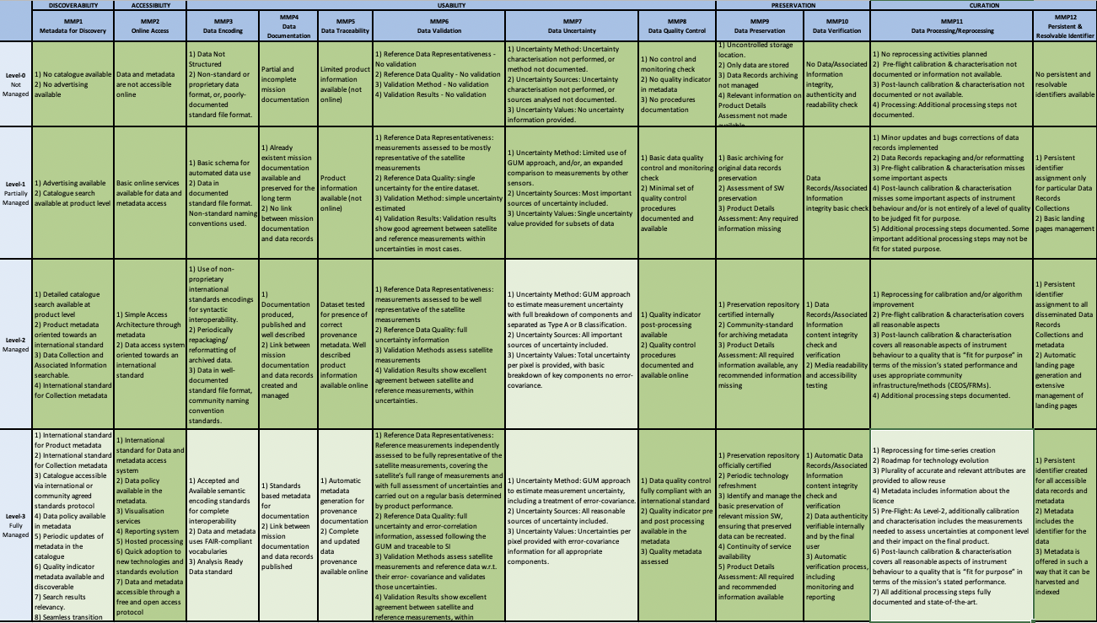
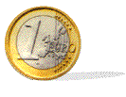
Data Management & Stewardship Maturity Matrix - Scope
Scope of the Assessment
Current state
Baseline
maturity
Future State
Analyse
results,
plan for
tasks to be performed
A way to measure the status of the Agency Data Stewardship processes in place
A way to plan goals of Data Stewardship processes and projects

Slide 7
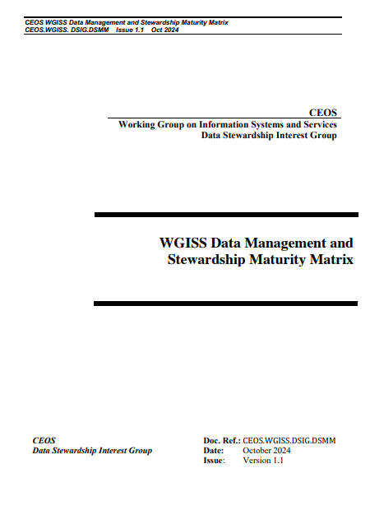
WGISS DMSMM pillars
5 Areas
Discoverability
Accessibility
Usability
Preservation
Curation
4 Level of Maturity
L0 Not Managed
L1 Partially Managed
L2 Managed
L3 Fully Managed
12 Components
Metadata for Discovery
Online Access
Data encoding
Data Documentation
Data Traceability
Data Validation
Data Metrology (e.g. Uncertainty)
Data Quality Control
Product Details
Data Preservation
Data Verification
Data Processing/Reprocessing
Persistent & Resolvable Identifier

Slide 8
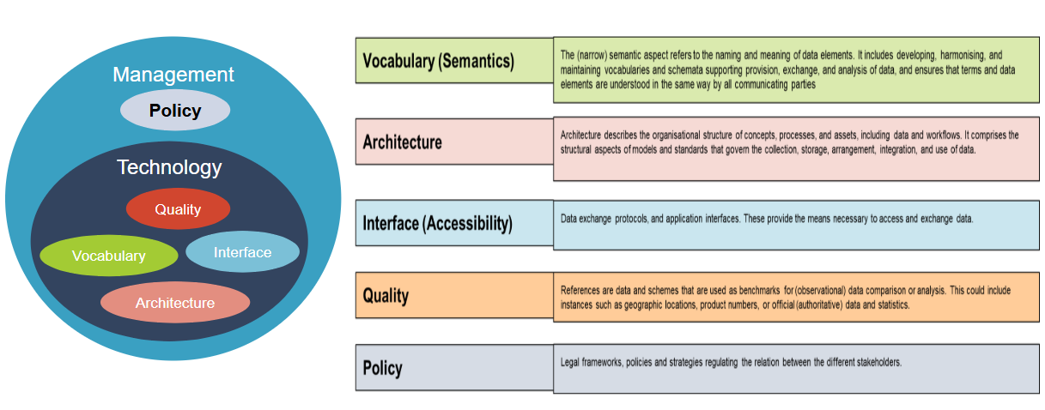

Slide 9
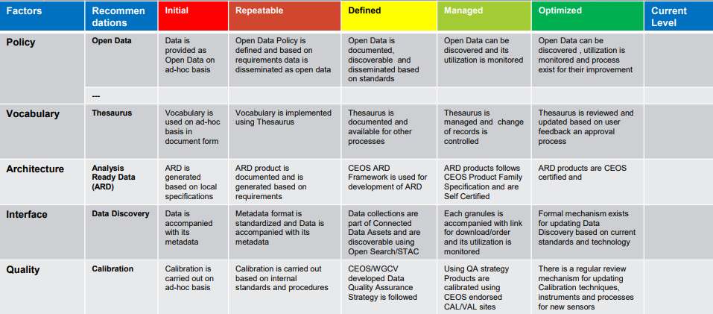
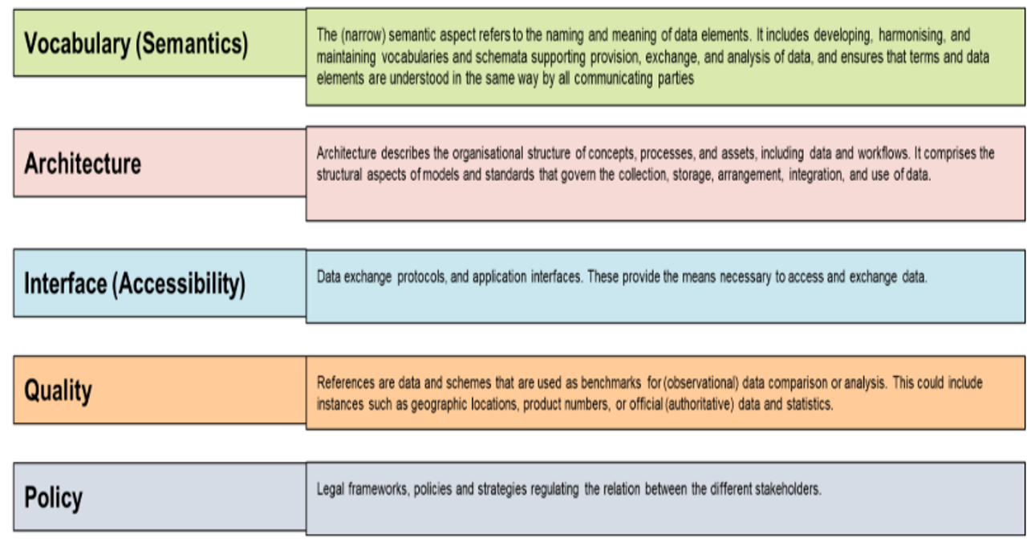
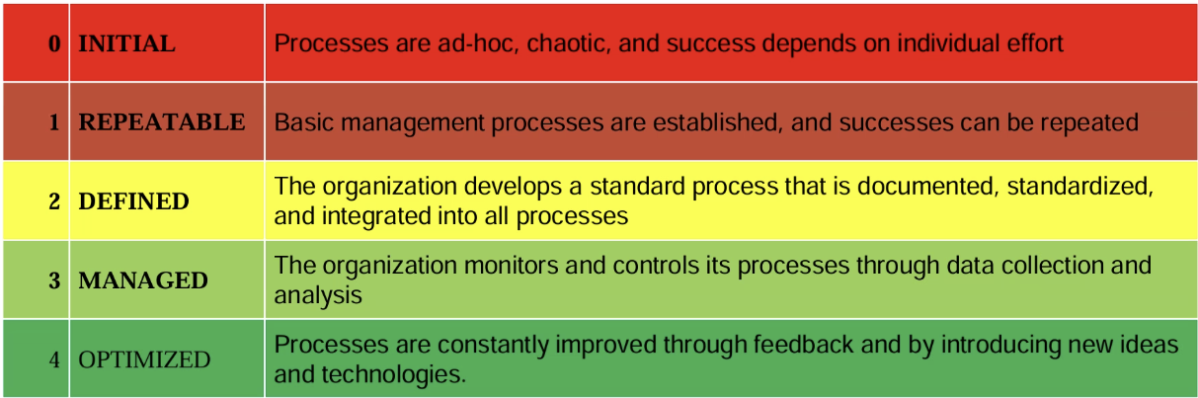

Slide 10
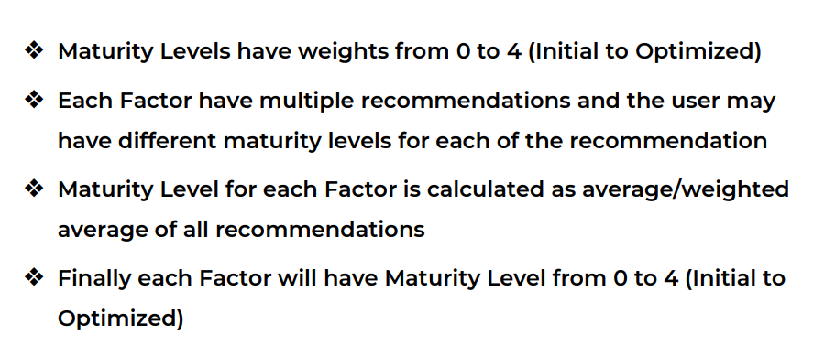
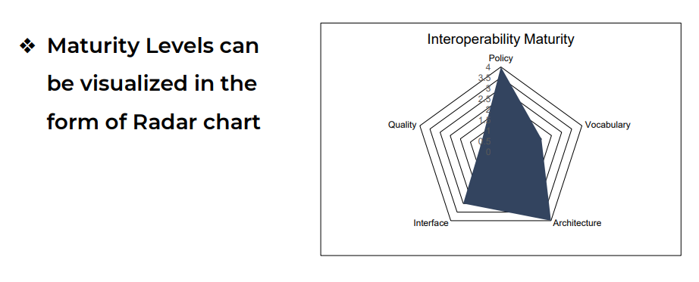

Slide 11
Maturity assessment approaches in scope of Interoperability

Slide 12

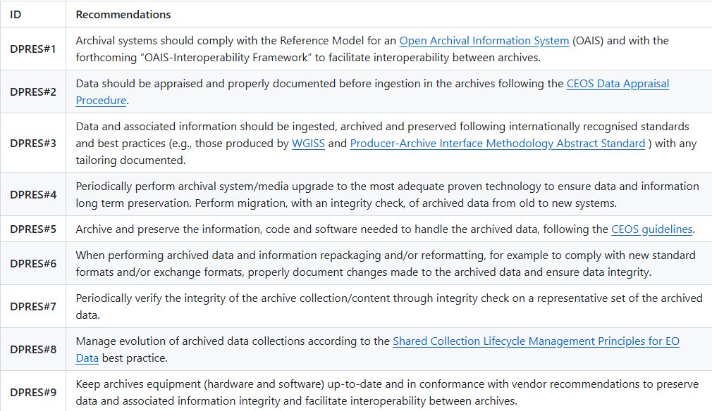
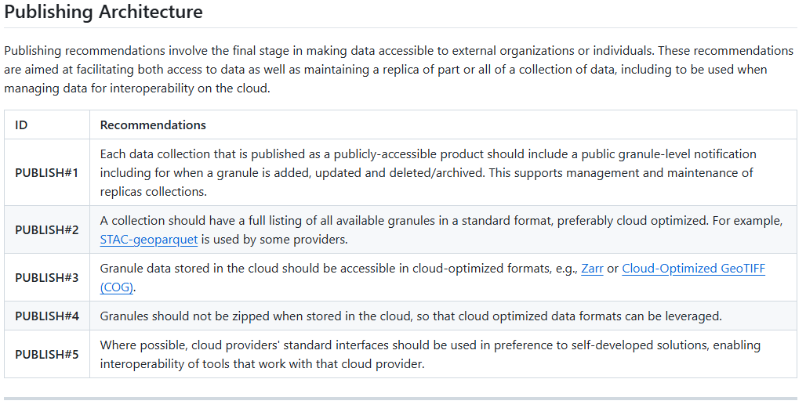
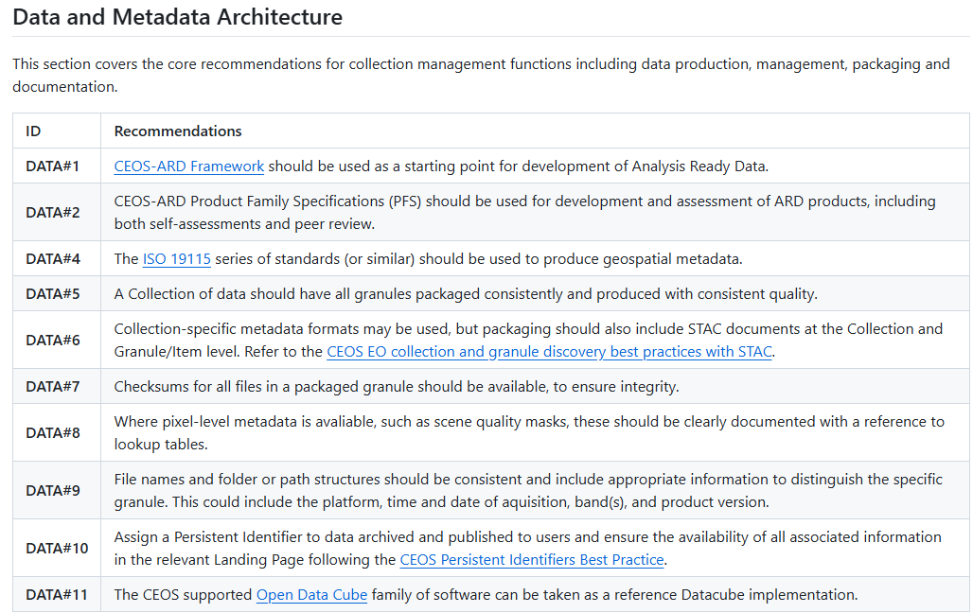

Slide 13
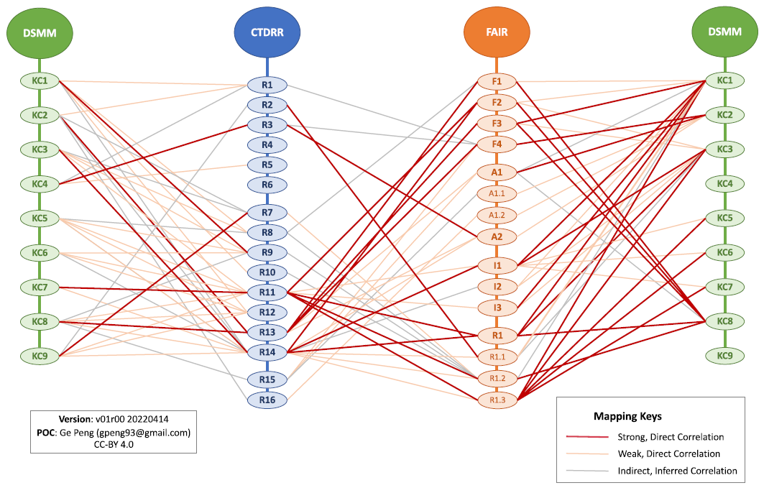
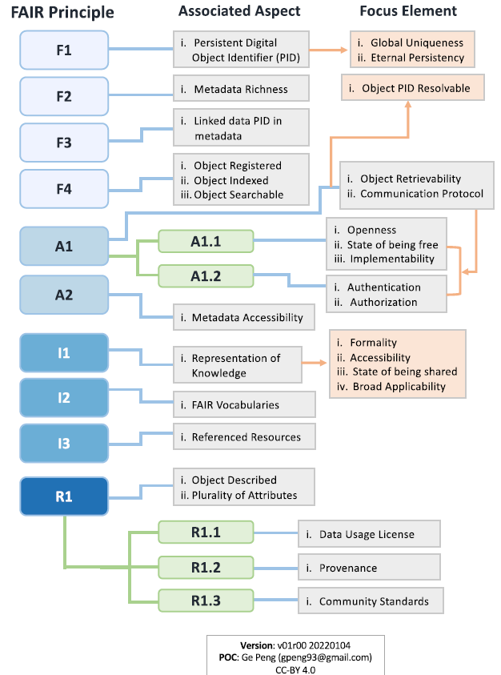
Focus elements associated with the FAIR principles and Mapping
The Research Data Alliance (RDA) FAIR Data Maturity Model Working Group has developed a set of core assessment criteria for FAIRness; Known as RDA FAIR Data Maturity Indicators (DMIs), they aim to enable direct comparison of assessment results.
DMSMM
CTDRR
DSMM
FAIR Principles

Slide 14
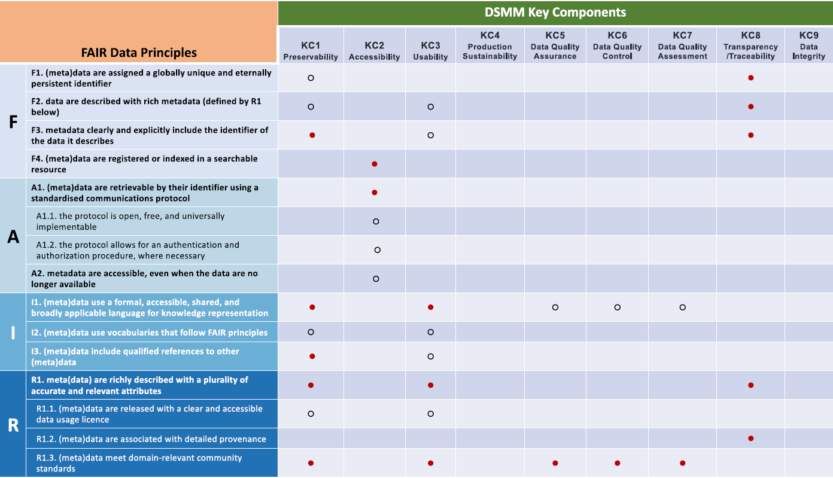

Crosswalk between FAIR Principles and DSMM
Strong synthesis was found between DSMM and the FAIR Principles, with stewardship practices captured in DSMM helping support the FAIRness of individual datasets

Slide 15
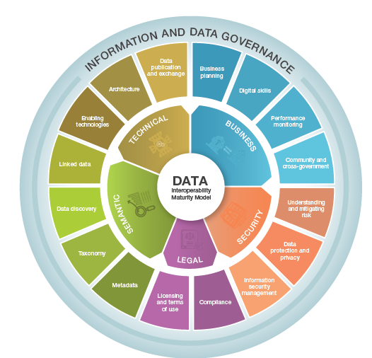
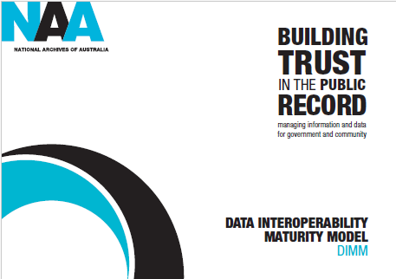
Data Interoperability Maturity Model at NAA

Slide 16
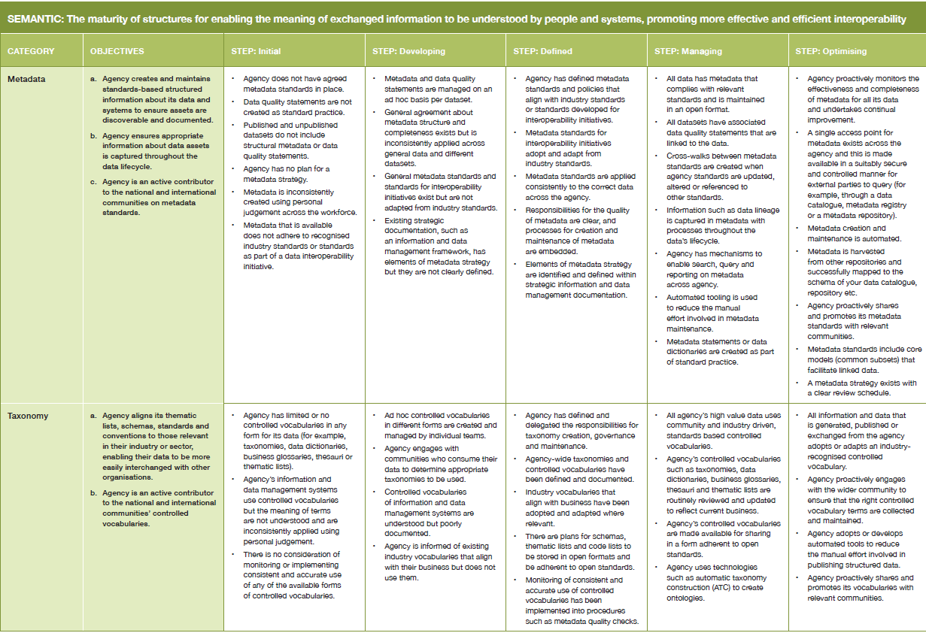
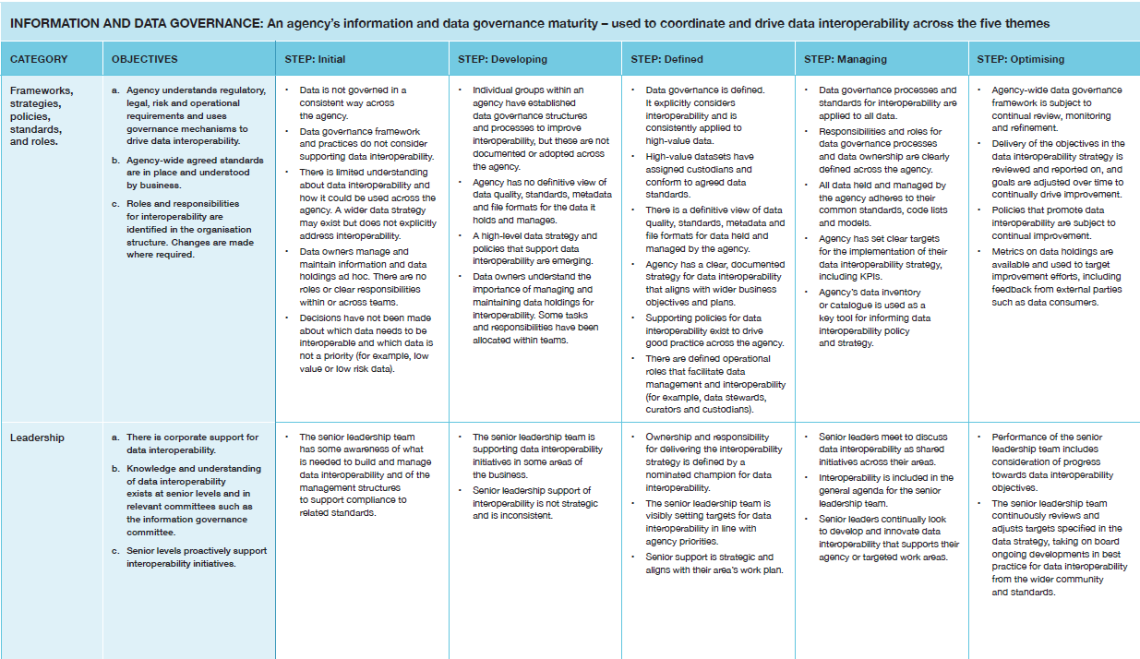
Data Interoperability Maturity Model at NAA

Slide 17
Maturity Matrices Relating Actions

Slide 18
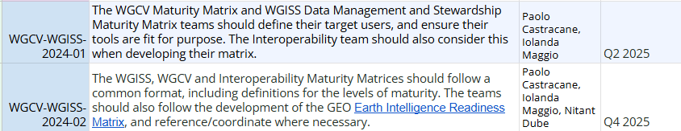
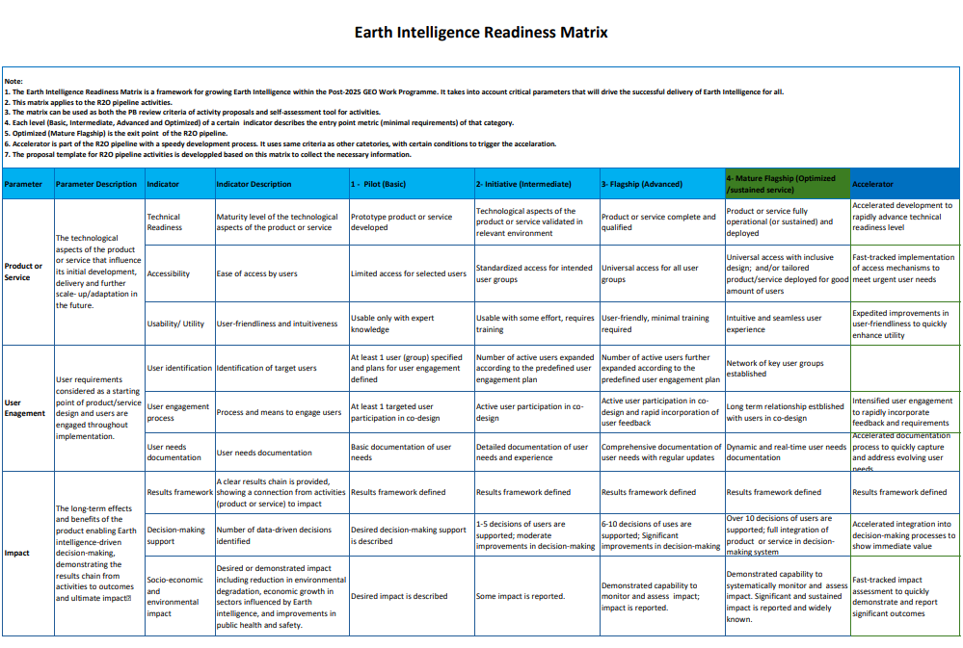
ACTIONS
The intended audience of DMSMM comprises:
Data providers
To evaluate and improve the quality and usability of their products
Modellers, decision-makers, and scientists
To improve their products
To make investments and take decisions
Data managers/stewards of data centres and repositories
To validate their compliance or lack of stewardship practice or standards
To assess the current state of their data holdings and repositories
To create a roadmap to improve or enhance the stewardship maturity of practices applied to all data holdings
The intended audience of WGCV Maturity Matrix (EDAP) comprises:
EO Mission Teams & Data Providers
Both Space Agency and commercial (“New Space”) operators.
Use the matrix to self-assess and communicate product’s quality and maturity of their Cal/Val processes.
Helps identify gaps, risks, and priorities in data quality processes.
Calibration/Validation Scientists & QA Managers
Responsible for implementing or documenting Cal/Val activities.
Use the matrix to standardize reporting and ensure consistency across missions and products.
Data Users & Application Developers
Obtain a transparent summary of a product’s quality and “fitness for purpose.”
Helps them decide which data products are reliable for their application or scientific use.
Decision-makers
Can use matrix outputs as evidence of product maturity and traceability, especially for commercial or public-private missions.
Under discussion during WGISS#60 meeting
GEO Earth Intelligence Readiness Matrix under evaluation

Slide 19


