Slide 1
WGCV Demonstrator:
Surface Reflectance Quality and Consistency
Medhavy Thankappan
Joshua Sixsmith

Slide 2
Background
The CEOS-Analysis Ready Data Product Family Specification (PFS) provides a strong basis for interoperability.
However, it tolerates different approaches for deriving the ARD, Surface Reflectance (SR) in particular. This affects the harmonisation of multi-sensor products, limiting their utility for applications requiring time-series data from several sources.
There is a need to continue building on the CEOS-ARD effort and developing approaches to achieve better harmonisation of multi-sensor data.
This proposal is about taking the next steps to support better harmonisation of CEOS-ARD Surface Reflectance products from multiple sources.
This is a status update on what is being done within CEOS – work in progress

Slide 3
Issue
Correction and Inputs | ESA S2 L2A Sen2Cor | USGS L2 LASRC | GA Lambertian | GA NBAR |  | GA NBART
BRDF Model | - | - | - | Ross Thick, Li Sparse
BRDF Parameters | - | - | - | MCD43A1 / VNP43
BRDF: solar angle | - | - | - | ✓ |  | ✓
BRDF: view angle | - | - | - | ✓ |  | ✓
Atmospheric: solar angle view angle | - | ✓ ✓ | ✓ ✓ | ✓ ✓ |  | ✓ ✓
Terrain illumination (slope/aspect/shadowing) | ✓ | - | - | - |  | ✓
Adjacency | ✓ | - | - | - |  | -
Pressure | default | Internal based on DEM | MODTRAN default atmospheric profile - DEM altitude adjusted
Air Temperature | default | MODIS/VIIRS CMG | MODTRAN default atmospheric profile - DEM altitude adjusted
Aerosol Optical Thickness | DDV / CAMS | Internal algorithm | AATSR Climatology
Water Vapor | Atmospheric Pre-corrected Differential Absorption | MODIS/VIIRS CMG | NOAA NCEP – DEM altitude adjusted
Ozone | ECMWF | MODIS/VIIRS CMG | OMI/TOMS
Atmospheric Correction | LibRadTran LUT | Internal algorithm/6S | MODTRAN 6
Sun and Sky glint correction | - | - | - |  | - | -
DEM | Planet DEM COP DEM since 3.01 | ETOPO5 (CMGDEM) | - |  | - | SRTM 1 sec (modified)
The CEOS-ARD Surface Reflectance PFS provides a good starting point for interoperability of multi-sensor SR products but there are some differences among CEOS-ARD SR products.
Notes:
This table represents just a few examples of the different approaches that are currently used in the production of surface reflectance products.

Slide 4
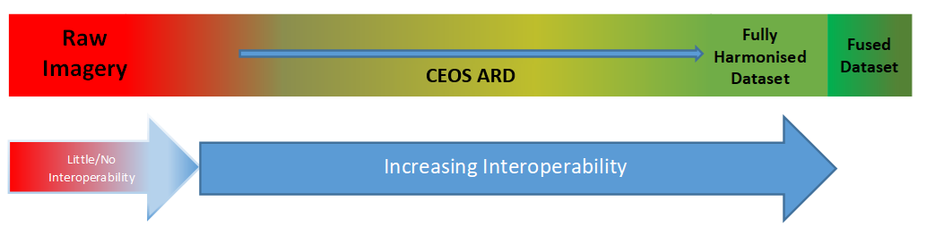
Why do we care?
Inconsistency in surface reflectance products from different providers limits combined use of multi-sensor data, performing impactful analyses and gaining deeper insights.
CEOS agencies' efforts in producing NASA HLS and ESA Sen2Like demonstrate the need to improve the compatibility of SR measurements across providers.
Planned major Collection upgrades (e.g. USGS – Landsat C3) provide an opportunity for input in support of better alignment and harmonisation of SR products.
CEOS-ARD is only the first step in the ‘interoperability continuum’, we need to plan the next steps to advance CEOS interoperability objectives.

Slide 5
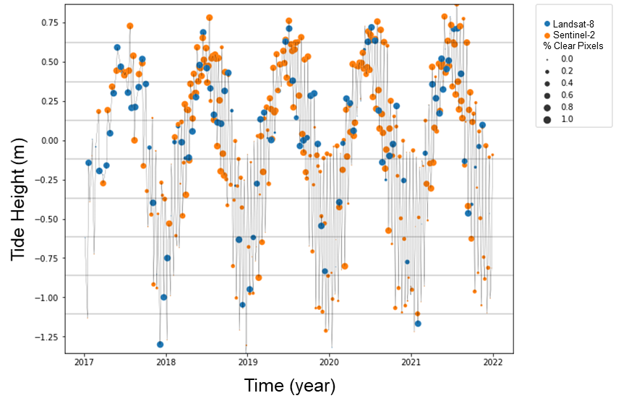
Harmonisation: synergies
By combining Landsat (blue) and Sentinel-2 (orange) data processed through the same workflow, a set of observations that best represent the tidal range in coastal northern Australia was achieved.
Credit: Robbi-Bishop Taylor, Geoscience Australia
Notes:
Larger dots represent clear observations smaller ones are affected by cloud glint etc. There are good Sentinel-2 observations for the higher tidal range, but fewer Sentinel-2 observations at the lower tidal range, but the shortfall is made up by the Landsat observations. this kind of synergy comes from using data from multiple sources that have undergone the same processing steps, enabling insights to be achieved much quicker – in this case a fuller picture of the tidal dynamics.

Slide 6
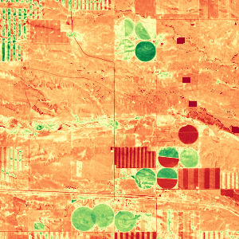
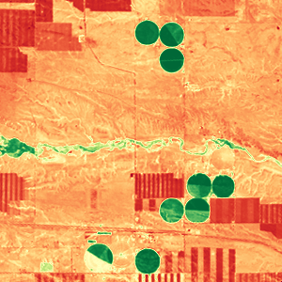
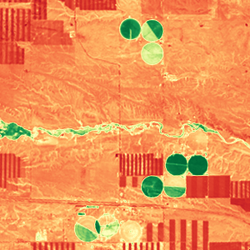
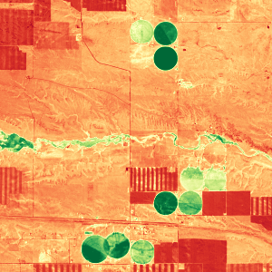
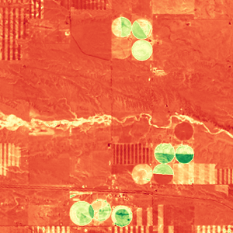

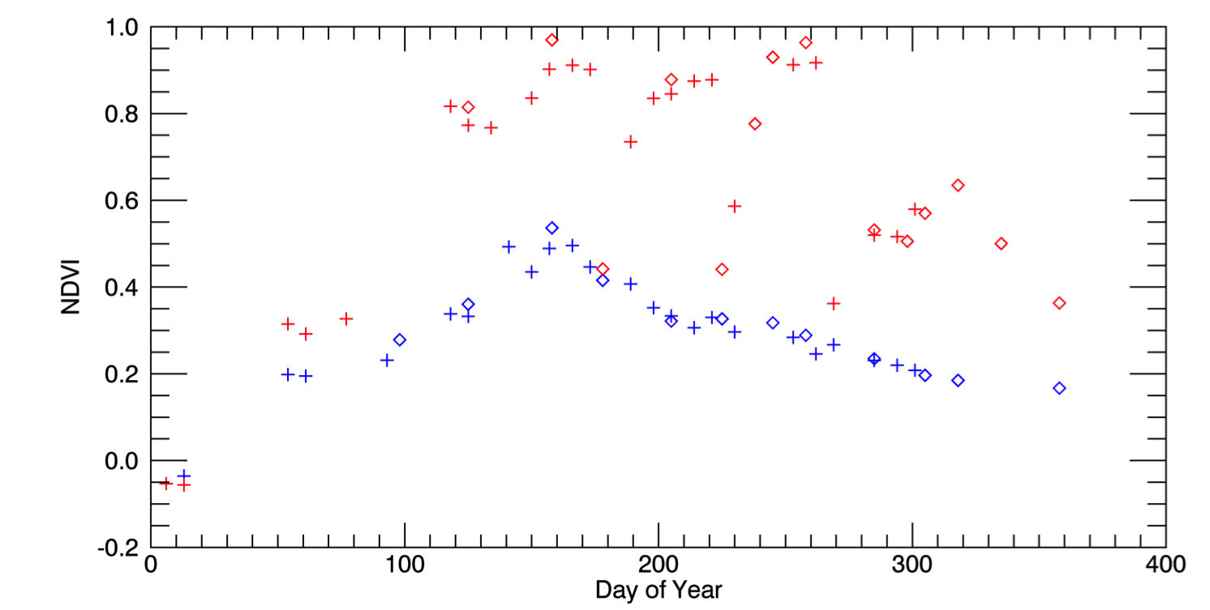
Harmonisation: better insights
Better insights into seasonal phenology could be achieved from Harmonised Landsat / Sentinel-2 data with high temporal density of observations
May 4, 2016 (S2)
Aug 8 (L8)
Aug 17 (L8)
Sep 1 (S2)
Oct 20 (L8)
3km
0.1 NDVI 0.9
Example from the US: Seasonal phenology (greening) for natural grassland (blue line) and irrigated alfalfa fields (red line) near Cheyenne Wyoming observed from Harmonized Landsat/Sentinel-2 data products. The high temporal density of observations allows individual mowing events to be detected within alfalfa fields. HLS Products available from https://hls.gsfc.nasa.gov
Credit: Jeff Masek, NASA
Sentinel-2
Landsat-8
+
Alfalfa
NDVI
mowing
Grassland
Notes:
Better insights into seasonal phenology could be achieved from Harmonised Landsat / Sentinel-2 data with high temporal density of observations. The high temporal density of observations allows individual mowing events to be detected within alfalfa fields, illustrated by the red dotted lines.

Slide 7
Proposal
Build on CEOS-ARD achievements so far, take next steps to achieve multi-sensor interoperability.
Unambiguous characterisation of the SR measurand in the context of CEOS-ARD products.
Identify a set of corrections for achieving better SR consistency in support of harmonised CEOS-ARD SR products.

Slide 8
Benefits
Consistent time-series across sensors, steps towards enhanced harmonisation amongst CEOS-ARD SR products.
Focused effort on value-adding with a common foundational measurand, improved results from multi-sensor analyses, and better insights.
Reduced duplication of effort, cost savings, increased global applicability of algorithms, higher return on investment.

Slide 9
Key objective
Describe a surface reflectance measurand (in the CEOS-ARD context), for achieving consistent quality, for generating harmonised surface reflectance products from different sensors with like bands.

Slide 10



Conceptual model (current)
Illumination conditions
A
B
A
Datasets A and B
Reflectance
B
A B
Atmospheric correction
BRDF correction
Terrain Illumination correction
Adjacency correction
Solar angle normalization
Target characteristics
Time
Surface Reflectance Profiles
Notes:
This slide is an attempt to represent the concept using illustrations – typical scenario where there is data flow from two sensors A and B with somewhat similar bands and a range of illumination conditions at the time of imaging, different sets of corrections applied to get surface reflectance profiles that are also slightly different.

Slide 11
Conceptual model (desired)
Reflectance
A+B
Harmonised datasets
A B
Atmospheric correction
BRDF correction
Terrain Illumination correction
Adjacency correction
Solar angle normalization
Time
Surface Reflectance Profile
Notes:
To a scenario where the set of corrections applied to the two datasets are the same, achieving surface reflectance profiles that are matching.

Slide 12
Review of activities
Original concept first presented at ARD23 Workshop, exposure document of the concept presented at WGCV-52 in June 2023, then at LSI-VC 14 in October 2023, revised concept paper presented at WGCV-53 in March 2024.
Following feedback, engaged the expert community after a call for ‘Expressions of Interest’ to participate in the Surface Reflectance Quality, and Consistency initiative.
Fortnightly meetings of the expert group continue, initial discussions focussed on terminology to enable shared understanding of objectives for the work.
Subsequent effort to document the discussions that could support interoperability initiatives within CEOS (Interoperability Framework, Handbook 2.0, led by WGISS).
Presentation at VH-RODA 2024 followed by workshop in January 2025, adoption of the initiative as a part of the CEOS Work Plan
A guidance document on the SR quality and consistency initiative is in development with contributions from the expert group.

Slide 13



Plan of action
Engage experts
Review literature
Identify / address gaps & sensitivities
Develop guidance
Publish
Document / Publish
Develop guidance for achieving consistency in SR quality
Identify issues and address them
Consolidate scientific literature that provides evidence
Seek expression of interest and engage with community of experts for discussion
Notes:
This graphic shows the original plan for getting to the guidance publication, but in recent discussion in the expert group, there have been suggestions to review the steps and modify the plan accordingly.

Slide 14
Expert community
Contributor | Organisation
Eric Vermote | NASA
Martin Bachmann | DLR
Peter Strobl | EC
Robert (Bob) Ryan | I2R
Mary Pagnutti | I2R
Raquel de Los Reyes | DLR
Simon Oliver | GA
Medhavy Thankappan | GA
Dani Schläpfer | ReSe
Rudolf Richter | DLR
Fuqin Li | GA
David Jupp | CSIRO
Cody Anderson | USGS
Sebastien Saunier | Telespazio
Steve Covington | USGS
Fabrizio Niro | ESA
Danika Wellington | USGS
Contributor | Organisation
Nimrod Carmon | NASA-JPL
Crystal Schaaf | U Mass Boston
Grit Kirches | Brockmann
Angela Erb | U Mass Boston
Nigel Fox | NPL
Josh Sixsmith | GA
Notes:
Here is a list of people who have contributed through participation in regular meetings on the topic and who also serve as the brains trust for this work

Slide 15














Contributor affiliations

Slide 16
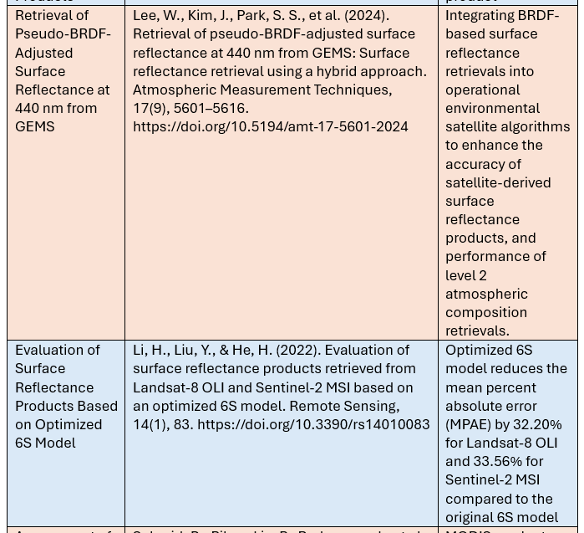
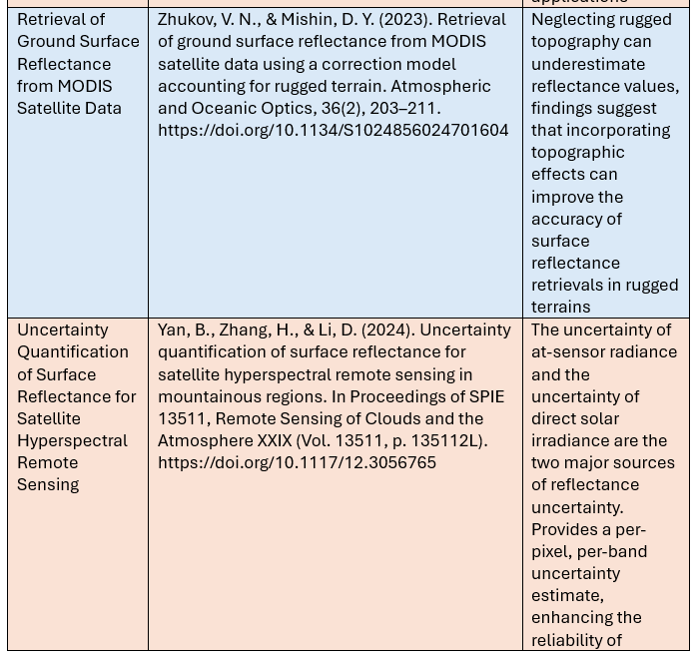
SR literature review

Slide 17
SR literature themes
Theme | Description
Introduction and Definitions | Overview of surface reflectance, its significance for remote sensing applications, and key foundational terms.
Atmospheric Correction Algorithms and Inter-Comparisons | Studies on atmospheric correction methods, comparative evaluations of algorithms, and assessments of correction accuracy.
BRDF Normalisation and Topographic Correction | Research on bidirectional reflectance distribution function (BRDF) normalisation and terrain/topographic correction to mitigate angular and elevation-related effects.
Traditional Inter-Sensor Harmonisation (Landsat–Sentinel-2) | Literature on physics-based methods for harmonising surface reflectance between different satellite platforms, particularly Landsat and Sentinel-2.
Surface Reflectance Product Evaluations and Datasets | Analyses of global and regional SR products, including validation studies and assessments of consistency, reliability, and temporal coverage.
Validation and Uncertainty Quantification | Research focused on validating SR data using ground-truth (in situ) measurements and approaches for quantifying uncertainty in reflectance estimates.
Machine Learning and AI-Based Harmonisation | Studies leveraging machine learning and artificial intelligence to harmonise reflectance across satellite sensors, with a focus on non-physics-based techniques.
Other Topics (not covered above) | Additional or emerging topics in surface reflectance not covered in the above categories.

Slide 18
Literature grouping

Slide 19
Thank you

