Slide 1
CEOS Common Dictionary An EO community glossary
Dominik Weckmüller Engineering Ingegneria Informatica S.p.A. for the Knowledge Centre on Earth Observation (JRC-EC)
Agenda Item 13.1
WGISS-60
13-17 October 2025
Oberpfaffenhofen, Germany

Slide 2
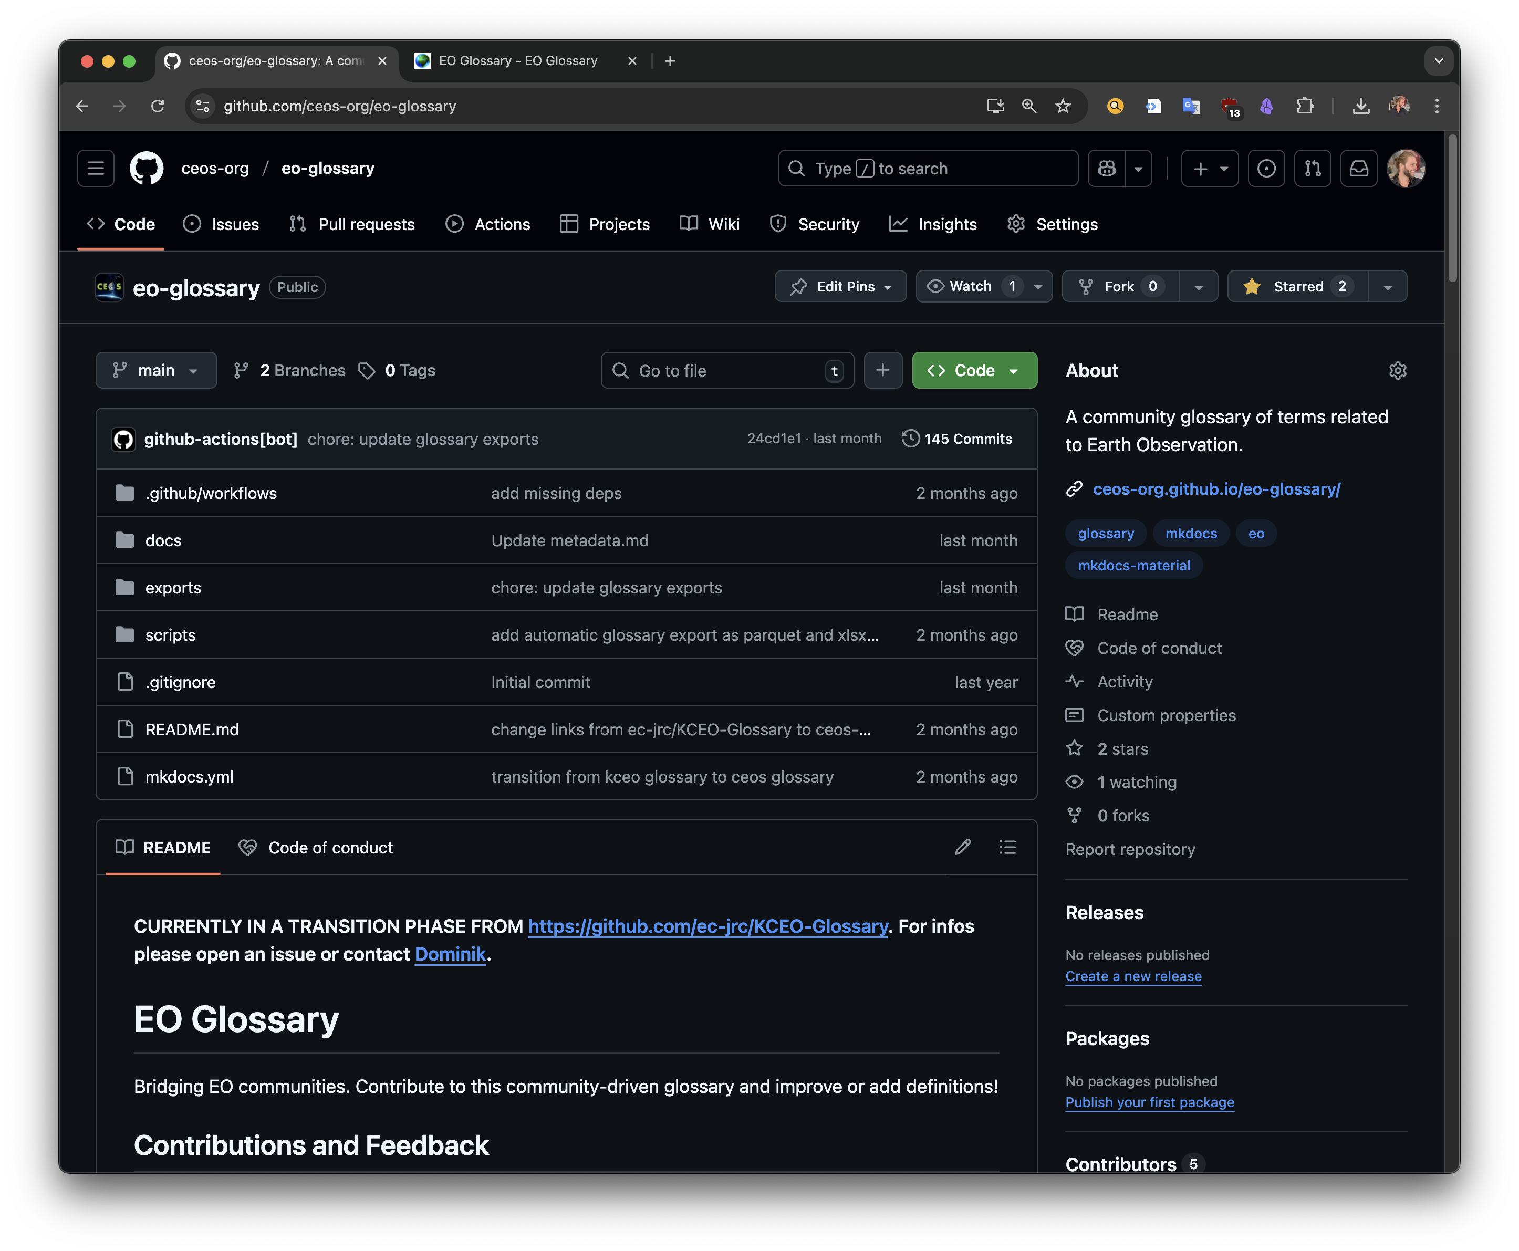
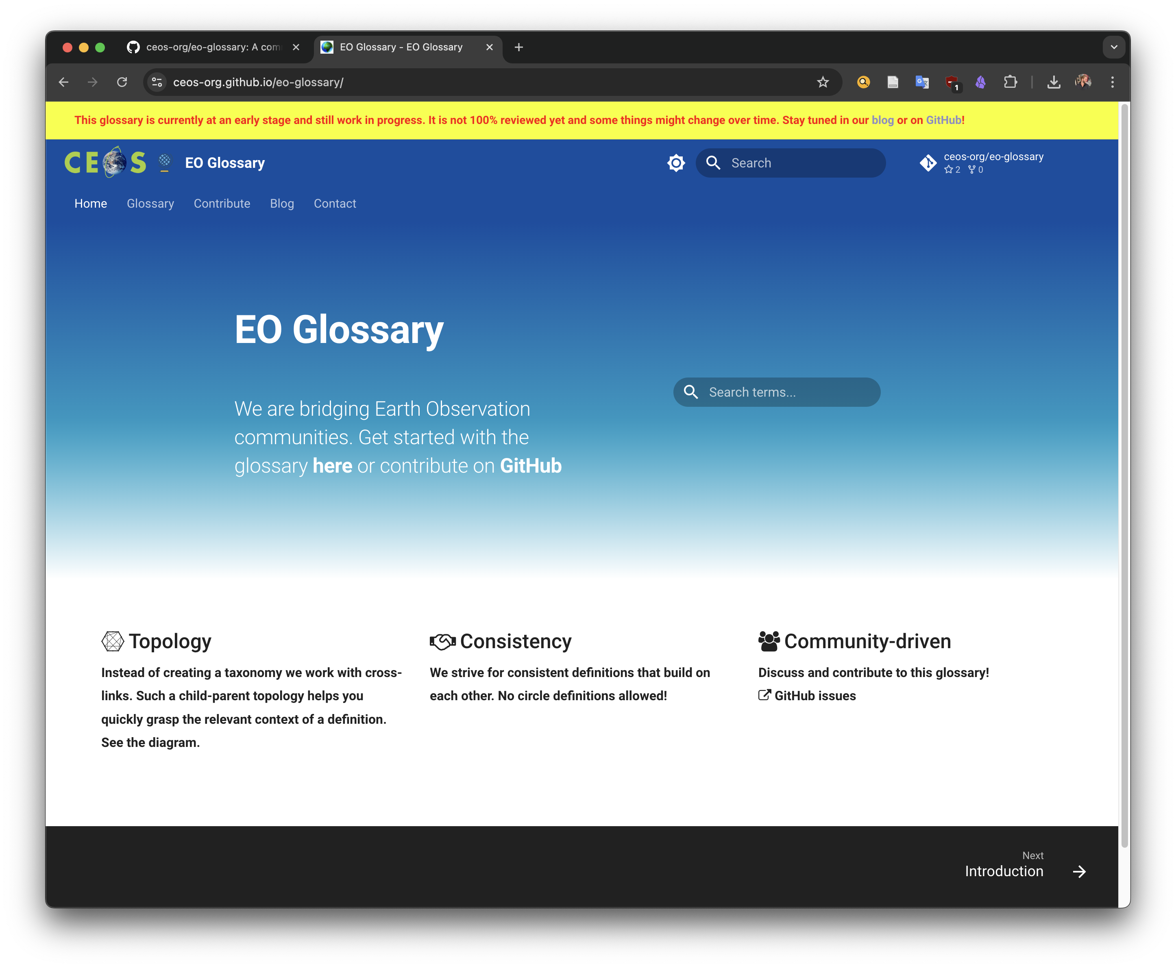
It’s live!
https://ceos-org.github.io/eo-glossary/

Slide 3
Agenda
Principles
Technicalities
Connection to the Interoperability Handbook
Workflow & Governance
Action Points / Discussion

Slide 4
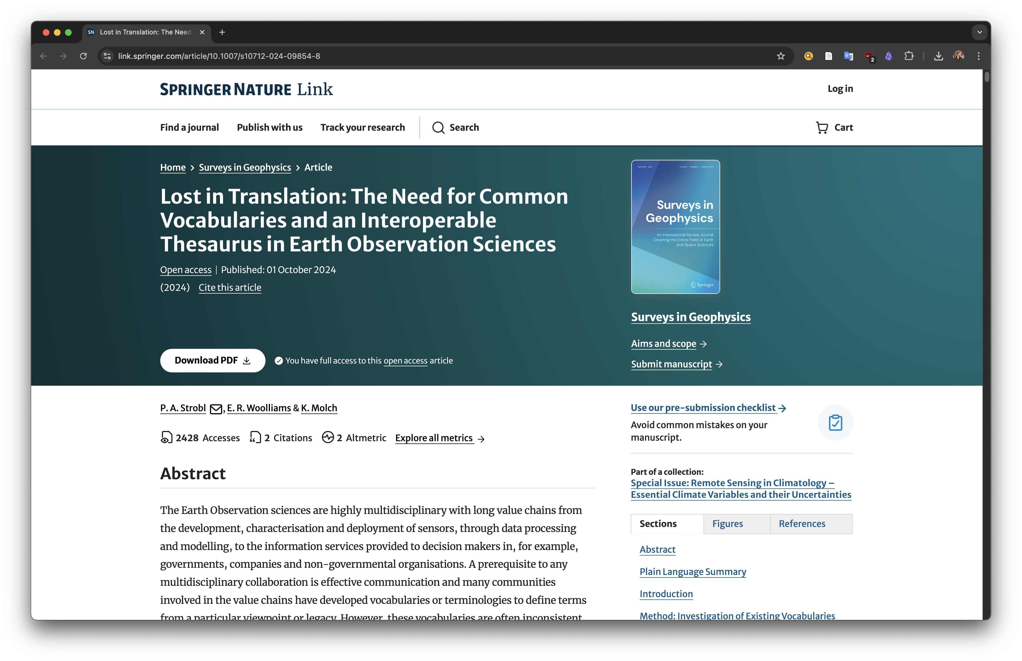
1.1) Principles: Origin
Strobl, P. A., Woolliams, E. R., & Molch, K. (2024). Lost in Translation: The Need for Common Vocabularies and an Interoperable Thesaurus in Earth Observation Sciences. Surveys in Geophysics, 1-29. https://link.springer.com/article/10.1007/s10712-024-09854-8

Slide 5
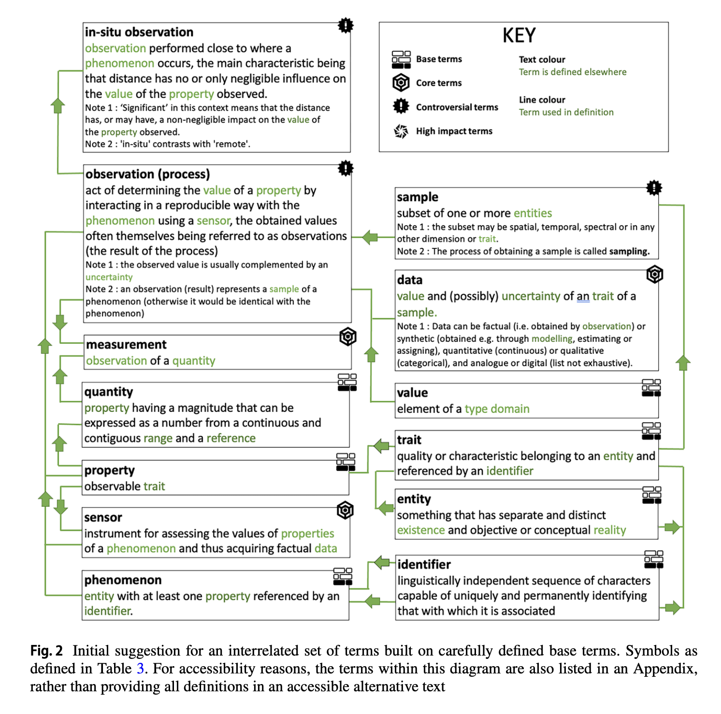
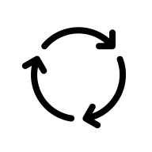
1.2) Principles: No circle definitions
1. Avoid circular definitions at all cost.
Instead, build on well-defined base terms.
Strobl, P. A., Woolliams, E. R., & Molch, K. (2024). Lost in Translation: The Need for Common Vocabularies and an Interoperable Thesaurus in Earth Observation Sciences. Surveys in Geophysics, 1-29. https://link.springer.com/article/10.1007/s10712-024-09854-8

Slide 6
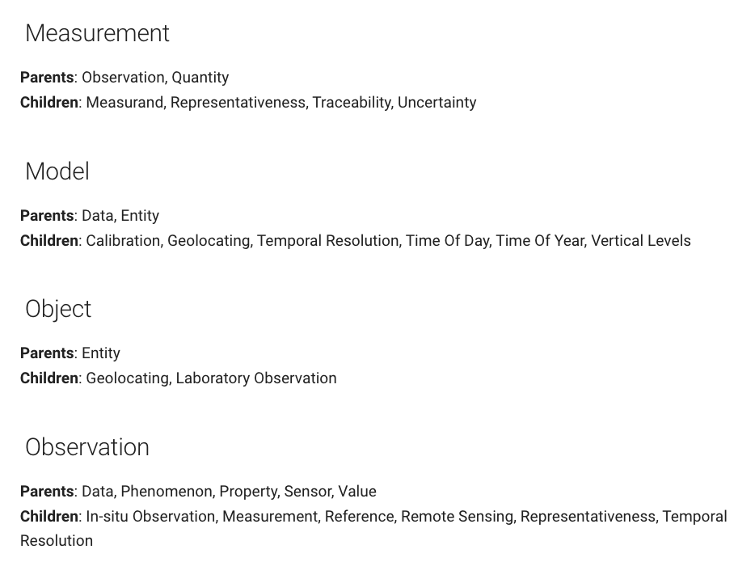
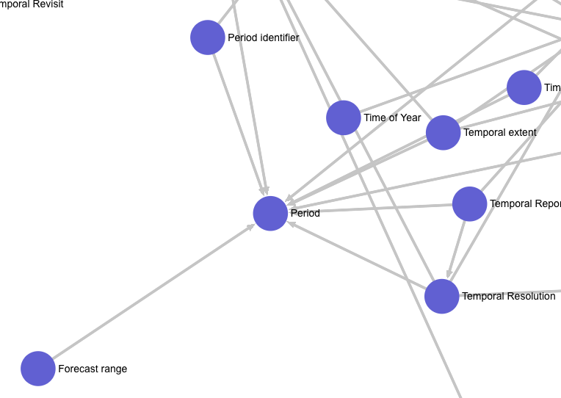
1.2) Principles: No circle definitions
Instead: Parent-Child relations
https://ceos-org.github.io/eo-glossary/glossary_topology/#measurand

Slide 7
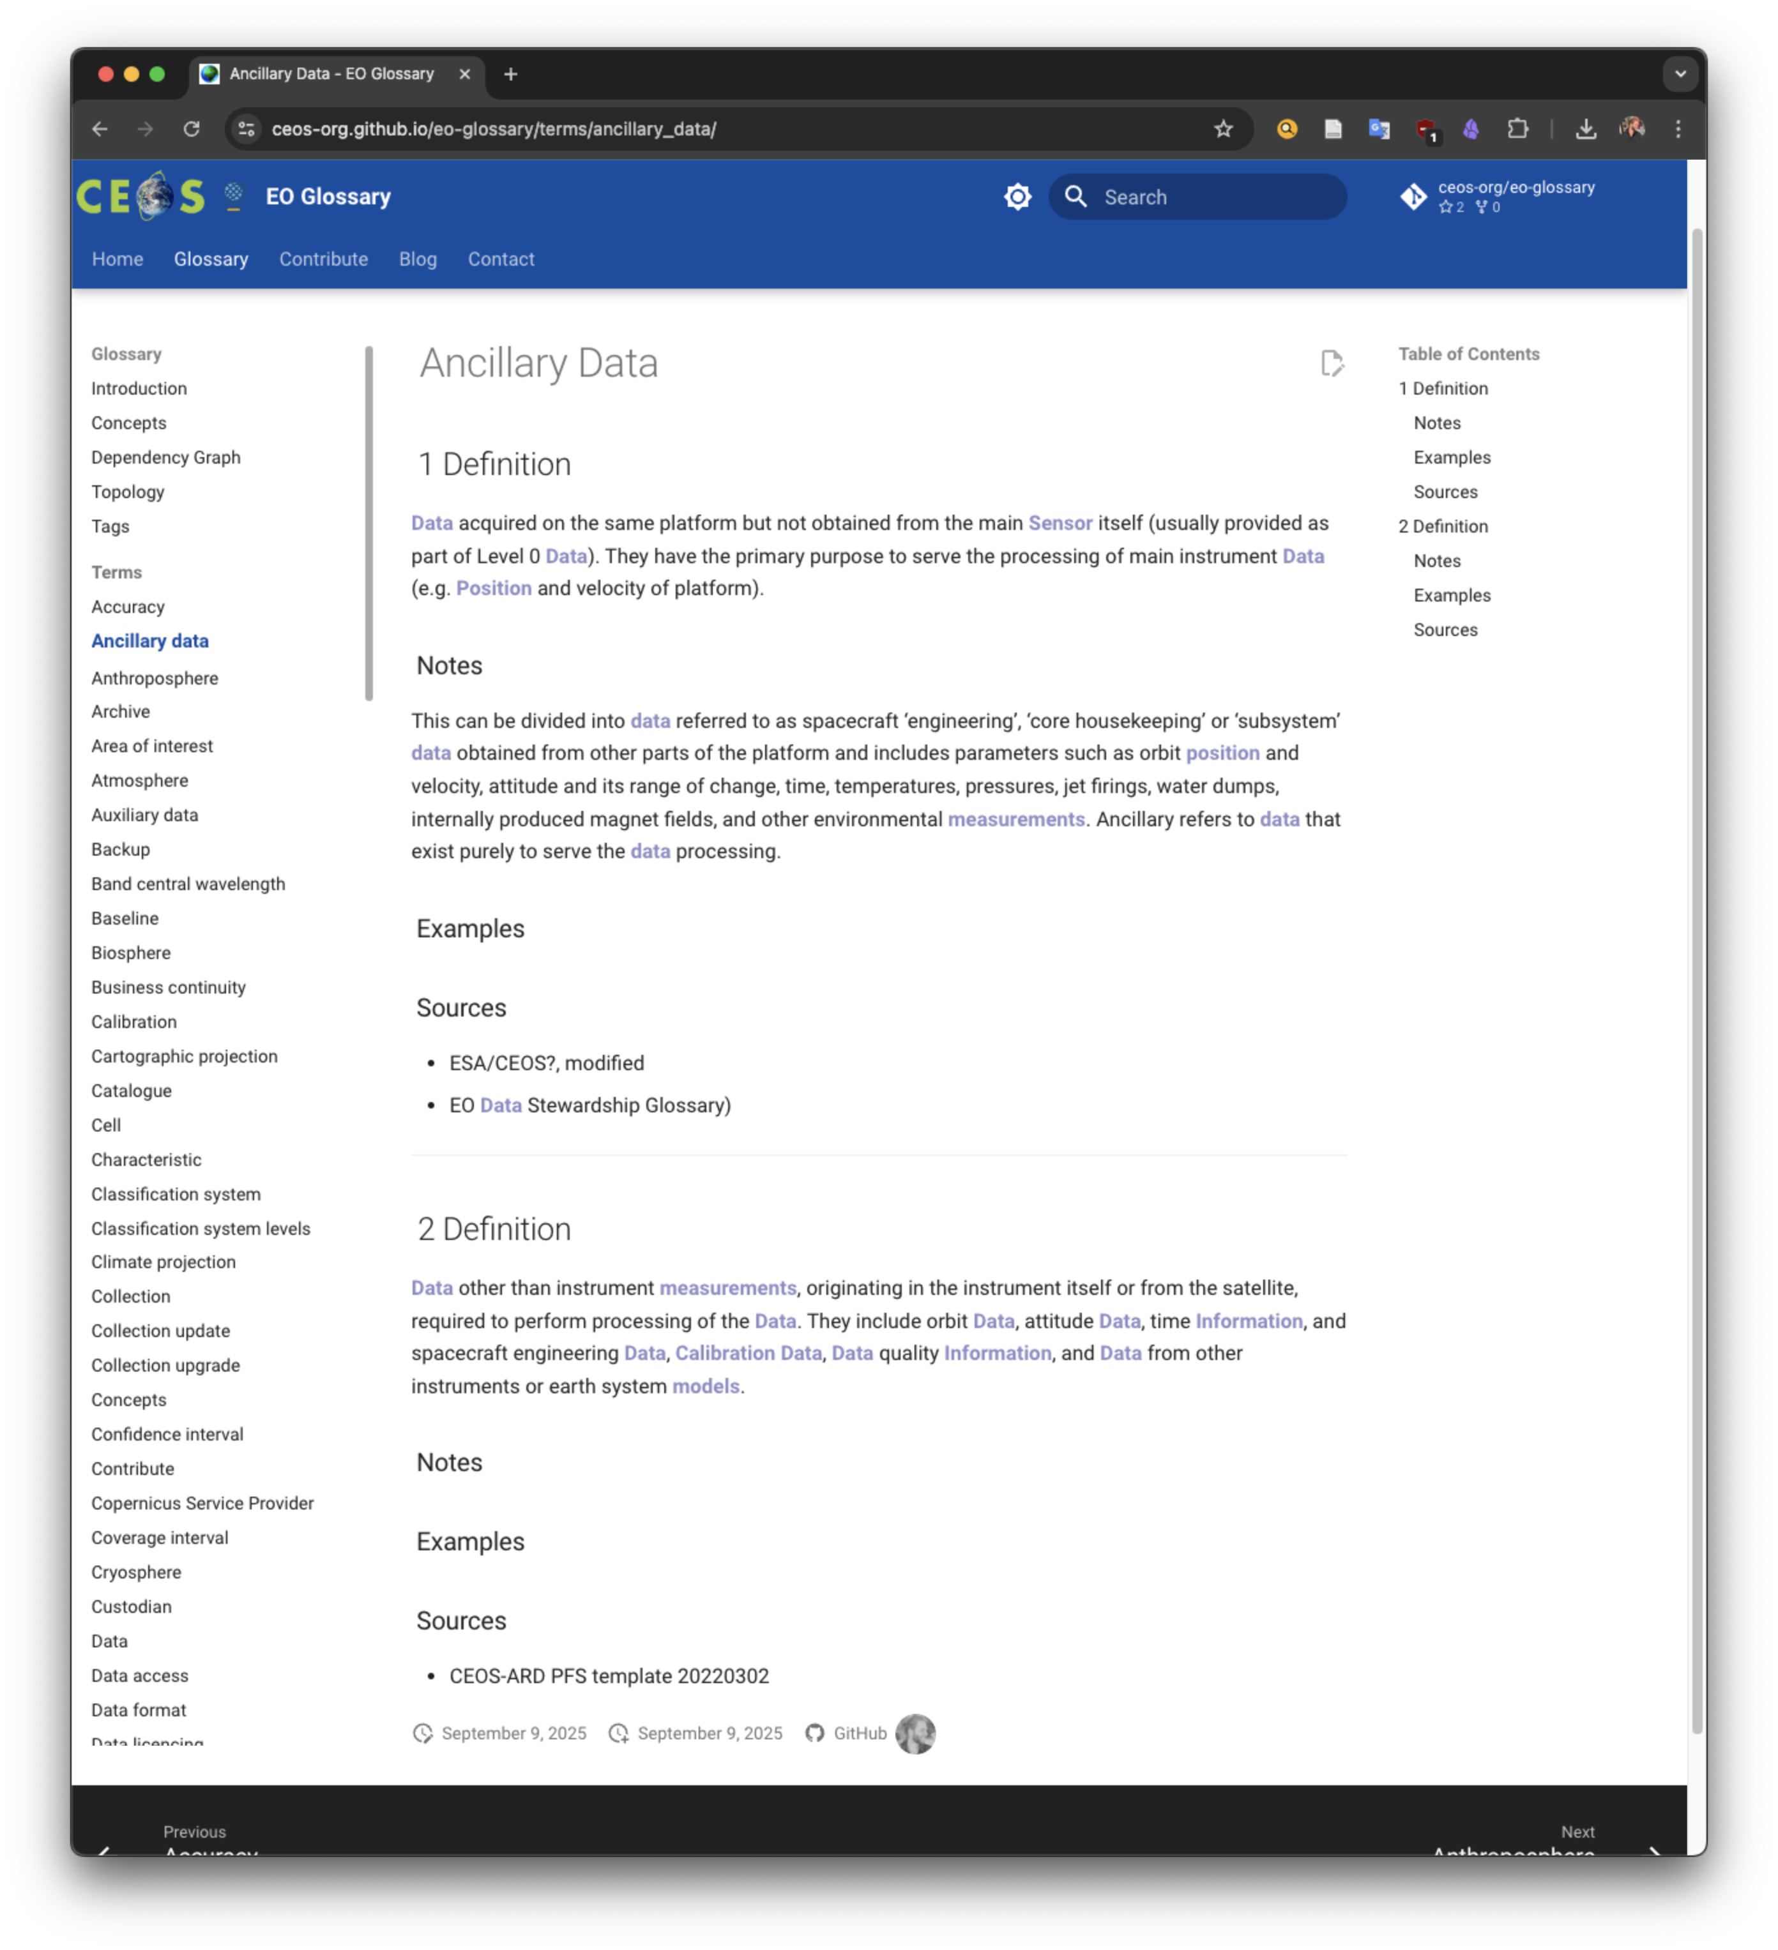
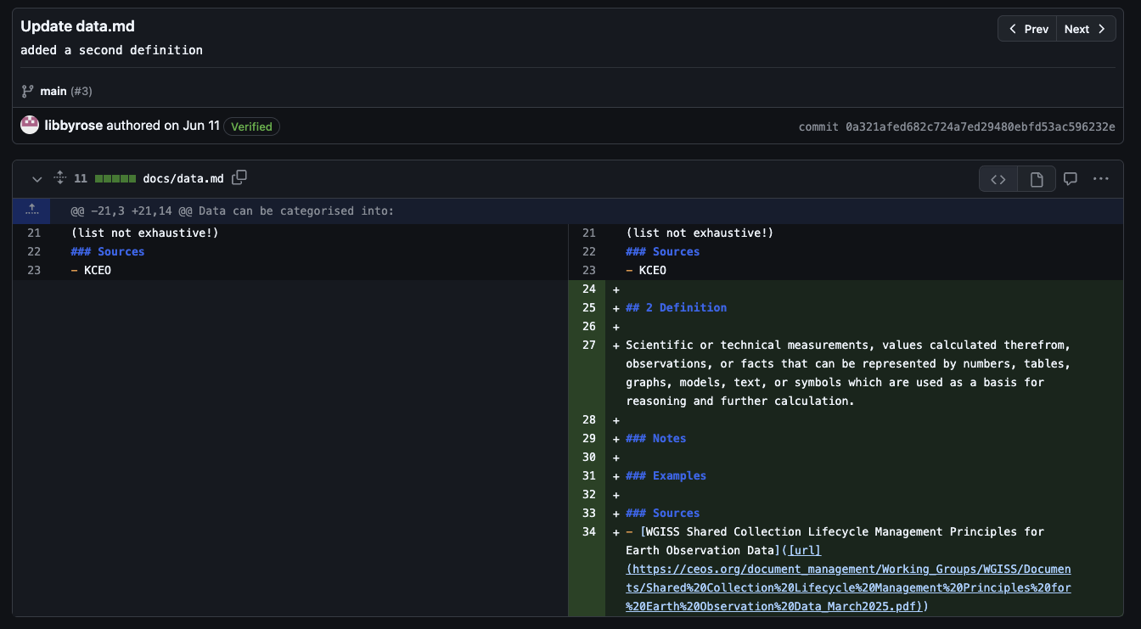
1.3) Principles: Diff. Definitions
Multiple different definitions are allowed if needed. The first definition is the most important one.
https://github.com/ec-jrc/KCEO-Glossary/pull/3/commits/0a321afed682c724a7ed29480ebfd53ac596232e https://ceos-org.github.io/eo-glossary/terms/ancillary_data/

Slide 8
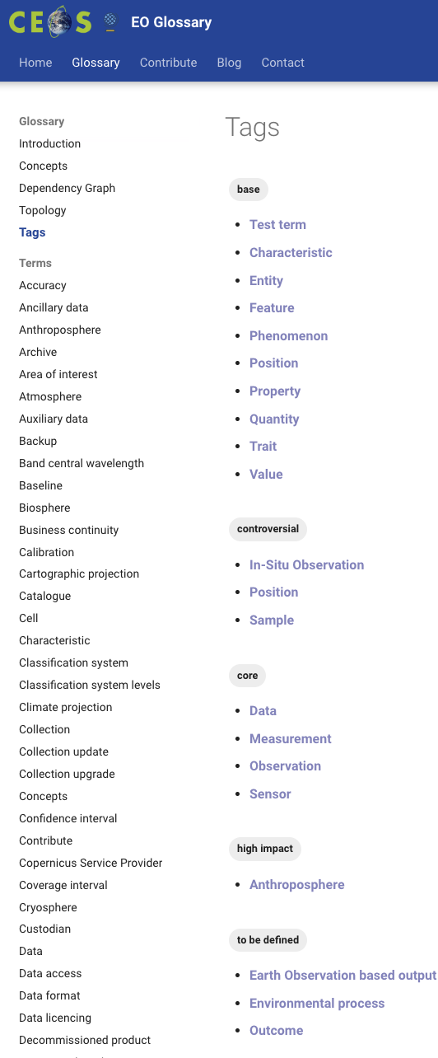
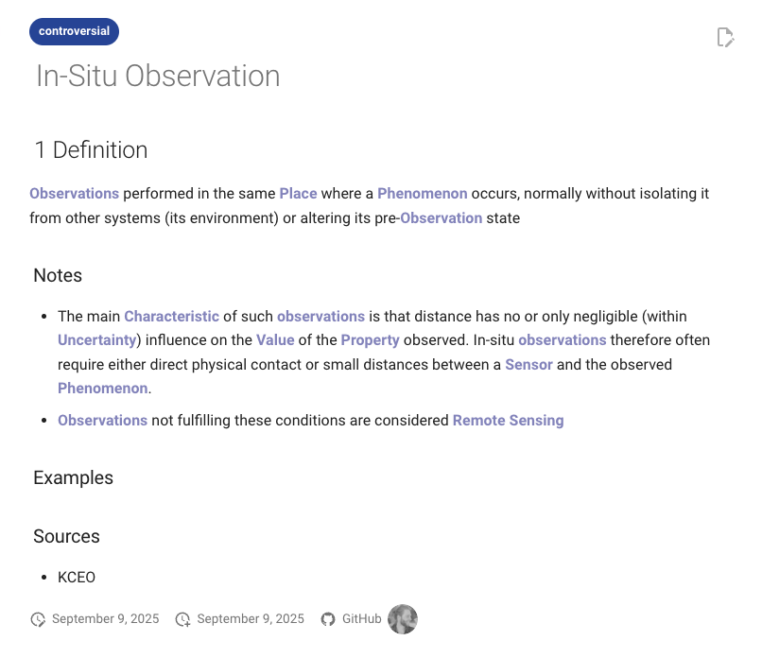


1.3) Principles: Tagging System
3. Tagging System
base term
core term
controversial term
high impact term
https://ceos-org.github.io/eo-glossary/tags/ https://ceos-org.github.io/eo-glossary/terms/in-situ_observation/

Slide 9
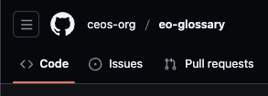

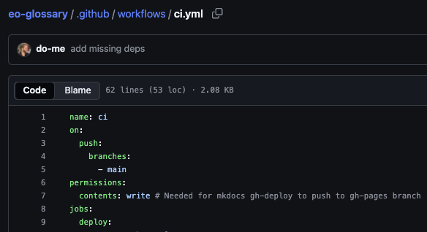
2) Technicalities
Hosted on GitHub & GitHub Pages for free
Mkdocs-Material (Python): markdown → html
CI workflows with custom scripts for extracting parent-child relations

Slide 10
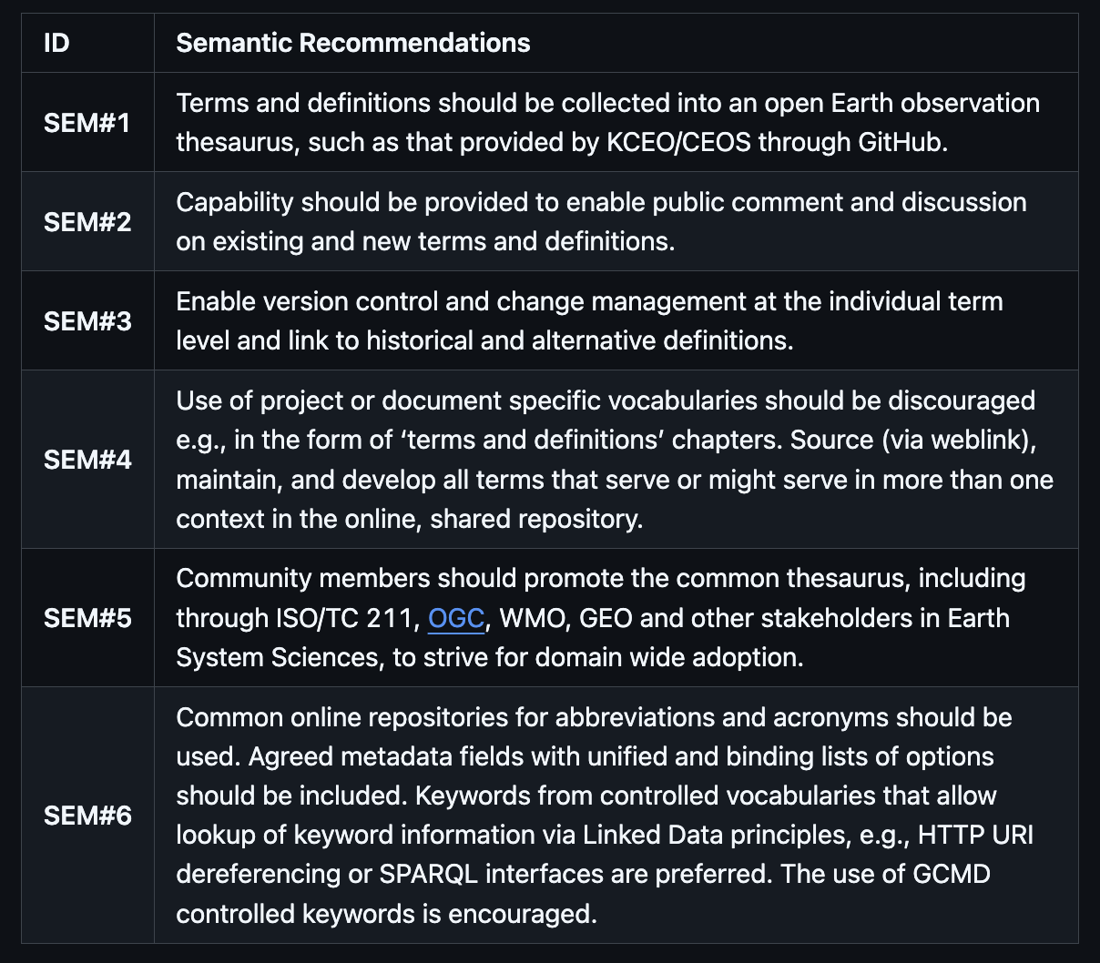
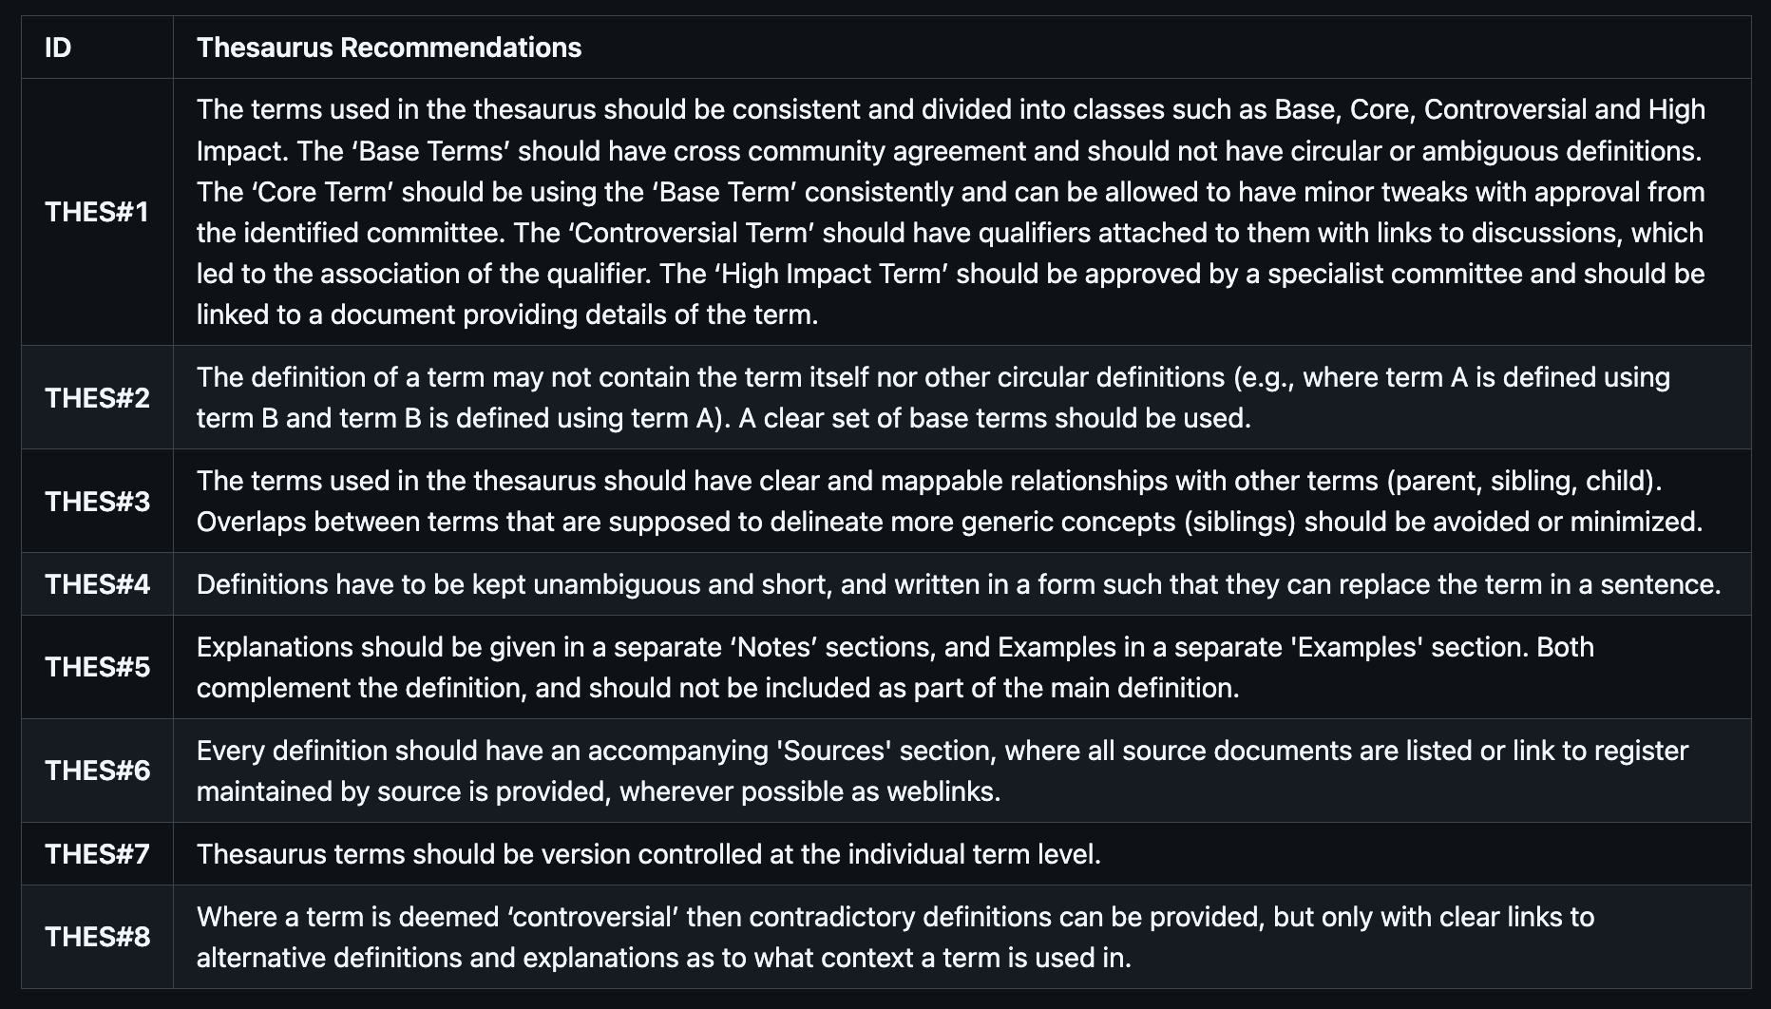
3) CEOS Interoperability Handbook 2.0 Vocabulary (Semantics)
https://github.com/ceos-org/interoperability-handbook/blob/main/Vocabulary.md

Slide 11
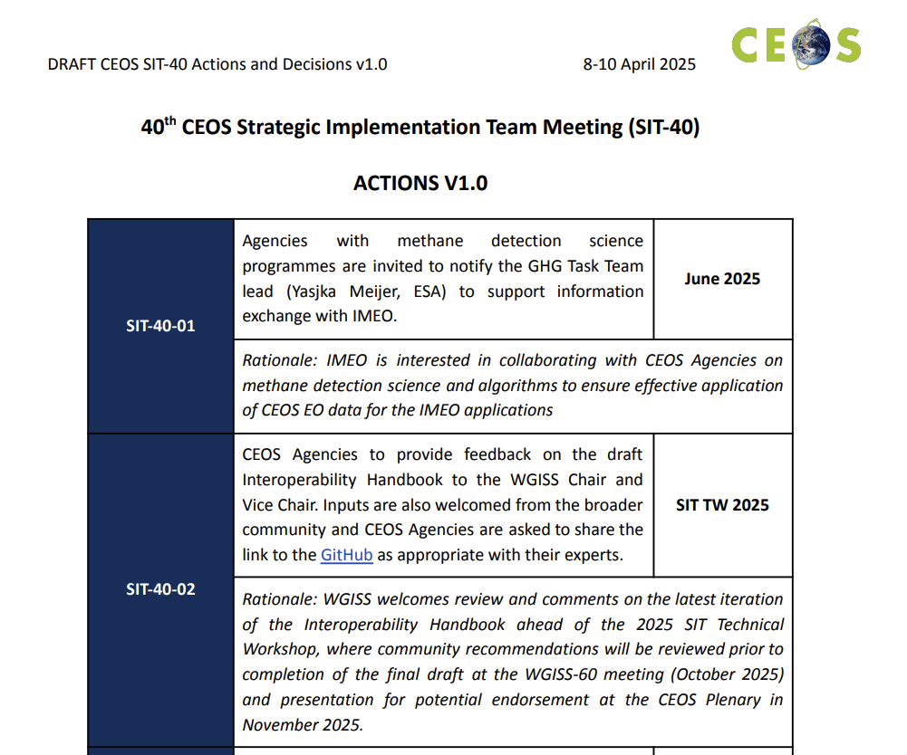

3) CEOS Interoperability Handbook 2.0 Vocabulary (Semantics)
40th CEOS Strategic Implementation Team Meeting (SIT-40)
“7. Review the update of the CEOS Interoperability Handbook (v2.0) before its presentation for potential endorsement at the 2025 CEOS Plenary. Discuss the long-term vision for implementation and actions for community uptake.“
Action Point: Endorsement!
https://ceos.org/document_management/Meetings/SIT/SIT-40/Minutes/CEOS%20SIT-40%20Actions%20and%20Decisions%20V1.0.pdf

Slide 12
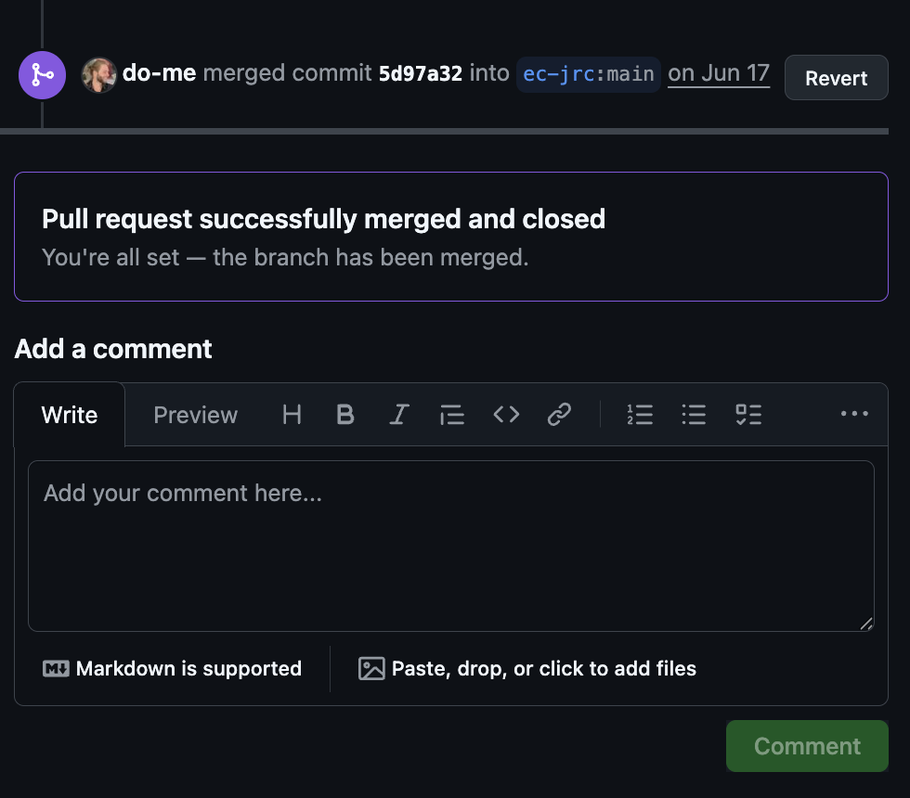
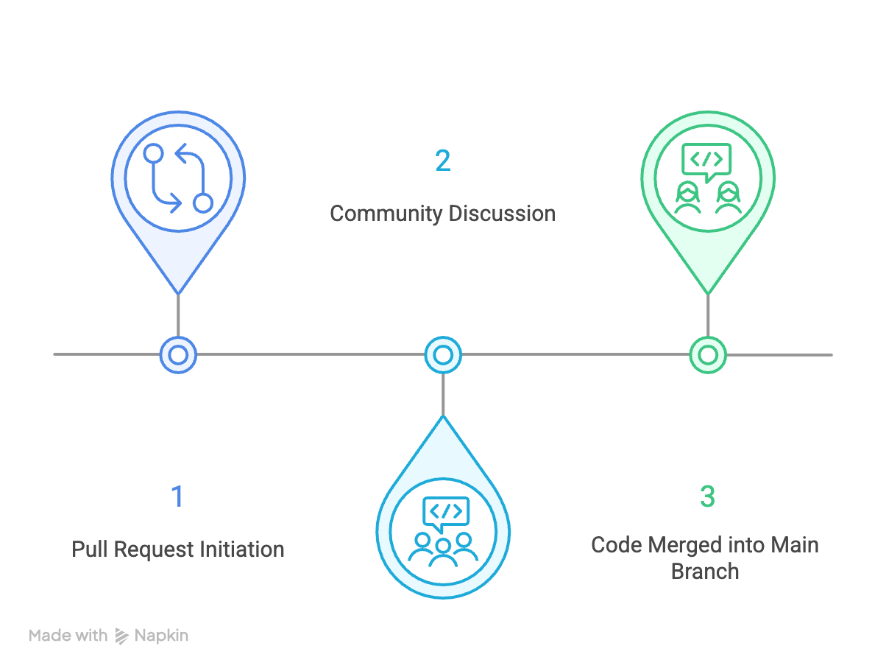
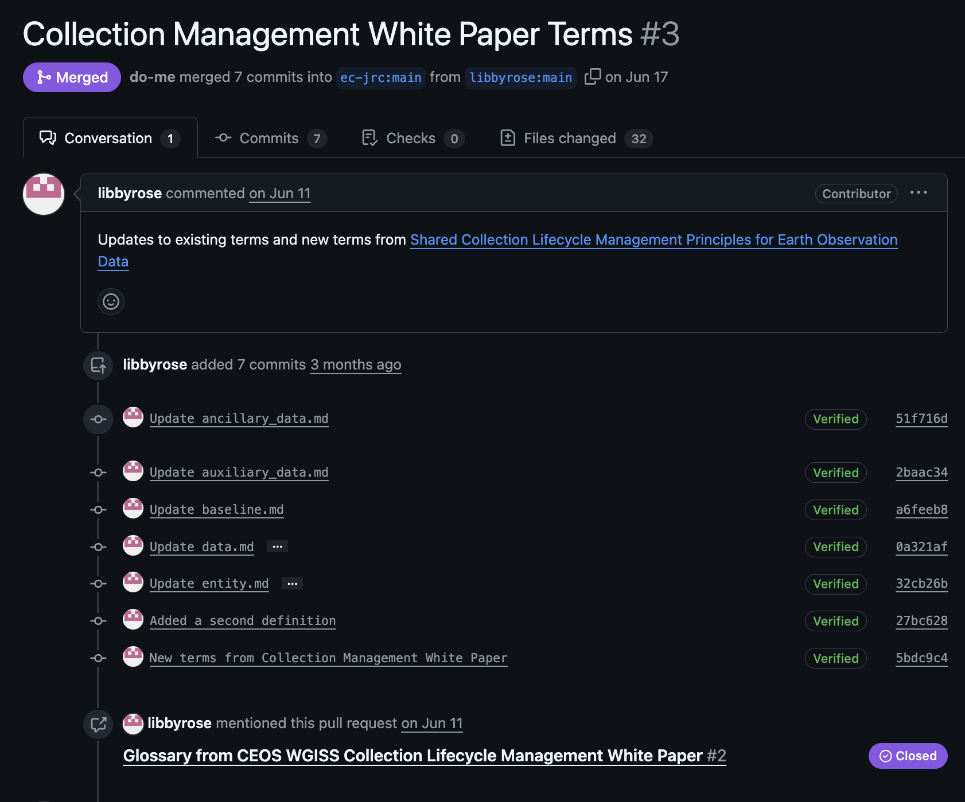
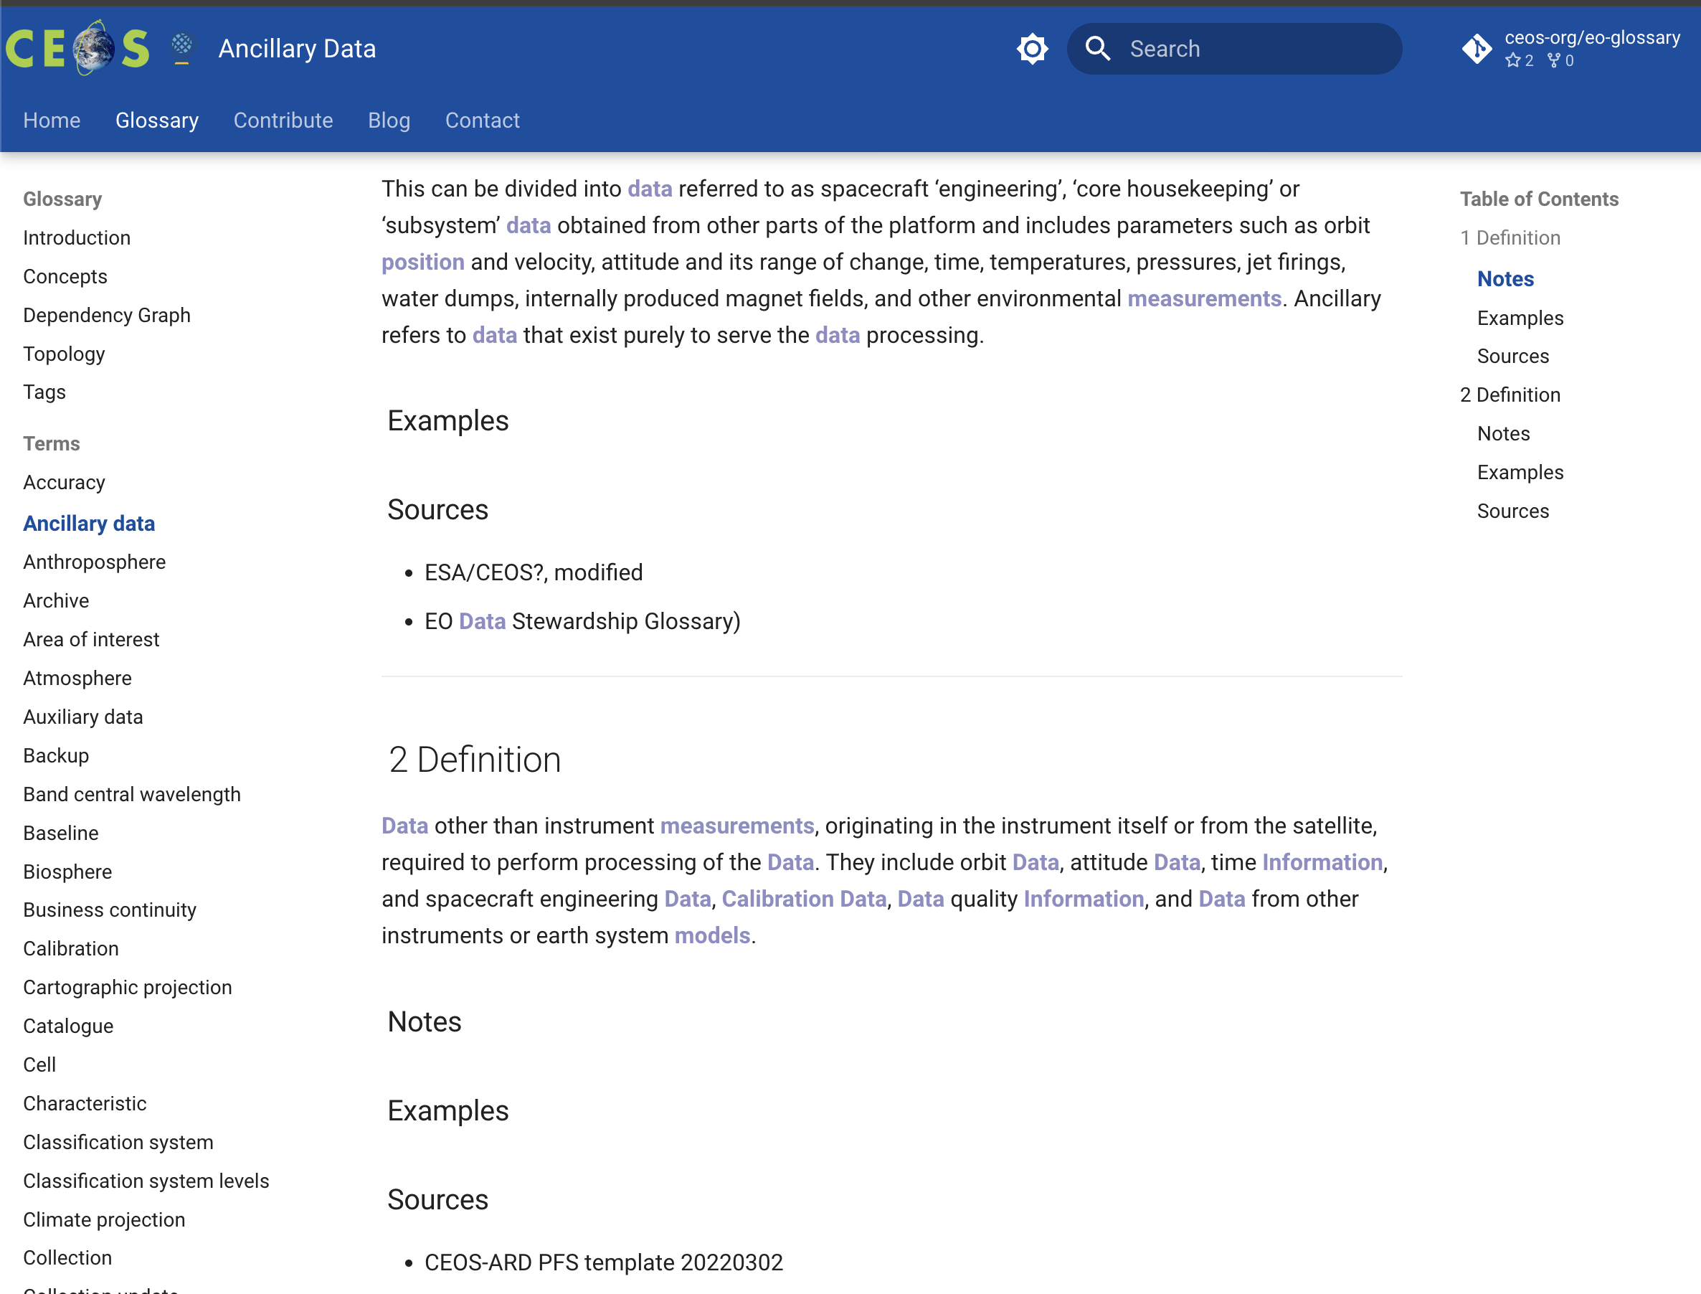
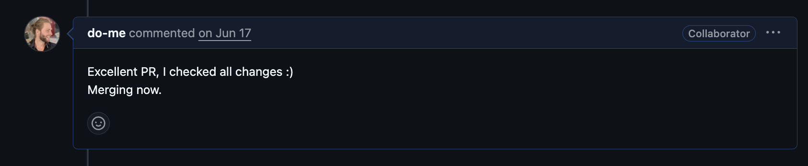
4.1) Technical Workflow

Slide 13
4.2) Governance Principles
Agility quick development, broad participation vs.
Authority must be trusted and stable; veto rights in case → Glossary Steering Group

Slide 14
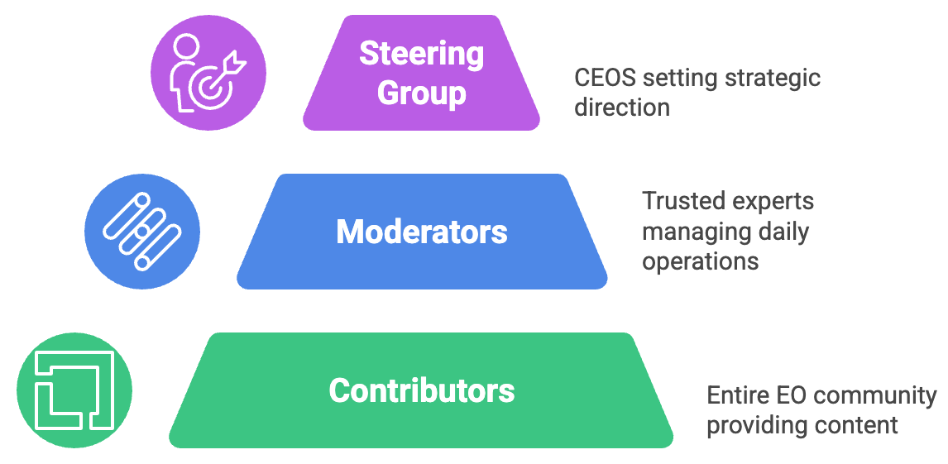
4.3) Governance Model - Draft
Diagram: napkin.ai

Slide 15
4.4) Governance - Contributors
(hopefully) many different contributors!
anyone (with a GitHub account)
open PR directly or engage in discussions
add new term or propose change to existing terms
Diagram: napkin.ai

Slide 16
4.5) Governance - Moderators
a handful of trusted experts for housekeeping
first review of all contributions
ensure quality, clarity, and adherence to principles to enable/facilitate community discussions
merge non-controversial changes right away
Diagram: napkin.ai

Slide 17
4.6) Governance – Steering Group
formal, nominated representatives from CEOS member agencies
ratify changes to high-impact or core terms!
serve as the final authority to resolve conflicts and make consensus decisions
Diagram: napkin.ai

Slide 18
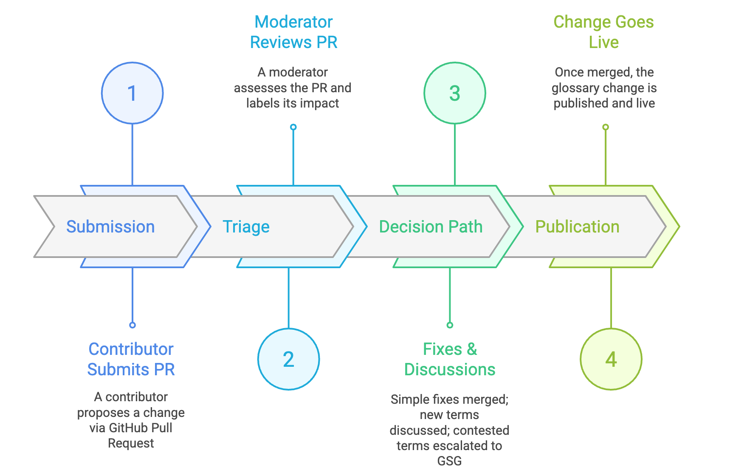

4.7) Glossary Contribution Workflow
Diagram: napkin.ai

Slide 19
5) Action Points / Discussion
WGISS Glossary Steering Group (GSG) – Who? E.g. 1 person per agency? Or open, internal chat?
What technical platform needed for GSG discussions? For voting, archiving discussions etc. Outcome: Structured Plan

Slide 20
Thanks!
Links
https://github.com/ec-jrc/KCEO-Glossary
https://github.com/ceos-org/eo-glossary
https://knowledge4policy.ec.europa.eu/earthobservation_en

