Slide 1
WGISS Communications Update
Presenter, Organisation
Agenda Item 14.1
WGISS-60
13-17 October, 2025
Oberpfaffenhofen, Germany

Slide 2
CEOS News Articles
Published Recently:
Building a 40+ Year Global Dataset Through CEOS Agency Collaboration
WGISS Connected Data Assets: 2025 Update
Coming Up:
CEOS Purge Alert Service
Other suggestions welcome

Slide 3
CEOS Newsletter
More of an internal focus
Run by JAXA on behalf of CEOS
https://earth.jaxa.jp/ceos-newsletter/
Interoperability Handbook article will be published Dec or Jan

Slide 4
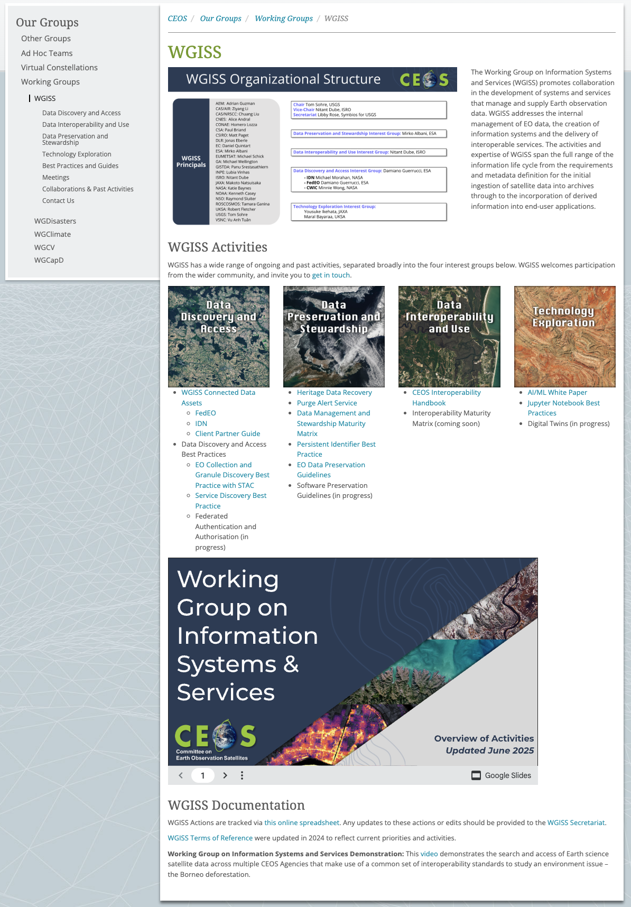
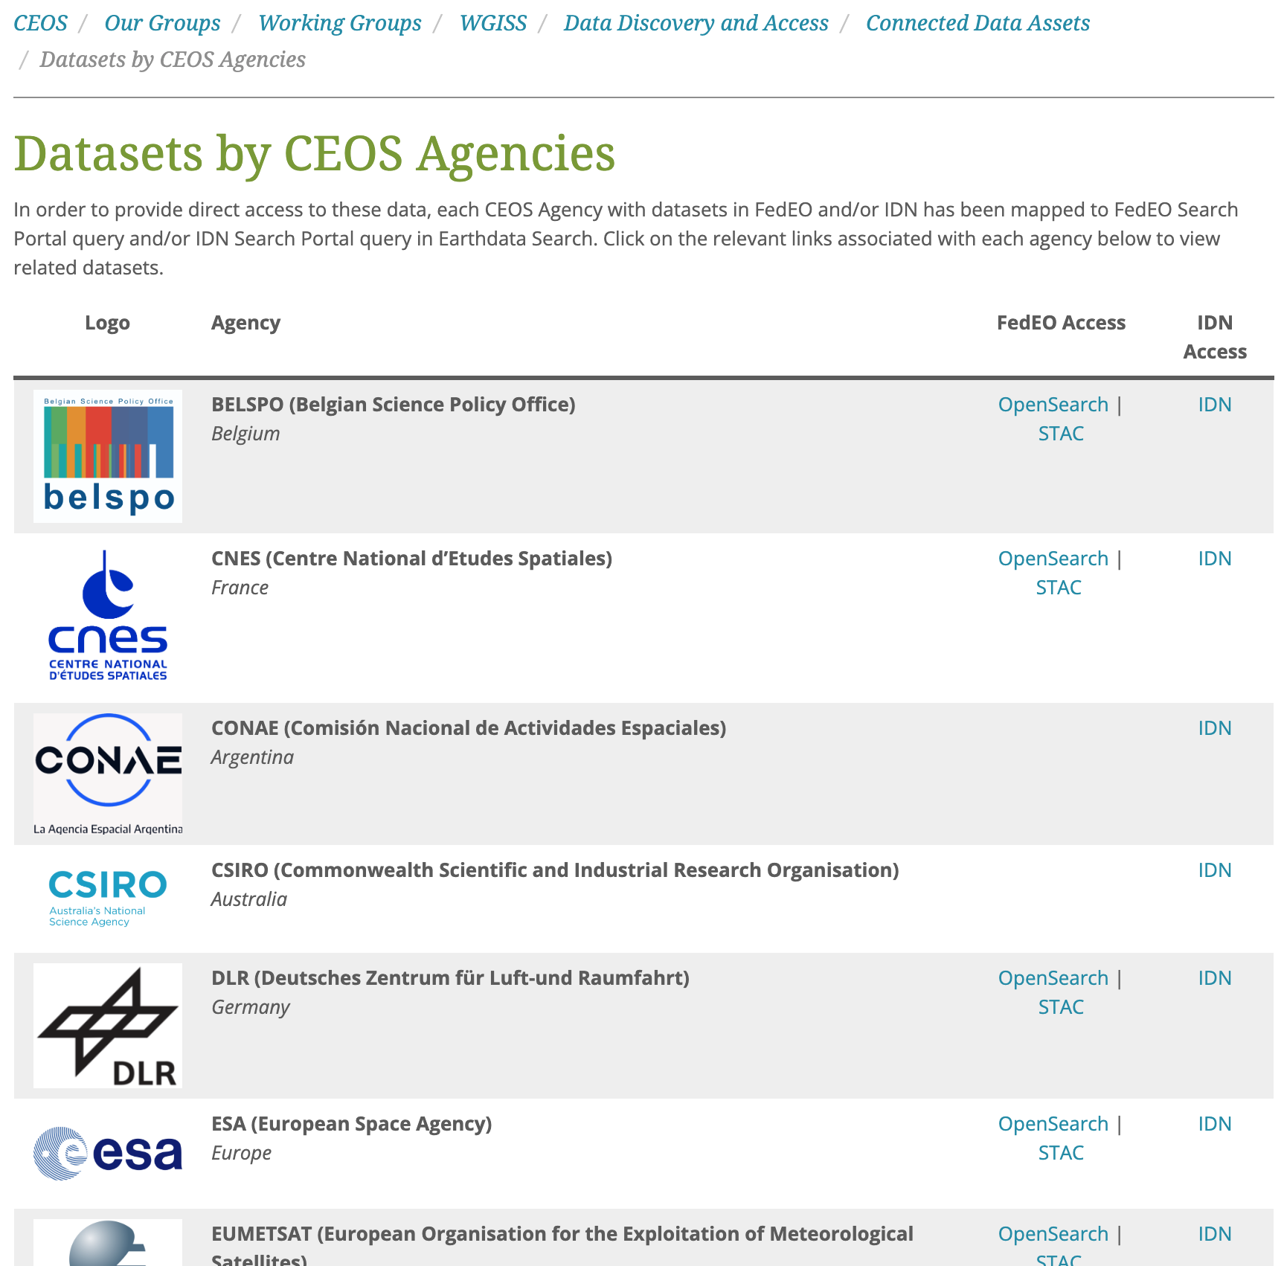
WGISS Website
Added combined FedEO/IDN Data Access Page
Updated Technology Exploration page
Embedded WGISS Overview Presentation on home page

Slide 5
CEOS Communications
2026-2027 CEOS Communication Strategy in development
‘Interoperability’ a key topic for both incoming CEOS & SIT Chairs
  What would WGISS like to get out of an ‘Interoperability’ Campaign? What would the goals be?
Campaign Outline Template
Goals | e.g. Encourage stakeholders to provide feedback on CEOS-ARD via the survey
Target Audience | e.g. Data providers and users
Tagline | e.g. “We’re building better ARD. Tell us what better looks like.”
Key Messages | e.g. “Help Shape the Future of CEOS-ARD”
Methods | e.g. CEOS social media channels, Targeted emails, CEOS-ARD newsletter mailing list
Materials | e.g. Slide deck, image cards for social media

Slide 6





Engage with CEOS
Twitter: @CEOSdotORG
Facebook: @socialceos
LinkedIn: @CEOSdotORG
YouTube: @CEOSdotORG
CEOS Communications Quarterly Revisit
Quarterly Newsletter Mailing list
Sign up!
http://eepurl.com/ij_2z1

