Slide 1
Framework for Digital Twins in Ireland
Alastair McKinstry
Irish Centre for High-End Computing
WGISS-60, 17 October 2025

Slide 2
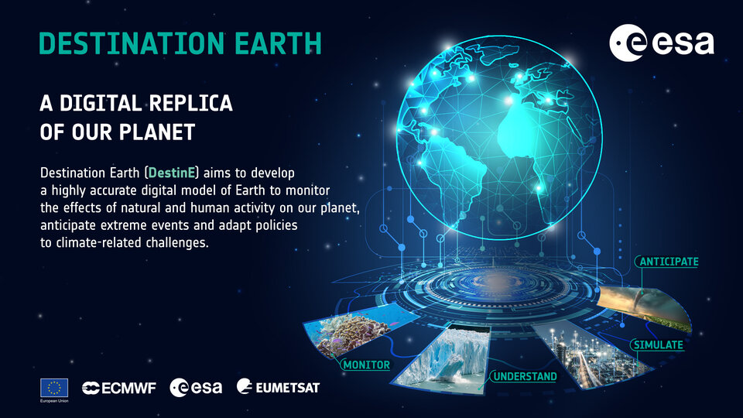
Digital Twins
Models of a system with sufficient real-time or projected data to enable operational use or policy decisions
There is a range of DTs and data products that mature from research to limited use to global, public components
Need to pay attention to local and research projects
Notes:
Ireland and DestinE / Destination Earth. This is not that
Work on other end: national and research DTs
Definition of DT:
SEAI:
Wind energy maps, EV and PV

Slide 3
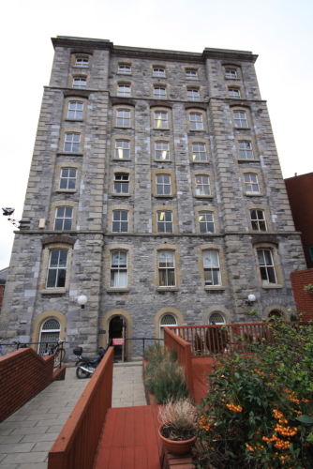
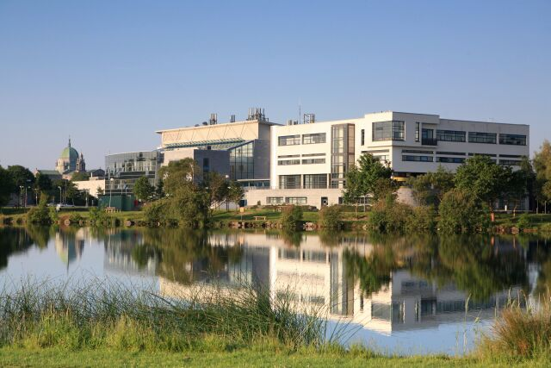
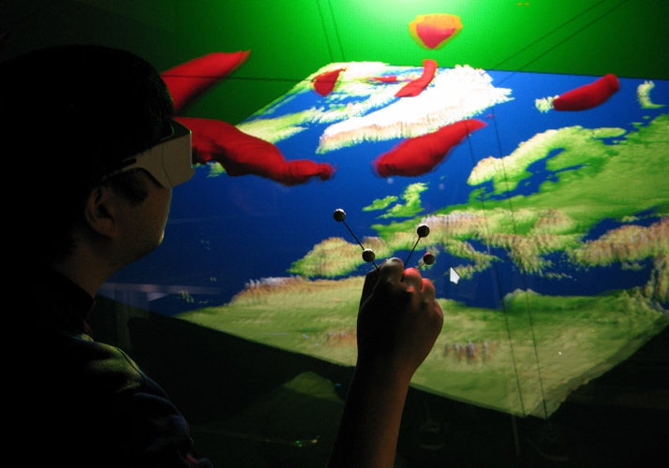
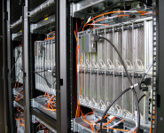
High Performance Computing at ICHEC
The Irish Centre for High-End Computing (ICHEC), founded in 2005, is Ireland's national high performance computer centre.
Part of EuroHPC, EuroCC
Its mission is to provide High-Performance Computing (HPC) resources, support, education and training for researchers in third-level institutions
Support Irish industries, large and small, to contribute to the development of the Irish economy.
Hosted by University of Galway
History of support for public sector:
Previously funded on per-project, ad-hoc basis
New agreement

Slide 4
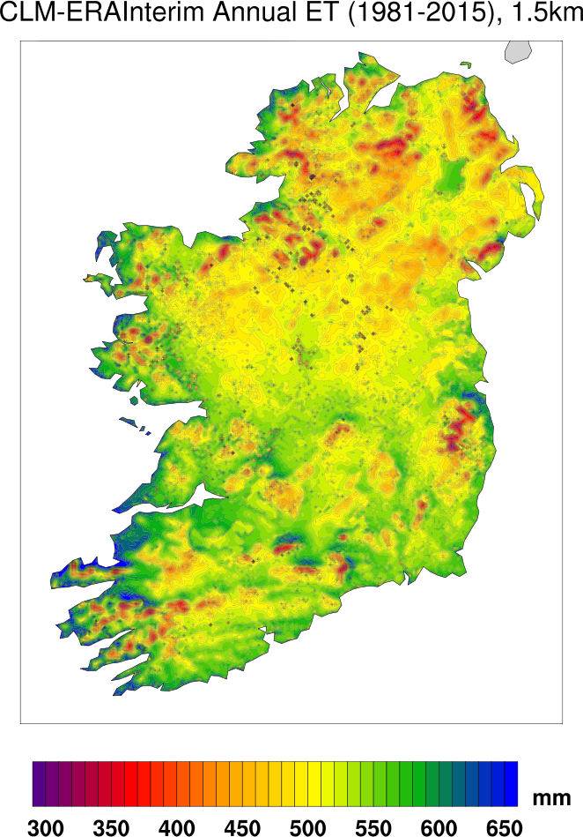
Evolution: from climate change modelling
ICHEC climate research involves simulating global climate change using the EC-Earth model. The resulting datasets comprise Ireland’s contribution to CMIP6 and directly inform the IPCC AR6 reports.
First Evapotranspiration Maps for Ireland
The simulations are run on the ICHEC supercomputer. All datasets are hosted on the ICHEC ESGF node and shared with the international community. Current data storage: ~2 PB.
The global dataset are dynamically downscaled using both standard atmosphere-only (WRF & COSMO-CLM) and coupled atmosphere-ocean-wave Regional Climate Models (COAWST, WRF, ROMS & WW3/SWAN) to provide high-resolution (~3.8km) projections of climate change in Ireland.
Results inform numerous governmental climate change reports (e.g, Biodiversity, Heritage Build, Agriculture, Transport, Health)
The historical climate of Ireland is simulated at very high spatial resolution (~1.5km) using regional climate models WRF & COSMO-CLM (1980-Present).
Feeds into wide range of applications in agricultural, public health, energy (wind, wave and solar), insurance, socio-economic planning and fundamental studies in observed climate change trends and variability.
High-Resolution Agri-Climate Datasets for Ireland
High-Resolution Wind & Solar Energy Maps for Ireland

Slide 5
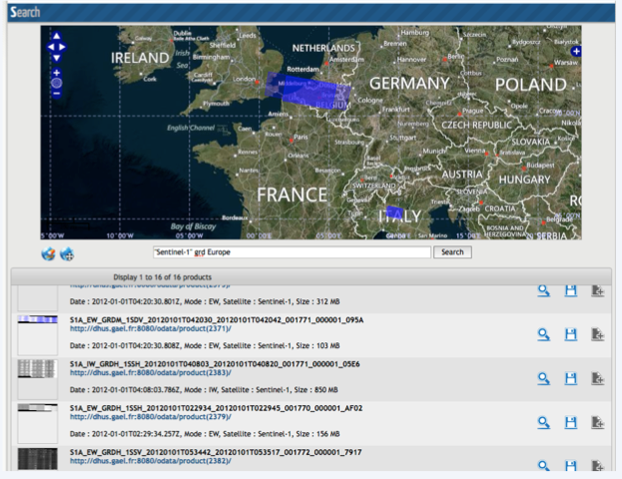
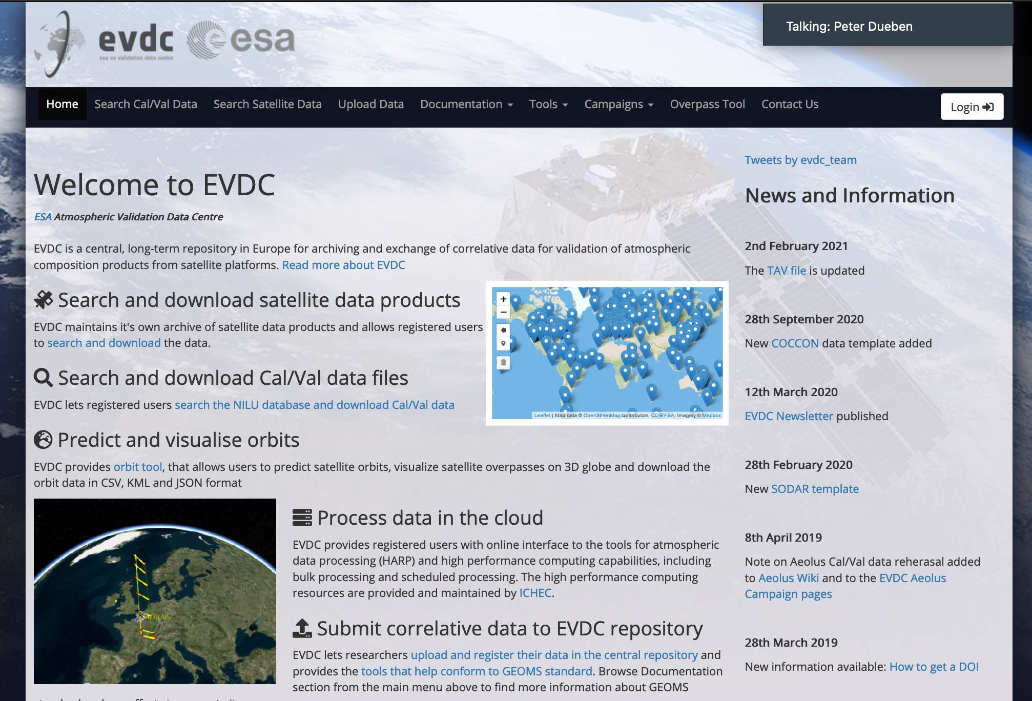
Earth Observation
SPÉIR: Archive of Sentinel / Copernicus for Ireland:
Sentinel 1,2,3
Support formalized under CASPIr/EuroCC
Extended under Datacube for ARD
ESA EVDC: Env. Validation data centre
Satellite archive for S5P, Aeolus, EarthCARE
Calibration and processing at ICHEC
AIREO: AI-Ready Earth Observation
Make all the EO data ready for Machine learning

Slide 6
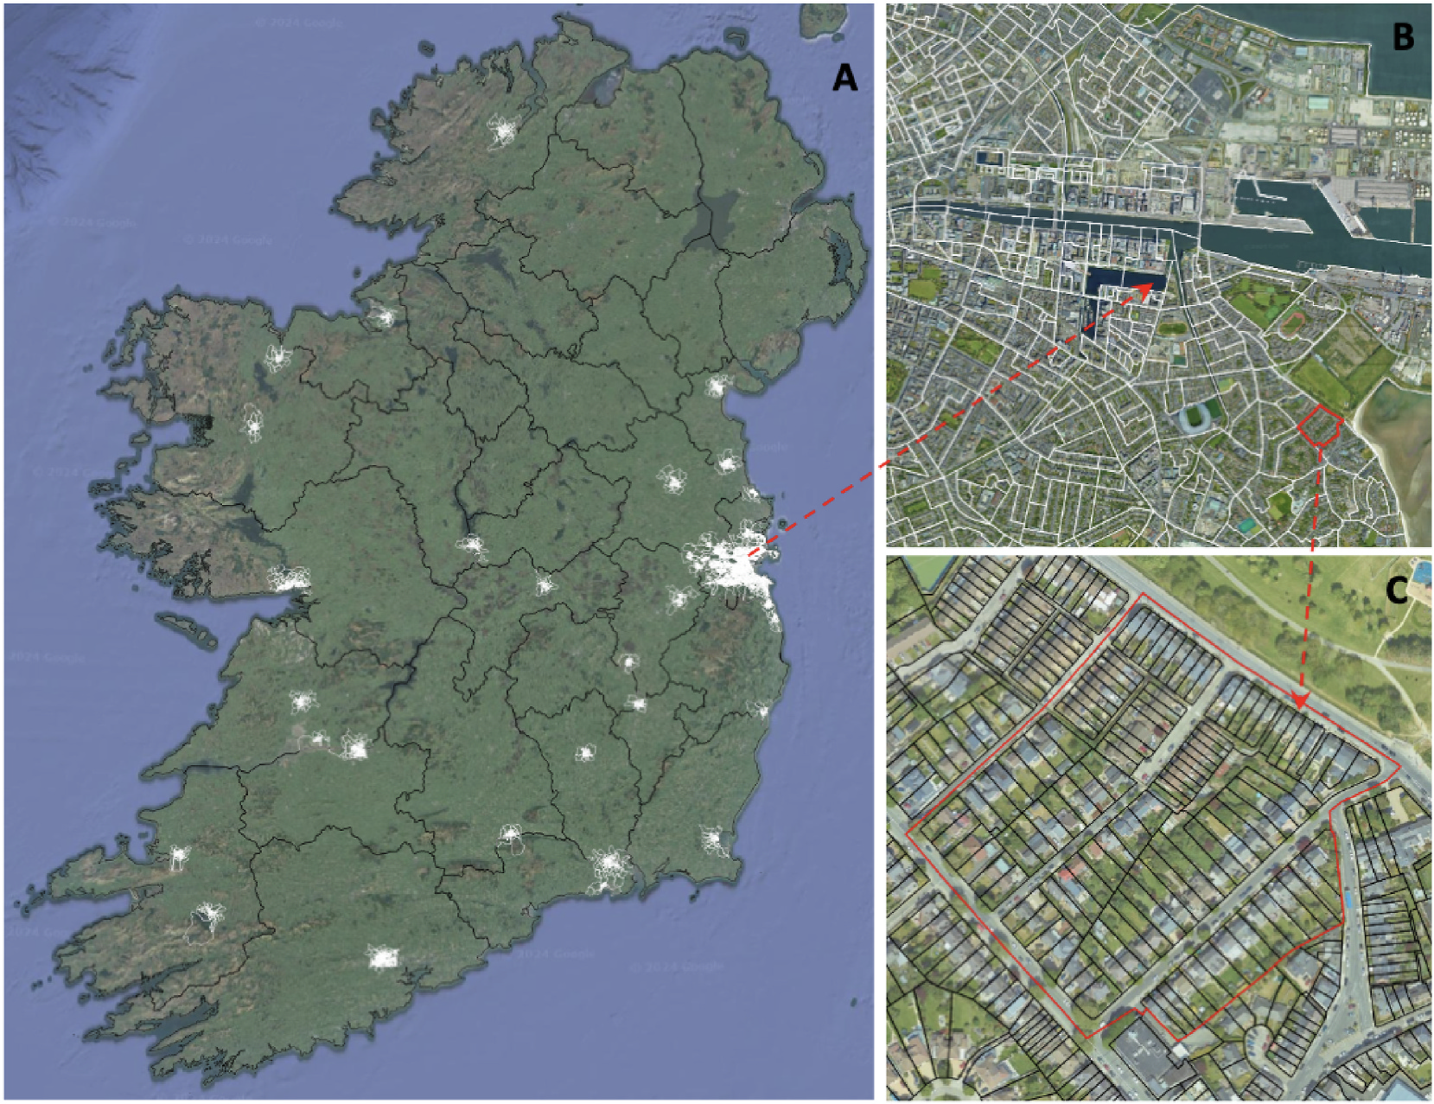
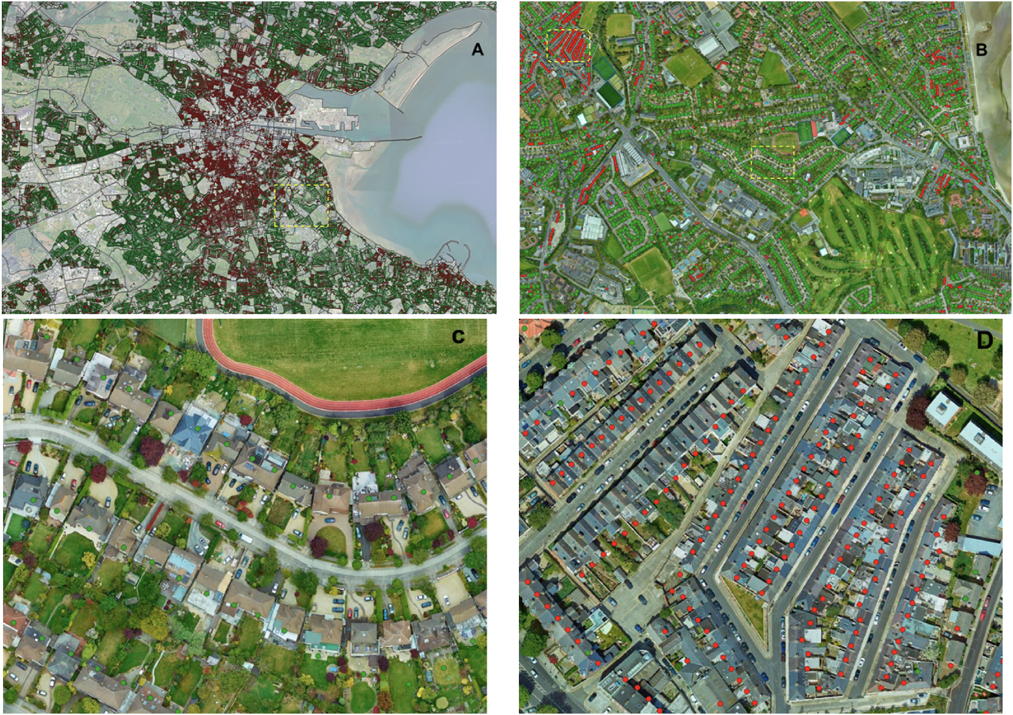
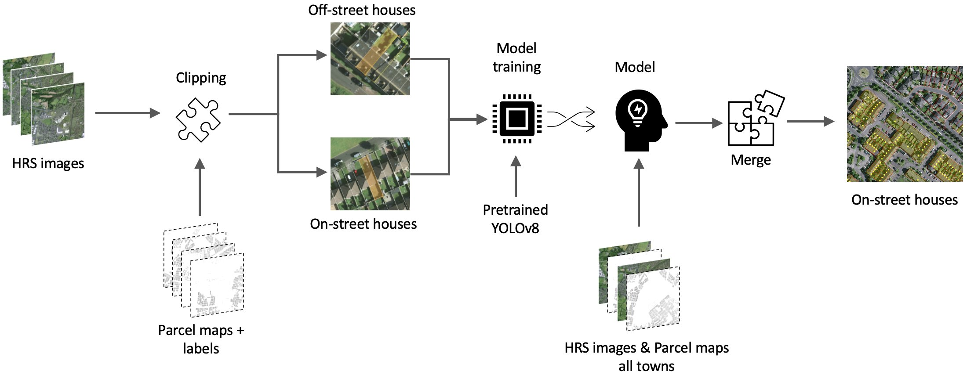
EO workflows and projects
ML identification of PV, EV opportunities for SEAI
South-facing roofspace, car parking for grid
Water quality
Lake pollution, invasive species
Seaweed farming
Hydrology: flooding under forestry

Slide 7

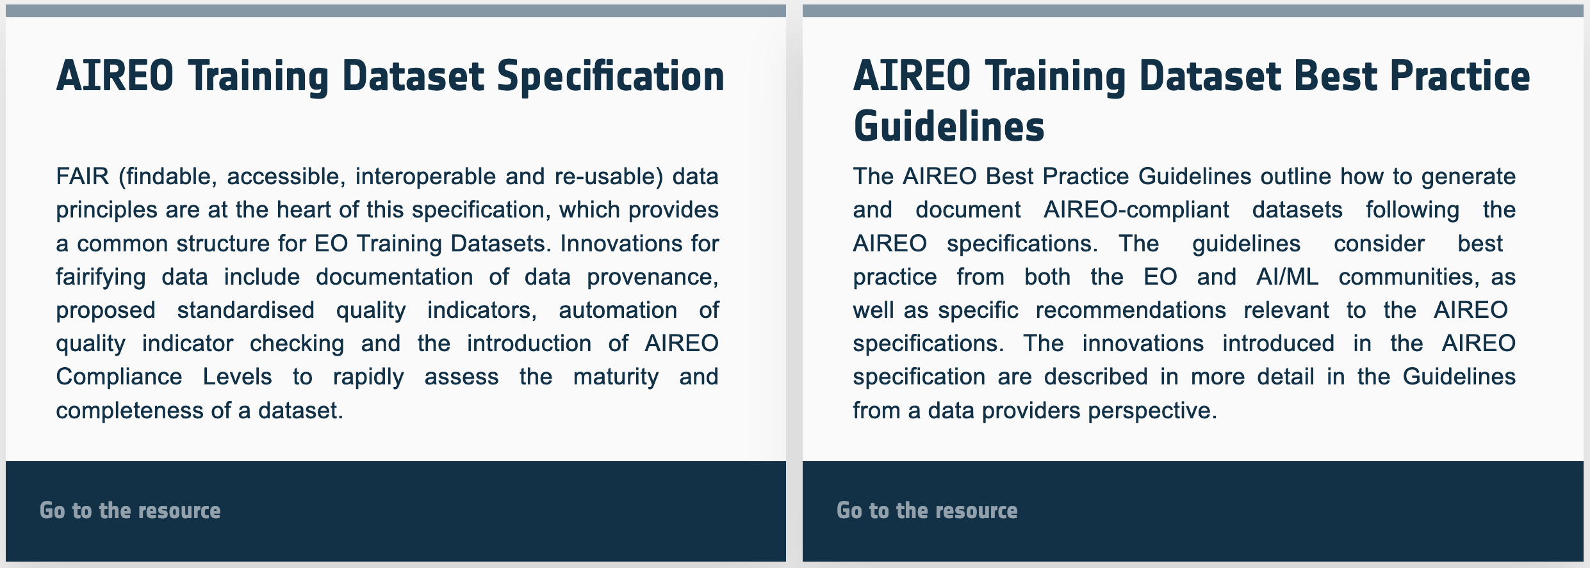
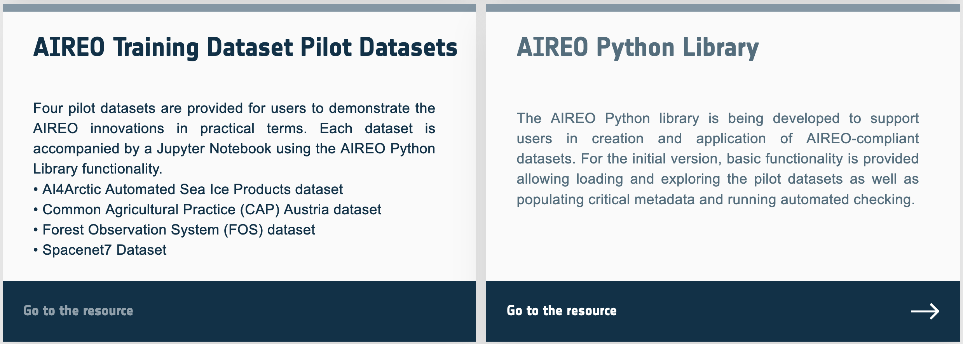
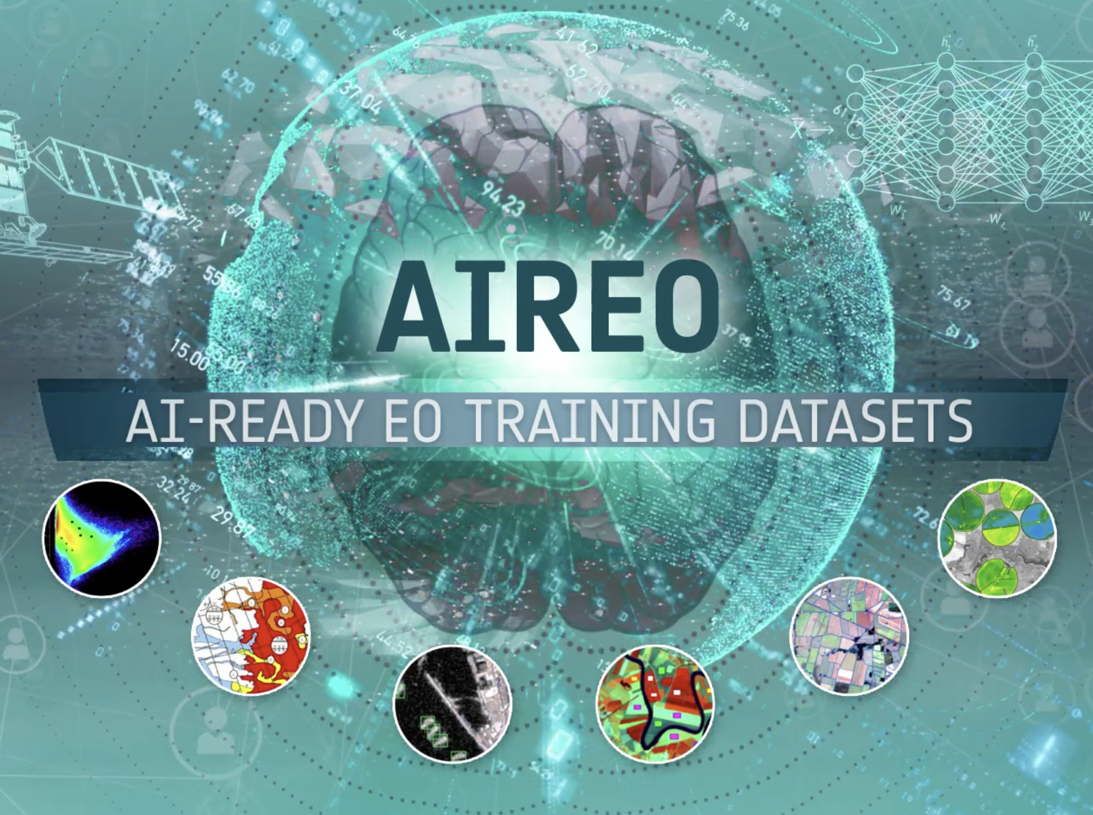
AI-Ready Earth Observation (AIREO)
Previous ESA project:
enabling pre-existing data for AI/ML training
Extend this work for public sector datasets
AM
Notes:
Previous work at ICHEC.
We plan to add metadata support to existing public datasets for AI/ML training

Slide 8
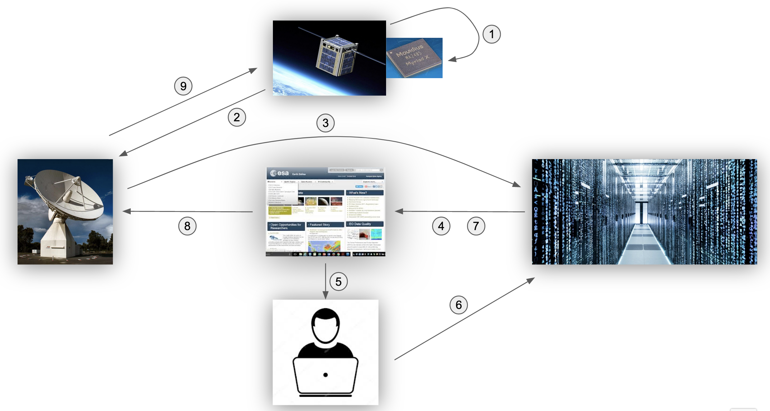
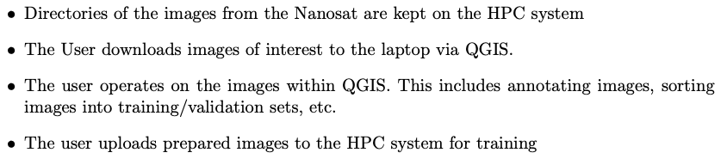
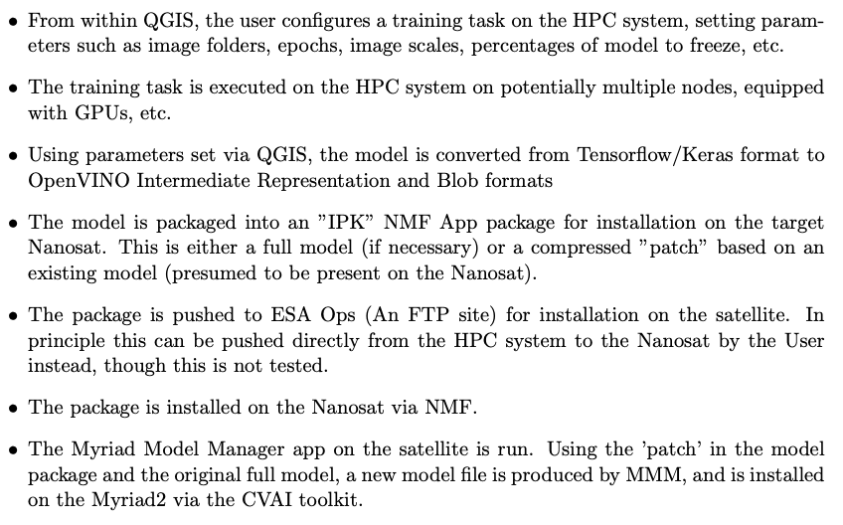


Space Networks
Complex workflow: user on laptop runs QGIS:
Analyses data from nanosat
Retrains model on HPC
Uploads changed model from HPC to nanosat
Notes:
More complex work

Slide 9
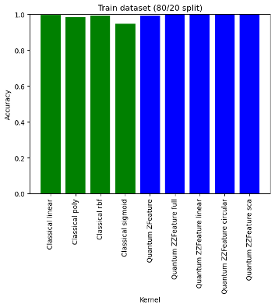
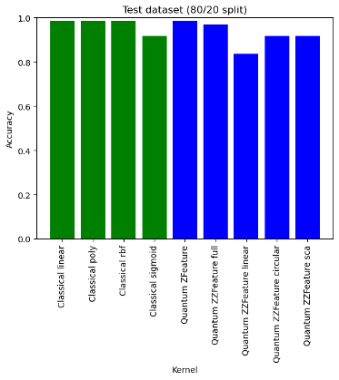
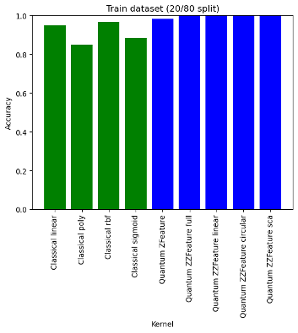
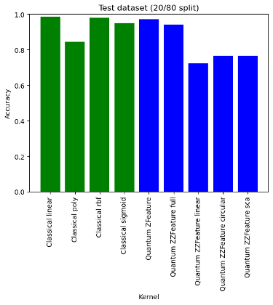
QSVM4EO
Connecting Quantum computing to EO software stack:
QSVM4EO (IGARSS, QIP, etc.) implementation and (provisional) results
IGARSS 23 presentations - "MULTICLASS LAND USE / LAND COVER (LULC) CLASSIFICATION USING QUANTUM ENHANCED MACHINE LEARNING ALGORITHMS"
Landsat-8 data, 8 bands
Dataset: 304 datapoints (training + testing), 3 labels
Classical SVM with 4 kernels
Quantum-enhanced SVM with Z and ZZ feature encoding
Scaling up
Sentinel-2 data, 4 or 8 bands
Datasets: 1k and 65k datapoints training , 1k and 65k datapoints testing, 5 labels
Classical SVM with 4 kernels
Quantum-enhanced SVM with Z and ZZ feature encoding, also investigating other encodings

Slide 10
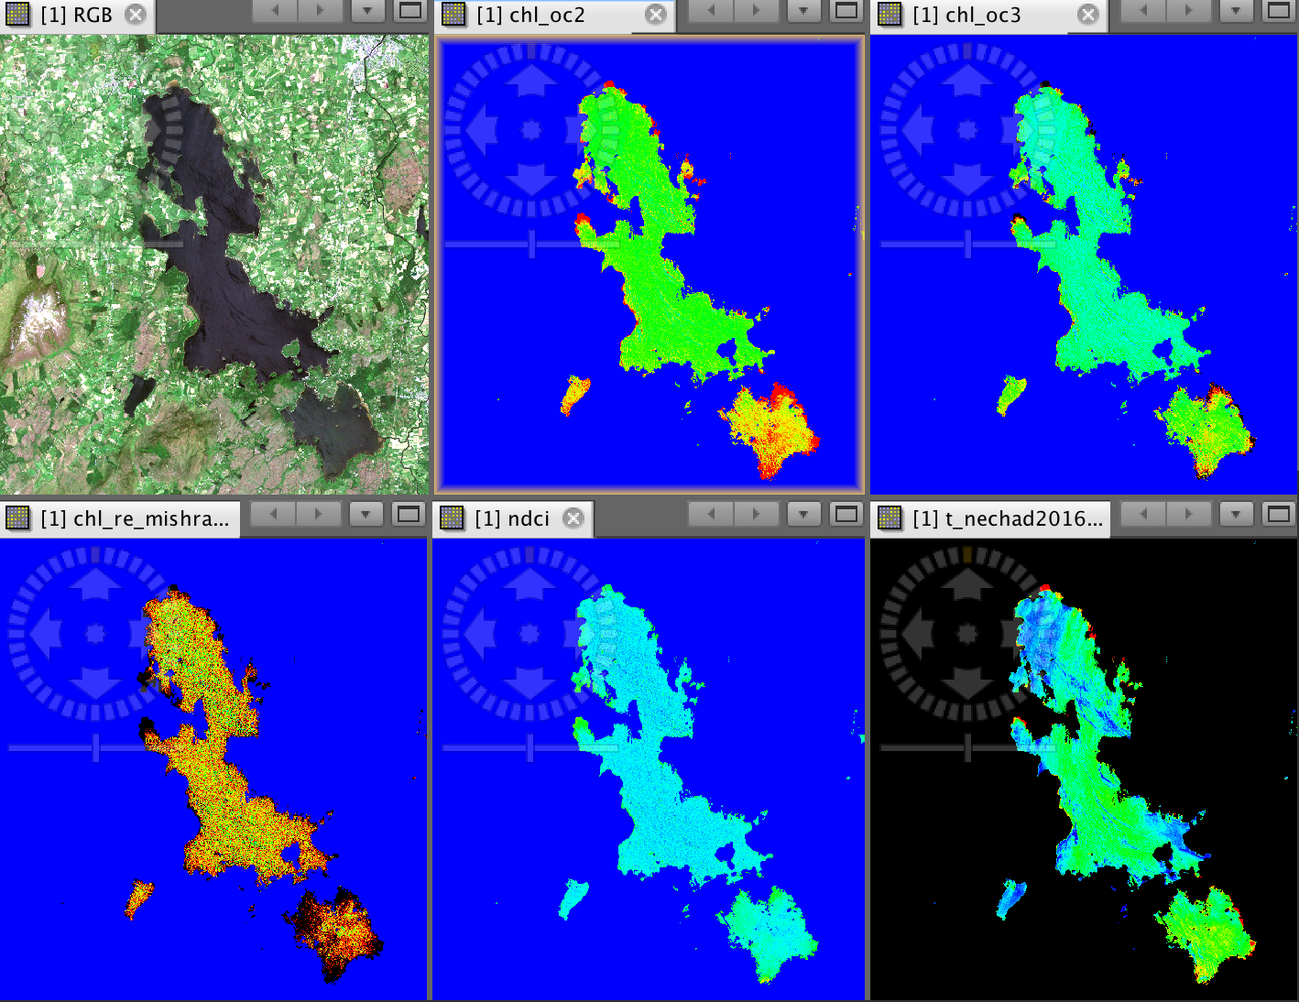
Small Digital twin: Lake water monitoring
Can we monitor lake water quality in Ireland from space?
Yes, with some AI/ML modeling
Used as a tool by EPA, by 1-2 staff
Challenge: maintaining product cheaply
Managing a small workflow/webpage “snowflake”

Slide 11
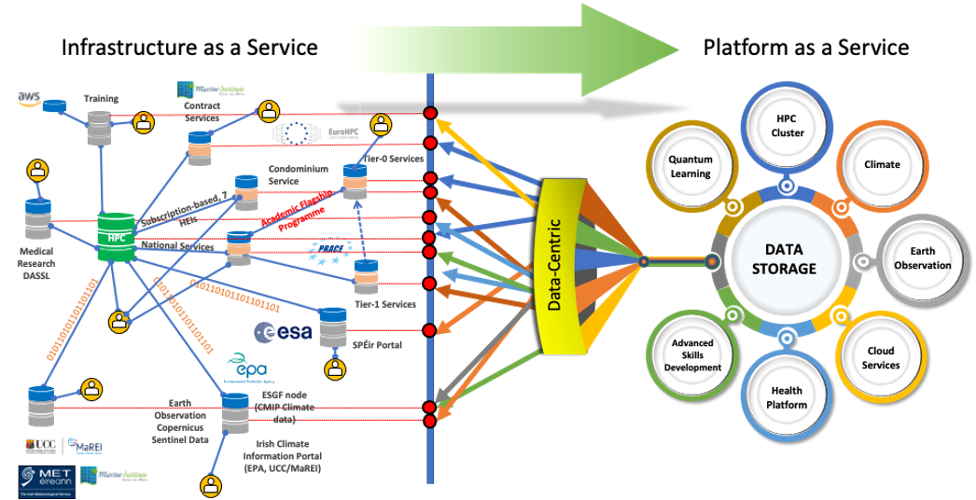
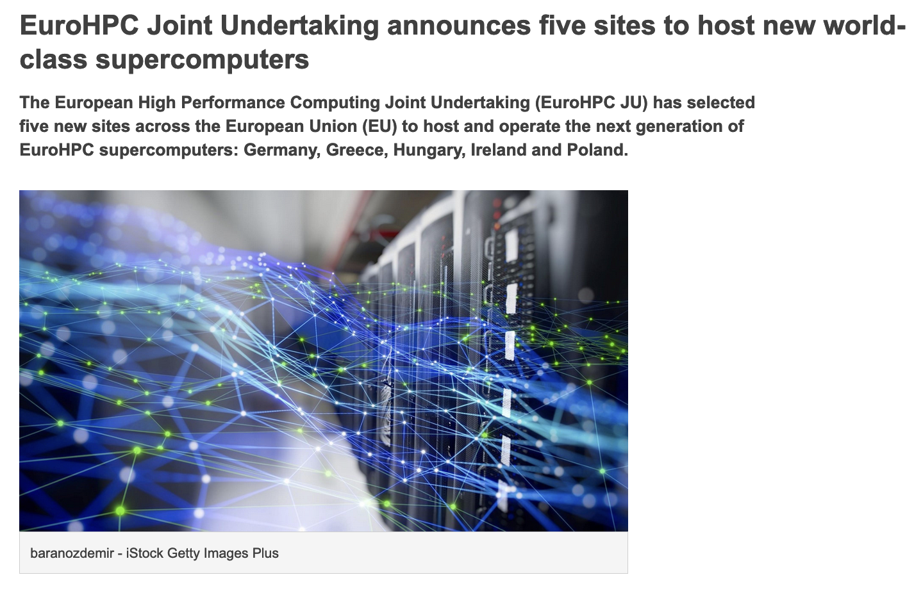
CASPIr system: platform as a service
Architecture oriented towards:
HPC cluster
Platform services (cloud)
GPU nodes for AI
Quantum simulator
In Government Datacentre
€65m investment, EU and national cofund
Manage the “snowflakes” in a consistent manner on a unified platform

Slide 12
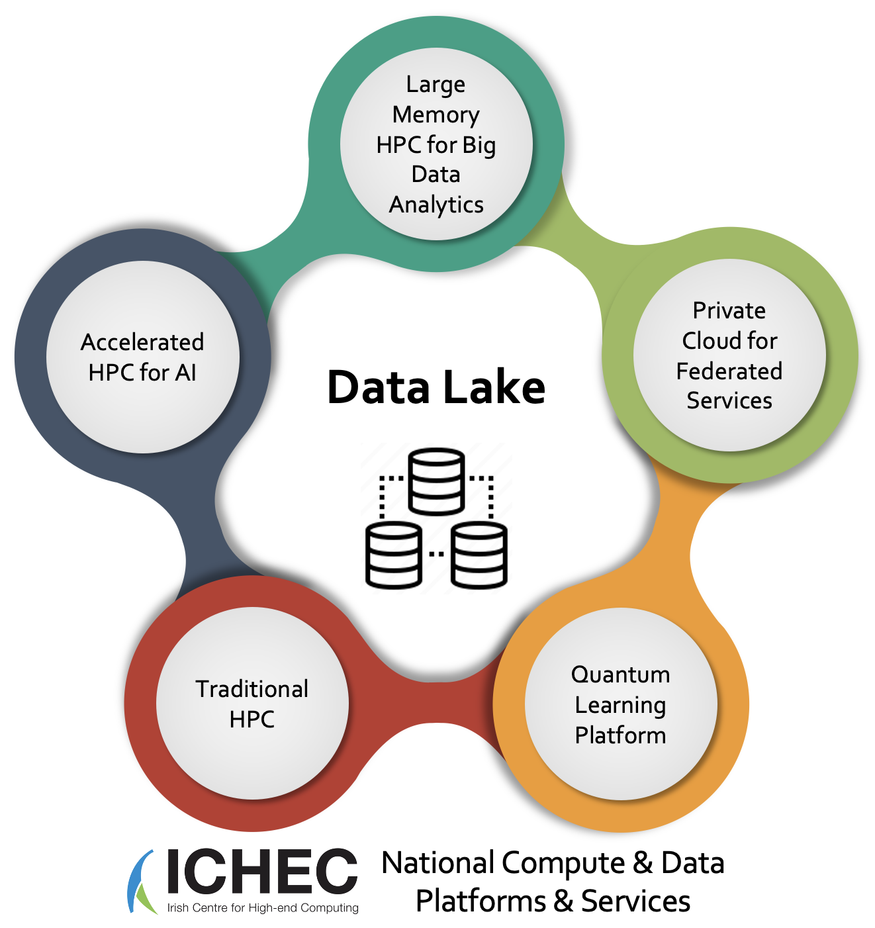
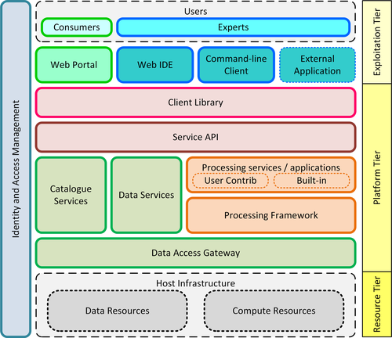
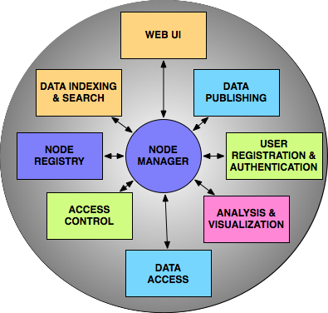
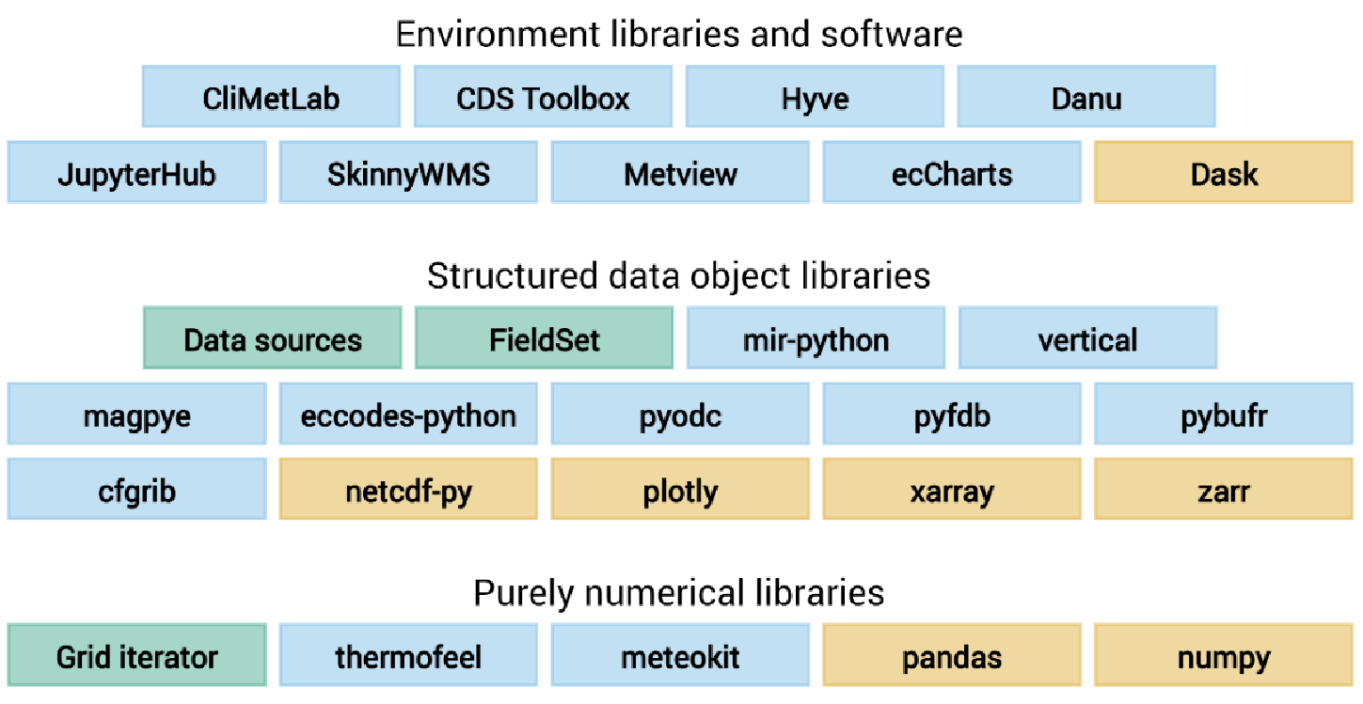















National & EU Platforms & Services​
CASPIr
EO Data Cube
ESGF
ECMWF software roadmap
Operational Platforms & Services
Towards Data Spaces & Digital Twin Platforms
Smart City Digital Twin for Engagement
Special Area of Conservation (SAC)
Protect & enhance High-Status Waters
Results Based Payment Scheme (RBPS)

Slide 13
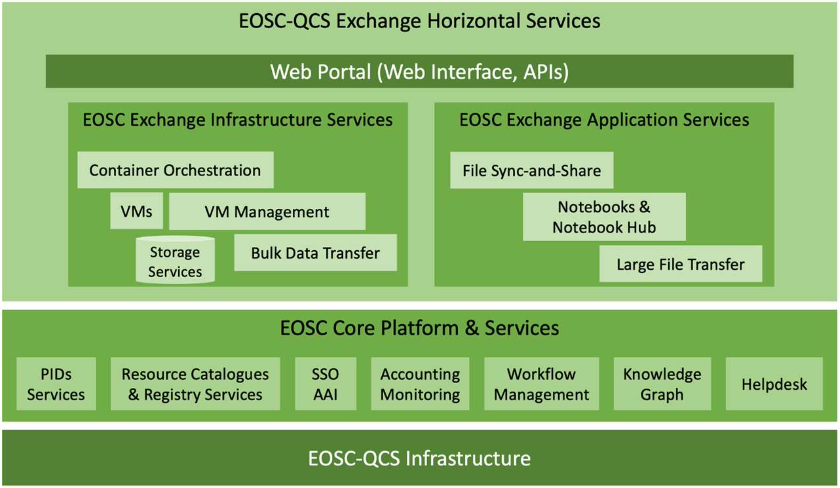
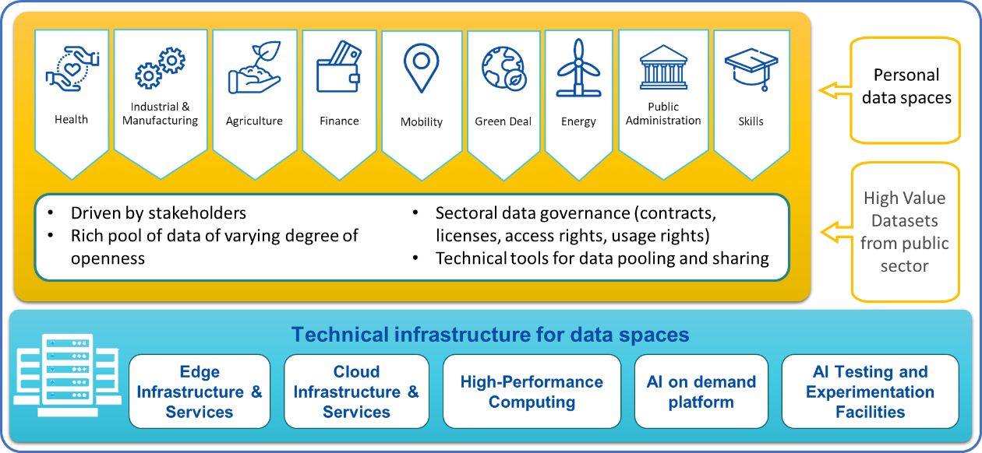
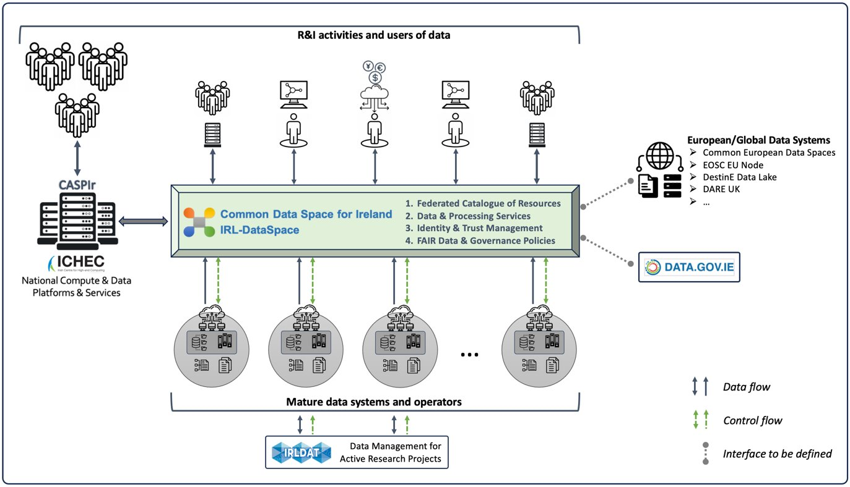
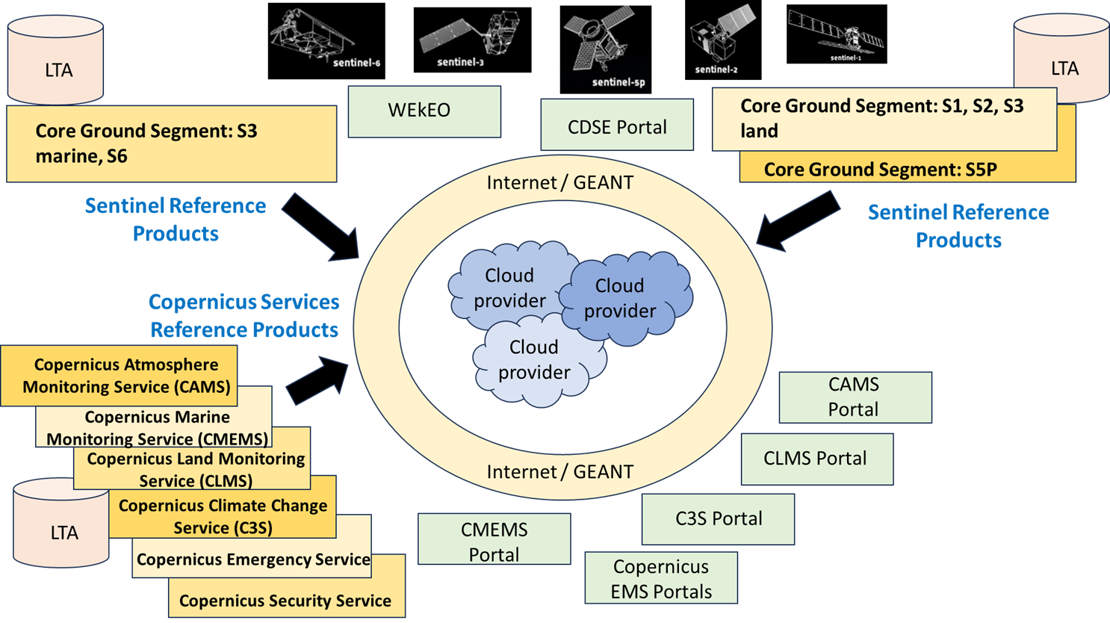
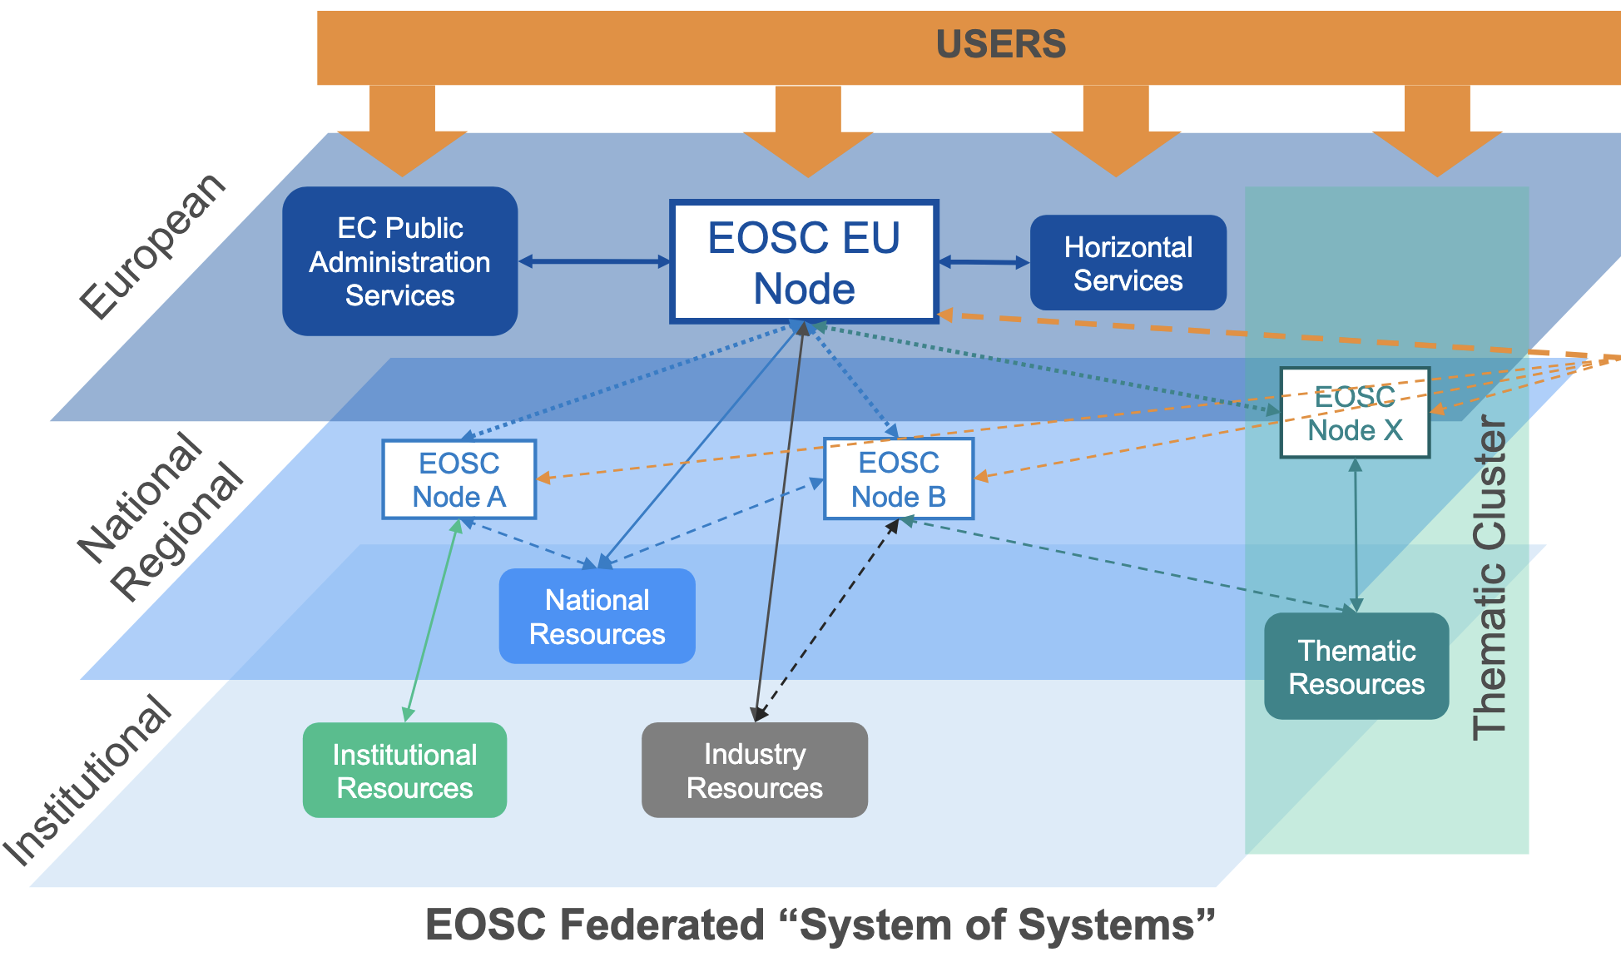
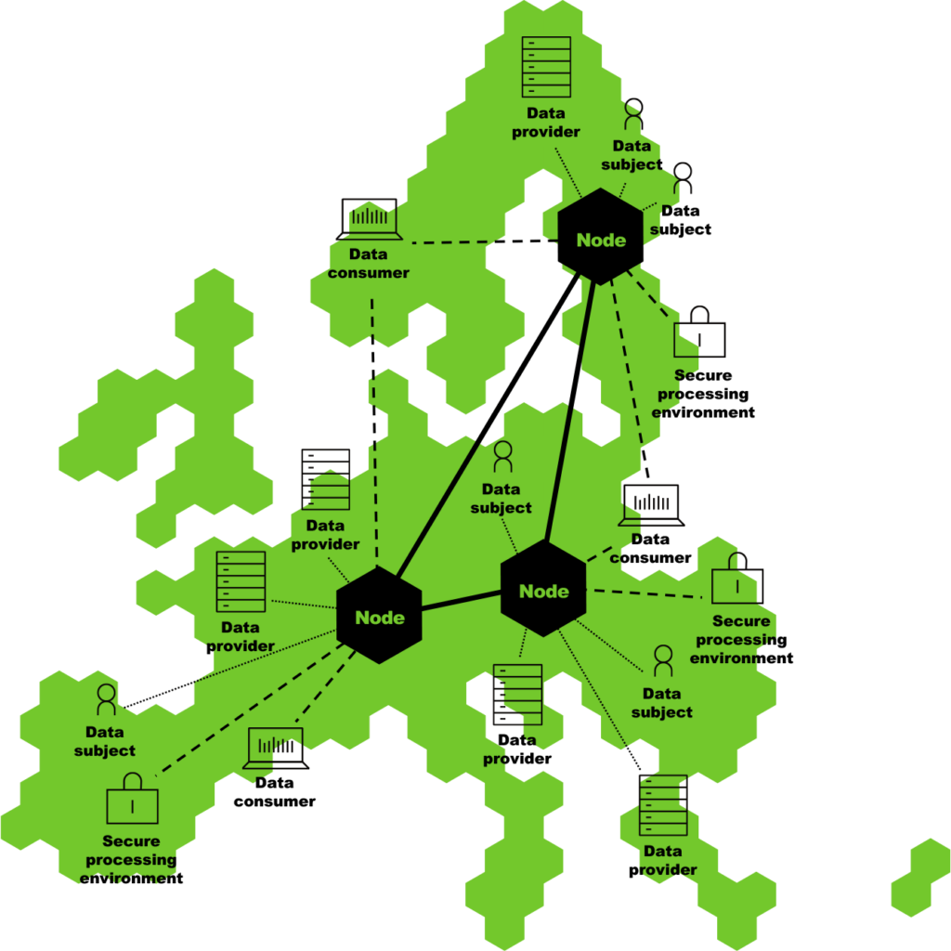
IRL Dataspace
Common European Data Spaces
European Open Science Cloud (EOSC)
IRL-DataSpace
Operations & Policies
R&I
Notes:
[VK] Spectrum of EOSC – IRL-DataSpace(s) - Data Spaces – GAIA-X
[VK] DestinE
[VK] EWC

Slide 14
IRL-DataSpace and IRL-DSSC (Data Space Support Centre)
Definition: A federated ecosystem of data stakeholders, systems, and services at a national level, linking with European resources.
Purpose: To unify the currently fragmented national data ecosystem, facilitating data sharing and collaboration across disciplines.
Functions:
Ensuring that data is Findable, Accessible, Interoperable, and Reusable (FAIR).
Providing a high-SLA (Service Level Agreement) and cost-effective digital platform for data sharing and governance.
Engaging with EU Data Spaces Support Centre for expertise and support.

Slide 15
EO and cloud services
EO Datacube:
Cornerstone service for Geographic data
Some core products:
Climate modeling (CMIP5, CMIP6, …, Regional and reanalyses)
Land use cover / change:
ML detection on Sentinel-1, Sentinel2, landsat data
Hydrology (flood detection)
Ensure all data is “AI-ready”: added metadata and gridded for training
Currently in internal development
Enable other research users to publish to ODC, discovery

Slide 16
EOEPCA
Private cloud section of CASPIr to implement EOEPCA+
Software platform in testing and development
Limited subset of services operational in-house
Expected to be live Jan 2027
Auth: support Edugain, institutional users (ESA ldP etc)
Integrate OpenSearch / STAC into wider FedEO
Standardise the workflows for support. ICHEC to support researchers in operating and publishing workflows and datasets

Slide 17
Digital twins
Building risk: Dublin
Land use modeling
Flooding and hydrological
AI detection of flooding, groundwater monitoring
Greenhouse gas emissions: ICOS
Challenge: putting 3D (atmos model) data on EODC

Slide 18
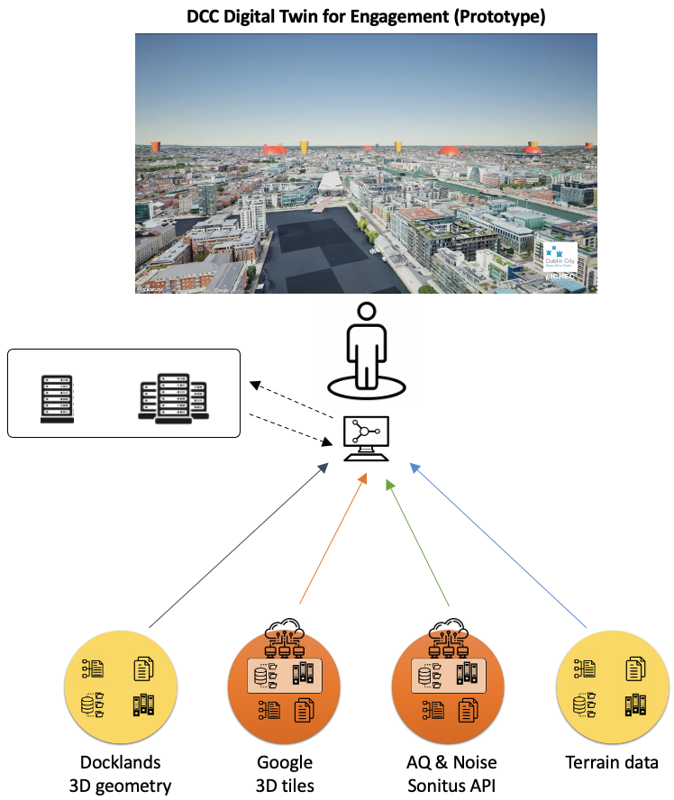
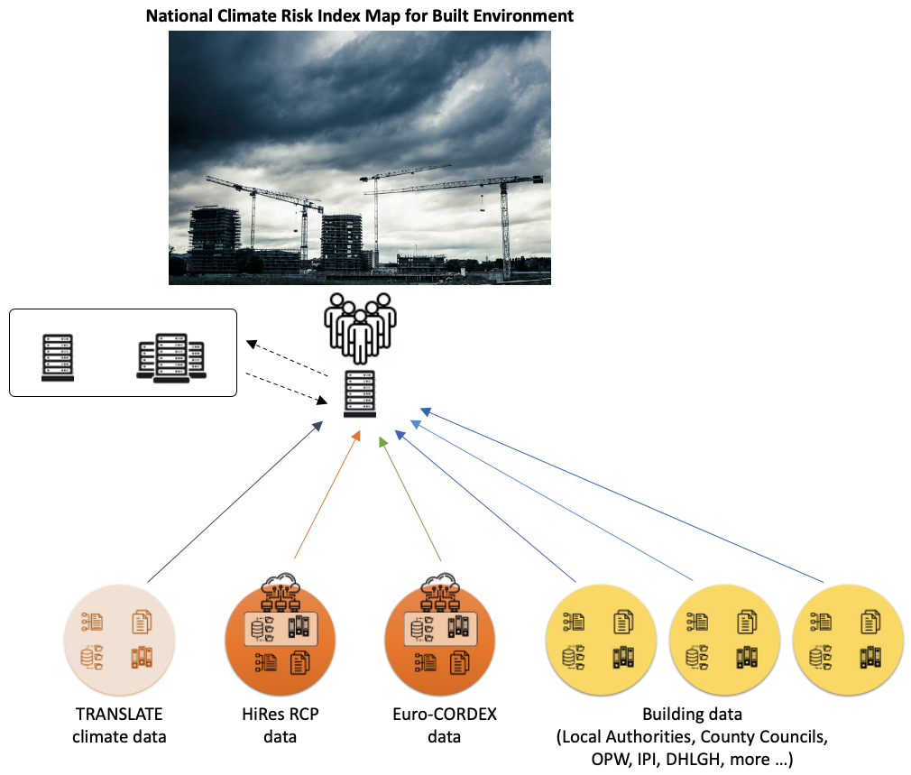
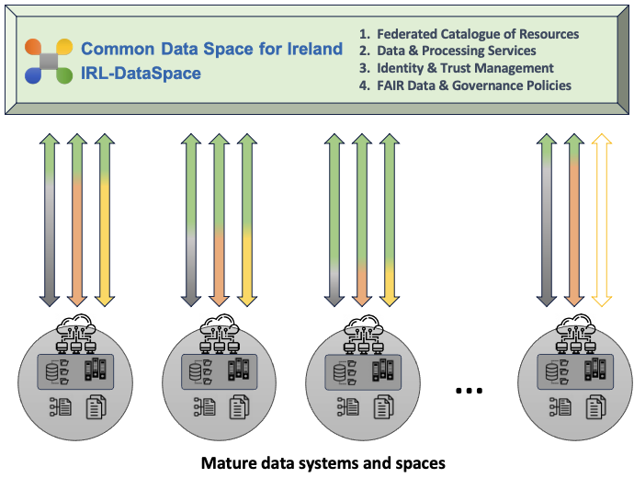
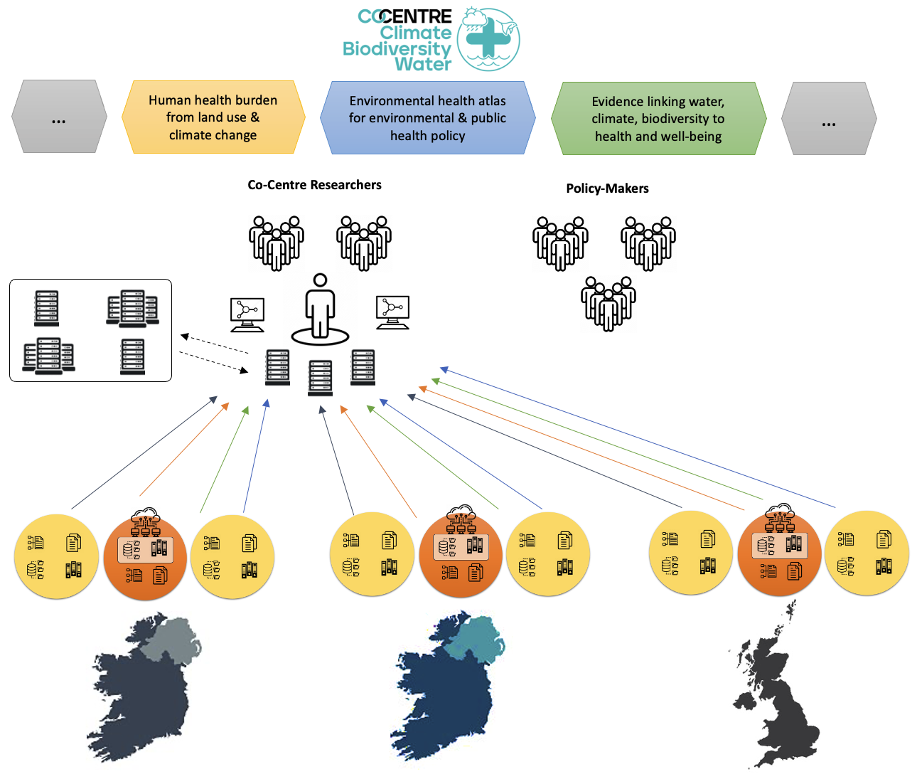
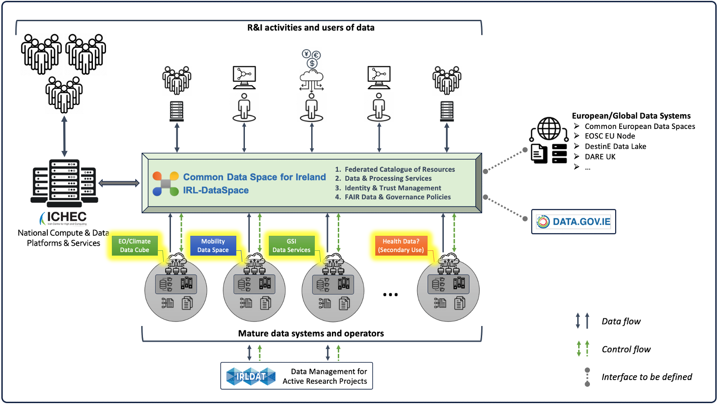
Buildings risk twins: Dublin and nationally

Slide 19
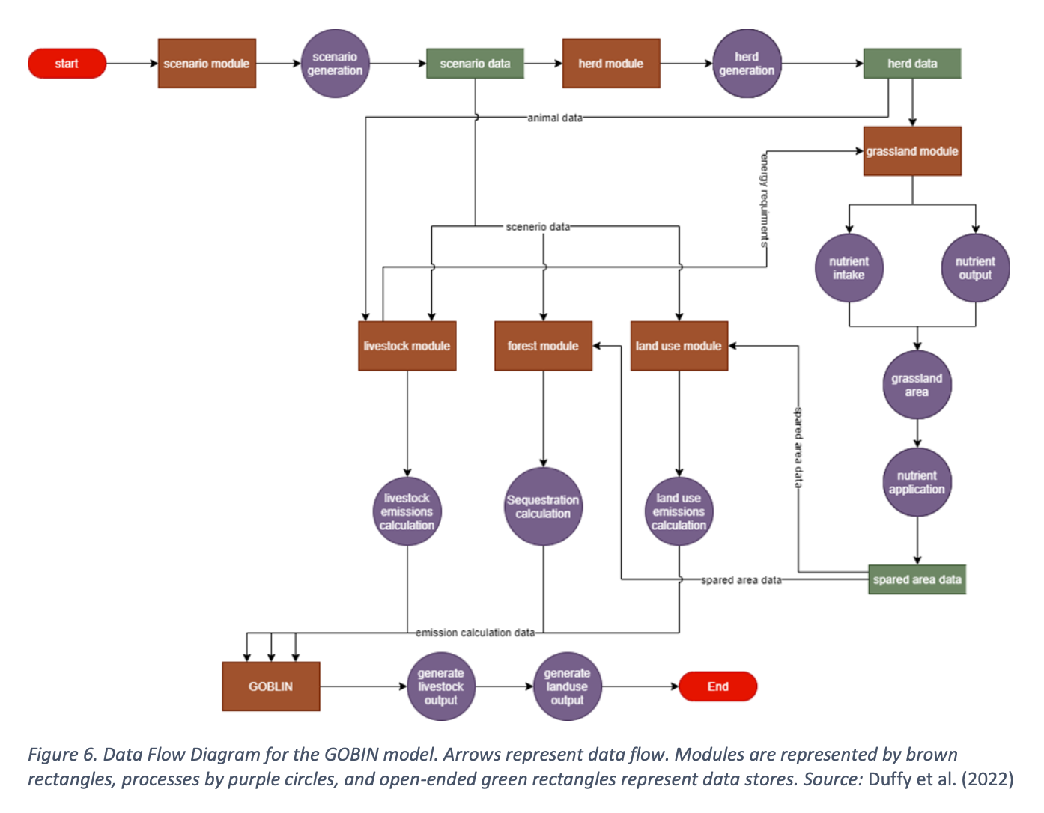
FORESIGHT
Land use change modelling for Dept of Environment:
Adapting existing models from national down to farm-level:
For policy development (net zero by 2050)
Developing land modeling capacity for policy, not research
Building on datasets of land use from ODC, climate projections
Includes bioeconomy models, biodiversity

Slide 20
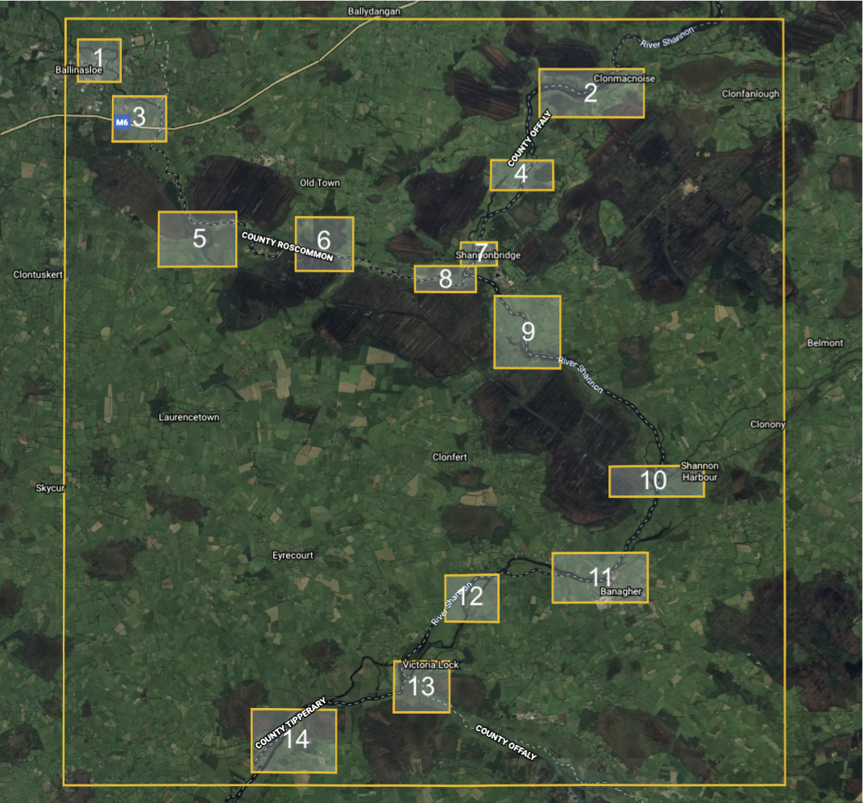
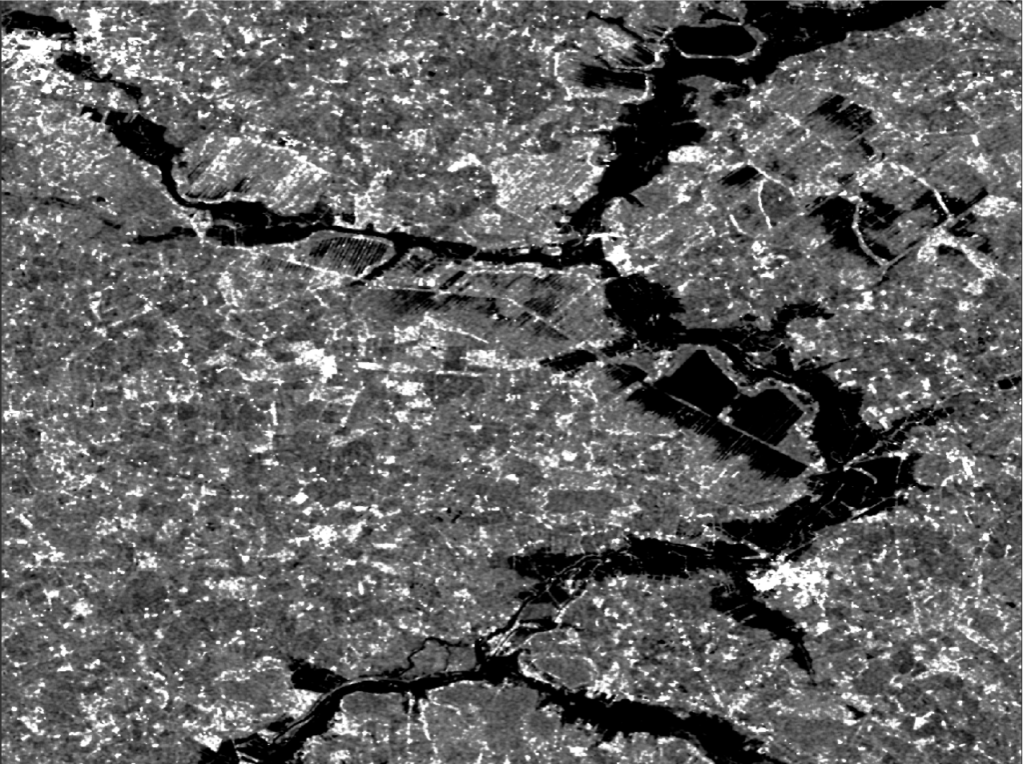
Land use modelling for hydrology, energy
Hydrology, the climate challenge
Model impact of land use change on flooding, droughts, water storage
Initial work with OPW and GSI
Larger/better model working with Met Éireann, the Marine Institute, Teagasc, .. required
Requires highly heterogenous, “AI-Ready” datasets
Digital Twins = Environmental models for Policies & Decision
Moving from 11% to 30% forestry – where ?
Cope with wetter winters, 10-fold increase in summer dry periods
Location of trees affects groundwater
Energy: locations of PV, EVs, biomass from FORESIGHT, SEAI work to a house-level energy planning twin (proposed) …
Estimating flooding under trees, groundwater via visible and Radar Images
AM

Slide 21
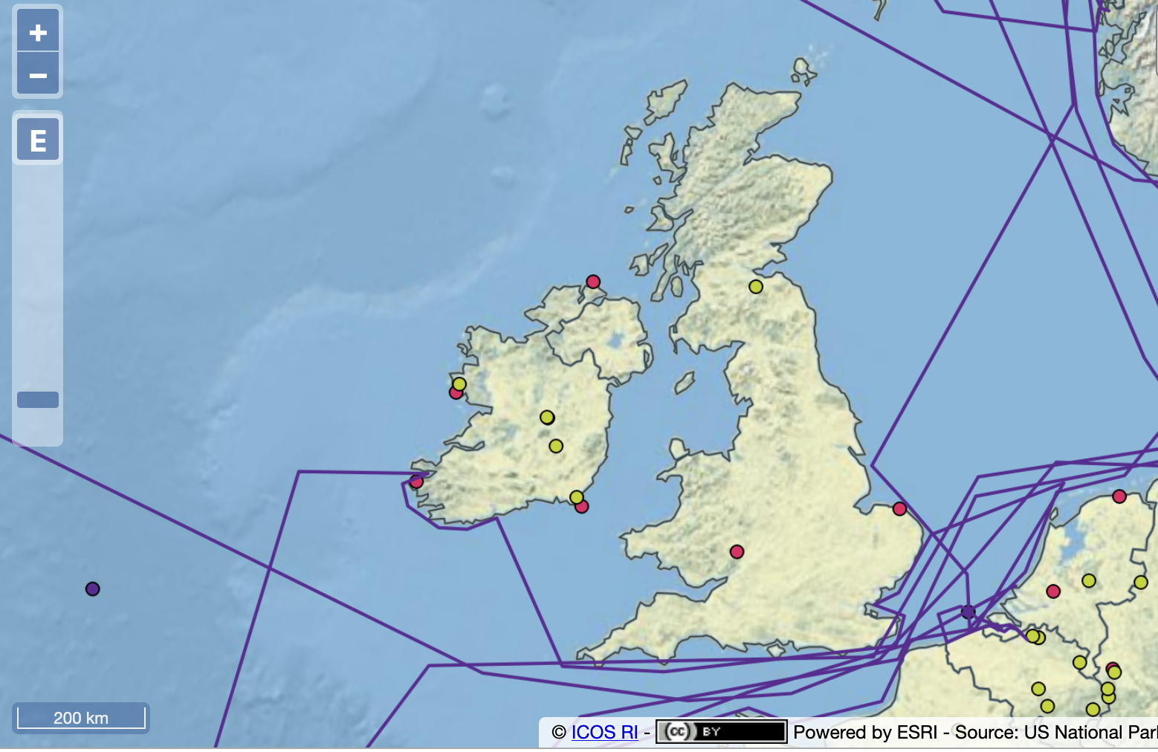
ICOS - Integrated Carbon Observing System
Challenge: calculating greenhouse gas emissions
Forward modeling:
Live land-cover maps and emissions factors + known point sources
Reverse modeling:
GHG assimilation modeling and EO monitoring
Measurement at stations on coast assimilated into chemistry atmos model
Reconcile these.
Forward planning: modeling with forestry stocks, scenario planning from FORESIGHT?

Slide 22
Lifecycle curation
Support Academia , public sector in maturing workflows
Bring them to a sustainable level:
Packaged so they can be supported by platform team
Data archiving
Discoverability, authentication
Curate
Manage a lifecycle of a workflow from academic, to component of someone else’s workflow. Mixture of private/shared/public products

