Slide 1
EO Collection Data Citation Guidelines – Introduction and survey
I.Maggio, Starion for ESA
Agenda Item 3.1/3.2
WGISS-60
13-17 October 2025
Oberpfaffenhofen, Germany

Slide 2
WHAT IS THE DATA CITATION?
Citation is the process of adding information to a text or other material that indicates where an external resource has been used to create it.
Data citation is the practice of referencing data products used in research.
Data citation means references to data, in the same way researchers routinely provide a bibliographic reference to other scholarly resources.
Although data are often shared, they are not always cited the same way as journal articles or other publications.
Research organizations play an important role in data citation by linking their data to the articles that cite them.
A newly written paper contains information about the data used in its creation so that a reader can find this data, or even just note who created it and draw some conclusions about its reliability.
Citing data properly is essential for ensuring transparency, reproducibility, and giving appropriate credit to data creators.

Slide 3
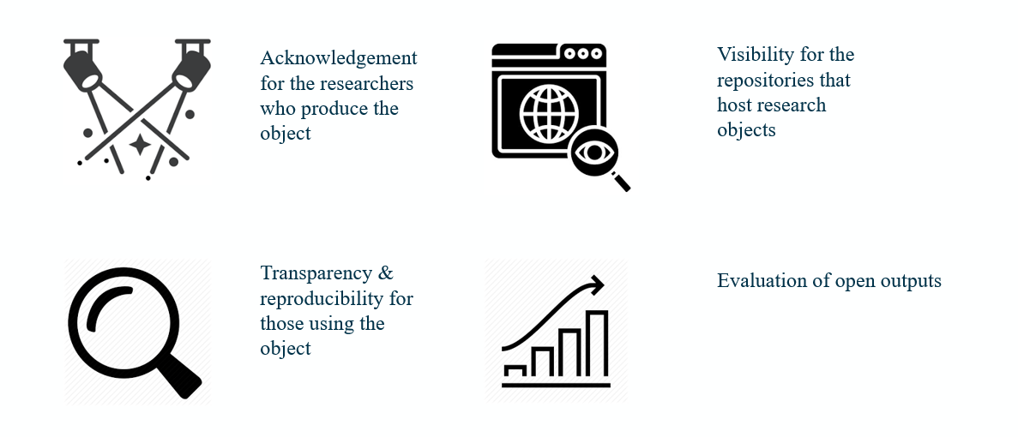
WHY CITE?

Slide 4
WHY CITE?
Data attribution: Data citation allows the authors of a publication to properly acknowledge data authors (including themselves if they created the data) and to attribute credit to them for collecting, documenting, and sharing their data.
Data findability and access: Data citation can be an entry point to data otherwise not or hardly findable. Indeed, data citation makes it easier for the readers to find and access the data. With the use of persistent and unique identifiers (such as DOIs), location and access to data is quick and ensured for the long-term.
Data reuse: Since data citation facilitates findability and access to the data used in a publication, it also helps and fosters reuse of the data by the readers in order to address new research questions.
Transparency: Data citation indicates precisely which data, and its specific version, has underpinned the research. This gives credibility to the work of the data user, in accordance with the research standards for citations.

Slide 5
WHY CITE?
Reproducibility: Data citation supports the reproducibility of science and, more specifically, of your research by enabling other researchers to find the data used for the analyses in order to reproduce and verify the results and, thus, assess their integrity.
Data recognition: Citing data specifically contributes to recognising data as a legitimate scholarly contribution, that is, recognising the creation and sharing of data as important scientific contributions alongside scientific articles and monographs.
Data impact: It is likely that data authors wish to know if, why, and in what manner the fruit of their work is used by others, as they do for other research outputs such as articles. Data citation ensures the traceability of reuse and facilitates measuring the impact of data.
Data sharing: Finally, citing the data and therefore acknowledging the data authors is an important incentive for future data authors to share their data.

Slide 6

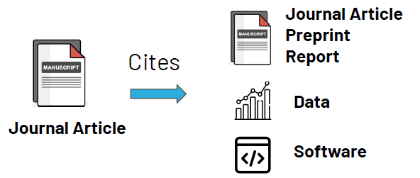
HOW TO CITE DATA?
A data citation includes key descriptive information about the data, such as the title, source, and responsible parties.
Three aspects should be considered to cite data correctly:
The citation should refer to the data. A dataset is composed of one or several data files and can include documentation files. Generally, datasets are accessible from a discipline-specific, institutional or journal data archive or repository. A data citation should, thus, link to the page where the dataset is published.
Second, the data should be cited in-text, in an abbreviated version, and included as a full version in the general reference section, as is the case for any other sources and materials contributing to a publication, such as books, articles, reports, conference presentations, or websites (Silvello, 2018).
Third, to be considered correct the full citation must include at least the core components.

Slide 7
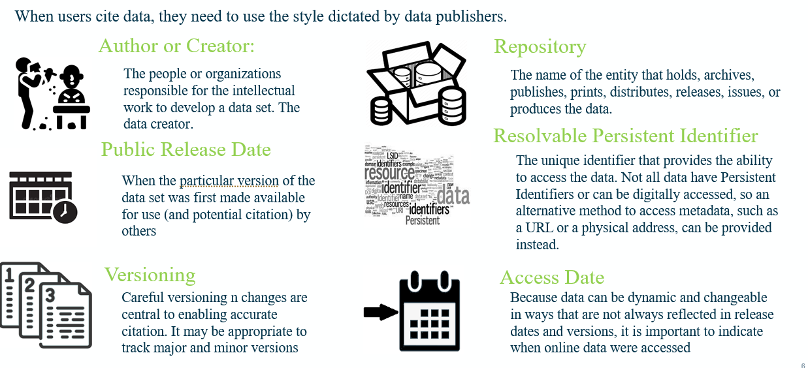
HOW TO CITE DATA?

Slide 8
HOW TO CITE DATA?
CORE COMPONENTS OF A DATA CITATION:
Author: Name of each individual or organisational entity responsible for the creation of the data. This could also be the rights holder.
Title of the data: Complete title of the data.
Year of publication: Year the data was published or disseminated for the version of the data used.
Version: Version or edition number associated with the data.
Data publisher: Organisational entity (e.g., data repository or archive) that makes the dataset available by preserving and/or disseminating the data.
Persistent identifier: Unique electronic identifier used to locate and access the data (such as a DOI). If available, the persistent identifier should be included as a link (e.g., https://doi.org/xxxxxx) and used instead of the URL or other Internet link.
ADDITIONAL COMPONENTS OF A DATA CITATION:
Depending on the citation format requested by the guideline or style, additional components, such as the data number, the resource type, the place of publication, or the date of access, might be requested.

Slide 9


EO COLLECTION DATA CITATION GUIDELINES
Main Objectives:
Perform a Data Citation guides survey
Share the agency experience and lessons learned in data citation
Confirm the CORE COMPONENT OF DATA CITATION for EO needs
Select ADDITIONAL COMPONENTS OF A DATA CITATION
Draft the EO Collection Data Citation Guideline

Slide 10
Data Citation Survey
I.Maggio, Starion for ESA
Agenda Item 3.1/3.2
WGISS-60
13-17 October 2025
Oberpfaffenhofen, Germany

Slide 11
Common Examples
Data citations drawn from commonly used style manuals:​
APA: Cool, H. E. M., & Bell, M. (2011). Excavations at St Peter’s Church, Barton-upon-Humber [Data set]. doi:10.5284/1000389​
Chicago: (Footnote) H. E. M. Cool and Mark Bell, Excavations at St Peter’s Church, Barton-upon-Humber (accessed May 1, 2011), doi:10.5284/1000389.​
MLA: Cool, H. E. M., and Mark Bell. “Excavations at St Peter’s Church, Barton-upon-Humber.” Archaeology Data Service, 2001. Web. 1 May 2011. <http://dx.doi.org/10.5284/1000389>. Oxford : Cool, H. E. M. and Bell, M. (2011), Excavations at St Peter’s Church, Barton-upon-Humber [dataset] (York: Archaeology Data Service), doi: 10.5284/1000389​
Citation formats suggested by three data repositories:​
PANGAEA: Willmes, S et al. (2009): Onset dates of annual snowmelt on Antarctic sea ice in 2007/2008. doi:10.1594/PANGAEA.701380 ​
Dryad: Kingsolver JG, Hoekstra HE, Hoekstra JM, Berrigan D, Vignieri SN, Hill CE, Hoang A, Gibert P, Beerli P (2001) Data from: The strength of phenotypic selection in natural populations. Dryad Digital Repository. doi:10.5061/dryad.166​
Dataverse: Frederico Girosi; Gary King, 2006, ‘Cause of Death Data’, http://hdl.handle.net/1902.1/UOVMCPSWOL UNF:3:9JU+SmVyHgwRhAKclQ85Cg== IQSS Dataverse Network [Distributor] V3 [Version].​

Slide 12
Earth Science Example
The Publishing Network for Geoscientific and Environmental Data (PANGAEA) - open access library and data publisher for the earth and environmental sciences.
  Giesecke, T et al. (2013): Validated sample ages from 823 EPD sites. doi:10.1594/PANGAEA.804597, Supplement to: Giesecke, Thomas; Davis, Basil AS; Brewer, Simon; Finsinger, Walter; Wolters, Steffen; Blaauw, Maarten; de Beaulieu, Jacques-Louis; Binney, Heather; Fyfe, Ralph M; Gaillard-Lehmdahl, Marie-José; Gil-Romera, Graciela; van der Knaap, Pim Willem O; Kunes, Petr; Kühl, Norbert; van Leeuwen, Jaqueline F N; Leydet, Michelle; Lotter, André F; Ortu, Elena; Semmler, Malte; Bradshaw, Richard H W(2013): Towards mapping the late Quaternary vegetation change of Europe. Vegetation History and Archaeobotany, 12 pp, doi:10.1007/s00334-012-0390-y
Oak Ridge National Laboratory (ORNL) Distributed Active Archive Center (DAAC) - for biochemical dynamics is one part of the NASA’s Earth Observing Systems Data and Information System (EOSDIS) managed by the Earth Science Data and Information System (ESDIS) project.
  Gu J.J., E.A. Smith, and H.J. Cooper. 2006. LBA-ECO CD-07 GOES-8 L4 Gridded Surface Ration and Rain Rate for Amazonia: 1999. Data Set. Available on-line [http://www.daac.ornl.gov] from Oak Ridge National Laboratory Distributed Active Archive Center, Oak Ridge, Tennessee, U.S.A. doi:10.3334/ORNLDAAC/831 ce Data and Information System (ESDIS) project.

Slide 13
Earth Science Example
Federation of Earth Science Information Partners (ESIP) - open networked community of more than 100 data centers in the United States. It includes organizations such as the National Aeronautics and Space Administration (NASA), the National Oceanic and Atmospheric Administration (NOAA), the Environmental Protection Agency (EPA), the National Science Foundation (NSF), the United States Geological Survey (USGS), the Department of Energy (DOE), and others.
  Cline, D., R. Armstrong, R. Davis, K. Elder, and G. Liston. 2002, Updated 2003. CLPX-Ground: ISA snow depth transects and related measurements ver. 2.0. Edited by M. Parsons and M. J. Brodzik. National Snow and Ice Data Center. Data set accessed 2008-05-14 at http://dx.doi.org/10.5060/D4MW2F23z.
Natural Environment Research Council’s (NERC) Environment Data Centers - provide a unique and irreplaceable record of the environment. NERC’s network of data centers provides support and guidance in data management to those funded by NERC, is responsible for the long-term curation of data, and provides access to NERC's data holdings in subject areas including atmospheric science, Earth sciences, Earth observation, marine science, polar science, science-based archaeology, terrestrial and freshwater science, hydrology, and bioinformatics.
  Science and Technology Facilities Council (STFC), Chilbolton Facility for Atmospheric and Radio Research, [Callaghan SA, Waight J, Walden CJ, Agnew J, Ventouras S]. 2009b. GBS 20.7 GHz slant path radio propagation measurements, Chilbolton site. NERC British Atmospheric Data Centre. doi:10.5285/639A3714-BC74-46A6-9026-64931F355E07.

Slide 14

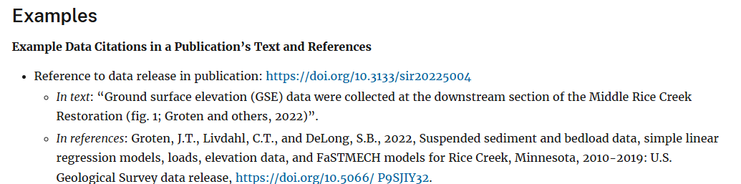
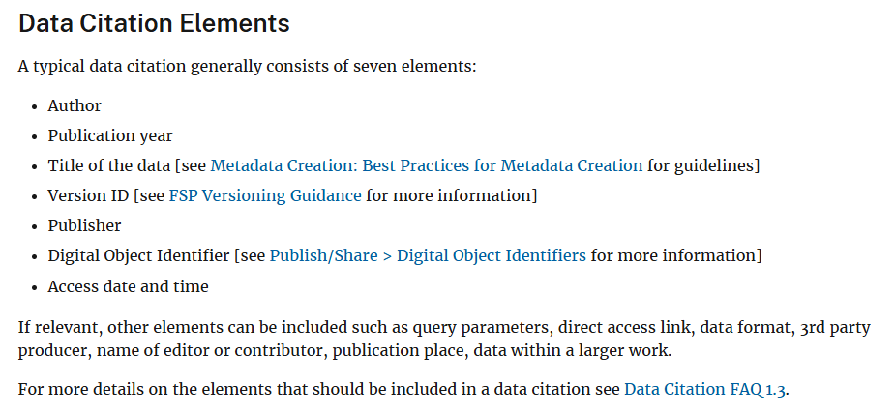
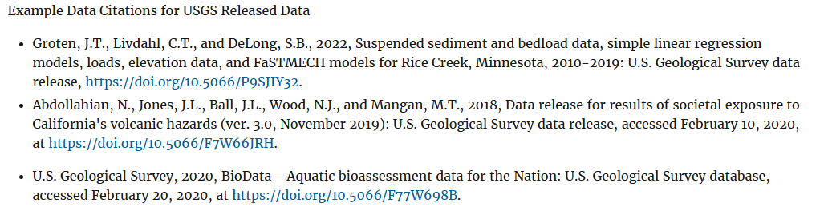
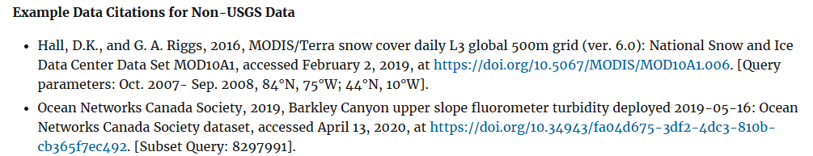
Earth Science Example

Slide 15

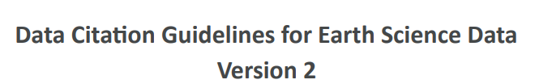

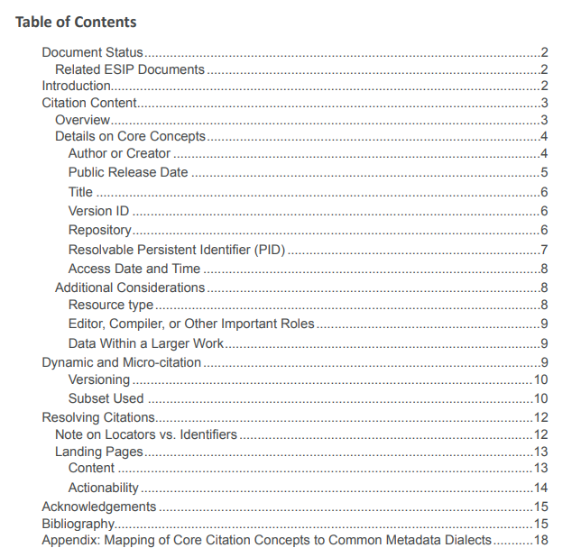
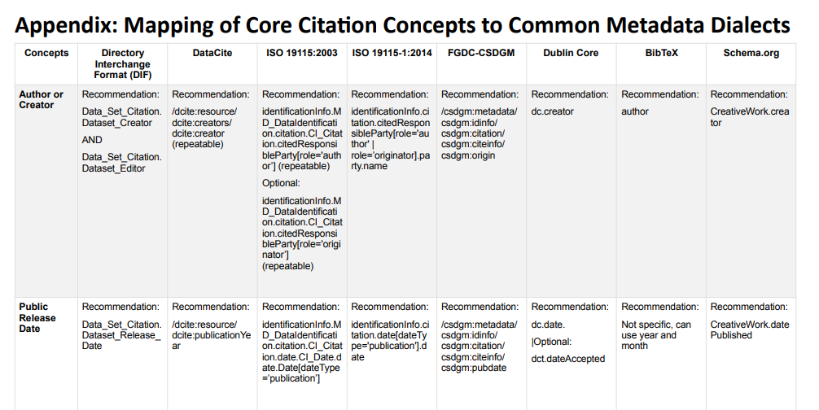
Earth Science Example

Slide 16



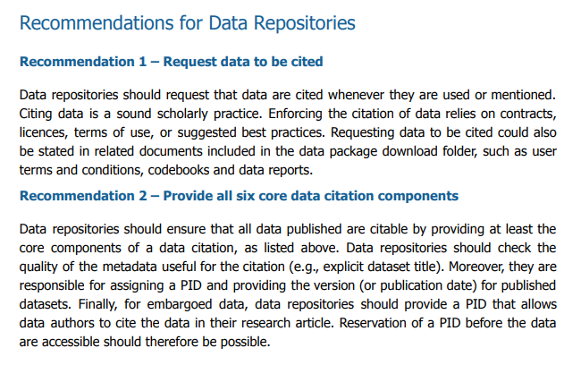
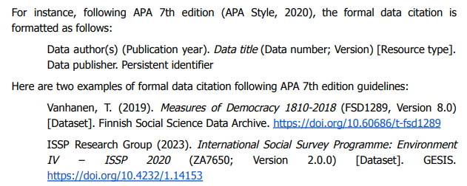
Earth Science Example

Slide 17
Proposed Way Forward
Sharing WGISS members lessons learned
Select ADDITIONAL COMPONENTS OF A DATA CITATION
Draft the EO Collection Data Citation Guideline (using, tailoring and mixing the already existent relevant literatures)

