Slide 1
Federated AuthN/Z
White Paper
Status
F.Marchesi, Solenix/ESA
Agenda Item 4.2
WGISS-60
13-17 October, 2025
Oberpfaffenhofen, Germany

Slide 2
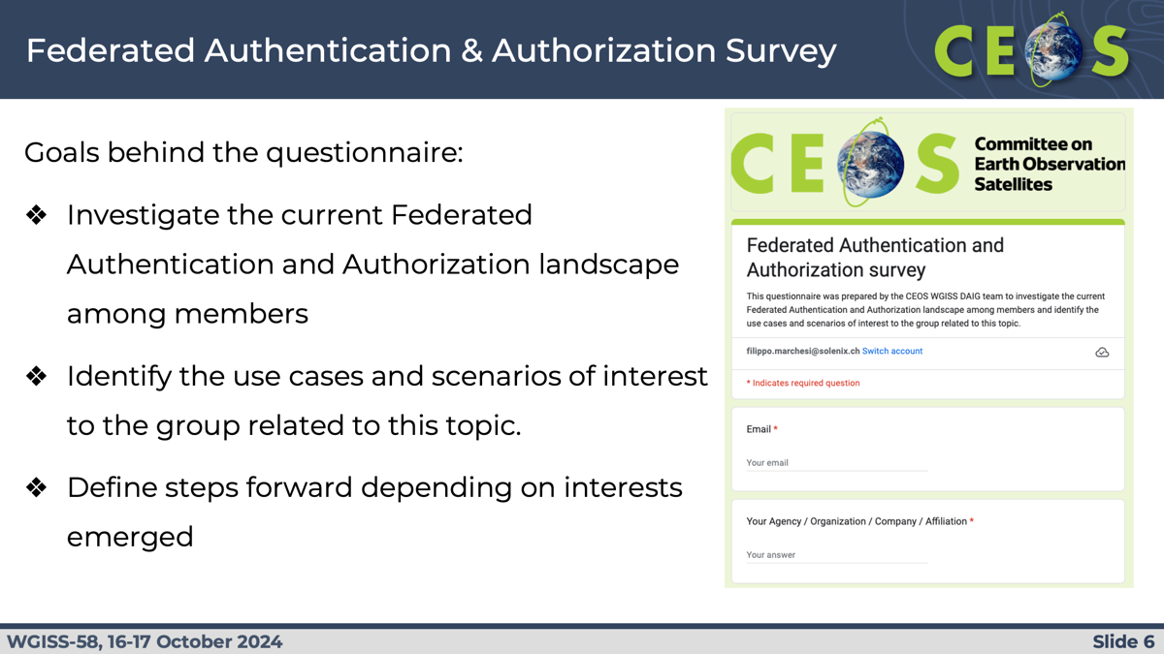
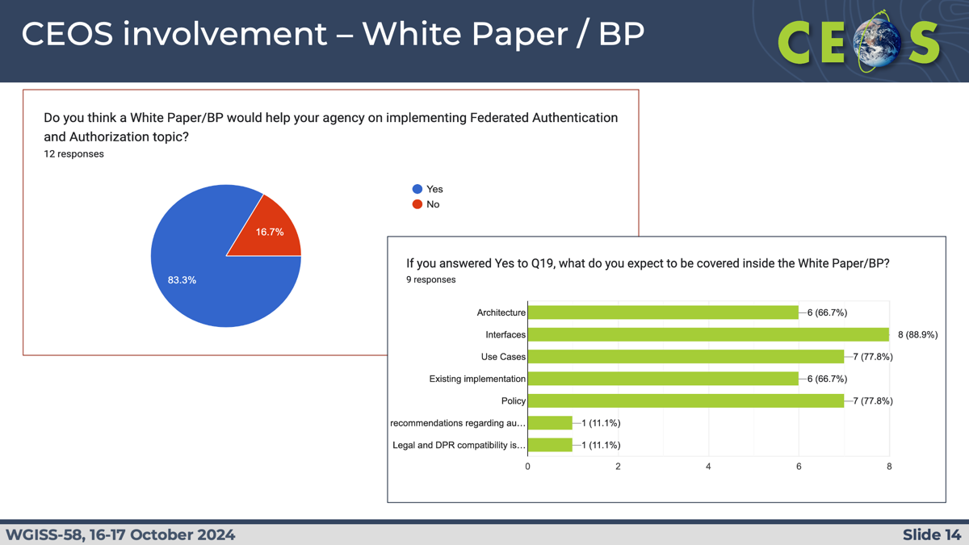
WGISS-57 Survey

Slide 3
Planned Deliverable
Number | Title | Completion Date | Description | Responsible CEOS Entity(ies) | Contributing Agency(ies)
DATA-25-01 | White paper on federated access | 2026-09-30 | The White Paper on Federation is expected to present background information related to federated authentication and authorisation. Later, through the description of a selected list of use cases, will attempt to provide basic conclusion useful to CEOS members willing to implement federation | WGISS | ESA
ToC and contribution definition
Consolidation and Implementation
Review and Publication

Slide 4
WGISS Actions
DAIG / TEIG shared actions
WGISS-58-20 | DAIG to investigate the infrastructure costs of centralised and decentralised authentication methods.
WGISS-59-11 | DAIG and TEIG to consider whether a separate white paper on Data Federation is needed, alongside the current work on User Federation.
Possible SEO involvement
WGISS-57-15 | DAIG to discuss with SEO the possibility of a central CEOS Authentication mechanism.
WGISS-58-21 | TEIG to investigate with DAIG and SEO the available technologies for federated authentication, and which would fit with the objectives of CEOS.

Slide 5
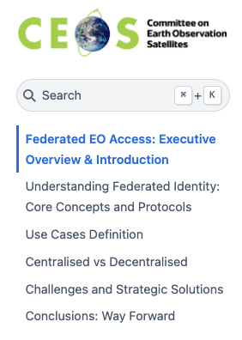
Action Plan
Table of Contents definitions
  In & Out of scope
  Assign contribution
  Use Cases definition
  Existing documentation
GitHub repository coordination (link)
  Review/contribution process coordination
  JupyterBook format for automatic update

Slide 6
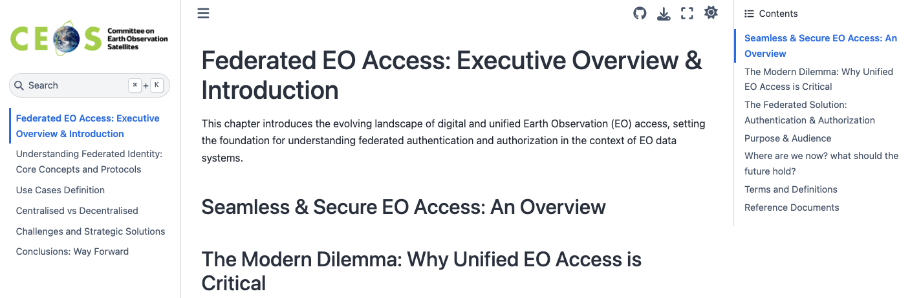
Table of Contents (1)
1. Federated EO Access: Executive Overview & Introduction
  Seamless & Secure EO Access: An Overview
  The Modern Dilemma: Why Unified EO Access is Critical
  The Federated Solution: Authentication & Authorization
  Purpose & Audience
Excluded | Federation of catalog Data federation WGISS-59-11
Included | User Federation

Slide 7
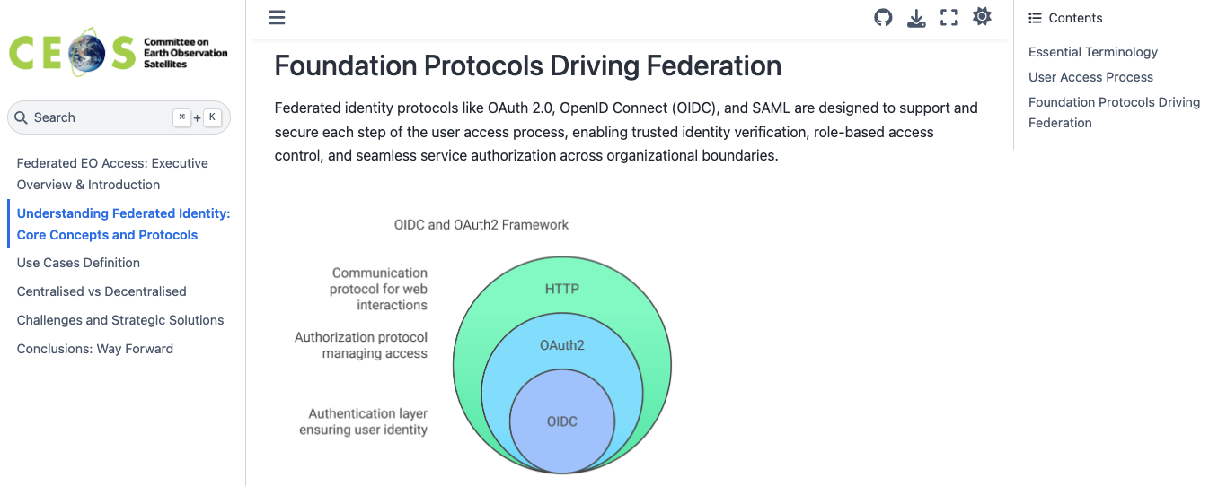
Table of Contents (2)
2. Understanding Federated Identity: Core Concepts and Protocols
  Essentials Terminology
  Foundational Protocols Driving Federation
    OAuth 2.0
    OpenID Connect (OIDC)
    SAML (Security Assertion Markup Language)
Included | easy diagrams references
Excluded | Not to explore too much beyond

Slide 8
Table of Contents (3)
3. Use Cases definition
  ESA/NASA MAAP
  NASA Use Case (WGISS-59)
  DestinE
  Bilateral ESA-DLR
  SSI Decentralised
  Copernicus Regional Data Hub (TBC)
  Use Cases Summary Table
Included | a summary table with the examples versus use cases covered / key techno applied / reasons for authentication, as cross reference.
Excluded
Use Case Example | Key Technologies Applied | AuthN | AuthZ | Objectives
ESA/NASA MAAP | (e.g., OIDC, OAuth 2.0, SAML, XACML, Attribute Exchange) | Yes/No | Yes/No | (e.g., cross-agency collaboration, data sharing, unified access)

Slide 9
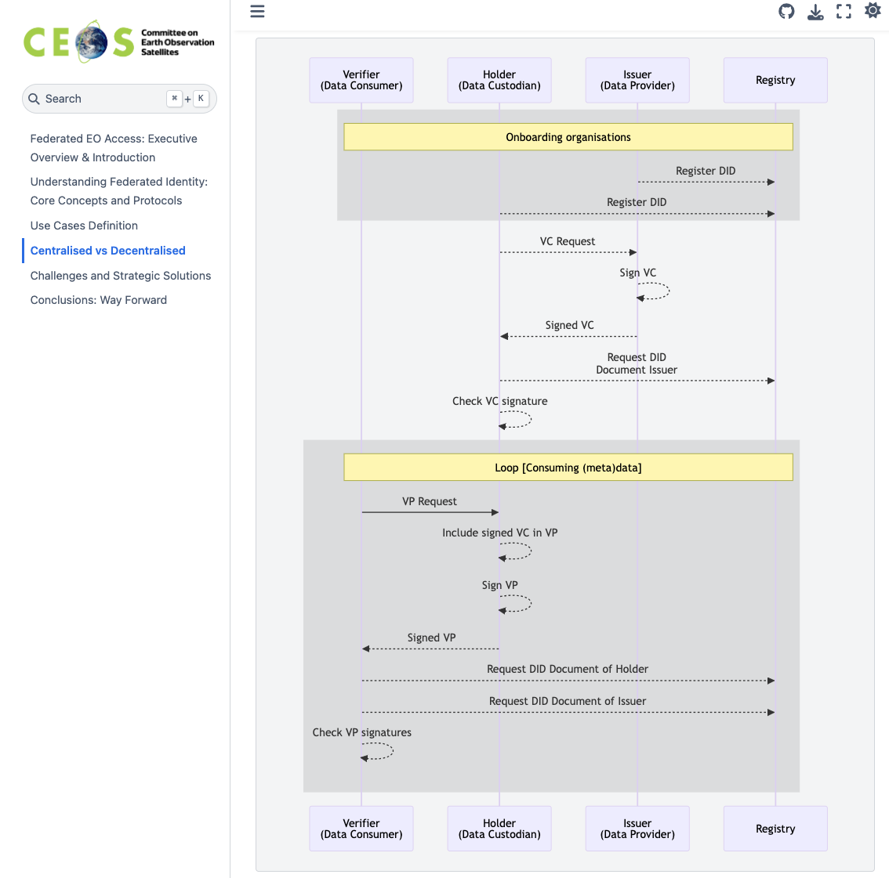
Table of Contents (4)
4. Centralised vs Decentralised
  Definitions
  IPT - Integrity Provenance & Trust
Included | OGC Testbed-21 Outcomes (IPT)
Excluded

Slide 10
Table of Contents (5)
5. Challenges and Strategic Solutions
  Technical Complexities and Interoperability
  Attribute Management and Governance
  Policy, Legal and Compliance Considerations
  Transformative Benefits for CEOS/EO Ecosystem
    CEOS possible implementation
6. Conclusions: Way Forward
  Call to Action/Recommendation
  Future Best Practices?
Included | - show differences on Authorization mechanisms and related implications - costs & security control
Excluded | not mandatory converge to suggest a specific solution

Slide 11
Meetings Coordination
Meeting | Date | Topics
Kick off meeting | Jun. 04, 2025 | Discussed vision, table of contents draft
#2 meeting | Jul. 10, 2025 | Contribution assignments
#3 meeting | Sept. 11, 2025 | Content review and additional assignments
#4 meeting | Sept. 30, 2025 12:00 UTC | Content review & GitHub coordination
#5 meeting | Nov. 10, 2025 12:00 UTC | Content review

Slide 12
Open Actions
Create a team for managing contributions on GitHub to facilitate easier access and collaboration. (TBC at next WGISS-60)
Create a contributing markdown document to guide new contributors on how to participate in the project.
Ensure the project has a Creative Commons license applied.
OGC Testbed-21 report on Integrity, Provenance and Trust, as additional contribution.

