Slide 1
STAC progress report
WGISS-60 10/13-17/2025
Doug Newman
NASA ESDIS Project, Goddard Space Flight Center
Notes:
STAC - Spatio-Temporal Asset Catalog
WGISS - Working Group on Information Systems and Services

Slide 2
Agenda
NASA ESDIS (CMR) STAC changes
What these changes means for CWIC
What is next
Notes:
ESDIS - Earth Science Data Information System
CMR - Common Metadata Repository
CWIC - CEOS WGISS Integrated Catalog
CEOS – Committee on Earth Observing Satellites

Slide 3
CMR STAC
Progress report

Slide 4
What we did since last time
Updated CMR-STAC to
Support Query and Sort API extensions
Support Storage and Opto-Electrical catalog extensions
Establish parity between cloud-stac and stac with respect to federation
Append collection search filters to item links
Updated STAC-Browser to allow
Independent item and collection search
Notes:
CMR - Common Metadata Repository
API - Application Programming Interface

Slide 5
What that means for CWIC
Progress Report

Slide 6
CMR-STAC can now…
Be used in the STAC Browser to find collections from INPE and USGS in CMR and navigate to items within their STAC catalogs
Preserve filter constraints from a collection search when navigating to item catalogs
Notes:
INPE - National Institute for Space Research, Brazil
USGS - United States Geological Survey

Slide 7
What inventory is available?
INPE - 73 collections
USGS EROS - 14 collections
NASA - 10,496 collections
We want more!
Notes:
EROS - Earth Resources Observation and Science center

Slide 8
Earthdata Search
Will move to using STAC for federated search when we have transitioned enough CWIC providers (API + metadata updates).
FEDEO et al - 53,843 collections
ISRO - 39 collections
NRSCC - 29 collections
USGS LSI - 128 collections
So, basically, FEDEO 😀
Notes:
FEDEO - Federated Earth Observation missions access
NRSCC - National Remote Sensing Center of China
LSI - Langelier Saturation Index

Slide 9
What is next
The big picture

Slide 10
Our CWIC wish list was…
Fix STAC browser to support collection search for collections that do not support granule search
Add support for more extensions
Build capacity for STAC Browser contributions
Add more STAC API enabled collections from other agencies
Replace OpenSearch implementation with STAC

Slide 11
Our new additions
Fix STAC browser to support item links with filters
Ensure that CWIC federated search works using Earthdata Search and STAC Browser

Slide 12
Demo!
Live!
Notes:
CEOS - Committee on Earth Observation Satellites
BP - Best Practices

Slide 13
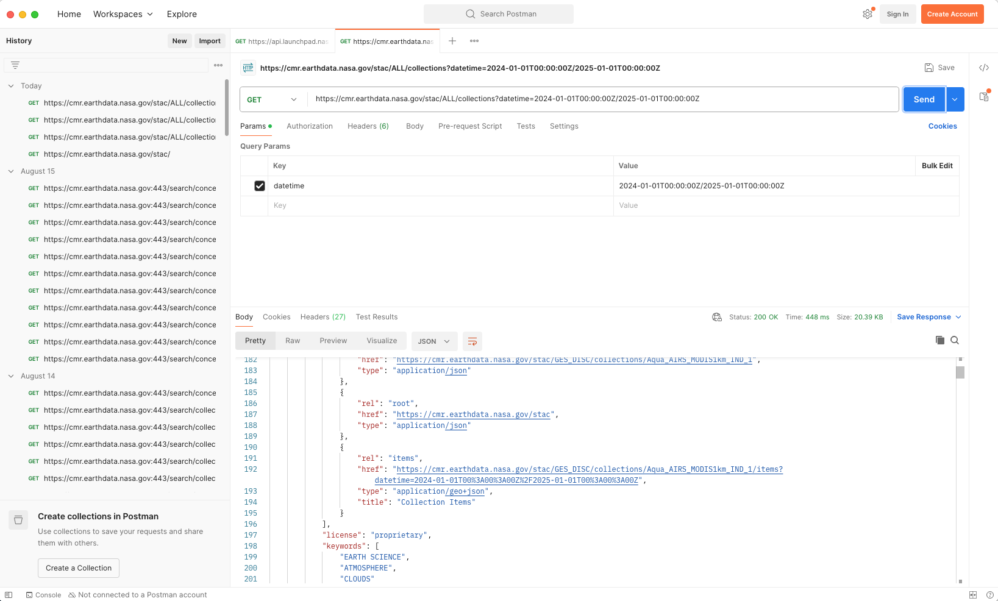
Using REST queries - filtered links
Notes:
REST - Representational State Transfer

Slide 14
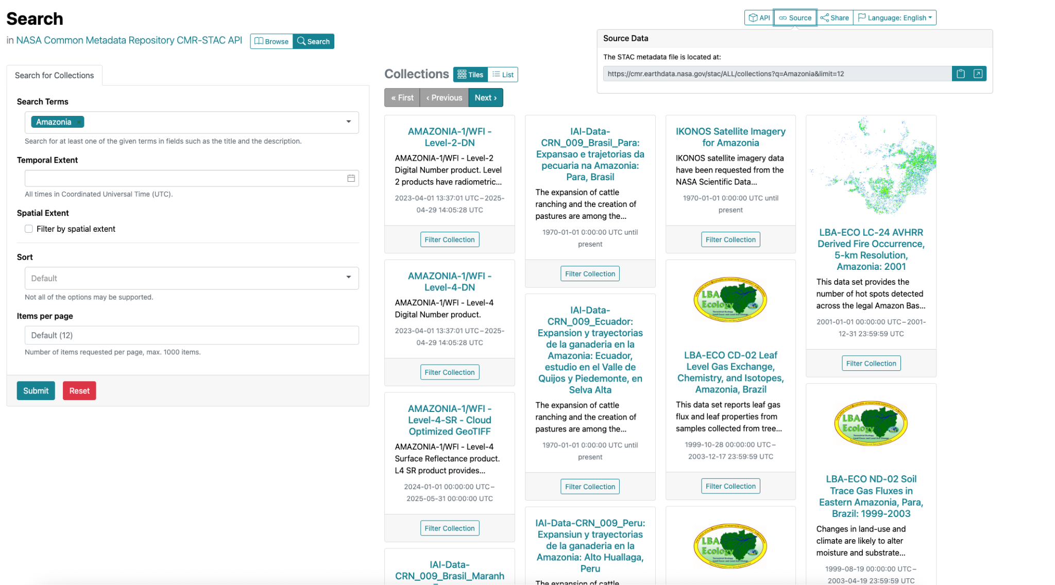
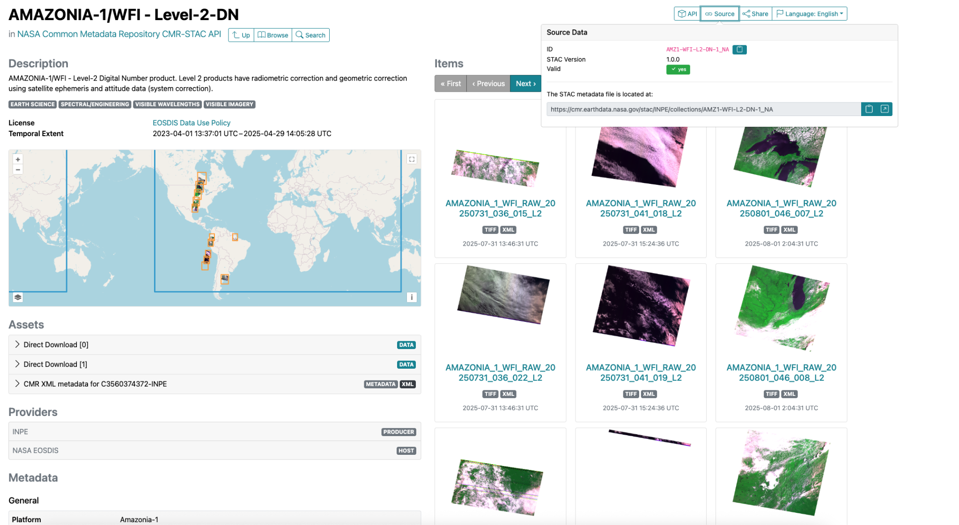
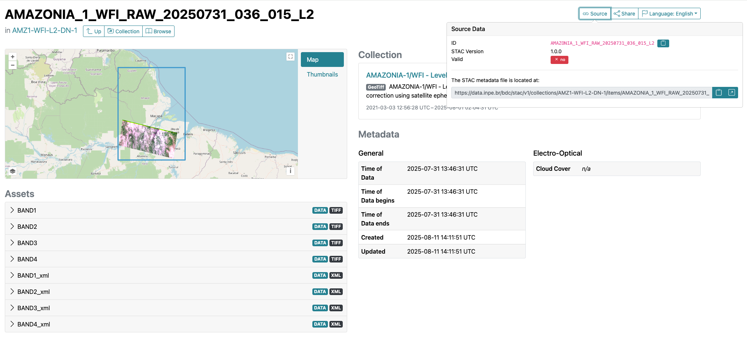
STAC browser - federated discovery
cmr.earthdata.nasa.gov/stac/ALL
Notes:
https://radiantearth.github.io/stac-browser/#/external/cmr.earthdata.nasa.gov/stac?.language=en
Select INPE catalog
Search for ‘Amazonia’

Slide 15
Let’s replace Open Search with STAC
CONTACT
douglas.j.newman@nasa.gov
WEBSITE
earthdata.nasa.gov
SOCIAL MEDIA
@NASAEarthData
Contact me at…

