Slide 1
EOEPCA Open Source Data Exploitation Platform
Richard Conway,
Telespazio UK
Agenda Item 4.4
WGISS-60
13-17 October, 2025
Oberpfaffenhofen, Germany

Slide 2
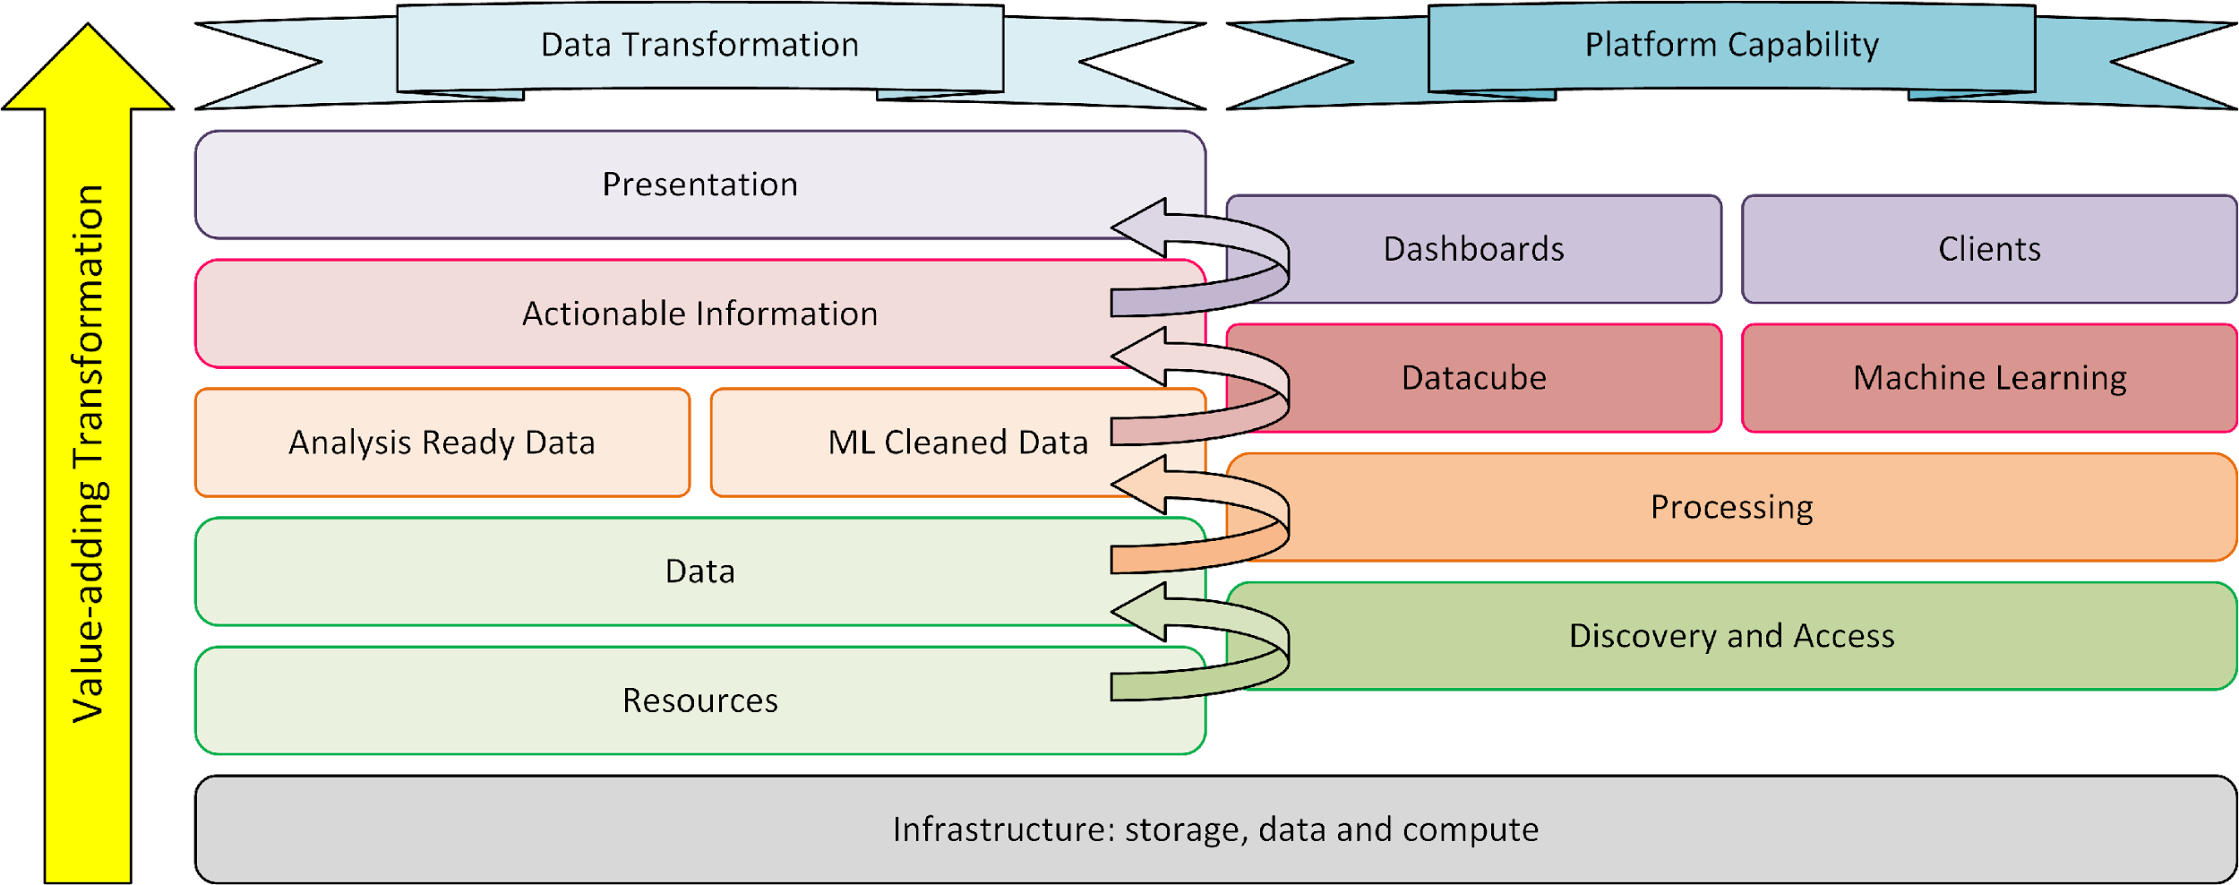
Context – Exploitation Platform
Transforming Data to Actionable Information – value-adding
Virtual analysis environment
Data
Compute
Tooling
Collaboration
Sharing
Publishing

Slide 3
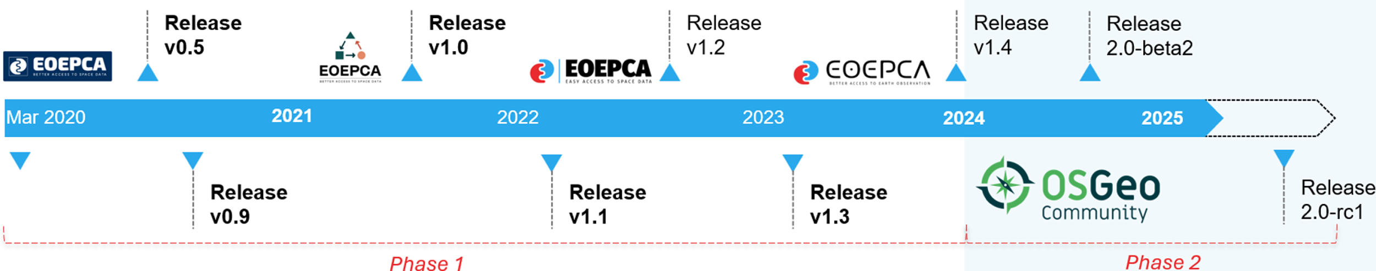
Aims and Objectives
Problem
Many platforms in a fragmented ecosystem
Difficult for users to exploit their complementary offerings
Our Approach
Common Architecture
Open Standards
Enabling Federation among EO cloud platform offerings
Promote and develop Interoperability standards
Reference Implementation
Open Source
Avoid further fragmentation
Reusable Building Blocks
Reduce development costs

Slide 4
Phase 2 – Introducing EOEPCA+
Goals
Fresh appraisal of the architecture and its implementation
Reusable building-blocks to promote interoperability and federation
Avoid fragmentation and reduce development costs
Open Source Governance
Strengthen open source approach through OSGeo – open governance
Focused Development
Roadmap informed by Steering Committee:
Stakeholders with Operational platforms intending to adopt EOEPCA building blocks
ESA Projects such as EarthCODE, APEx
Adoption and also possibility to contribute
New capability requirements
Consolidation of processing workflow approaches (OGC API Processes / openEO)
Datacubes
Machine Learning
Open science and best practice
Operationalisation of added-value resources (algorithms, applications, data)

Slide 5
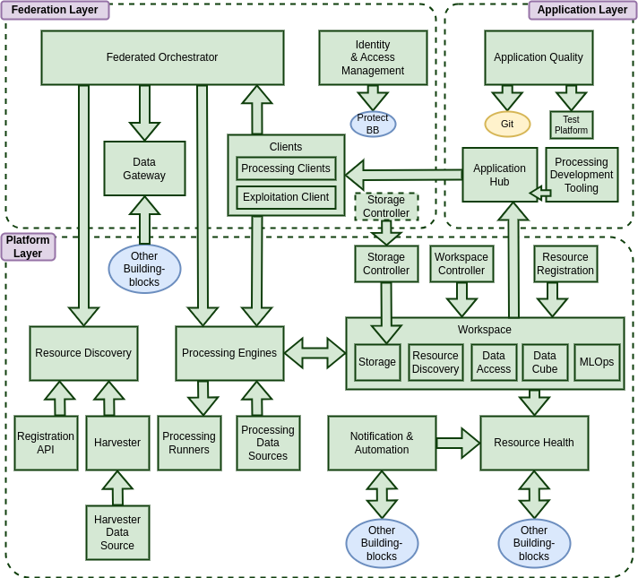
Building Blocks
Reference Implementation of the Common Architecture defined by Building Blocks with open standard interfaces
What is a Building Block (BB)?
Software component that implements a specific platform capability
Typically provides a service interface (REST API) -> standards
Designed to be used on their own, or in combination as a system
Open Source
Deployment
Kubernetes
Containerised implementation
Dedicated helm chart for each BB

Slide 6
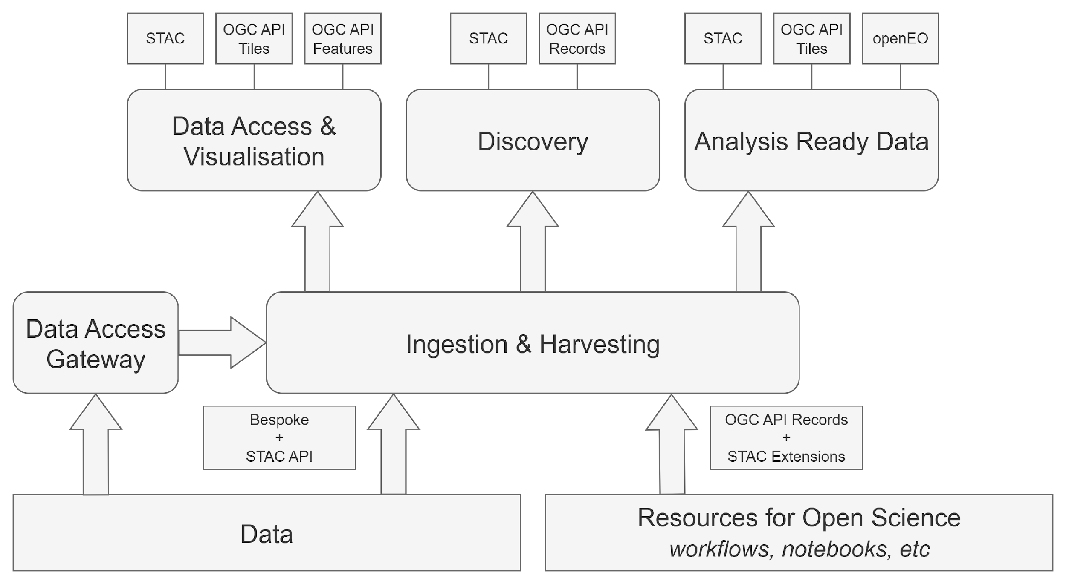
Data and Resources
Building Blocks for discovery, access and management of data and resources

Slide 7
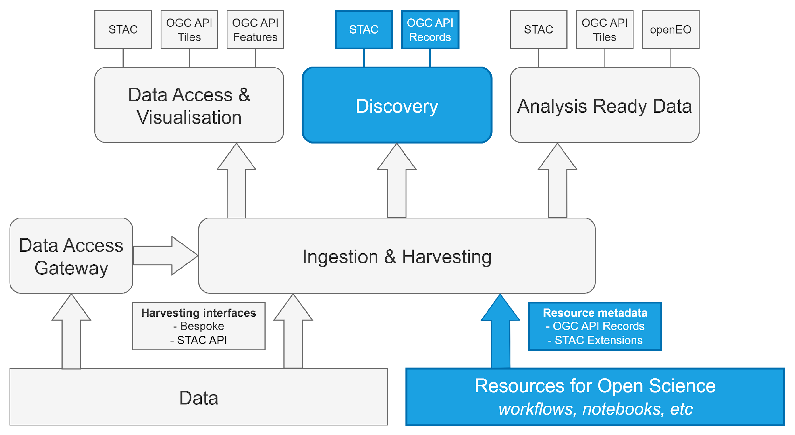

Data and Resources Resource Discovery
Resource Discovery BB
OGC and STAC interfaces
For Reproducible Open Science:
Workflows, datasets, notebooks, ML models, training data, source repo, documentation, …
EOEPCA Metadata Profile:
OGC API Records schema
With STAC Extensions

Slide 8
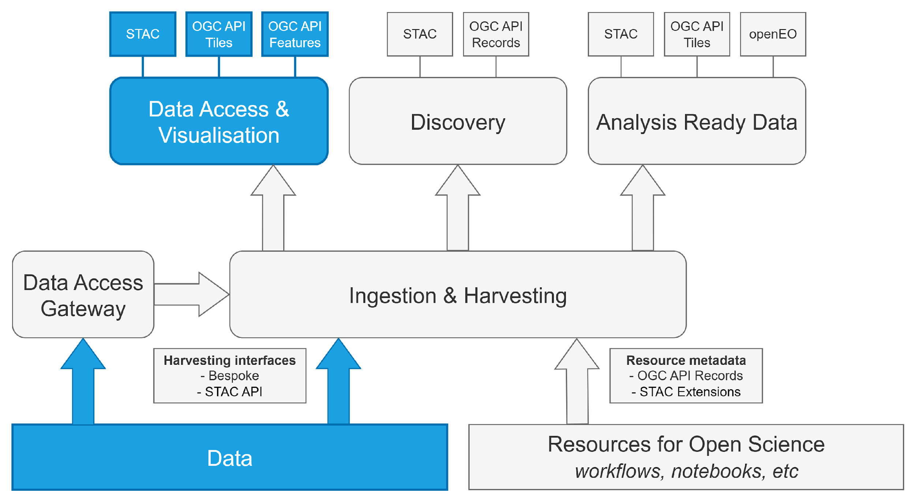
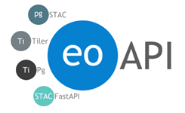
Data and Resources Data Discovery & Access
Data Access BB
STAC interface for data discovery
OGC Tiles/Features interfaces for data access and visualisation

Slide 9
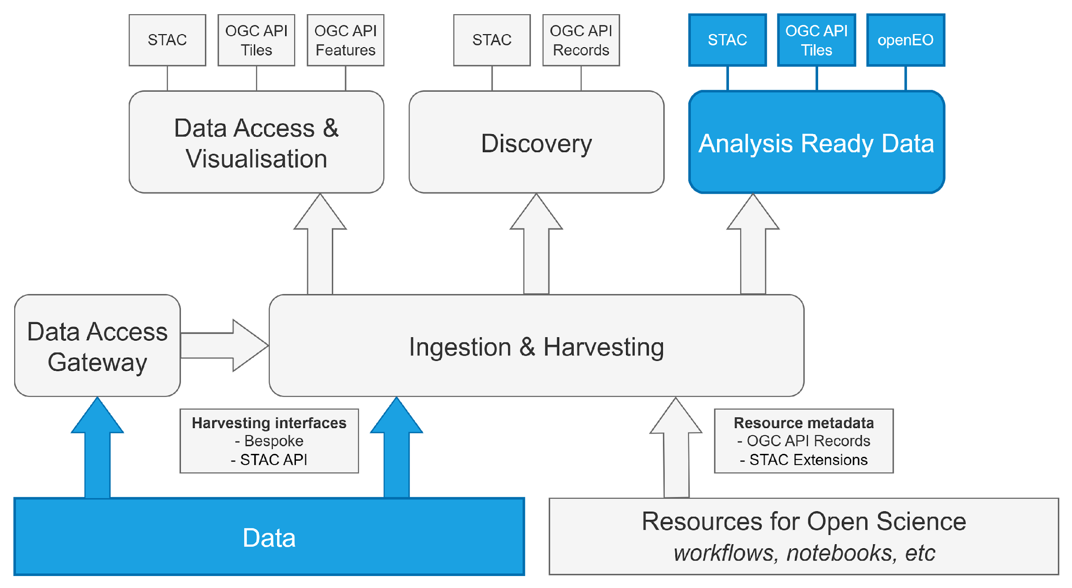



Data and Resources Datacube Access
Coming Soon
Datacube Access BB
Pixel-based access to multi-dimensional Analysis Ready data
Consolidated API for datacube discovery (STAC), access (Tiles) and synchronous processing (openEO)
Informed by OGC (Testbed-20) GeoDatacube API
STAC Best Practice for Datacubes

Slide 10
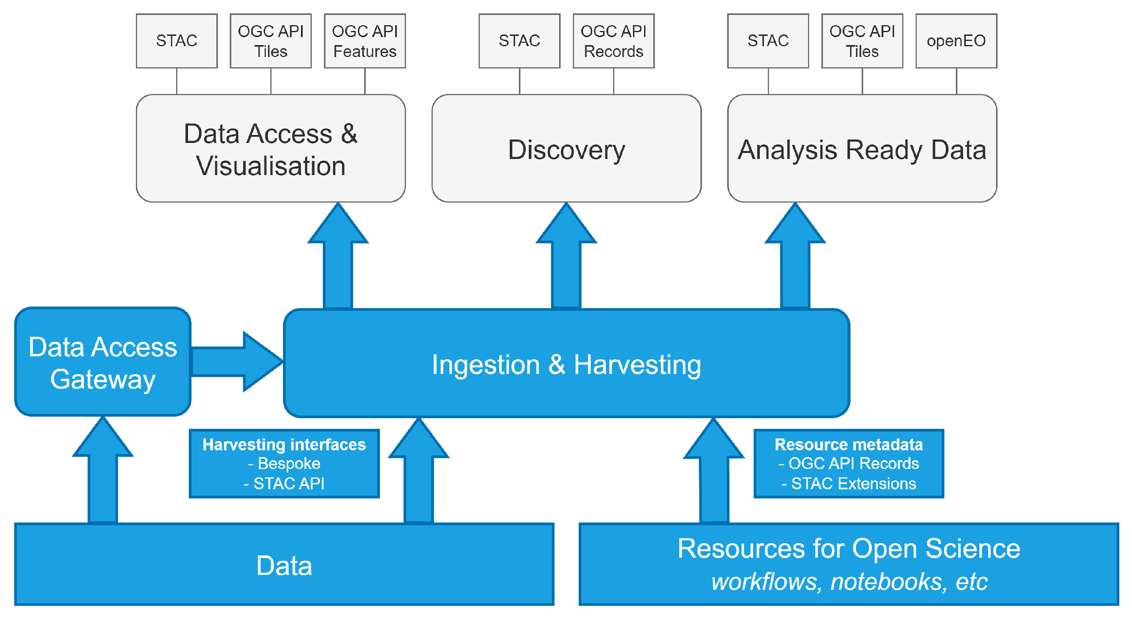



Data and Resources Ingestion & Harvesting
BETA
Resource Registration BB
Data harvesting from external sources:
Generic STAC harvester
Tailored workers
API for resource registration
EOEPCA Metadata Profile
Data Access Gateway BB
EODag:
Data source abstraction
Data access protocol
Authn / Authz
Python library
Extensible data providers

Slide 11
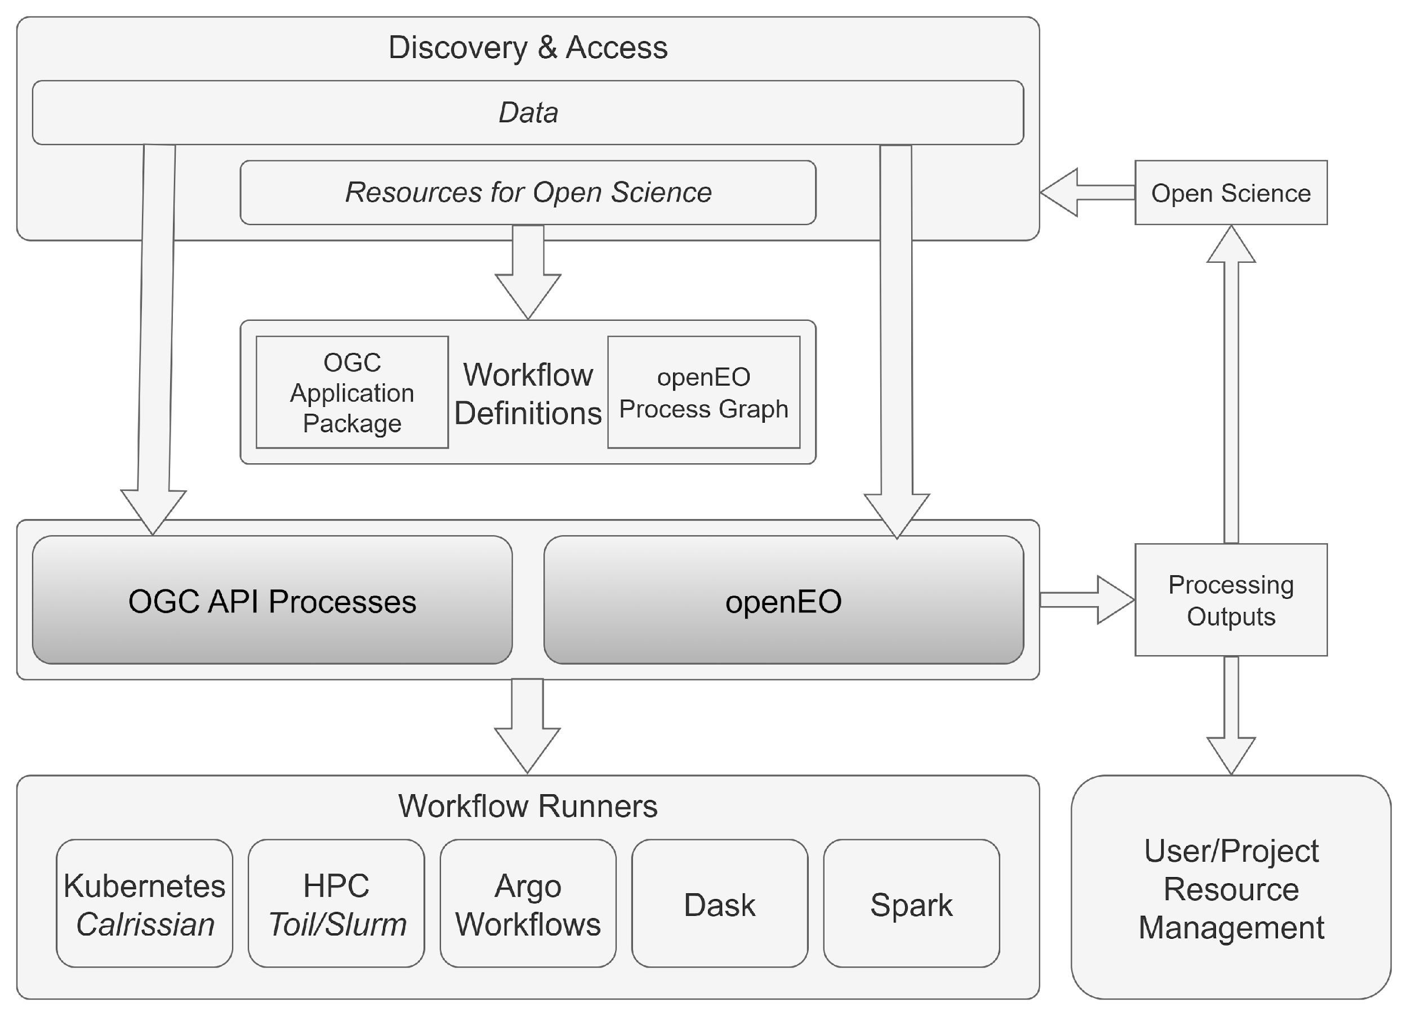
Processing
“Bring the processing to the data”
Building Blocks for user-defined processing and analysis
Two complementary approaches

Slide 12
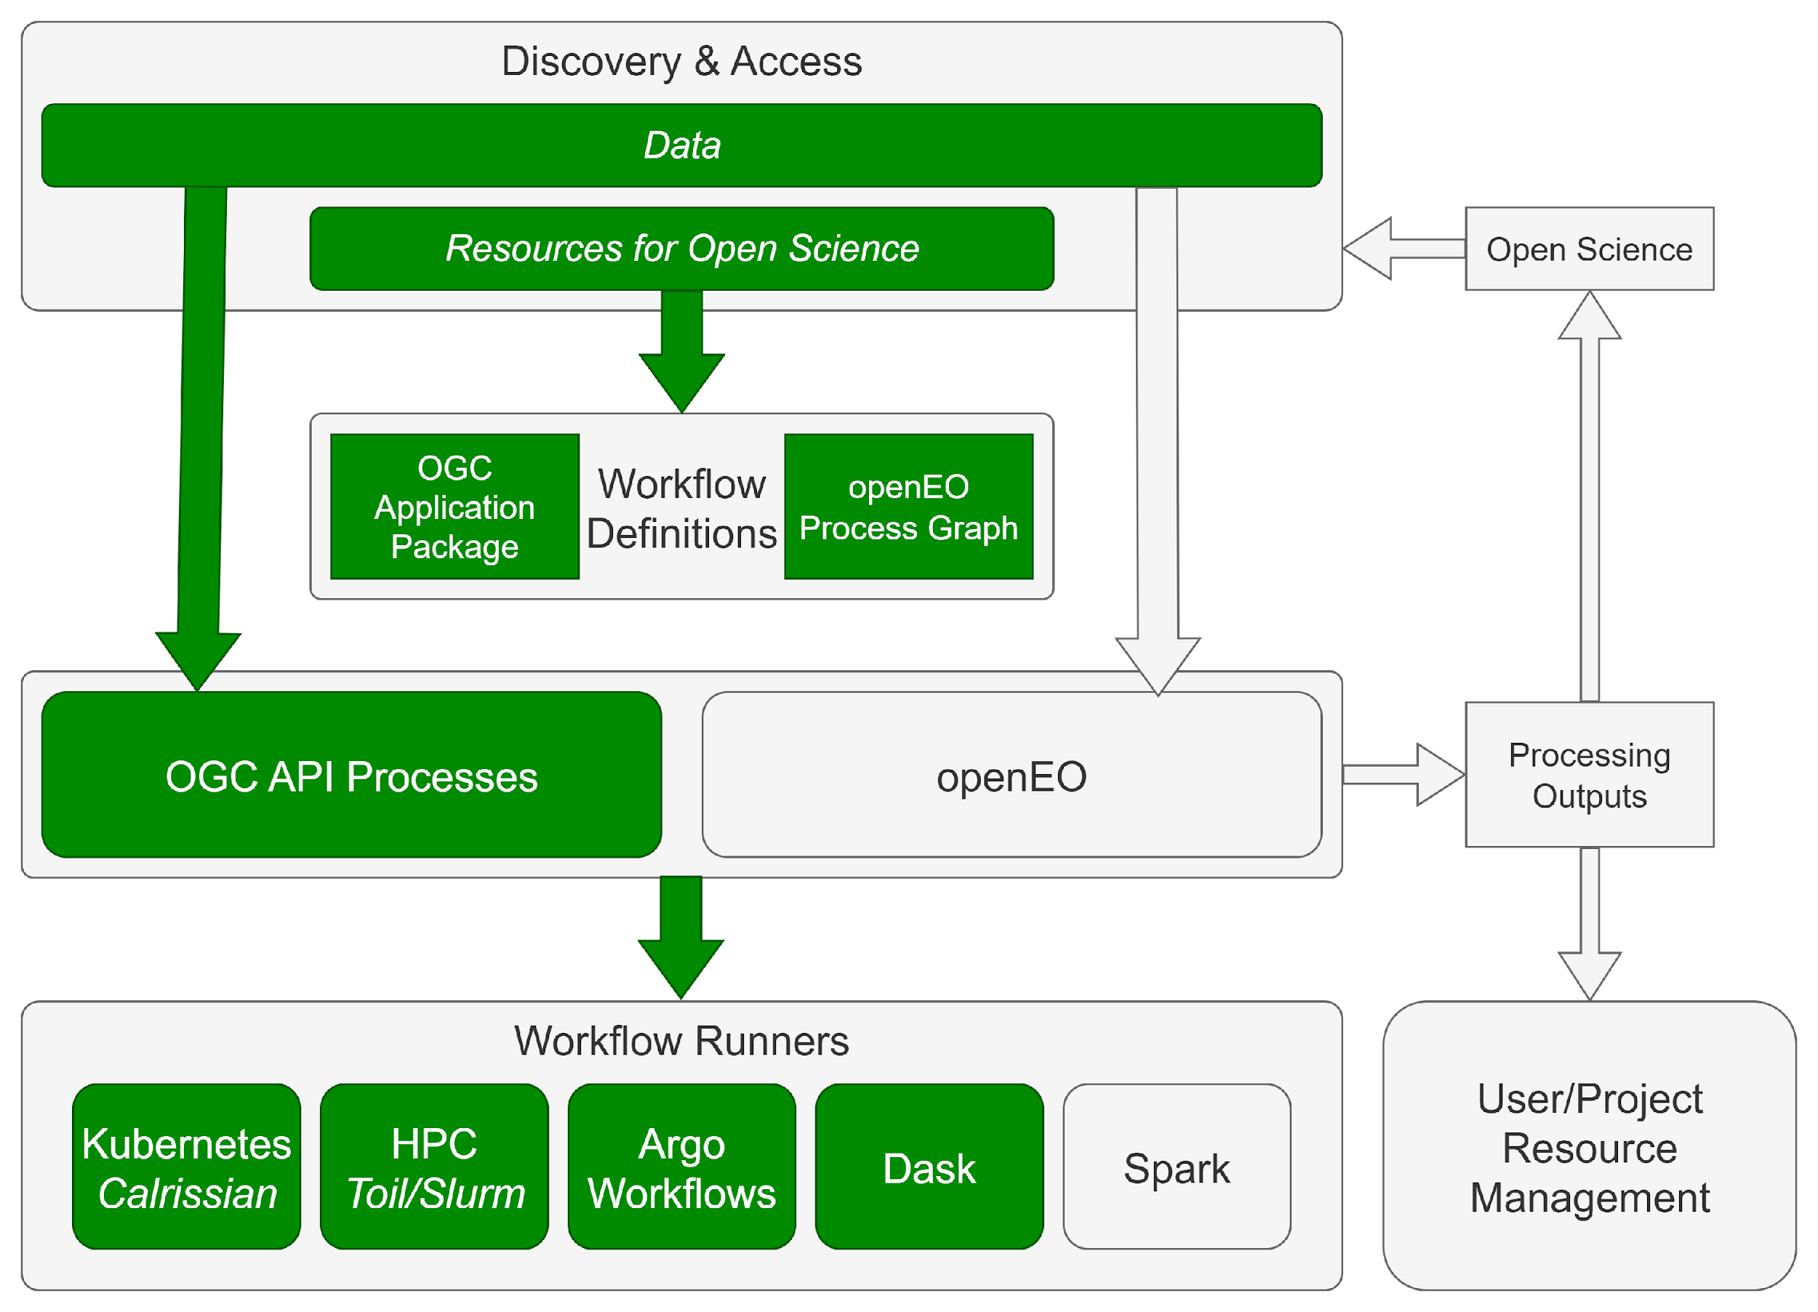

Processing OGC API with Application Packages
OGC Application Package
Portable processing workflows
Common Workflow Language
Steps: Containerised algorithms
OGC Best Practice
Processing BB
OGC API Processes
General Purpose Processing
Containerised workflows
OGC Application Package
Suited to batch processing
Workflow Runners
Backend workflow execution
Extensible integrations for CWL orchestration

Slide 13
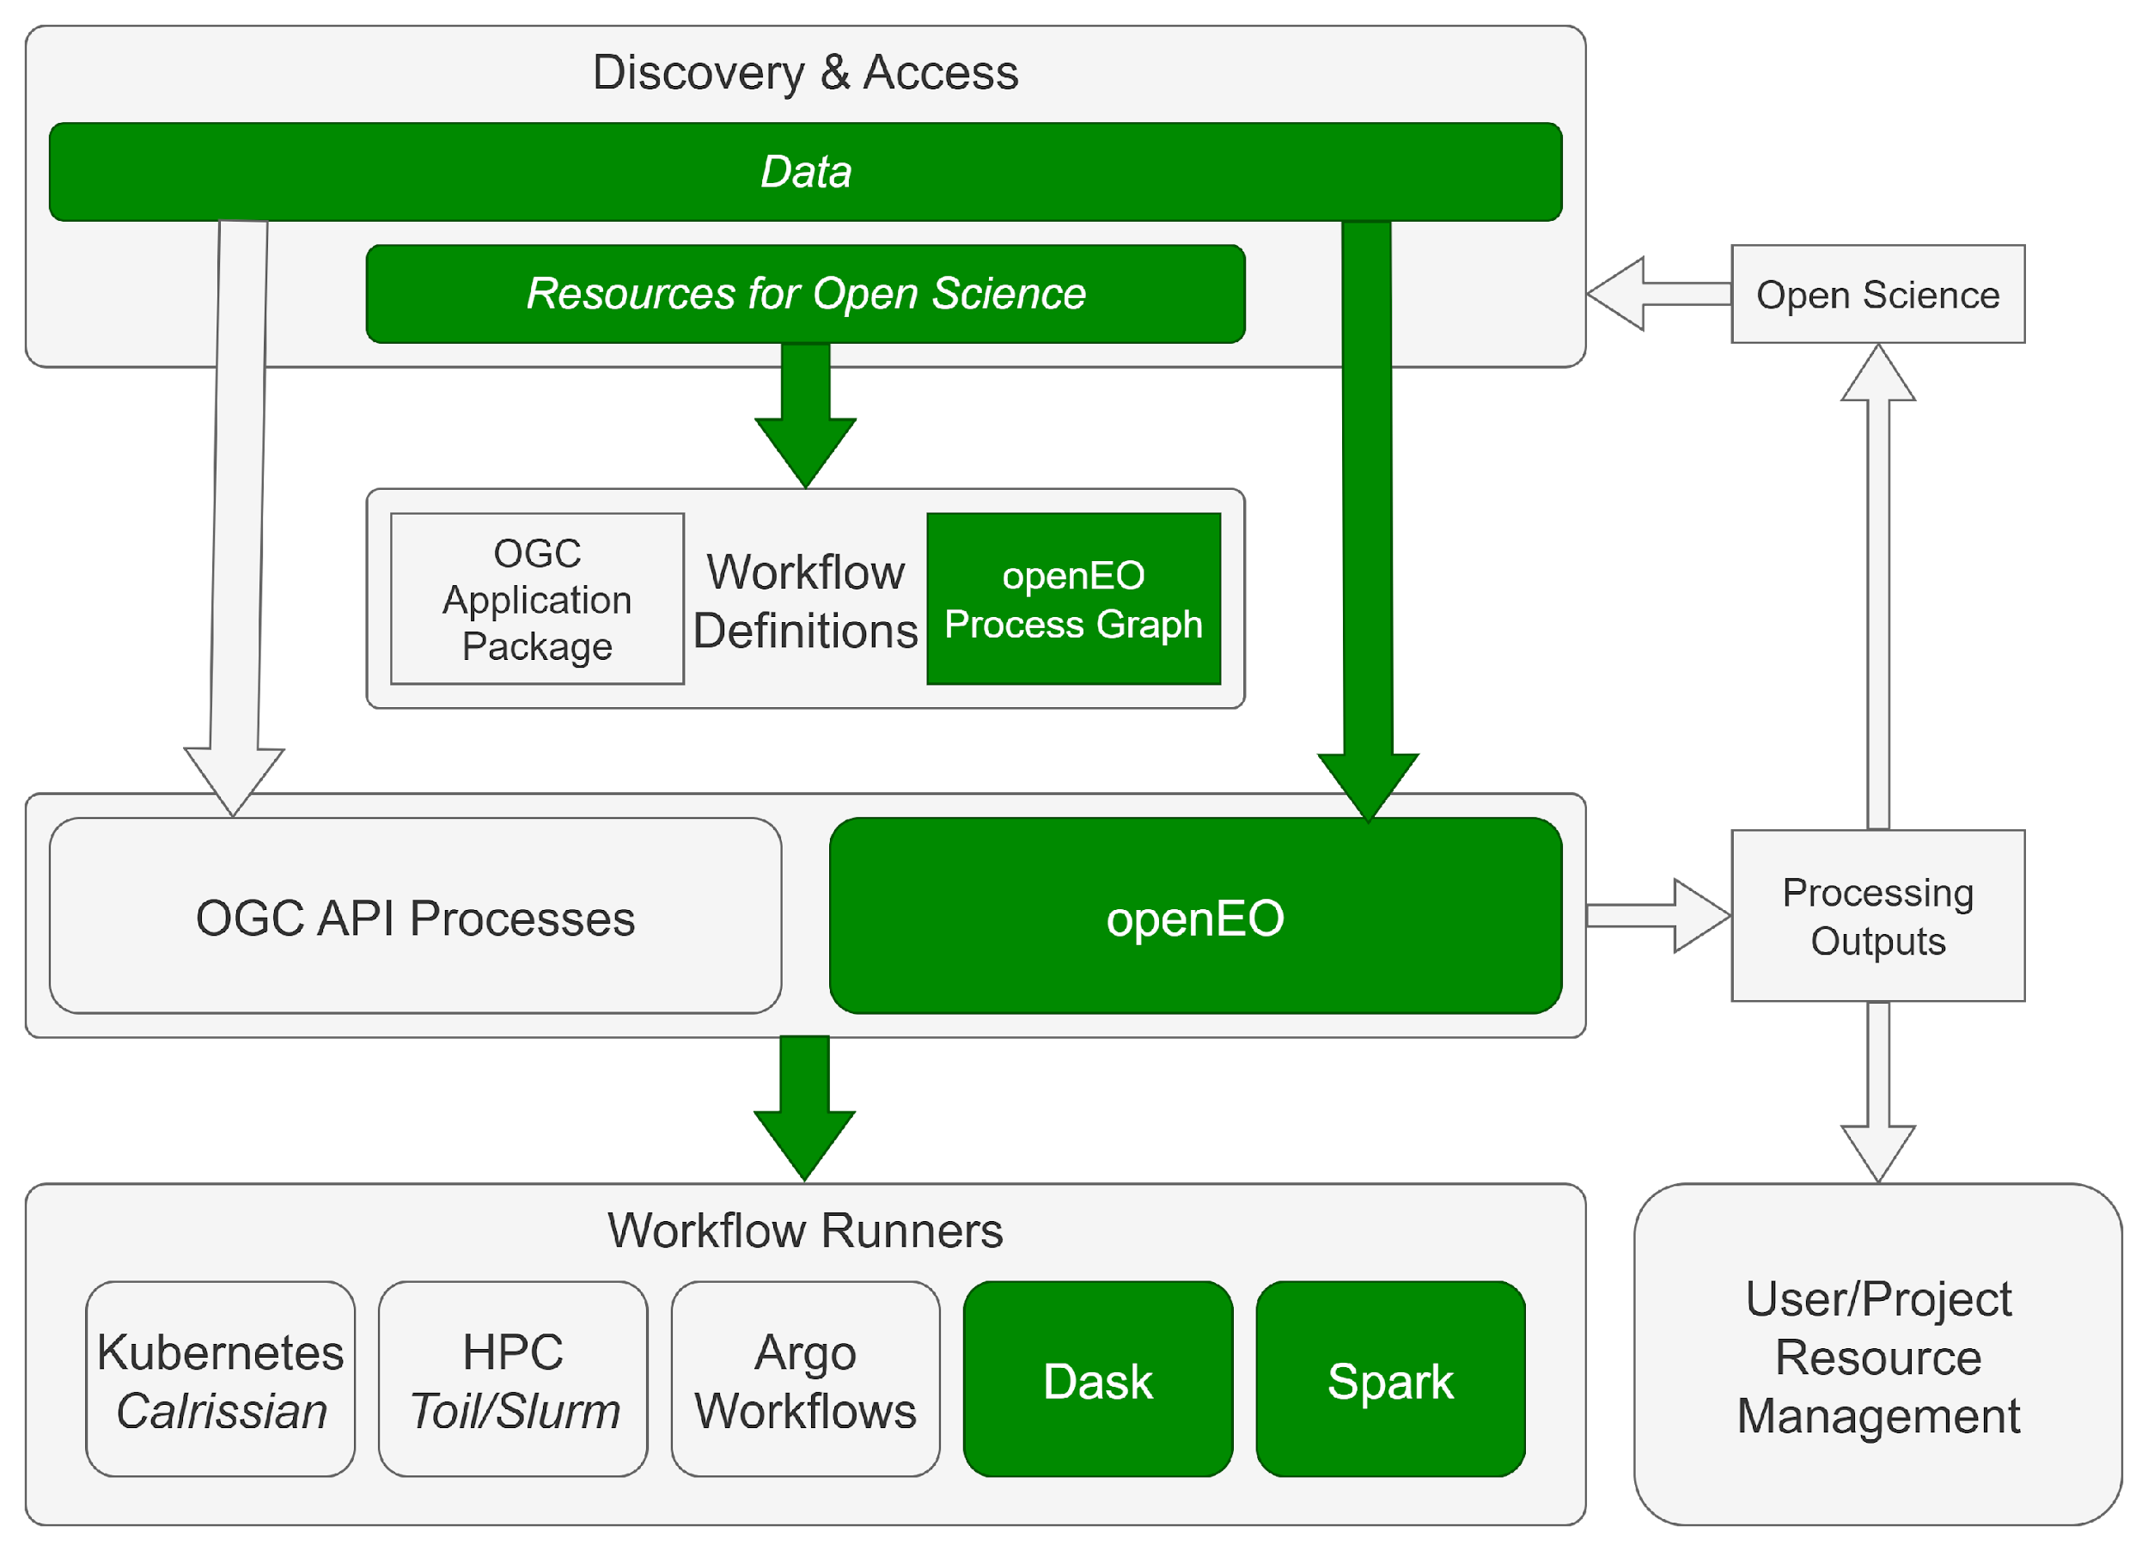
Processing openEO
Processing BB - openEO
Client-oriented Semantics
Python, R, JavaScript clients
JSON workflow representation
Close data integration
Emerging support for Application Packages
Workflow Runners
Backends for Dask and Apache Spark
Also TiTiler-based implementation for synchronous Datacube Access
Coming Soon
Federated Orchestrator BB
Cross-platform workflow execution
Hybrid workflows, combining:
openEO / OGC API Processes
Application Packages
openEO Process Graphs

Slide 14
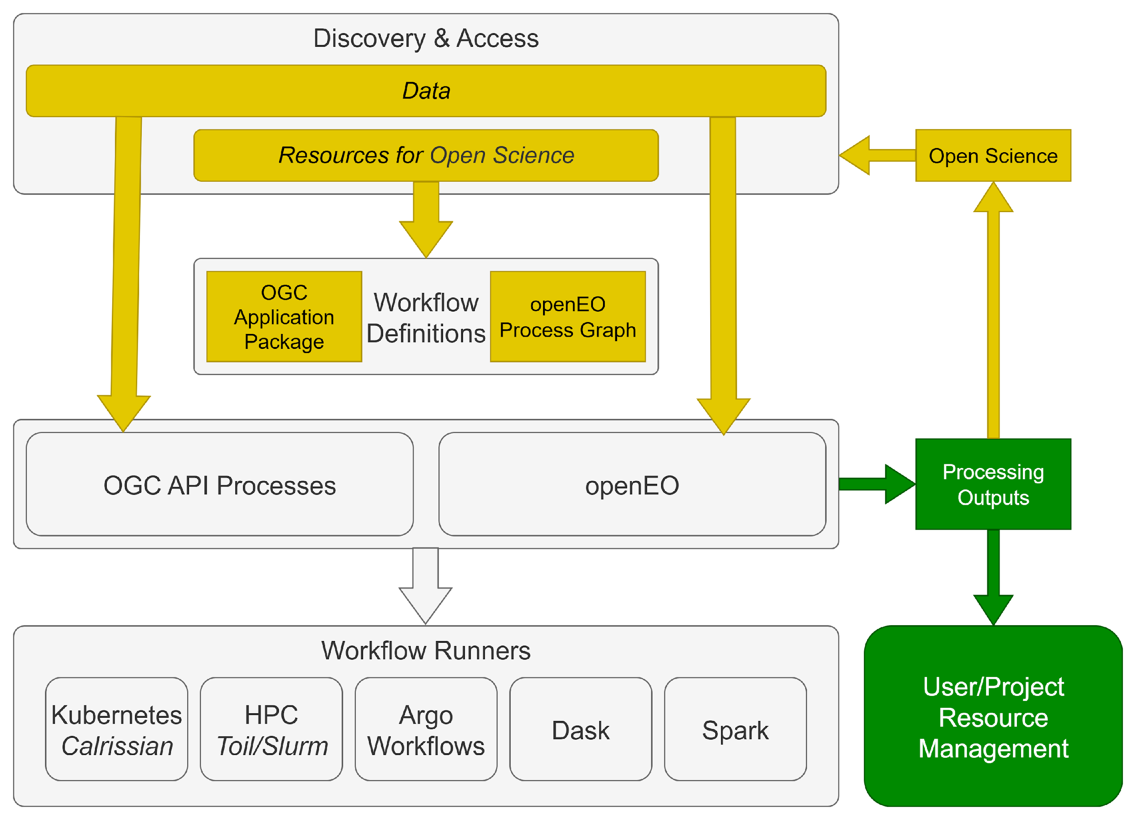
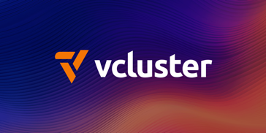

Processing Open Science
Reproducible Open Science
Portable/reusable workflows
Shared processing results
My Outputs => Your Inputs
EOEPCA Metadata Profile
Workspace BB
User / Project / Team
Resource management
Collaboration / sharing
Storage and shared services
Integrates with other BBs

Slide 15
And there’s more…
Federated User Identity
IAM BB
Single Sign-on
Access and Sharing
External Identity Provider integration
Machine Learning
MLOps BB
Model Training & Management
Training data management
Interactive Analysis
Application Hub BB
Notebooks for Analysis and Scientific Storytelling
Dashboards to showcase research outcomes
Application Best Practice
Application Quality BB
Best practices for Reproducible Open Science
Static analysis
Performance tuning
Event-driven Behaviour
Notification & Automation BB
Automated behaviour
E.g. systematic processing
Building Block decoupling
Operational Outcomes
Resource Health BB
Added-value Outcomes
Datasets, workflows, applications
Automated monitoring and alerts

Slide 16

















Partner Organisations
14 Building blocks (and counting) by a variety of developers
Communications & Outreach
Processing
Resource Discovery
Resource Registration
Data Access
Application Hub
Datacube Access
Workspace
Federated Orchestrator
Notification & Automation
IAM
Application Quality
MLOps
Resource Health
Data Gateway

Slide 17
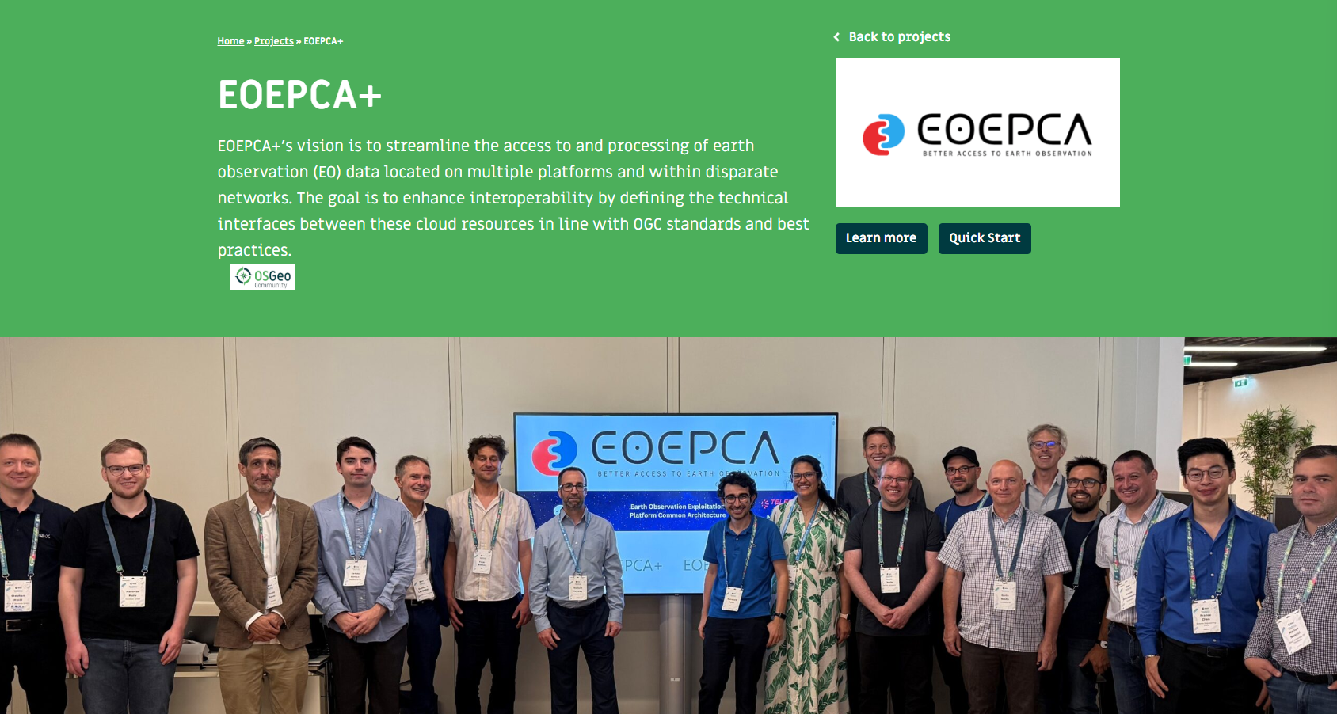
EOEPCA @OSGeo

Slide 18
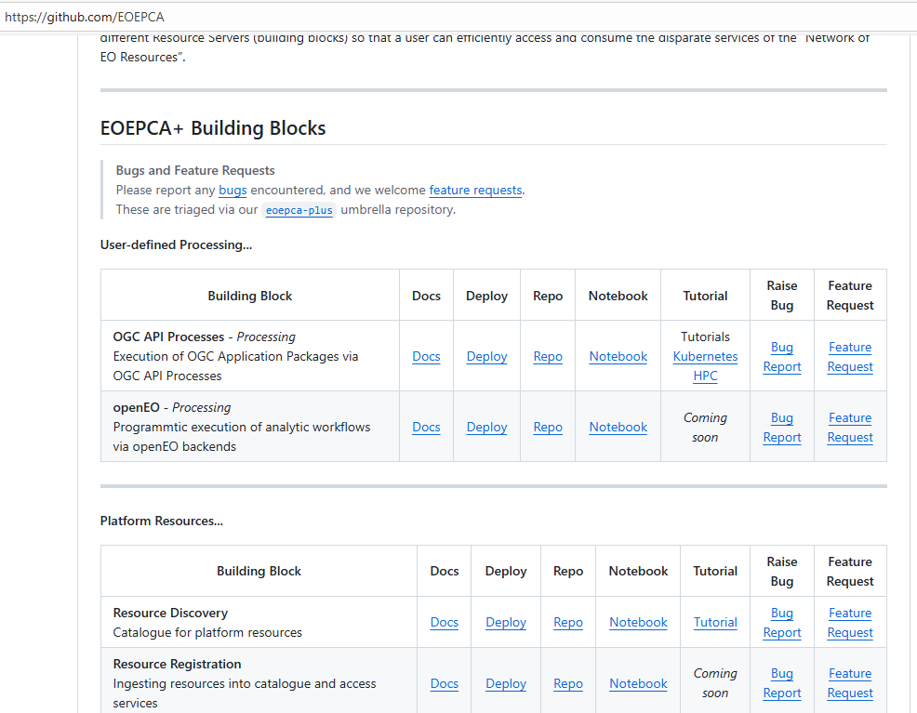
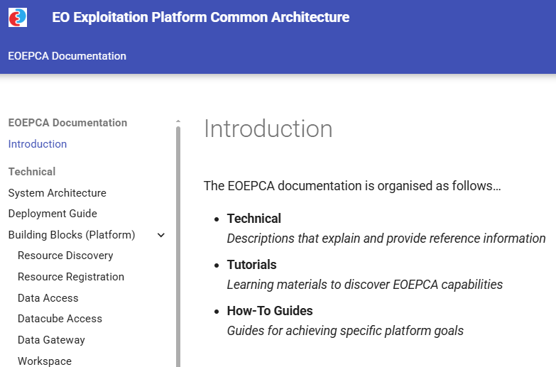
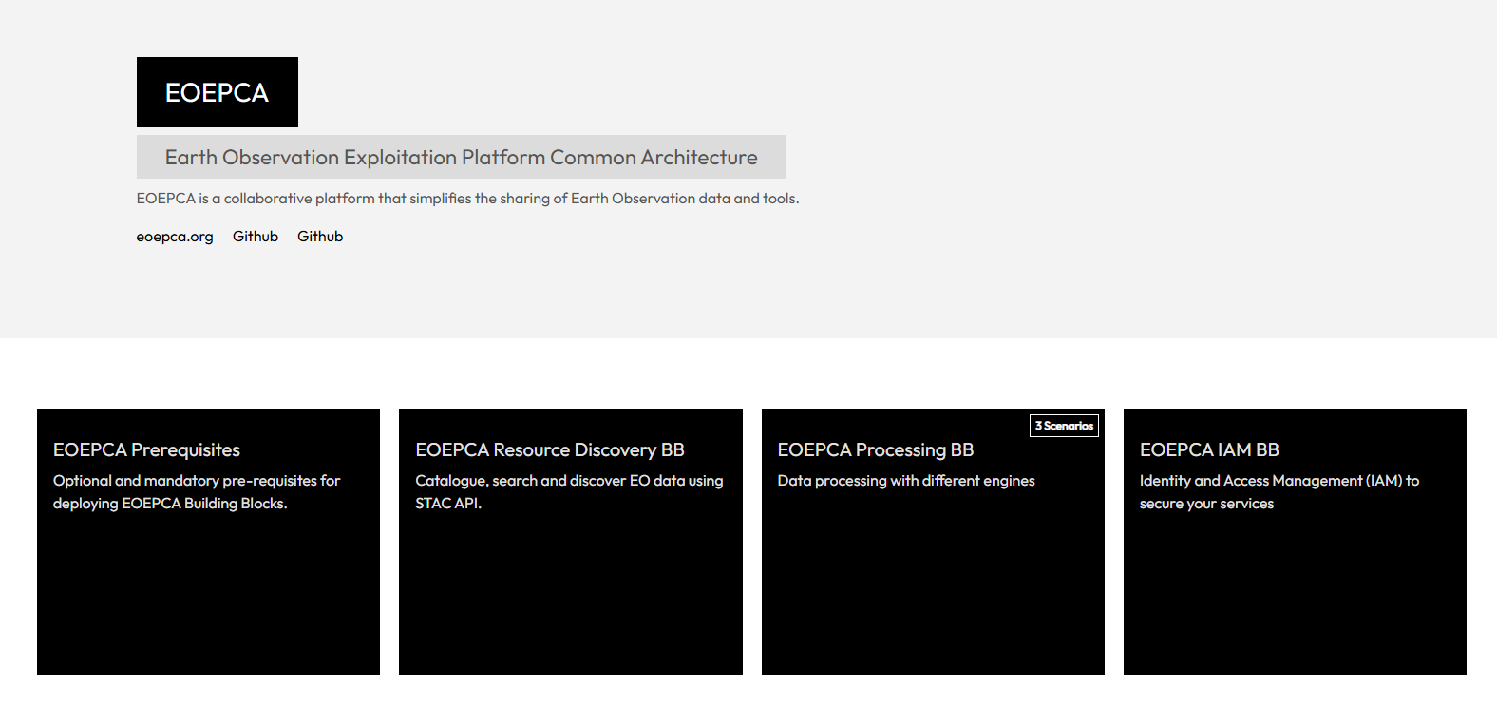
Project Resources
Central Repository
https://github.com/EOEPCA
Documentation
https://eoepca.readthedocs.io/
Interactive Tutorials
https://killercoda.com/eoepca/

Slide 19
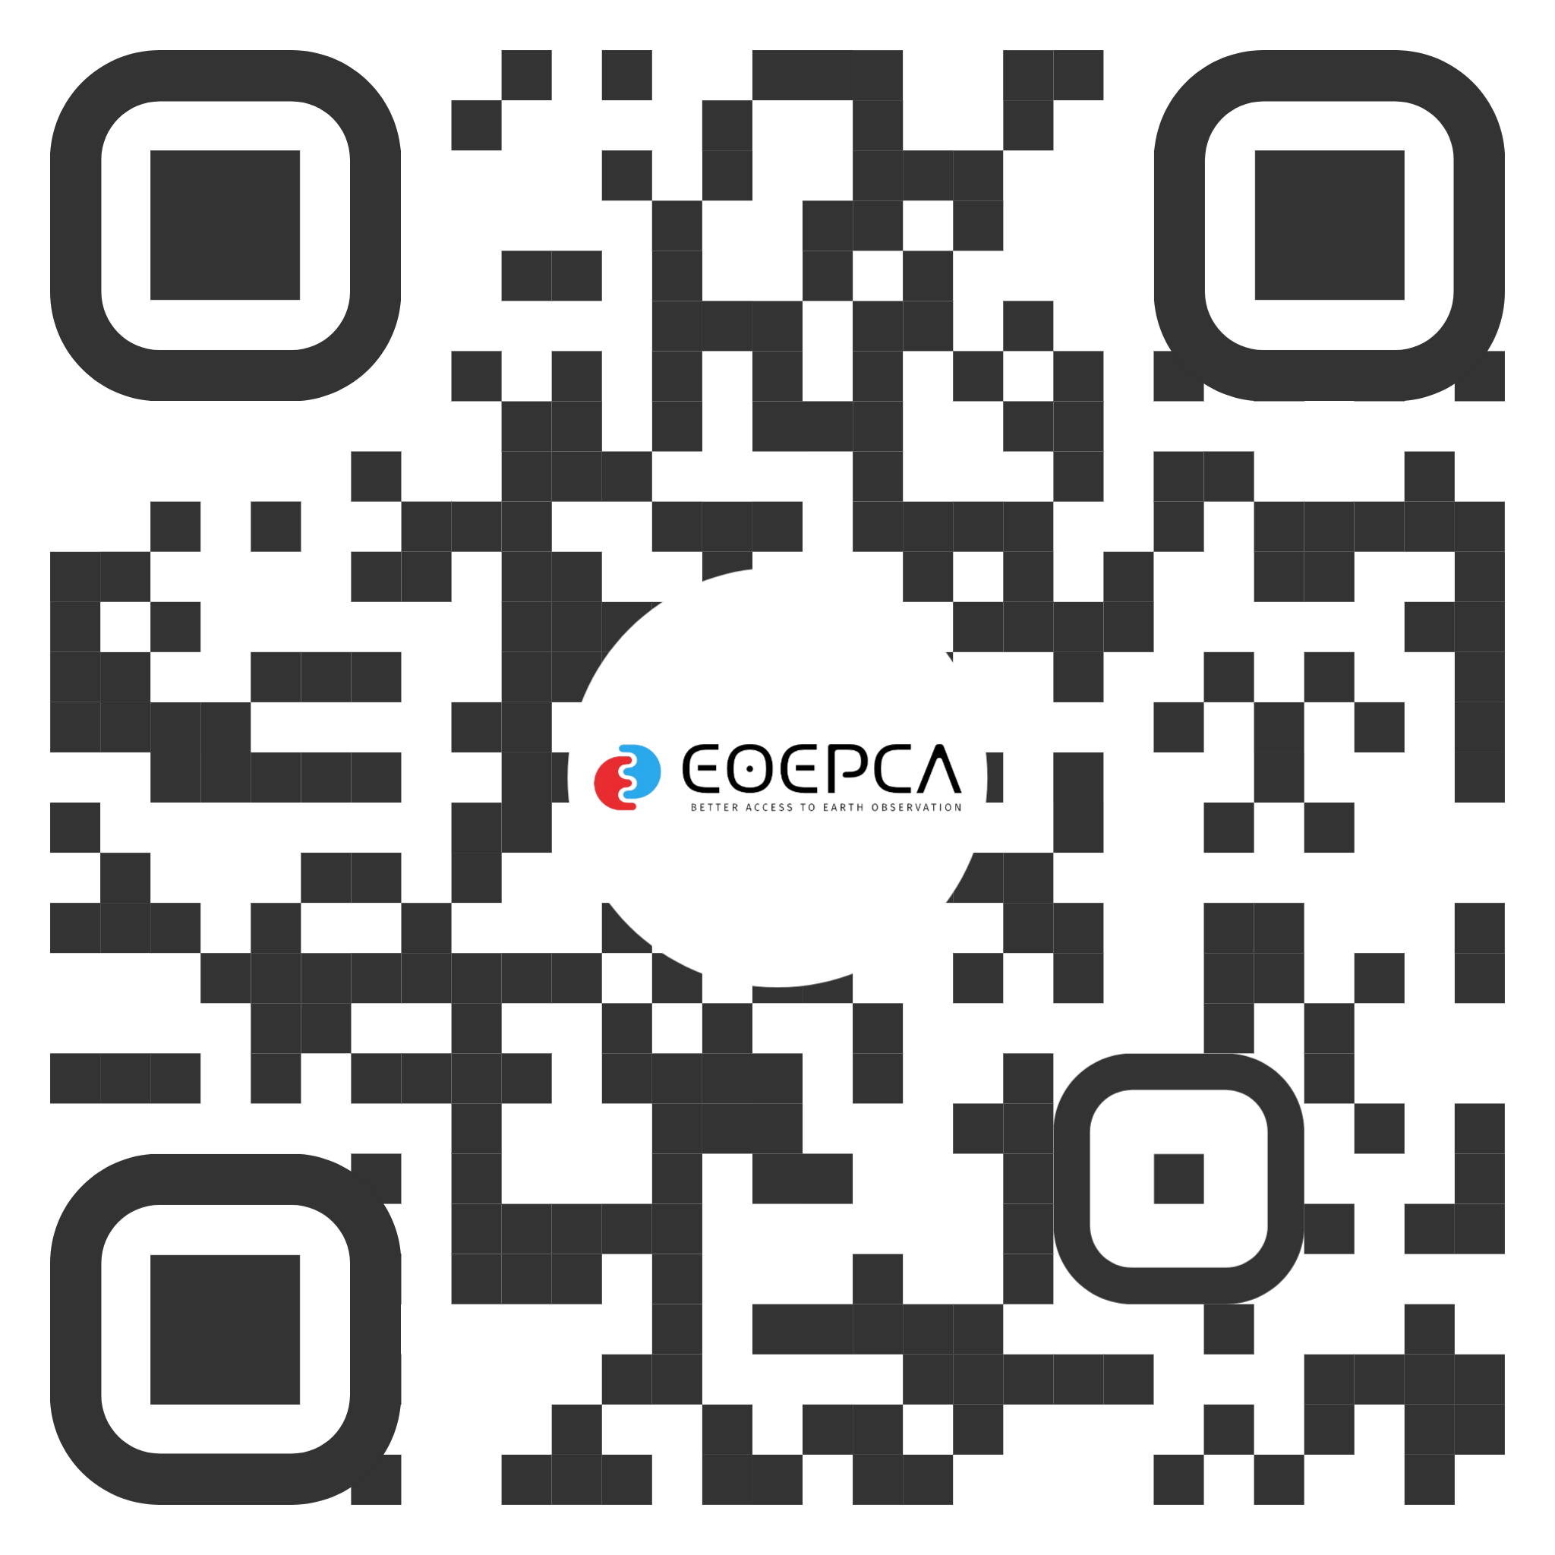
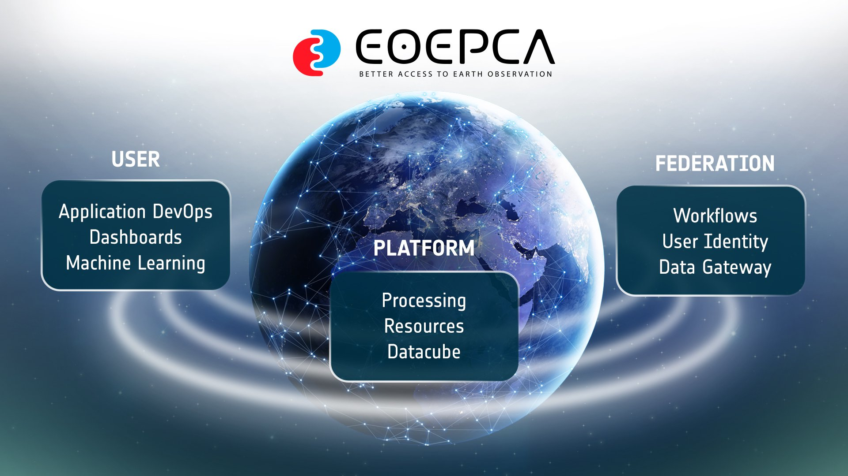
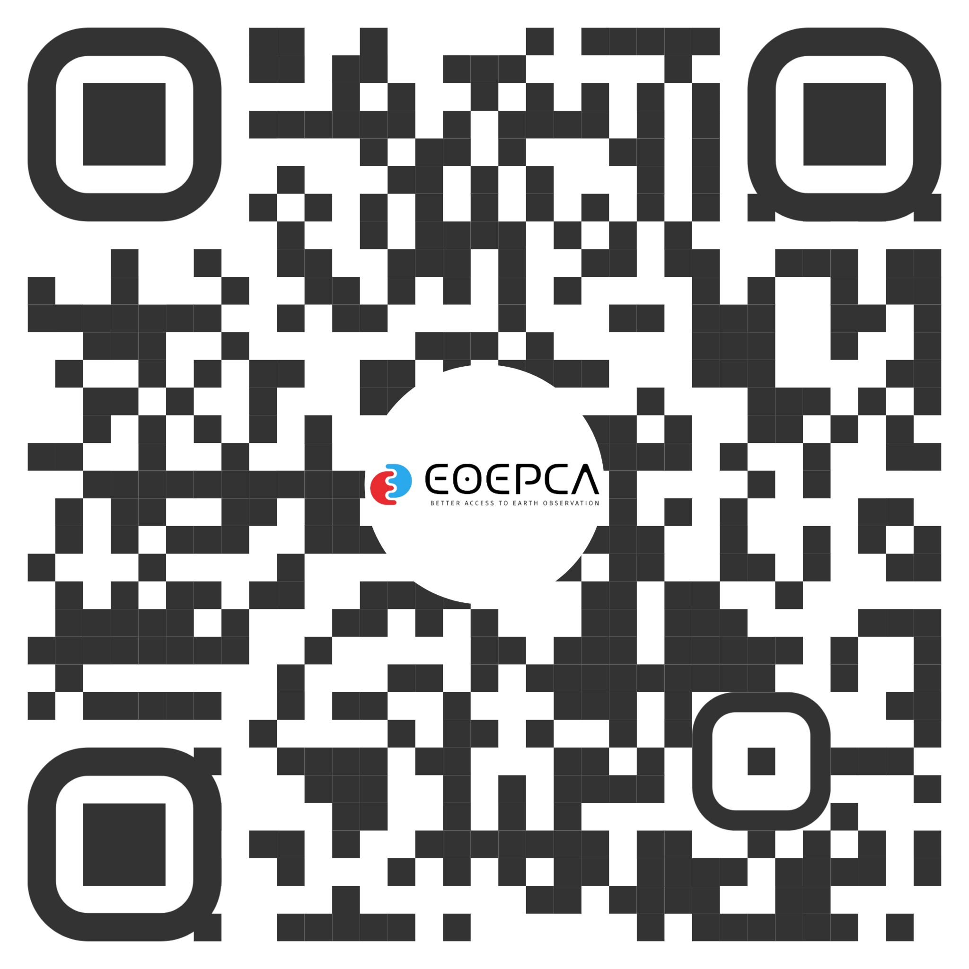
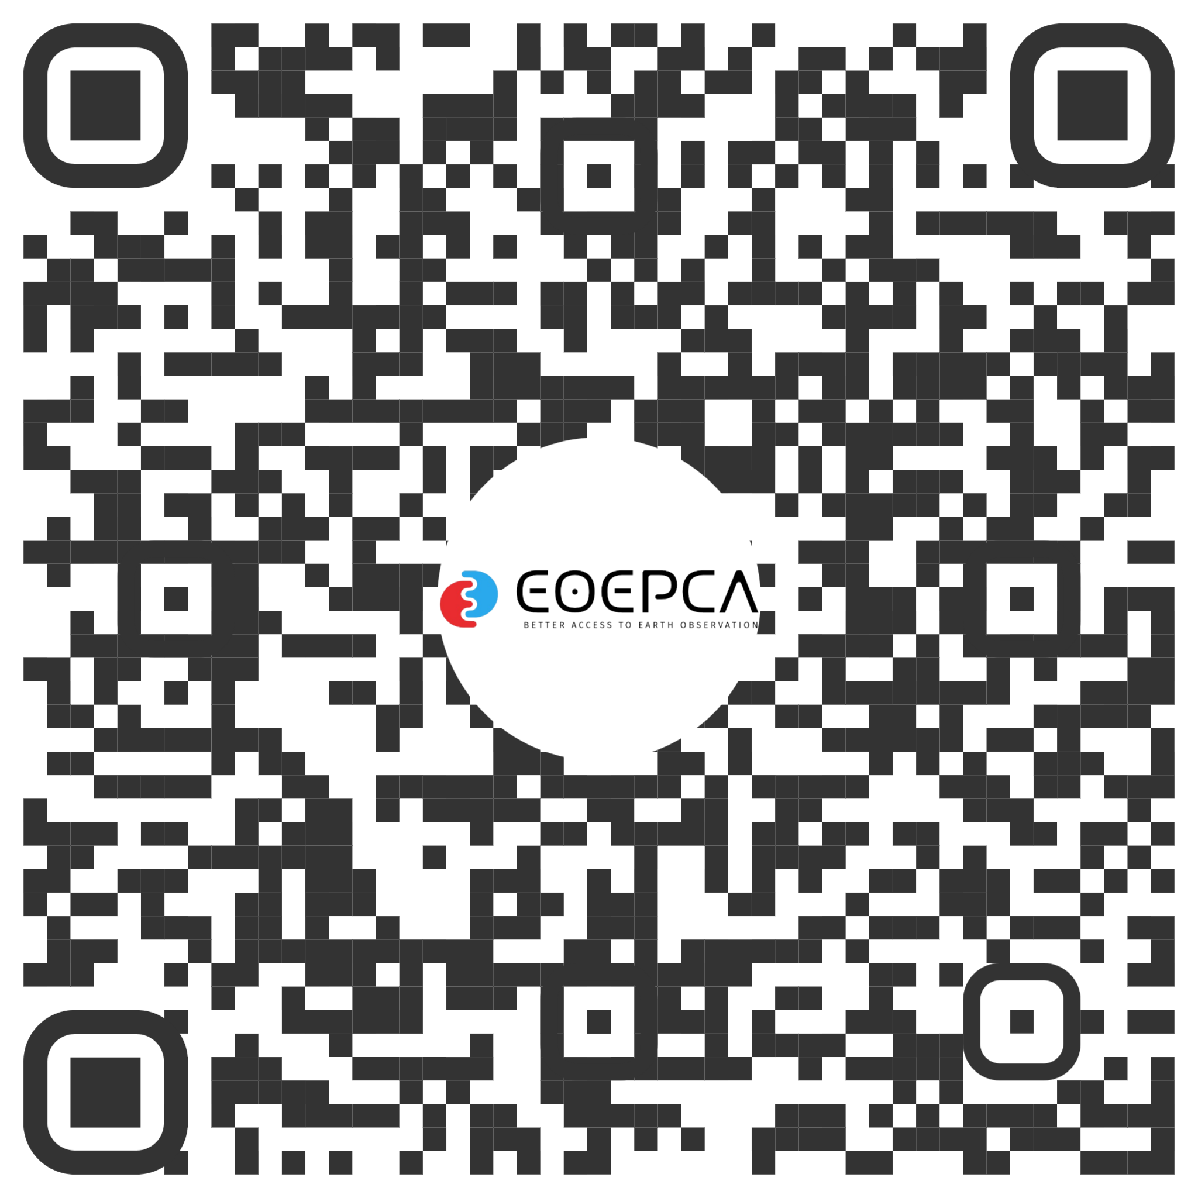
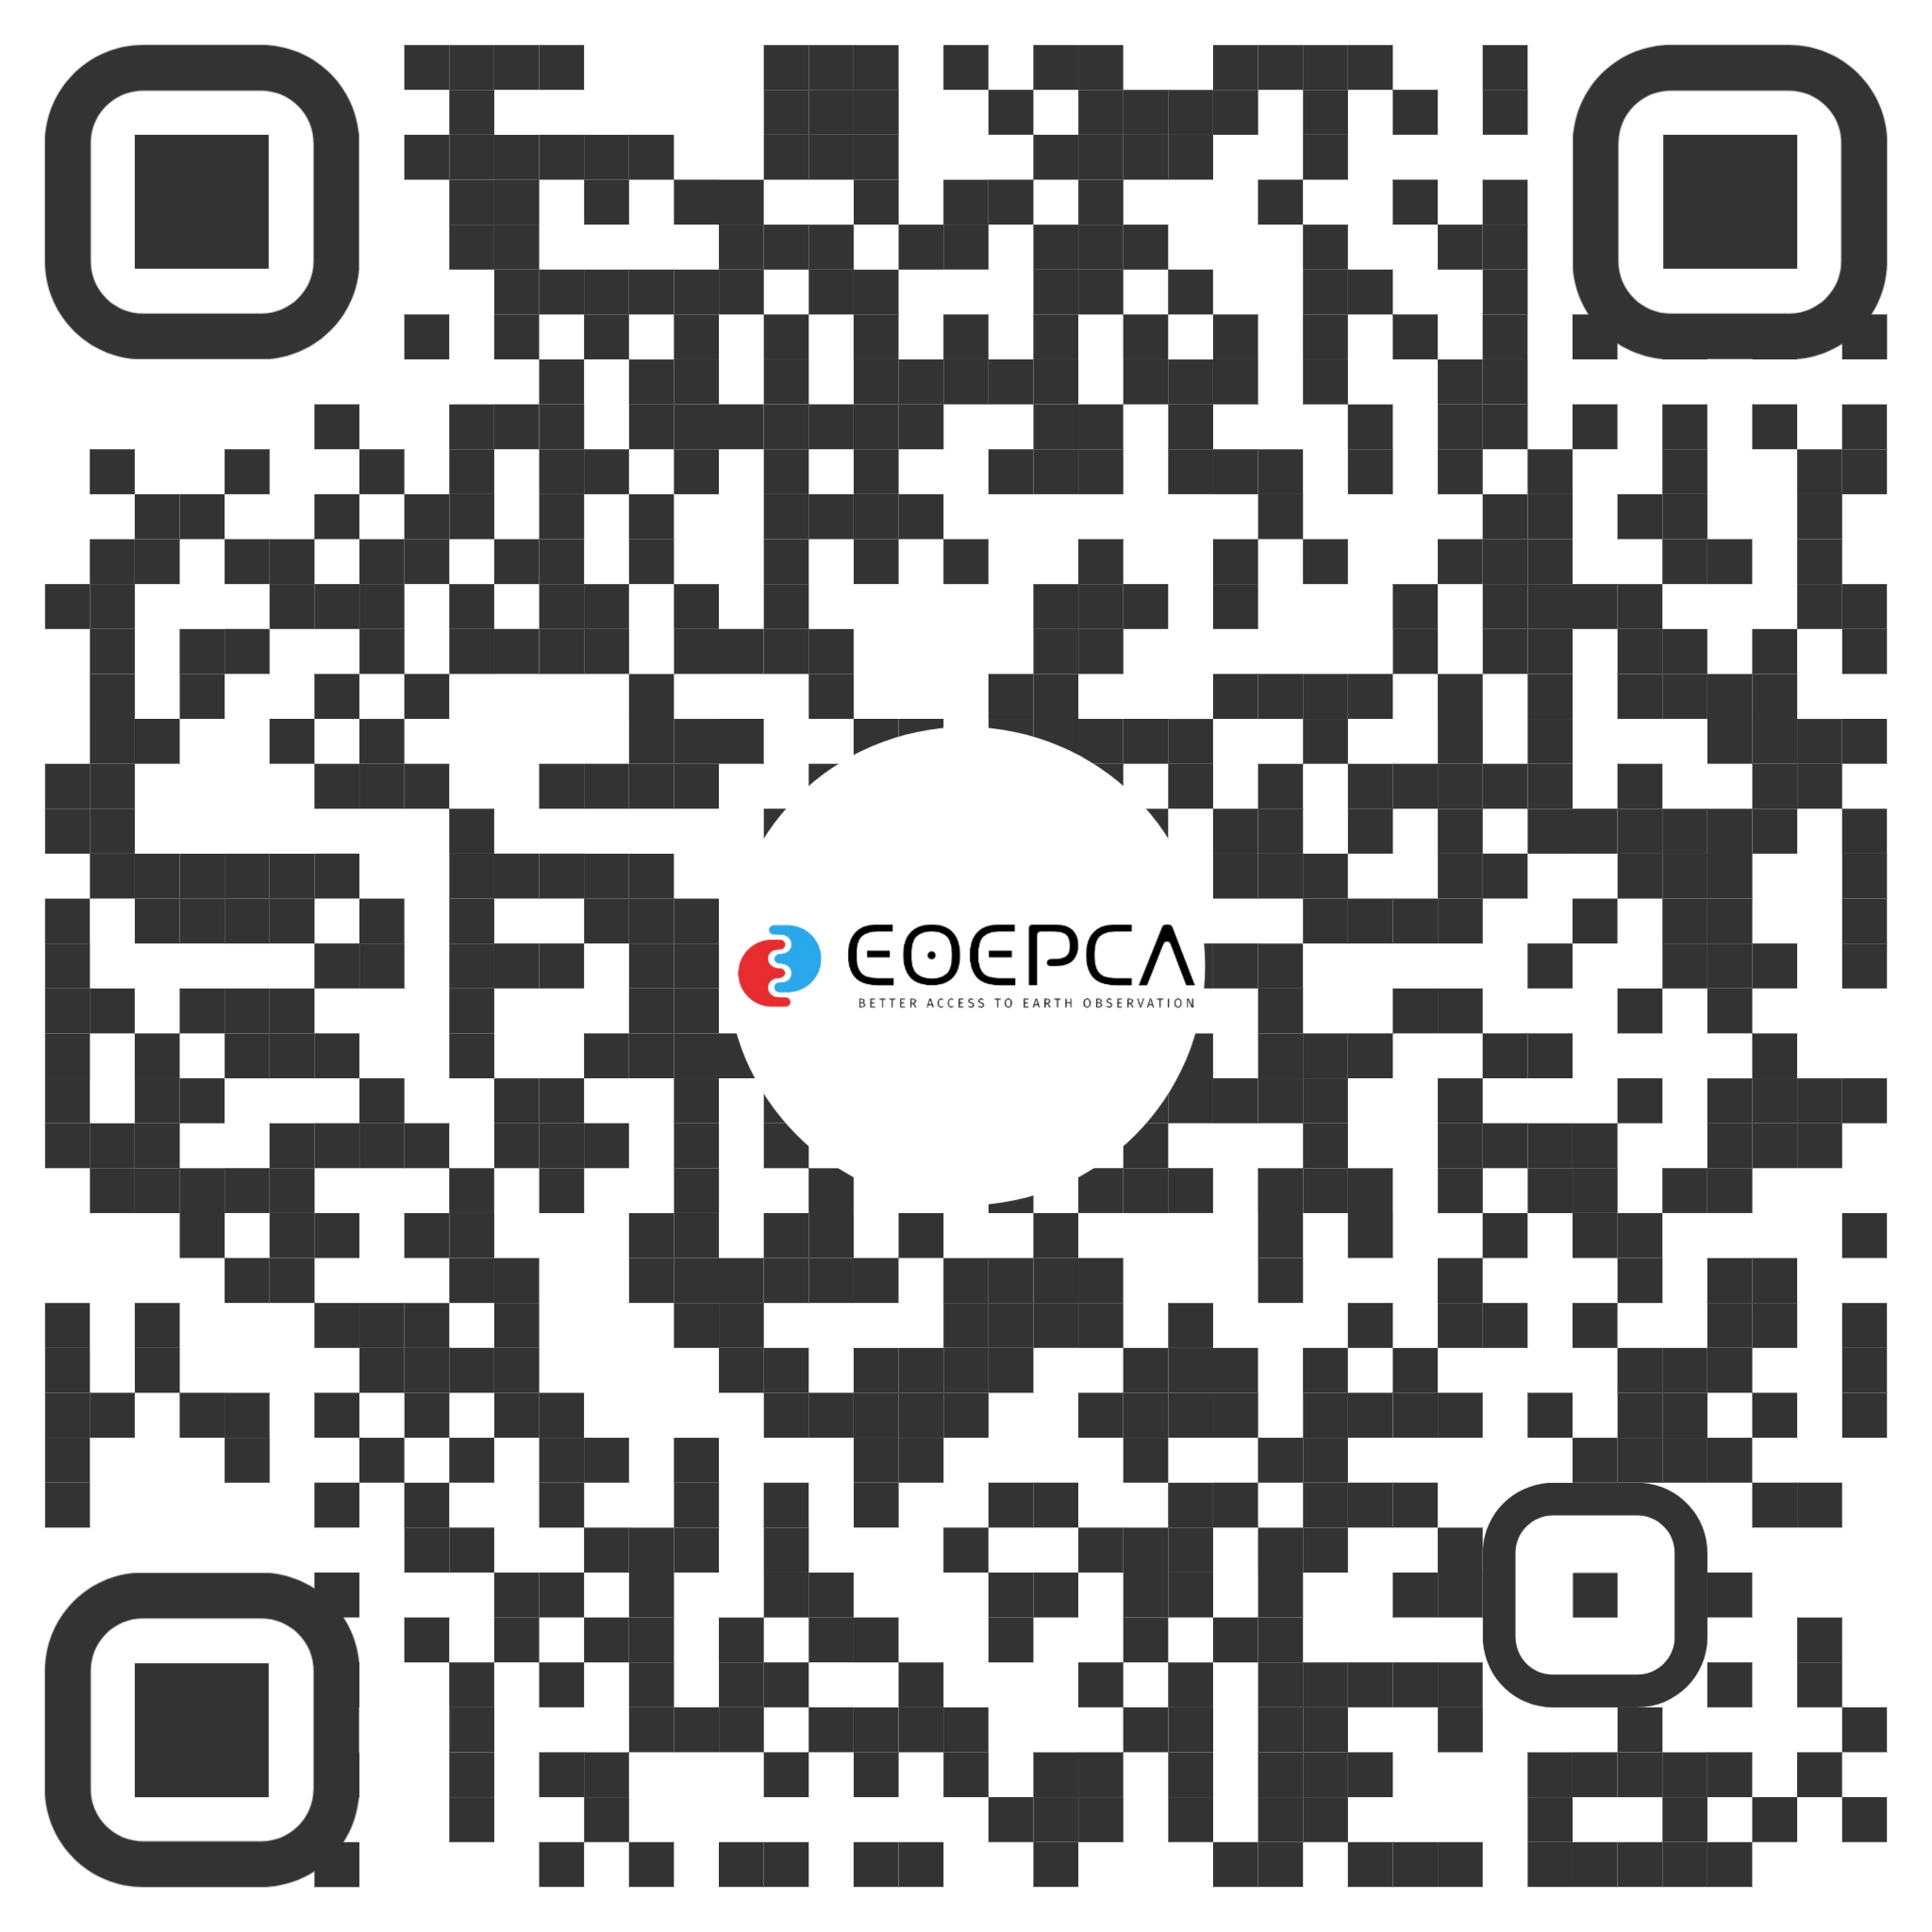
Find Us
eoepca.org
Documentation
Newsletter
LinkedIn

Slide 20
THANK YOU
FOR YOUR ATTENTION
telespazio.co.uk

