Slide 1
WGISS CDA CSIRO Integration
Matt Paget, CSIRO
Damien Ayers, Tisham Dhar, Ben Melville
Agenda Item 5.5
WGISS-60
13-17 October, 2025
Oberpfaffenhofen, Germany

Slide 2
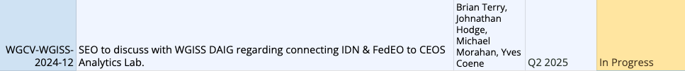
Overview
Relevant or contributing to the above items
Experiences enabling a CDA endpoint for CSIRO
Review of CDA and STAC best practices guides
Recommendations

Slide 3
Enabling a CDA endpoint for CSIRO
CSIRO have a mature OpenDataCube metadata system
Products + datasets >> Collections + assets
Datacube Explorer app with STAC endpoint, https://github.com/opendatacube/datacube-explorer
Also relevant to CAL, DEAustralia/Africa/Antarctica/..., and other “ODC Explorer”s
Case for a non-opendatacube STAC endpoint
Contributed datasets non- or pre-datacube
Supplement external collections with metadata to support processing
Assets link to external resources
Which STAC server technology to use/choose? https://github.com/stac-utils

Slide 4
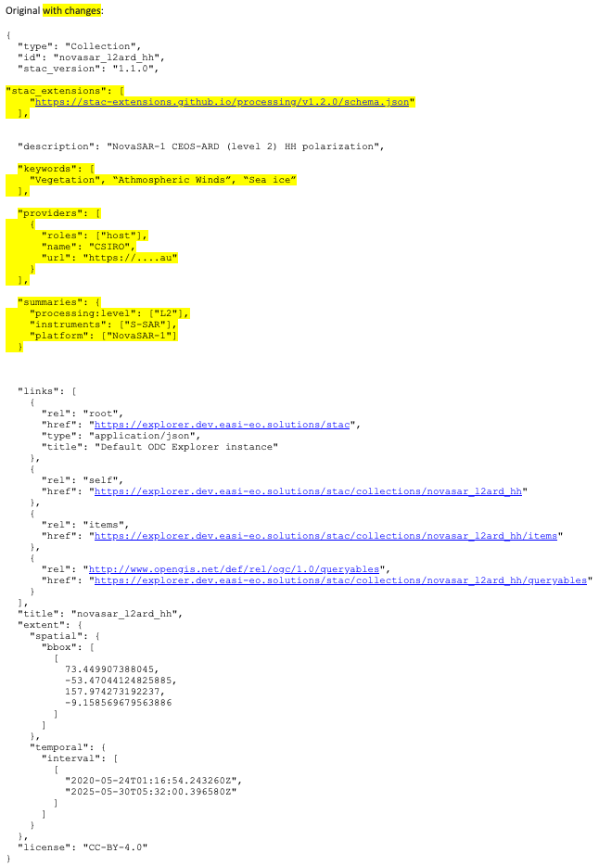
Opendatacube Explorer app with STAC
https://explorer.csiro.easi-eo.solutions/stac
Fixed /collections endpoint. Previously was timing-out due to internal inefficiencies
Suitability for CDA (feedback from Yves)
Add “stac_extensions": [https://stac-extensions.github.io/processing/v1.2.0/schema.json]
Under review for compatibility
Add Providers, Keywords, Summaries
Yes, mappable from OpenDataCube metadata
Add /collections queries for Provider or Collection
Select collections for federation, e.g. NovaSAR and AVHRR
More? TBC after implementing these recommendations

Slide 5
Review of CDA and STAC guides
WGISS-CDA best practices
Rationale for Collections and Granules
Relationship between IDN, CMR/CWIC and FedEO
Opensearch API examples
No reference to STAC as a (now) viable CDA endpoint
WGISS-STAC best practices
Comprehensive mapping of STAC extensions for a CEOS (opensearch) context
However, as a prospective CDA partner
How do I get started?
How do I set up and validate a CDA-compliant STAC endpoint?
Comprehensive description of Opensearch implementations in IDN/CMR/FedEO
Great for fine-tuning and element/field details

Slide 6
Recommendations
Proposed CDA revised layout
Collections and granules in a CEOS context
Opensearch and STAC in a CEOS context
STAC implementations Minimum viable and best practices
Opensearch implementations IDN/CMR/FedEO structure FedEO example CMR example with short name work-around (if still necessary) Best practices
Getting validated/verified/connected as a CDA partner
Update CDA guide
Proposed revised layout to help users/providers navigate the content
Supplement STAC guide
Advice/experience on which backends might be more suitable for partners to implement
However, WGISS wouldn’t necessarily want to, nor would it be sustainable to, promote particular technologies
Consider a minimum viable CDA-compatible reference implementation for STAC services
Link to https://fedeo.ceos.org/stac.html (thanks Yves!)
Consider stac-utils/stac-api-validator ?
CSIRO trialling backends … stac-fastapi-elasticsearch-opensearch
Helm chart PR contributed
But maybe stac-fastapi-pgstac ?
DB, maintenance, scalability, …

