Slide 1
Biodiversity Study Team progress and recommendation
Gary Geller, NASA & BST
With Shaun Levick & Marc Paganini
Agenda Item 6.1
WGISS-60; 13-17 October, 2025
Oberpfaffenhofen, Germany

Slide 2
Content
History of CEOS biodiversity
Biodiversity Virtual Constellation overview
Up for Approval: SIT-41 in April 2026
Potential discussion areas
How to leverage WGISS expertise
Missing products: How to fill gaps
Workflows, services, interoperability
BON in a Box Pipeline and OpenEO
“Demonstrators” and the CEOS Analytics lab
Technology exploration (esp: AI/ML, and Digital Twins)

Slide 3
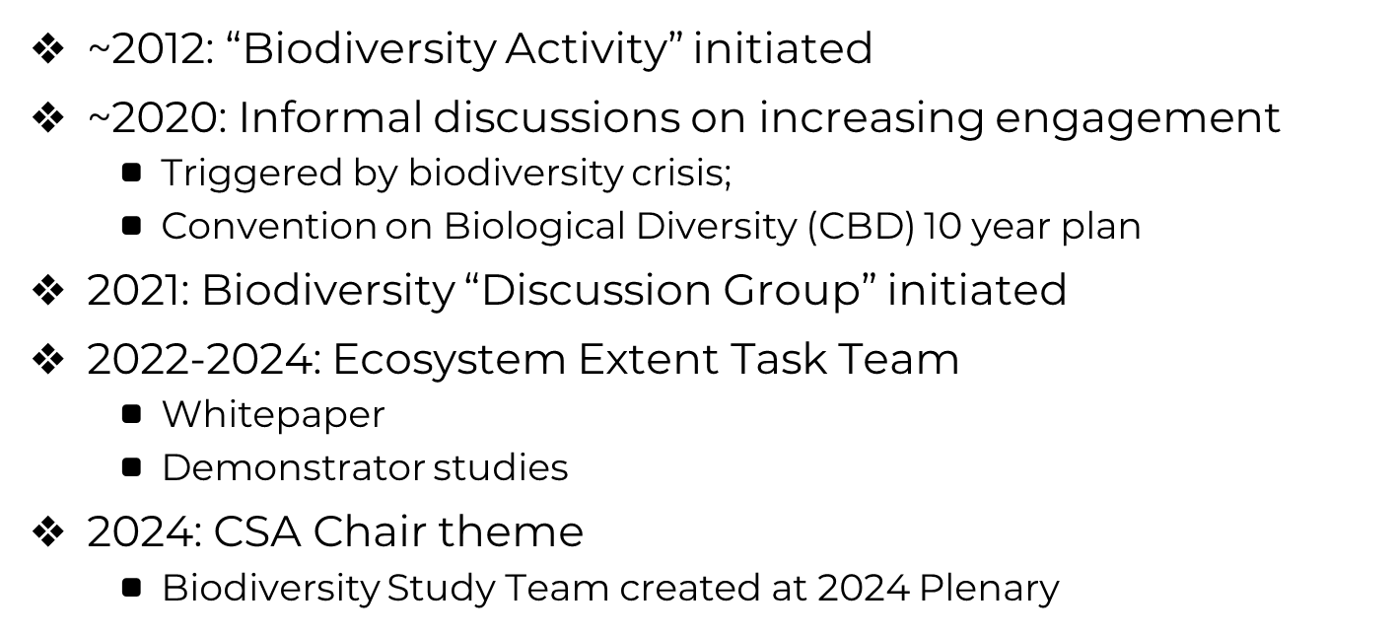
Road to Here

Slide 4
Biodiversity Study Team Tasks
Task: Assess CEOS options for enduring engagement with biodiversity
Phase 1: User assessment
Phase 2: Potential connections with CEOS WGs and VCs
Phase 3: Assess options and make a recommendation

Slide 5
Why a VC? Six Options
No Action
CEOS Working Group
CEOS Virtual Constellation
New subgroup in LSI-VC
Federated approach
Ad Hoc Teams approach

Slide 6
B-VC Mission & Objectives
Enhance utilization of space-based Earth observations and data products
to improve biodiversity understanding, monitoring, and conservation
for the benefit of society.
Objectives
Maximize impact of EO
Engage Users
Leverage Capabilities within CEOS

Slide 7
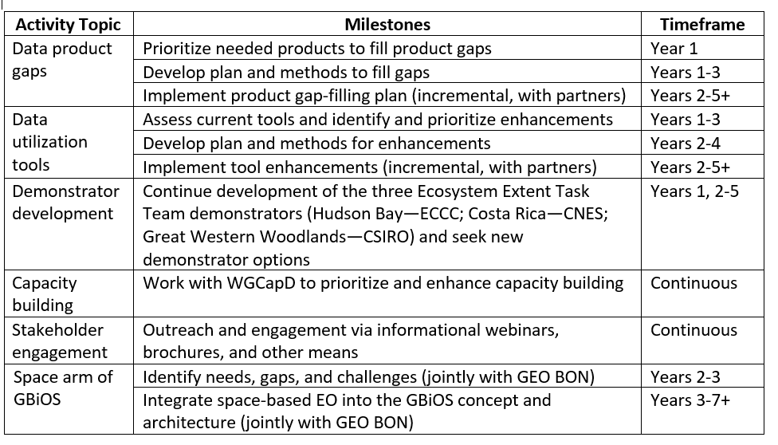

Activities

Slide 8
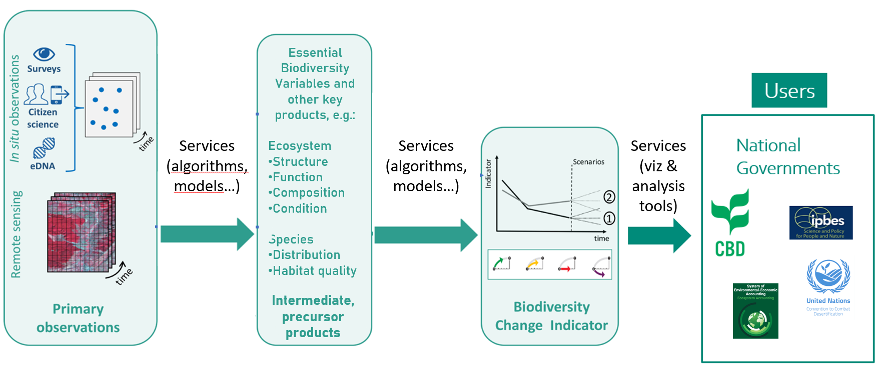
Product workflow has gaps…
Based on Navarro et al 2017

Slide 9
Partial solution…
Based on Navarro et al 2017

Slide 10
Partial solution…
?
Based on Navarro et al 2017

Slide 11
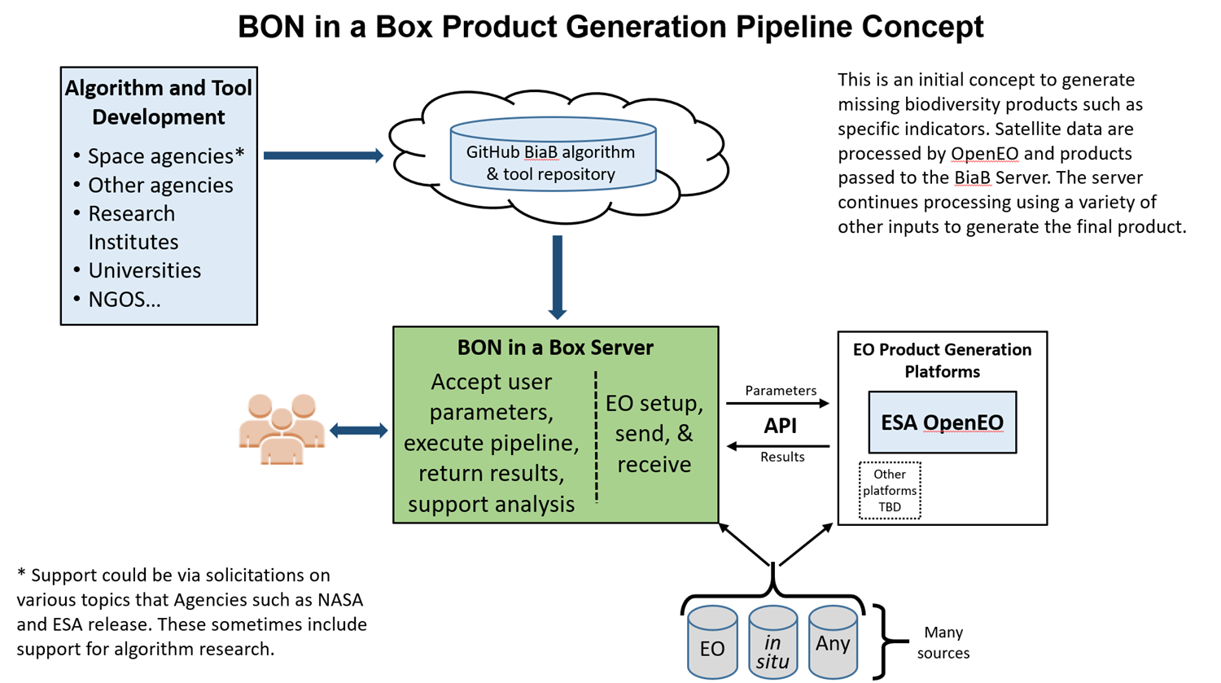

BON in a Box pipeline concept
Notes:
Details available in a pre-print: https://ecoevorxiv.org/repository/view/7941/
The BiaB server can be downloaded and installed anywhere, e.g. a user’s desktop.
Other platforms: in the concept but not currently implemented…potentially could include commercial cloud-based platforms like Amazon.
Not shown: The workflow pipeline involving intermediate products that is needed for many biodiversity indicators and other products.

Slide 12
Demonstrators & CEOS Analytics Lab
Analogous to the EETT demonstrators
Framework for B-VC activities
Data product and tool development testbed
Including end user testing
User engagement vehicle
Idea generator
Cross-ecosystem algorithm transferability
Outputs & outcomes
Products and tools for “algorithm warehouse”
“Real-world” experience (e.g., understanding end user constraints)
Ideas

Slide 13
Discussion
History of CEOS biodiversity
Biodiversity Virtual Constellation overview
Up for Approval: SIT-41 in April 2026
Potential discussion areas
How to leverage WGISS expertise
Missing products: How to fill gaps
Workflows, services, interoperability
BON in a Box Pipeline and OpenEO
“Demonstrators” and the CEOS Analytics lab
Technology exploration (esp: AI/ML, and Digital Twins)

Slide 14
Backup

Slide 15
Presentation Guidance
All presentations should be uploaded to the shared google drive: https://drive.google.com/drive/folders/1w7MdXIUU_pvLebfX0JP9uscXYtEsTXTK
Ask Libby for edit access as required (libby@symbioscomms.com)
Files should be named Item_Presentation Title_Name_version
E.g. 1.3_WGISS Chair Report_Tom Sohre_v1
Presenters should join the webex line and present from their own screen using screen share features

Slide 16
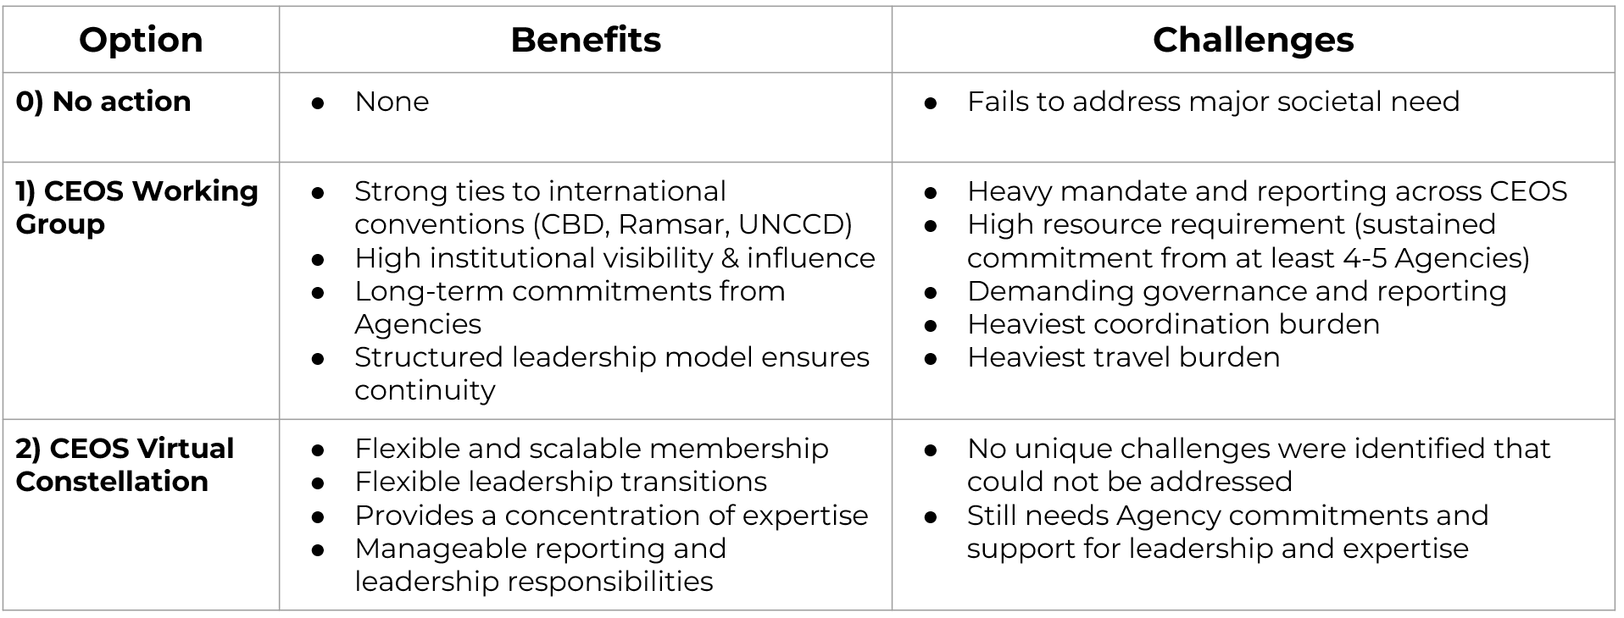
Options comparison (1 / 2)

Slide 17
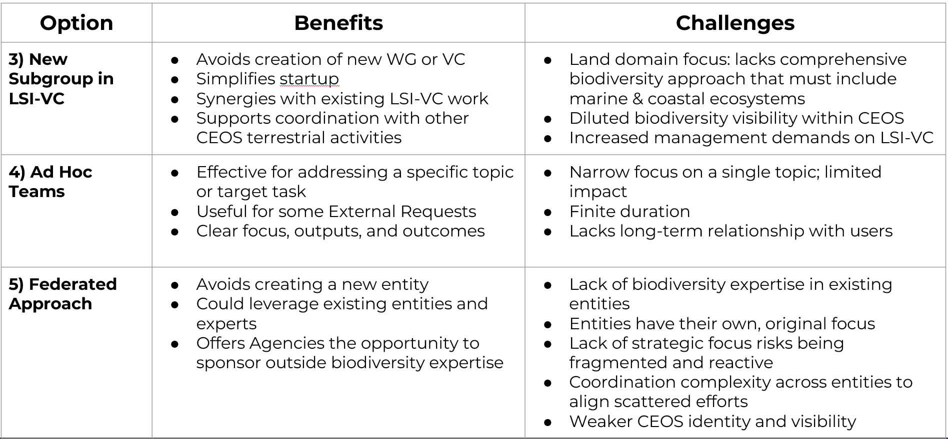
Options comparison (2 / 2)

Slide 18
Recommendation
A Biodiversity Virtual Constellation is the most effective and sustainable option for ensuring a long term and impactful CEOS engagement in support of Biodiversity.
A Biodiversity Virtual Constellation (B-VC) would offer the flexibility to tailor the VC with the expertise needed to address identified user needs and activities for which the ensemble of CEOS Agencies is ideally suited
A Virtual Constellation can accommodate a range of contributions, from sustained Agency leadership to smaller or targeted inputs, allowing broad participation across CEOS
The B-VC model also supports the possibility for agencies to sponsor external biodiversity experts for defined periods, useful for Agencies that may not have in-house biodiversity programmes
The B-VC is envisioned as a dynamic and evolving structure, capable of adjusting its composition and priorities over time.

Slide 19
Objectives
Maximize Impact
Maximize the societal benefit of space-based EO & derived data products
Focus: biodiversity understanding, monitoring, and conservation
Engage Users
Maintain active dialogue with biodiversity stakeholders
Support continued understanding of evolving user needs
Adapt activities accordingly
Leverage Capabilities within CEOS
Facilitate alignment & connectivity across CEOS Agency missions, observations, data products, & services
Coordinate with activities of other CEOS entities

Slide 20
Membership & Leadership
Membership
Primarily CEOS Agency personnel, including support from other CEOS entities
Where needed, augmented with outside expertise
Goal for geographic diversity, and range of expertise
Leadership
Three co-leads preferred
Provided by CEOS Agencies

Slide 21
Resources
B-VC team members
In-kind support by Agencies* (including from other entities)
Invited outside experts (voluntary)
Existing Agency Research and Development Programs
Proposals for projects with specific deliverables
Submitted by B-VC team members or outside experts
Algorithm and product development
Demonstrator development
External support via proposals to outside entities
National government agencies, institutions, philanthropic orgs…
Submitted by B-VC team members or outside experts (e.g., at universities), in coordination with B-VC

Slide 22
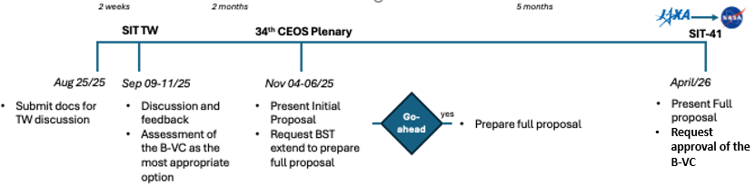
Plans and Timeline

Slide 23
Schedule

Slide 24
Activities
Identify priority gaps in data products such as biodiversity indicators and facilitate development of solutions to fill critical gaps
Facilitate enhancement of data processing and utilization tools needed to increase utilization of EO for biodiversity applications
Enhance existing CEOS biodiversity demonstrators, and explore possibilities for new ones, to provide useful exemplars and facilitate development and testing of needed EO capabilities
Prioritize and implement capacity building initiatives through close collaboration with CEOS WGCapD
Actively seek to increase biodiversity community engagement with EO and its applications for biodiversity understanding, monitoring, and conservation
Coordinate with GEO BON and its Global Biodiversity Observing System (GBiOS) concept to facilitate the wider use of space-based EO

