Slide 1
DLR‘s approach for replica datasets used in terrabyte
CEOS-WGISS #60, 15.10.2025
Dr. Jonas Eberle

Slide 2











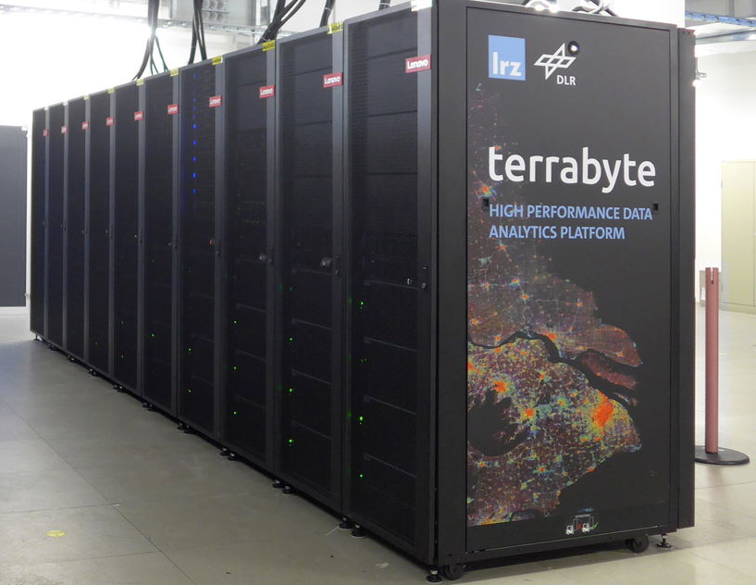




terrabyte
terrabyte
55 PB storage
44.000 vCPUs
188 GPUs
330 TB RAM
HPC
Cloud
Data Storage Management
DLR EO long-term archive
External data sources

Slide 3
Connected data providers
terrabyte Data Science Storage (Online)
Internet
WAN
USGS EROS
USGS LPDAAC
NSIDC DAAC
NASA ASF
Copernicus Data Space Ecosystem
DLR
D-SDA
Landsat
MODIS
VIIRS
MODIS
VIIRS
Sentinel-1
Sentinel
Sentinel-1
Sentinel-2 L1C

Slide 4
terrabyte data inventory
Available services
Inventory database
STAC API based on inventory database
STAC-Geoparquet files based on inventory database
Inventory database based on SpatioTemporal Asset Catalog (STAC)
order:status extension for STAC items
orderable = not yet ingested into terrabyte
pending = currently being ingested into terrabyte
succeeded = available on terrabyte
deleted = removed from terrabyte due to removal by the data provider
deprecated flag = Item has been replaced by another scene or removed from the catalog
https://docs.terrabyte.lrz.de/datasets/terrabyte-datasets/inventory/introduction/

Slide 5
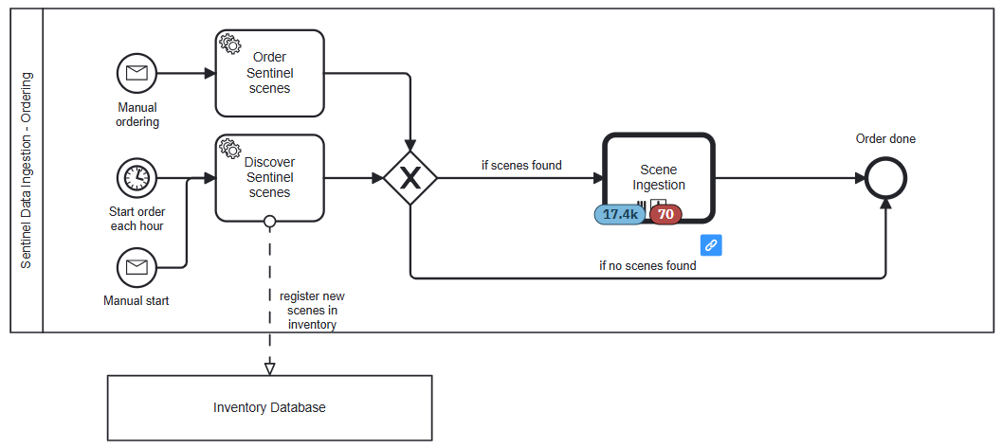
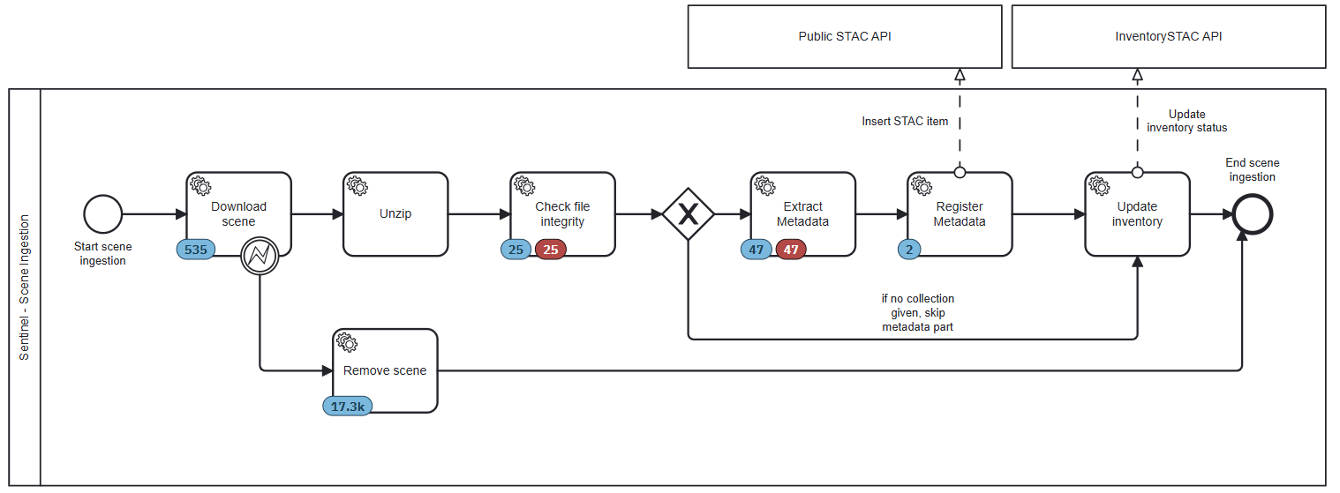
Ingestion workflow

Slide 6
What needs to be considered for consistency checks?
Questions
Do we have all scenes (=granules) ingested?
Have individual scenes been reprocessed?
How can we identify reprocessed scenes?
Have individual scenes been deleted?
If yes, what is the reason?
Assumptions
Scene identifiers are unique (usually, not always… ☹ )
We can identify reprocessed scenes based on the scene identifier (usually, not always… ☹ )
Requirements
List of available scenes
USGS Landsat: https://www.usgs.gov/landsat-missions/bulk-metadata-service
ESA Sentinel: https://csv.dataspace.copernicus.eu
NASA MODIS/VIIRS: none available
List (or API?) of deleted scenes
ESA Sentinel: https://documentation.dataspace.copernicus.eu/APIs/OData.html#odata-deletedproducts-endpoint
USGS Landsat: none available
NASA MODIS/VIIRS: none available

Slide 7
terrabyte inventory consistency checks
Regular inventory comparison (USGS Landsat, ESA Sentinel, NASA MODIS/VIIRS)
Download of bulk CSV files with complete inventory (no inventory files for MODIS/VIIRS!)
Synchronization of scene identifiers between data provider and inventory
Get scenes available at data provider but missing in own inventory 🡪 insert into inventory with status orderable and start ingestion of scenes
Get scenes missing at data provider but available in own inventory 🡪 mark scenes as deleted in inventory and remove them from storage/user catalog
Report deviations between data provider and own inventory
Regular check of deleted scenes (only Copernicus Dataspace Ecosystem)
Check an API for deleted/removed scenes (e.g., DeletedProducts-API from CDSE)
Mark scene as deleted in inventory
Delete scene from storage and user catalog

Slide 8
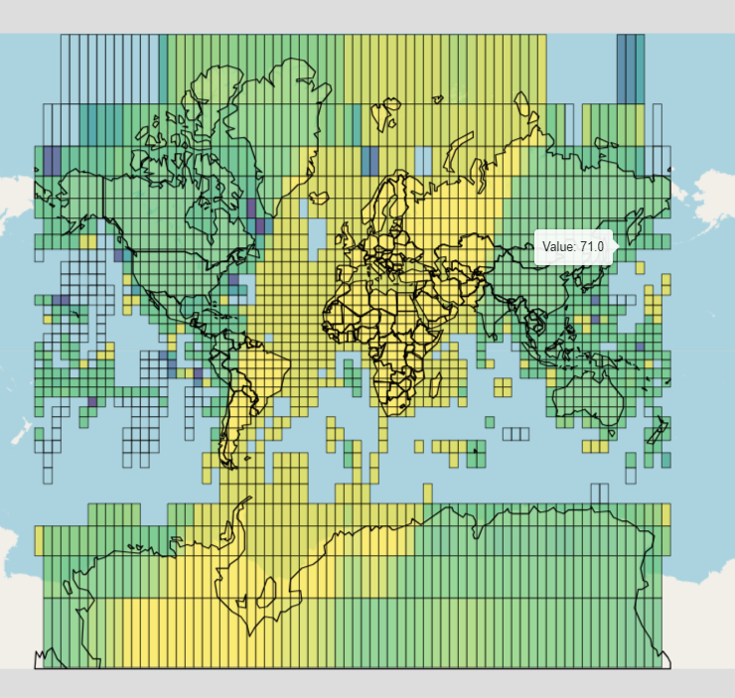

terrabyte ‘EO data checker’
Example: Landsat 8 Collection 2
Which satellite scenes from the data providers' inventory are available on terrabyte?
This is answered by the terrabyte 'EO data checker'
Dashboard on the completeness of the data on terrabyte compared to the catalogs of the data providers
Targeted search for your own areas and time periods or individual satellite scenes
Continuous comparison with the overall catalogs of the data providers
More information: https://docs.terrabyte.lrz.de/category/inventory/
%
https://docs.terrabyte.lrz.de/datasets/terrabyte-datasets/inventory/dashboards/

Slide 9
Conclusion
Bulk metadata files (e.g., CSV, Geoparquet) necessary for consistency checks
Notifications / API for deleted scenes
Enormous effort to do it the ‘correct way’
What is next?
Is there a need for a common approach for dataset replication?
How can we lower the demand of dataset replication?

