Slide 1
Data next to compute
Robert Fletcher, UKSA
Agenda Item 7.2
WGISS-60
13-17 October, 2025
Oberpfaffenhofen, Germany

Slide 2
Presentation Guidance
All presentations should be uploaded to the shared google drive: https://drive.google.com/drive/folders/1w7MdXIUU_pvLebfX0JP9uscXYtEsTXTK
  Ask Libby for edit access as required (libby@symbioscomms.com)
Files should be named Item_Presentation Title_Name_version
  E.g. 1.3_WGISS Chair Report_Tom Sohre_v1
Presenters should join the webex line and present from their own screen using screen share features

Slide 3


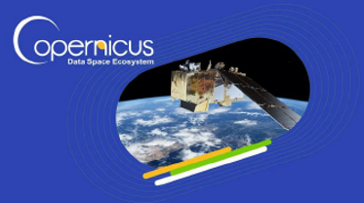

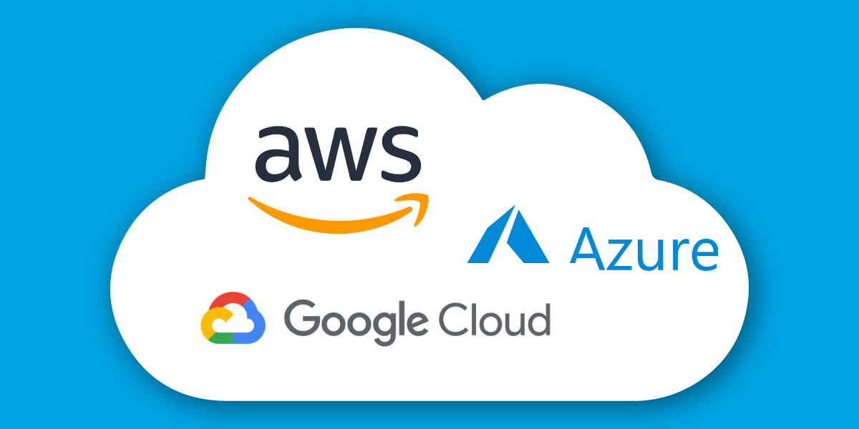



Data has gravity!
2013
2016
2022
Collaborative Ground Segments
Benefits:
Bring users to the data
Process the data in the storage location
Reduce the need for large data transfers
Take advantage of Cloud computing services
Build a community of EO data users in one location
Create a marketplace of applications
Receive support from EO data experts
Develop a collaborative ground segment
Challenges:
Vendor lock in – hard to migrate
Expensive to operate
Expensive to use (at scale)
ITC (Datacentre) skills required by end users
Long term stability/funding
Duplication of data
Private clouds not able to keep up with the hyperscalers
Siloed data access
Dispersed user base

Slide 4
Discuss!
Does the approach of compute next to data work in the context of EO data access and analytics?
Is the approach an environmentally efficient method of data dissemination?
Data remains in silos per operator – would a more distributed method of data access be preferable?
A study presented at BiDS stated that ‘most users prefer to use local infrastructure for processing’ – why?
Are egress costs the biggest reason to stay within the cloud?

