Slide 1
Data Preservation & Stewardship Interest Group (DSIG) Data Collection Appraisal Procedures
Iolanda Maggio,
Starion for ESA
Agenda Item 8.1
WGISS-60
13-17 October 2025
Oberpfaffenhofen, Germany

Slide 2
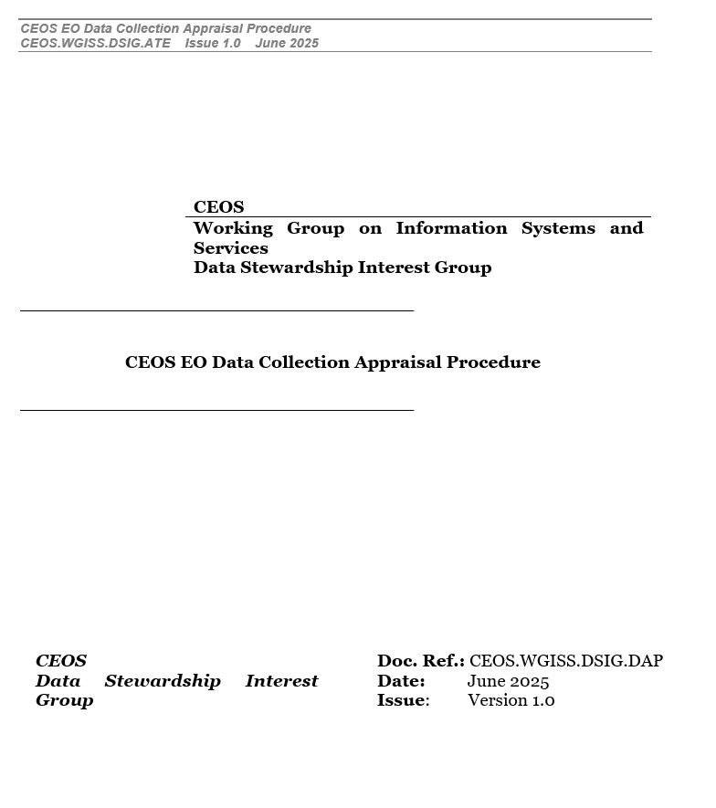
CEOS EO Data Collection Appraisal Procedure
White Paper
A Mission Data Collection(s) Appraisal Step is recommended as input to any decision on preserving and curating EO data collection(s) (e.g. for heritage missions).
The appraisal report includes a high-level mission description, sensor typology, archives holdings, mission peculiarities, designated communities, and every technical detail supporting the decision process and helping the subsequent preservation and curation steps.
The appraisal questionnaire can be used to perform an assessment of the status of the mission assets and to define an initial conception of whether the datasets under evaluation has to be preserved and kept accessible and usable for the long term.
The appraisal task is mandatory for missions under the Agency responsibility (e.g. when the mission becomes historical, surveys on Mission managers and Operations Managers could help the Data Curator with the preservation and curation process).

Slide 3
CEOS EO Data Collection Appraisal Procedure
The space data appraisal is the process which allows:
Assessing the value, relevance, and usability of space mission data.
Determining what data should be preserved, archived, or shared.
Establishing quality standards, metadata, and long-term storage protocols.
The Space Data Appraisal procedure is relevant because of:
Data Overload: Space missions generate enormous volumes of raw and processed data.
Cost of Storage: Long-term archiving and access management are expensive.
Scientific Value: Some datasets may lead to new discoveries decades later.
Legal & Ethical Compliance: Especially for Earth observation data with privacy or geopolitical implications.

Slide 4
CEOS EO Data Collection Appraisal Procedure
Report content
The benefit resulting from Agency keeping the data custody and preserving the data, including the value of the mission data in terms of potential utilisation for scientific and/or operational purposes:
        Uniqueness: type of sensor and characteristics, domain and variety of applications; specific and unique aspects of the mission as stand-alone data utilization potential.
                Spatial and temporal complementarity: data exploitation in conjunction with other data sources; complementarity and gap filling of Agency and national missions data holdings.
                Continuity of services, research, and exploitation with on-going and future missions.
                Data quality.
                Usefulness for research and application projects and potential future impact: checked with different European user communities (e.g. Researchers, Public services, Value-adding Industry).
Status of accessibility and rights for users:
  Access conditions: time-unlimited right for the Agency to use and distribute the Dataset according to an open and free access policy. Former data owners’ credits by the Agency when data are distributed to users, and right to get a copy of the data for free or at reproduction cost for their internal use.
  Preservation responsibility: responsibility for preservation and management (e.g. archiving, processing, access provision, disposal or handover to third parties) granted to the Agency for an unlimited time in case data and information to be kept within the Agency infrastructure.
  Ownership and copyrights: kept with owner or transferred to the Agency.
Cost/Investment
  Cost assessment depending on the type and technical realization needed for dataset recovery, consolidation, and preservation. It might include costs raised by the third- party operator and for data consolidation activities, ingestion, archiving, etc.
Assessment of suitability of the Dataset to the Agency programmatic scheme concerning:
      Relevance for/impact on Agency EO strategy and objectives (also data policy).
      New products and services potential/spin-off and synergy effects for Agency products.
      Opportunity for new international collaboration/"door-opener" function.
      Experience gained for future missions.
      Continuity of agreements.

Slide 5
CEOS EO Data Collection Appraisal Procedure
Questionnaire
How significant, different, or unique are the records to the remote sensing, cartographic, and Earth science data user community, i.e. what significant and unique contributions do the collection contain that upgrade our current archive holdings?
What are the consequences for the Agency if the collection is not obtained or maintained?
How can the records Authenticity be judged, i.e. how are the records considered to be authentic?
How can the records Reliability be assessed?
How can the records Integrity can be determined?
How are the records Usability conducive to our anticipated exploitation of the information value in the records?
Do the data involve any legal rights of the Government or individuals or will the data be needed to defend the agency or the Government against charges of data fraud or misrepresentation?
Which are the relevant designated communities? Who are the anticipated user groups and what are their expected demands for the collection?
Which Archive holdings? Detail all the locations where the collection exists and the organisations that the collection has been offered to.
How is this collection to be distributed or accessed?

Slide 6
CEOS EO Data Collection Appraisal Procedure
Questionnaire
What are the physical, intellectual, or legal barriers to making the records accessible?
What is the spatial area covered by the collection?
What is the temporal range(s) spanned by the collection?
Does the collection represent a complete population or a statistically valid sample? If the collection is not complete, describe what is missing.
Who created the records and for what purpose, noting whom else in the past has owned this collection and who is considered the current owner, i.e. detail the lineage and provenance of the collection? Will any legal tags such as copyright notices be removed before transfer?
How would acceptance of the records impose unique, different, or difficult archiving, distribution, or customer service requirements?
If this is a continuously growing data collection, detail the anticipated volume of additional records and volume per year.
Describe if any of the records hold intrinsic or historical value.
What media are the records stored on?
Describe the total size of the collection in terms of volume, e.g. scenes, swaths, mini-swaths, boxes, pallets, tapes, canisters, or whatever is appropriate for the collection.

Slide 7
CEOS EO Data Collection Appraisal Procedure
Questionnaire
What order, level of processing, and/or format(s), especially noting proprietary ones, are the records currently in? Describe how the order or format has changed over time including any processing histories available. Note what the best preservation level would be and if that differs from what is most useful to researchers.
Detail what physical condition and overall quality the records are in. Include any metrics on cloud cover, if available. Indicate if the scenes, swaths, mini-swaths, or images are north-oriented or have been rotated in any way.
Describe in detail any compression techniques utilised on the records.
What is the file or image naming convention used?
If the collection contains browse imagery, describe the format and availability of the browse.
Detail the amount, quality or accuracy, level, availability, and usability of metadata describing this collection.
What additional information is available (e.g. libraries of documentation, guides, Data Information Files, fact sheets, …)?
What Programme(s) or funding source has been identified to sponsor any costs associated with acquiring, preserving, and making the records accessible?
Estimate the expense to reproduce the collection by us or someone else and how the scientific, operational, or secondary value of the collection exceeds the costs to preserve and make the records accessible.

Slide 8
CEOS EO Data Collection Appraisal Procedure
Questionnaire
Identify any unique equipment required to read or process the records. Identify if any equipment needs to be purchased or can be obtained from the donor and any costs involved.
Estimate the cost for deaccession/purge/disposal of the collection.
What priority will the Project assign to processing this collection?
Identify any risks inherent in maintaining or accepting this collection.
Is there a time constraint related to the collection, e.g. the records will be destroyed if not acted upon by a certain date?
Any other question to be considered?

