Slide 1
Software Preservation White Paper Concept and Status
Iolanda Maggio,
Starion for ESA
Agenda Item 8.5
WGISS-60
13-17 October 2025
Oberpfaffenhofen, Germany

Slide 2
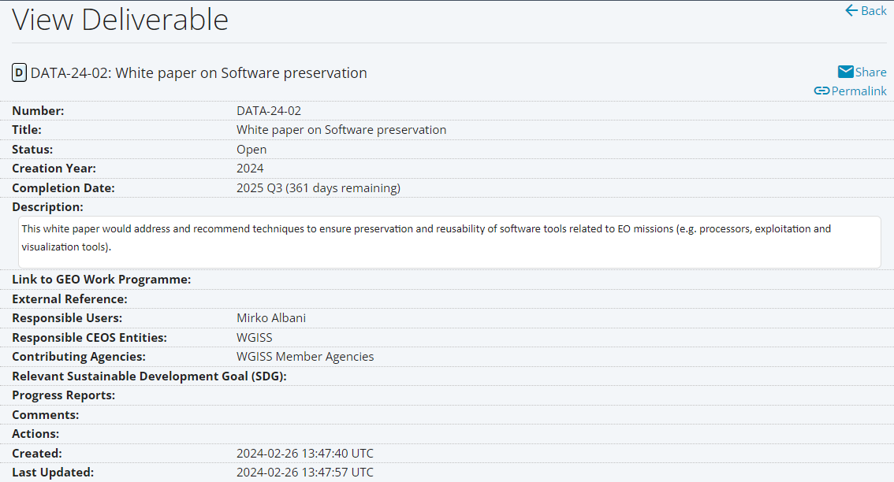
CEOS DELIVERABLE FROM DSIG

Slide 3
The white paper is intended to assist data/software managers in the Earth observation (EO) domain with the task of ensuring the long-term preservation of EO missions and data related software, thus improving data accessibility and usability for current and potential future users.
The intended audience comprises data and software providers, decision makers and scientists, and data managers/stewards for data centres and repositories.
It introduces the concept of software preservation, outlining its importance and justifying the effort to ensure effective preservation of EO data related software.
Details of the main principles of software preservation is provided, as well as brief descriptions of the primary strategies that may be implemented by data managers, together with challenges.

Slide 4
WHY TO PRESERVE SOFTWARE
There are several reasons that justify expending the effort required to preserve software, foremost of which is the simple fact that since data is being preserved, any associated software should be preserved alongside it to maintain the data’s maximum value.
Having access to the original software is crucial for any potential reanalysis/reproduction of earlier work, ensuring that researchers can understand how data was processed in the past, thus enabling meaningful comparisons with modern data analysis.
Data processing software provides valuable historical context for scientific data as it reflects the analysis methods and technologies used over time.

Slide 5
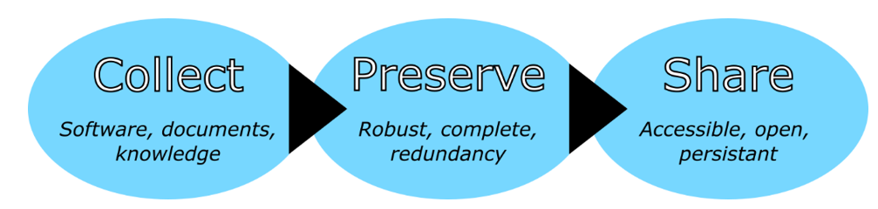
PRINCIPLES OF SOFTWARE PRESERVATION
These three principles, which correspond to the different phases of the software preservation process, help to guarantee the robust preservation of software while maximising benefit to, and usage by, potential future users of the software.

Slide 6
A wide array of challenges face software preservation, from technical complications to legal issues and resources availability. A well planned and proactive approach to software preservation may help to avoid some of the following most encountered challenges, particularly for larger, well-resourced organisations.
Lack of documentation and expert knowledge represent a challenge for the preservation process (mitigated by early adoption of a preservation strategy that ensures an adequate documentation and expert knowledge collection).
Preserving the full functionality of the software may be difficult as data managers/curators may not be familiar enough with the entire software to accurately assess whether all aspects are functioning as designed.
Risk of partial or full obsolescence prior to beginning the preservation process poses a critical risk that is particularly pronounced for software that depends on any specialised hardware (mitigated by a good preservation planning).
The need to avert these risks further reinforces the importance of planning the preservation activities as soon as possible so that software (and hardware) may be preserved while they are still available.

Slide 7
Intellectual property (IP) rights which may prevent the distribution of the software without first receiving explicit permission from the rights holder.
Software preservation often requires the manipulation of the software in a manner which may not be permitted by the licence agreements.
Resource availability, both in terms of personnel and finances.
Software preservation activities can involve expenses, particular if employing a strategy of technical preservation for software that relies on specialist hardware that must be purchased and preserved.
Even if all the required expertise are available, preservation is still a time-consuming process that requires significant effort and commitment from the personnel involved.

Slide 8
Preservation
Retrieve
Reconstruct
Replay
Preserve: a copy of a software “product” needs to be stored for long term preservation. There should be a strategy to ensure that the storage is secure and maintains its authenticity over time, with appropriate strategies for storage replication, media refresh, format migration etc.
Retrieve: in order to retrieve it at a date in the future, it needs to be clearly labelled and identified, with a suitable catalogue. This should provide search on its function and origin (provenance information).
Reconstruct: The preserved product can be reinstalled or rebuilt within a sufficiently close environment to the original that it will execute satisfactorily. For software, this is a particularly complex operation, as there are a large number of contextual dependencies to the software execution environment which are required to be satisfied before the software will execute at all.
Replay: In order to be useful at a later date, software needs be replayed, or executed and perform in a manner which is sufficient close in its behavior to the original. As with reconstruction, there may be environmental factors which may influence whether the software delivers a satisfactory level of performance.

Slide 9
SOFTWARE PRESERVATION ATTRIBUTES
Functionality
What it does and what data it depends on
Environment
Platform, operating system, programming language
Versions
Dependencies
Compilation dependency graph
Standard libraries
Other software products
Specialised hardware
Software is a Composite digital object
Collection of modules
Specifications, Configuration scripts, test suites, documentation
Architecture
Client/server, storage system, input / output
User interaction
Command line, User Interface
User model
Notes:
to be taken into account

Slide 10
SOFTWARE PRESERVATION RECOMMENDATIONS: APPROACHES
Three specific cases to be considered:
Future Missions:
Recommendations about software engineering best practice such as clear licensing; clear documentation; use of commonly adopted and modern programming languages; modular design; revision management and change control; established software testing regime and validated results; separation between data and code; and clear understanding of dependencies all make the work of software preservation easier. If the already existing Software Engineering Best Practices cover all preservation requirements, only a statement, with the standards references, could be highlighted.
Historical Missions:
Recommendations take into consideration different scenarios based on data uniqueness, available funding, etc. Example of Recommendation: if reduced funding available and similar instrument dataset already preserved then hibernation and procrastination recommended (i.e. keep in original format without any further effort).
Current Missions:
Mixed approach. For any new development, the Future Missions recommendations should be implemented, otherwise the approach to be followed is the Historical missions one.

Slide 11
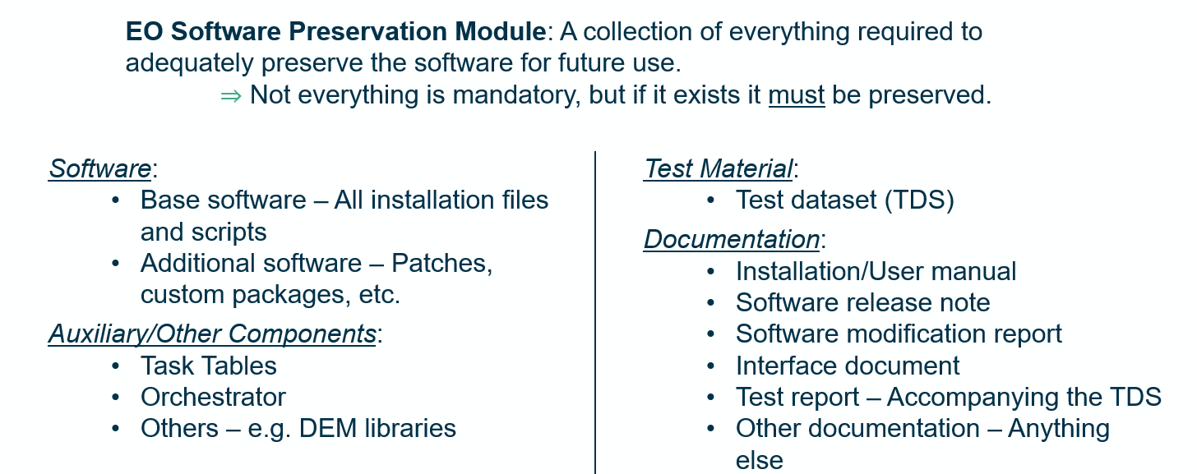
SOFTWARE PRESERVATION ELEMENTS
Software/Tools:
Software Applications:
Data Product generation
Quality control
Product visualization
Value adding
SW related “IT Infrastructure”:
Compiler
Programming language
Storage system
Operative System
Libraries
Databases

Slide 12
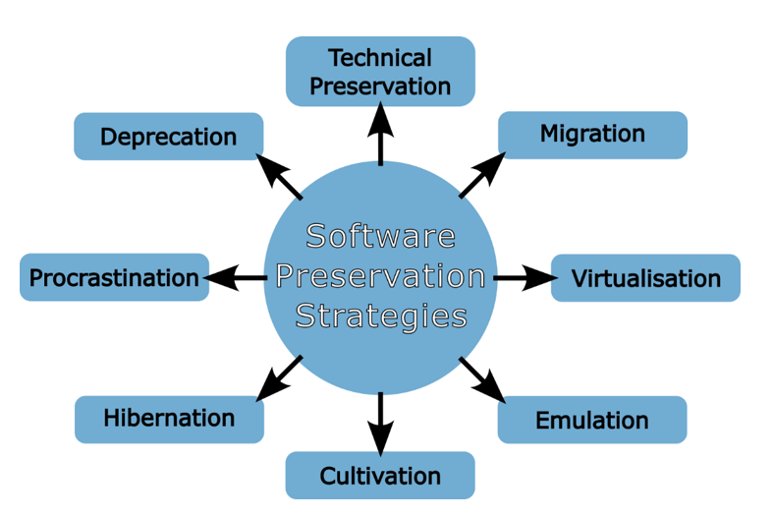
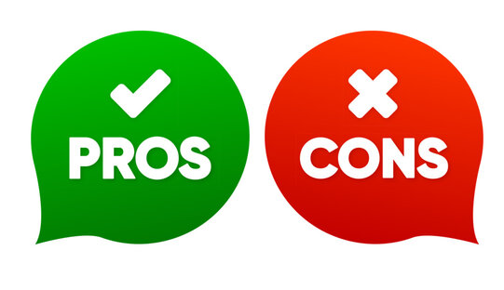
SOFTWARE PRESERVATION STRATEGIES
When it comes time to initiate the software preservation process there exist a number of strategies available to the responsible data curator. The choice of a strategy depends on the exact nature of the software to be preserved, and in some cases more than one strategy, or a hybrid approach, might be adopted. The appraisal process drives the decision.

Slide 13
TECHNICAL PRESERVATION OF HARDWARE
Easiest way to ensure that there will always be hardware on which to run your software is to preserve the hardware (and its operating system and any other reliant software).
Advantages:
It is easy and clearly defined
Can change to Hardware Emulation at later date
Disadvantages:
Costly, especially when hardware fails
Does not guarantee future access if dependent on other hardware/software (e.g. networking)
Maintenance (over time hardware components will wear out and must be replaced; If the hardware is no longer manufactured components become scarce and expensive)
Isolation (if your software only works with very specific hardware, you limit your users to those people with the right hardware)

Slide 14
EMULATION
Emulation addresses the original HW & SW environment of the digital object and recreates it on a current machine. The emulator allows the user to have access to the software on a current platform as if it was running in its original environment.
Emulate hardware platforms with another piece of hardware, typically a special purpose emulation system
Emulate applications & Operating System: ability of a software to emulate (imitate) another software (e.g. application or operating system).
Advantages:
Emulating hardware easier to manage
If emulation layer continues to be developed, software can continue to be run indefinitely
Disadvantages:
Right and ad-hoc emulator should be found; if old hardware is rare, no emulator might exist
Need all aspects of hardware to be emulated correctly
The emulation software could itself become obsolete

Slide 15
VIRTUALIZATION
Hardware virtualization or platform virtualization refers to the creation of a virtual machine that acts like a real computer with an operating system. Software executed on these virtual machines is separated from the underlying hardware resources.
Different types of hardware virtualization include:
Full virtualization – complete simulation of the actual hardware to allow software to run unmodified.
Partial virtualization – some but not all of the target environment attributes are simulated.
Hardware virtualization is not the same as hardware emulation. In hardware emulation, a piece of hardware imitates another, while in hardware virtualization, a hypervisor (a piece of software) imitates a particular piece of computer hardware or the entire computer.
Advantages:
No need to update/migrate software running on a Virtual Machine when underlying hardware changes
Disadvantages:
Need to virtualize SW to run on virtual machines

Slide 16
MIGRATION
Updating software as required to maintain same functionality, porting/transferring before platform obsolescence. Periodic transfer from one HW and/or SW configuration to another, or from one generation of computer technology to a subsequent one.
Migration approaches:
Complete re-write of the code allows the software to be used on a completely different system
Continual migration, keeping code up to date with the latest changes to the hardware and software that code relies on
Advantages:
Enables access on other platforms
Retain ability to retrieve/access/use data exploiting technology progress
Disadvantages:
Requires continued effort for development; significant effort if complex SW; time-consuming, costly, error-prone

Slide 17
CULTIVATION
Cultivation is the process of opening development of an own software. It aims at keeping software “alive” by moving to a shared development model through:
Distributing and spreading knowledge about the software to minimize single point of failures (e.g. departure of a developer)
Building a self-sustaining community of developers working together and sharing efforts to keep software up to date
Advantages:
Increases chances of further development of software and possible migration to other platforms
Disadvantages:
Long process, requiring more coordination
Possibility for loss of control of direction
Time investments into building the community, which requires work to understand what the community wants and how to appeal to them

Slide 18
HIBERNATION
Aim to preserve the knowledge of how to resuscitate/recreate the exact functionality of the software at a later date. Applicable for example when:
the software has come to the end of its useful life, but there is the possibility that it might need to be resurrected to double-check analysis or prove a result in future
Currently there is not a user community but this might occur in the future
Advantages: allows break in effort
Disadvantages:
Can be difficult to check if hibernation processes are rigorous until after it is too late
Preparing software for hibernation can be resource heavy, and if the software is never resurrected you may feel that those resources were wasted

Slide 19

DEPRECATION & PROCRASTINATION
Deprecation
Not properly a preservation approach; it is easy to perform but often marks the end of a software package’s life and is typically only chosen when no other option is available.
It might be expensive or impossible to resurrect the software in future.
Procrastination
“Never put off until tomorrow what can be done the day after tomorrow... or the next day”
Advantages:
Comes naturally, very easy and very cheap
Disadvantages:
Not a valid preservation technique!
May require software archaeology skills in the future

Slide 20
Approaches and Lessons Learned at ESA

Slide 21
APPROACHES AT ESA: SW PRESERVATION
During the initial dataset appraisal a decision on the approach to be followed to handle and preserve the mission data, information and the related SW is taken.
Decision depends on mission relevance, temporal and geographical coverage, size, storage media and archiving format, technical aspects and cost.
Software Preservation approach can be based on different strategies for different missions (e.g. virtualization, periodic migrations, hibernation).

Slide 22
APPROACH AT ESA: VIRTUALIZATION EXPERIENCES
Dependency on legacy hardware, difficult to maintain, was a critical issue for long-term exploitation of the EO products archive and a typical situation for IPFs of historical missions.
Instrument Processing Facilities Virtualization: a series of mission data processors was virtualised - AVHRR, SeaWiFS, Landsat TM, Envisat ASAR, Envisat MERIS, Envisat AATSR, Envisat GOMOS, Envisat MIPAS, Envisat SCIAMACHY, Envisat MRA2/MWR, ERS SAR, ERS Scatterometer, ERS GOME, ERS Altimeter.
Multi-Mission Facility Infrastructure Virtualization: Migration of MMFI building elements including IPF processors to a virtual-machine hosted environment, identifying and eliminating as much as possible dependencies on specific HW and related SW libraries.
IPFs and MMFI components can be now executed in virtual environments and have been installed on Cloud for many pilot and operational activities.

Slide 23
APPROACH AT ESA: PRESERVED MISSIONS EXAMPLES
SEASAT and JERS-1:
JERS-1:
After an initial dataset appraisal JERS-1 Processing Software was improved, aligned to ALOS mission and VIRTUALIZED
Reprocessing campaign performed in a Cloud environment
SEASAT:
After an initial dataset appraisal, the decision on DEPRECATION of the original processing software was taken
New SAR IPF derived from ALOS-JERS processors: virtualized to run on cloud.
Full reprocessing done and processor HIBERNATED.
Other Historical Missions
Processing software hibernation (e.g. after reprocessing campaigns)

Slide 24
Standards & Publications on Topics

Slide 25




SOME STANDARDS & PUBLICATIONS
EO Data Preservation Guidelines
GUIDELINE 7.3 – Processing software environment - (Level B)
Actively monitor the evolution of the environment (e.g. hardware and software operating systems) used to run “Processing Software” and perform hardware migration and software porting when necessary to maintain the original capabilities.
GUIDELINE 7.4 – Processing software virtualization - (Level C) Virtualize mission specific Processing Software to minimize dependency on the underlying environment (e.g. hardware and software operating systems).
“Reference model for an OPEN ARCHIVAL INFORMATION SYSTEM
Main Standard for digital data preservation. Potential Emulation Approaches recommendation was considered in this presentation.
“Selecting File Formats for Long-Term Preservation”: general advice in relation to electronic records preservation and management
“ELECTRONIC RECORDS - Recommendations for Preservation Formats“: guidelines on file formats for electronic records preservation
“The Significant Properties of Software: a Study”: information on software components and their preservation

Slide 26
OUTCOMES FROM SURVEY IN OTHER DOMAINS
No defined Best practices on Software and Document preservation in Space domain;
Recommendations on document format standard in Libraries and Archives domain;
Only few references about Software preservation approaches but no recommendations
Need for an harmonized approach in software preservation best practices

Slide 27
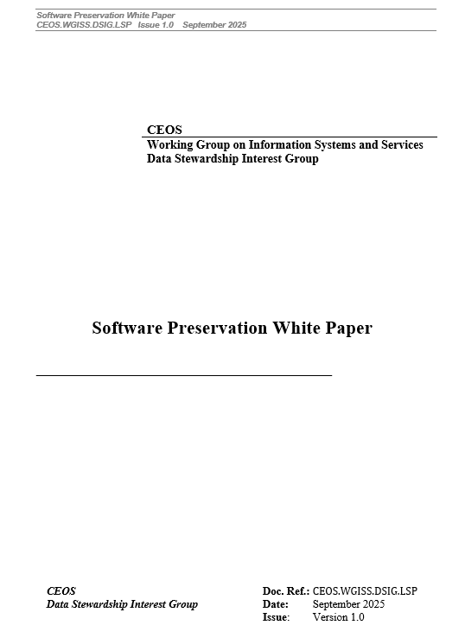
NEXT STEPS
Circulation of the Draft Version of the Software Preservation White Paper – by the end of WGISS#60 meeting
Feedback from WGISS members – by 24th of October
Finalisation and Circulation of the final version of the Software Preservation White Paper – by the end of October

