Slide 1
WGISS-60 AVHRR Data Recovery Project Updates
M. Albani, ESA
Agenda Item 11.2
WGISS-60
13-17 October 2025
Oberpfaffenhofen, Germany

Slide 2
AVHRR a unique long time data series
AVHRR data available as GAC (4 km) or LAC (1km). 1-km AVHRR LAC data gives new insights on structural changes on land in comparison of coarse resolution AVHRR GAC data.
GAC DATASETS
NOAA POES AVHRR GAC global archive: 1978 onwards
LAC DATASETS
EUMETSAT MetOp AVHRR 1km FRAC global archive: March 2008 onwards
Global Land 1-km AVHRR data set covering the period 1992-99 “1Km project”
Many national / regional data archives of LAC data around the world covering a longer period with high value for the retrieval of ECVs. Some of them accessible to users, others not due to unknown accessibility, responsibility, data format and structure.

Slide 3
AVHRR 1 Km digital data archives (excerpt)
Europe: ESA & University of Bern (Switzerland), STFC CEDA (UK, including Dundee Satellite Receiving Station), MeteoFrance (France), DLR (Germany), METoffice (UK), IGiK (Poland);
Americas: NOAA and USGS (USA), NRCan/CCMEO (Canada), GiDyC-Servicio Meteorológico Nacional (Argentina), INPE (Brazil);
Africa: SANSA (South Africa), ASI / University of Rome (Kenya);
Asia: CMA (China), IRIM (Mongolia), GITSDA (Thailand), Jaxa (Japan), ISRO (India);
Australia: CSIRO.
Datasets from Meteorological Institutes, Universities and other organizations all over the globe
Fundamental to ensure accessibility of 1-km LAC data from all available sources (in particular in the period before 2008)

Slide 4
Cooperation Activities on AVHRR
Objective: Build a worldwide coverage AVHRR LAC data series from 1978 onwards
Unfolding and making accessible 1km AVHRR data from regional archives (possibly open and free);
Transcribing unique data from heritage media;
Identifying a common format for AVHRR Level-1b and Level-1c data and pursuing (re)processing from AVHRR data owners/holders and data accessibility;
Facilitating data discovery through the WGISS Connected Data Assets Infrastructure.

Slide 5

WGISS
Committee on Earth Observation Satellites
AVHRR Global Land 1km Dataset

Slide 6
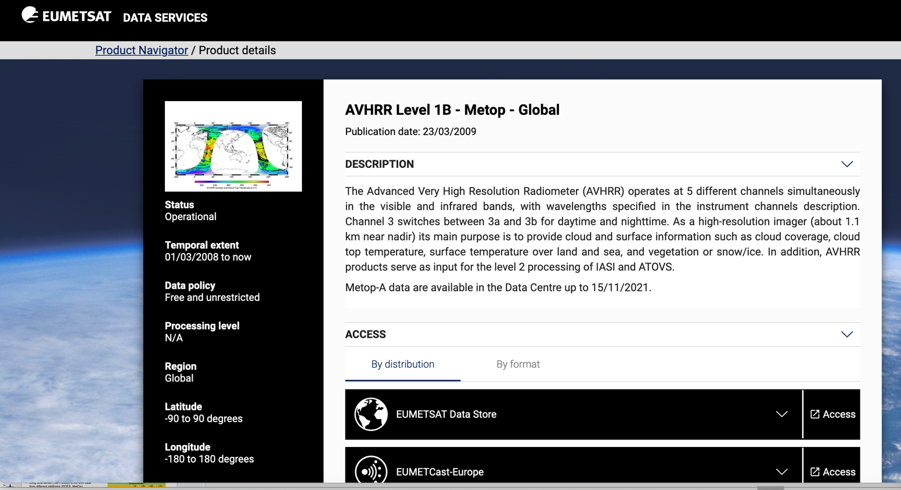
Global 1km AVHRR dataset 2008 - today
Metop satellites operated by EUMETSAT
Temporal extent: 01/03/2008 to today
Level-1b data
Open and Free

Slide 7
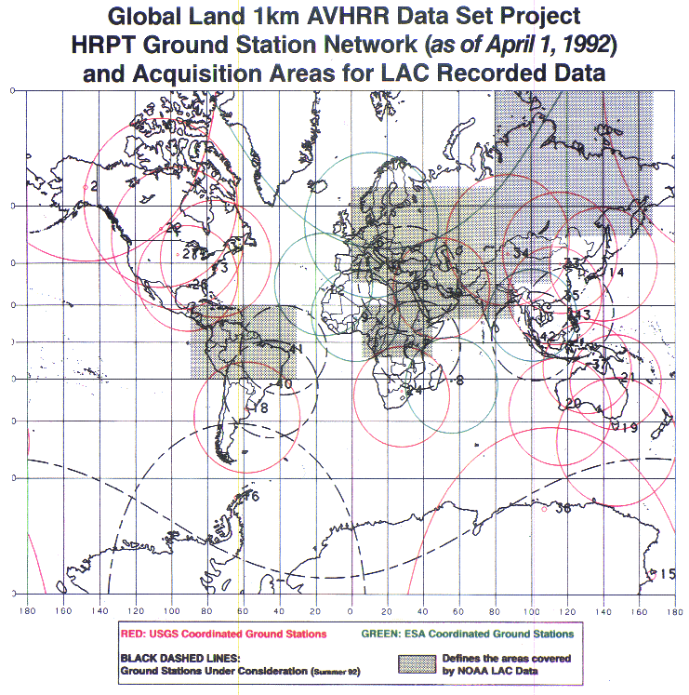
Global 1km AVHRR dataset 1992-1999
Two different global Land 1-km AVHRR datasets covering the period 1992-1999 are available at ESA :
Data acquired at ESA network stations (Terranova, Nairobi, Manila, etc..) processed up to L1C and accessible through ESA as dataset Out-of-Europe.
Data in stitched format (.arch files) from USGS network stations not accessible at USGS/NOAA but available at ESA in stitched format.
Unstitching, conversion, full processing into Level-1B and Level-1C completed at ESA.
Open access to users through ESA dissemination systems by Q1 2026.
AVHRR receiving stations contributing to global land 1km AVHRR data set. (https://lta.cr.usgs.gov/1km/hrpt_image)
Products Number*
 | L0 | L1A | L1B | L1C
1Km-Project (out of Europe) |  | 3901 | 3901 | 2991
* No L0 available.

Slide 8
WGISS
Committee on Earth Observation Satellites
AVHRR Regional LAC Archives

Slide 9
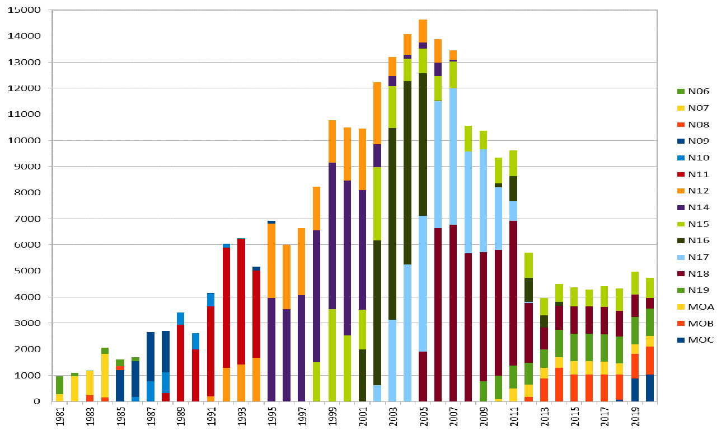
Europe – ESA & University of Bern
Long time series (1981–2020) of AVHRR data from different platforms (POES, MetOp)
Unique source to retrieve Essential Climate Variables (ECV) to investigate climate change over last 40 years.
Products Number*
 | L0 | L1A | L1B | L1C
Europe | 145231 | 259747 | 260060 | 259164
*The L0, L1A and L1B input data are scattered.
European dataset includes data from University of Bern, Dundee Station and ESA holdings: 260.000 products harmonized and consolidated through a dedicated ESA project (Heritage Space Programme).
Processing to L1C completed. All data safely archived at ESA and accessible free of charge via ESA since end 2024.
Presentation at WGISS#56
https://earth.esa.int/eogateway/catalog/avhrr-level-1b-1c-local-area-coverage-imagery
https://doi.org/10.5270/AVH-f1i8784

Slide 10
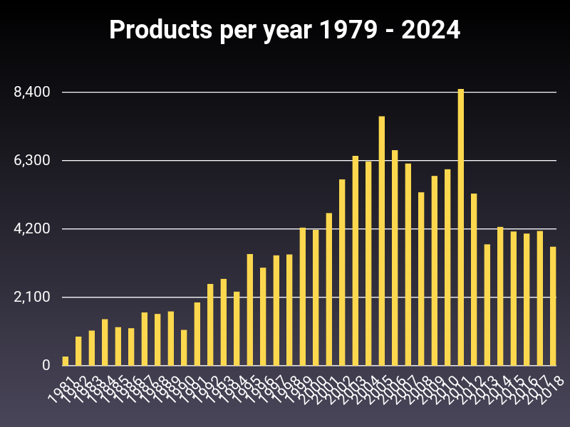
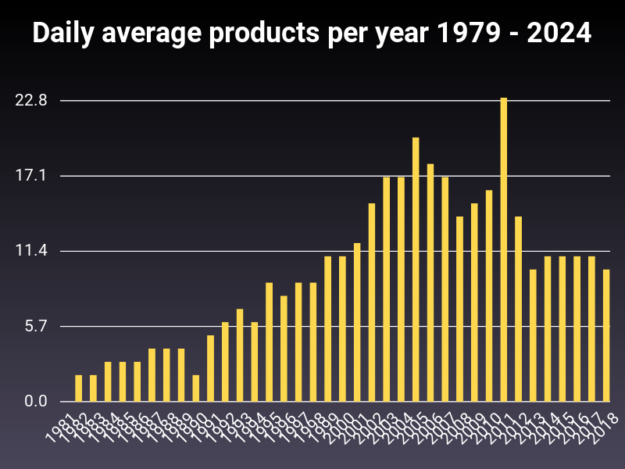
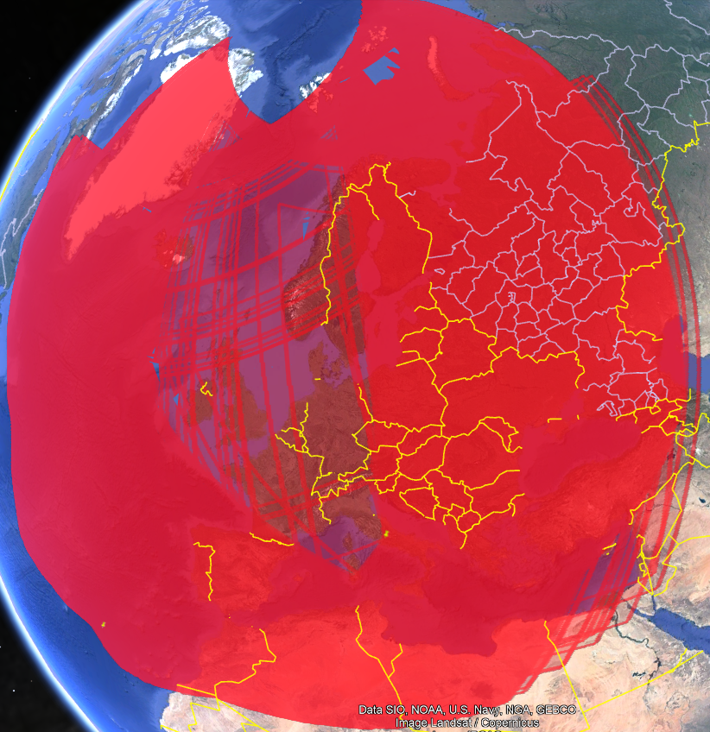
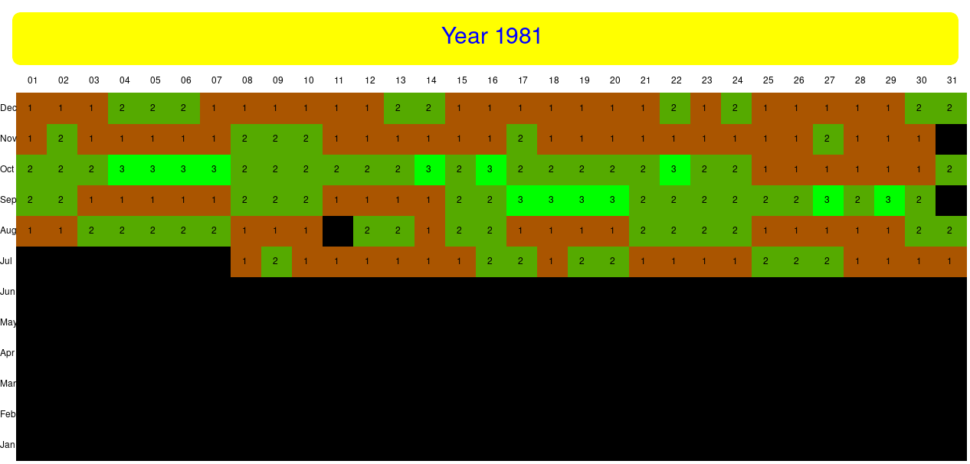
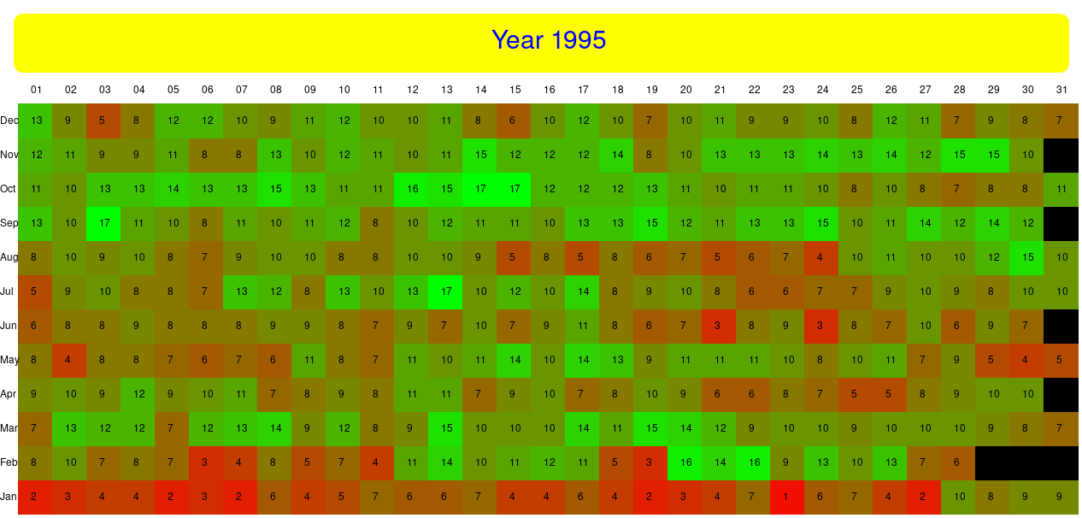
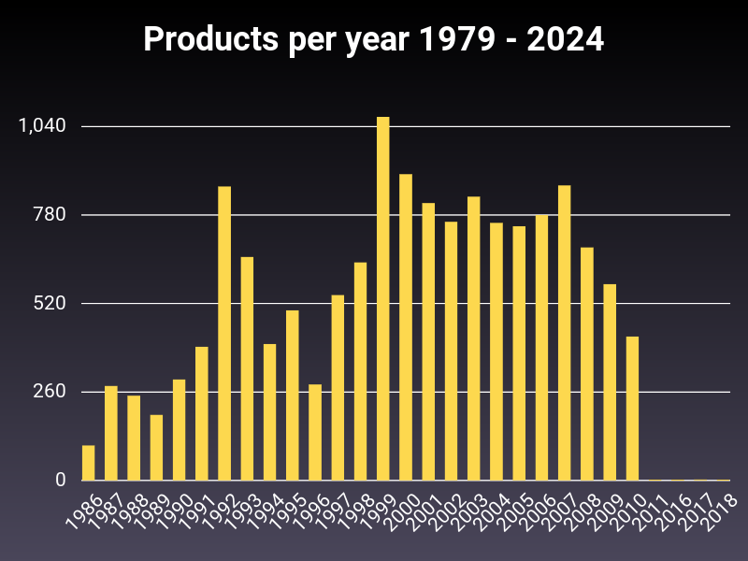
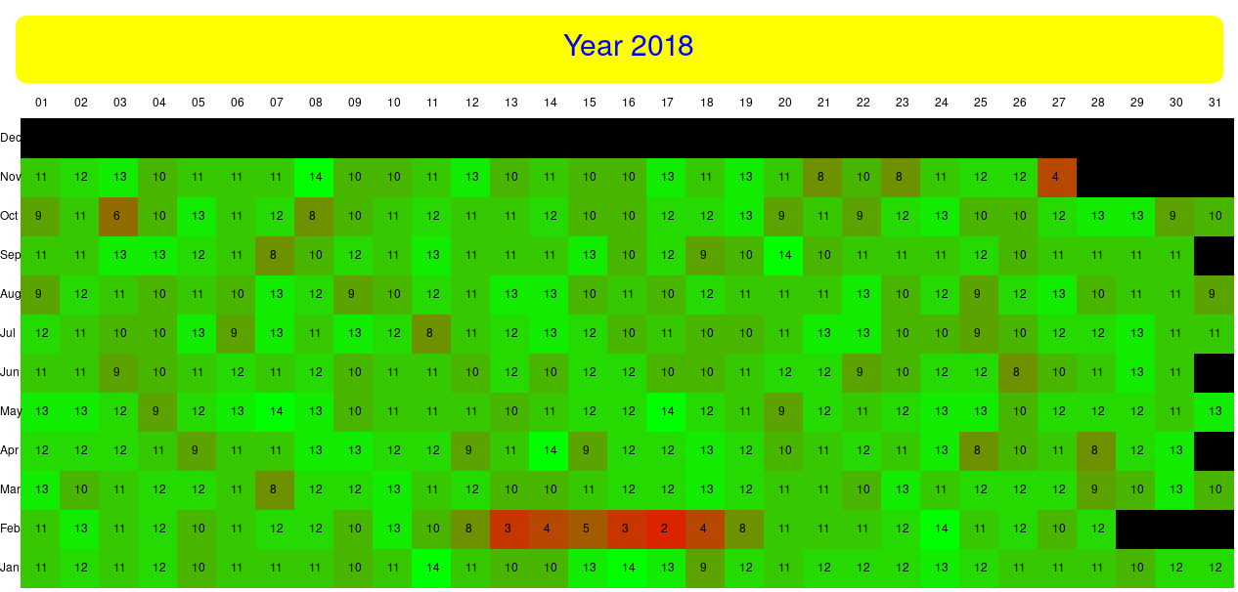
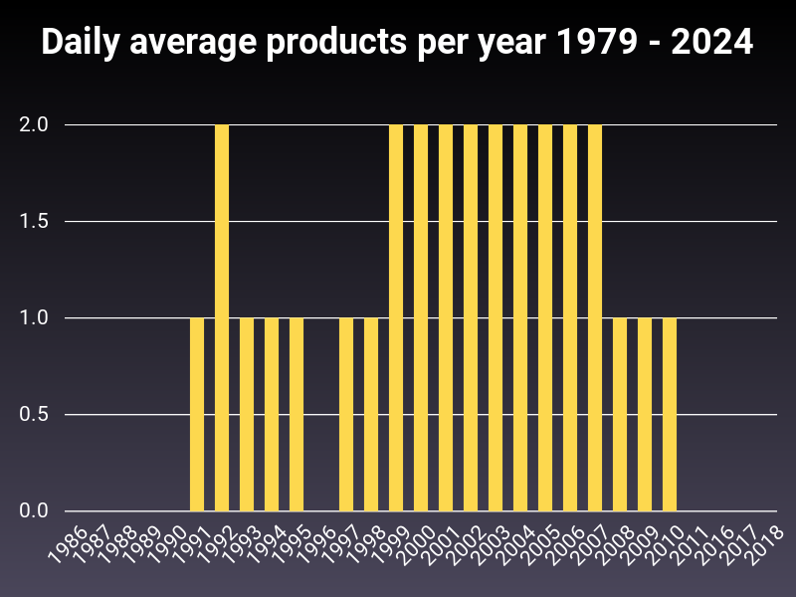
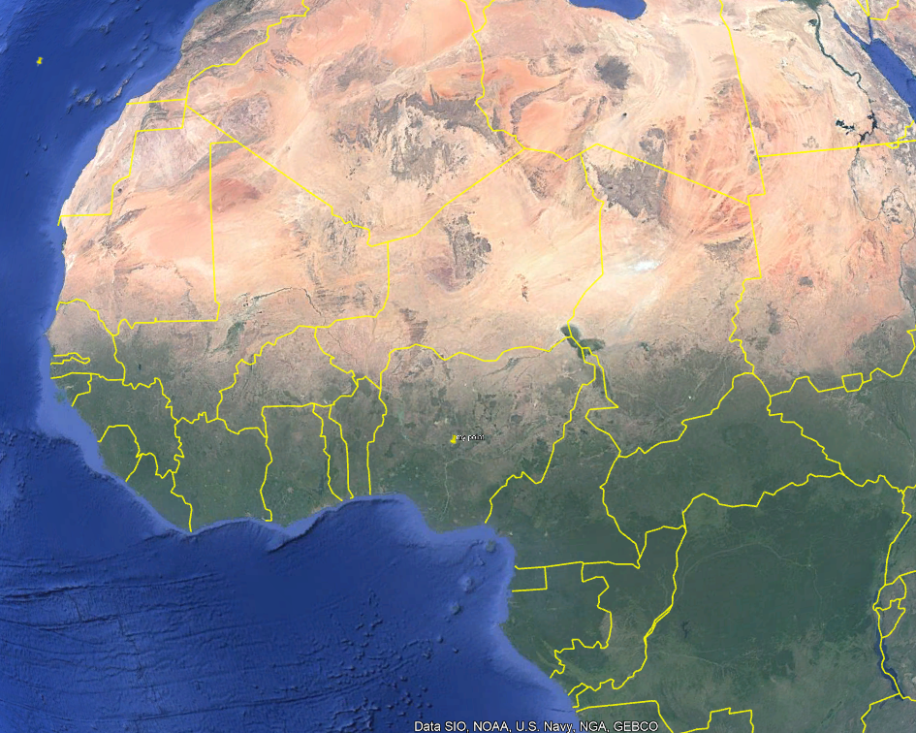
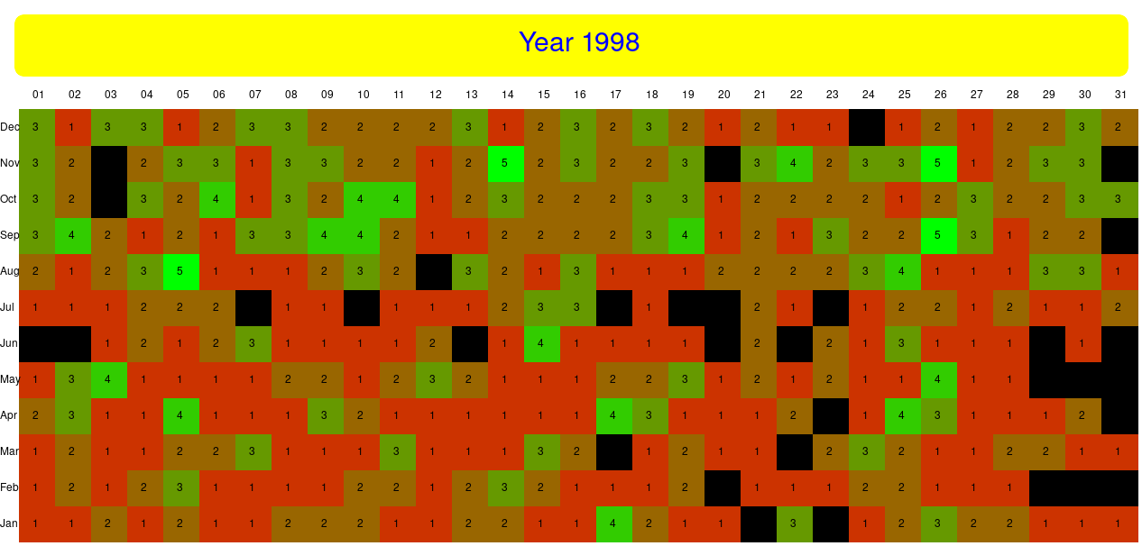
ESA AVHRR geoTool
A tool was developed to select AVHRR products available at ESA over specific Earth points (lat, lon) and time range. The tool generates:
KML files with available products frame coordinates
Graphs with products per year and average daily products per year
Heat charts per year to identify daily gaps and trigger/support data retrieval activities
Data gap analysis being extended to other CEOS agencies AVHRR datasets (global map)
Rome
Lat 42N Lon 13E
No data
Nigeria, Lat 8N Lon 6E
Products per day

Slide 11
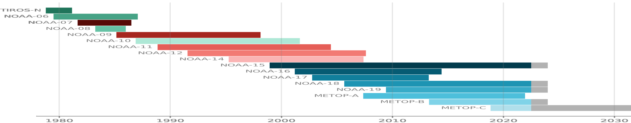
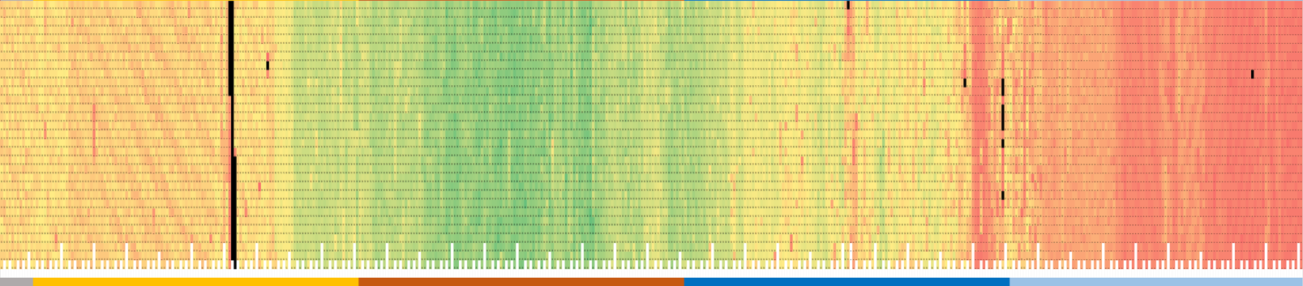
ESA European dataset temporal coverage
1980
1990
2000
2010
2020
D
A
Y
of
M
O
N
T
h
31
1
Missing data
Metadata extracted from ESA L1C products to build a heat chart on data acquisition frequency per day:
  min value: 1, max value: 50, Missing data: black
Data gap will be closed getting missing products from other sources

Slide 12
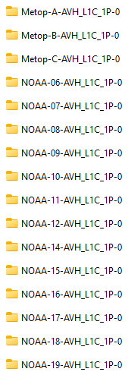
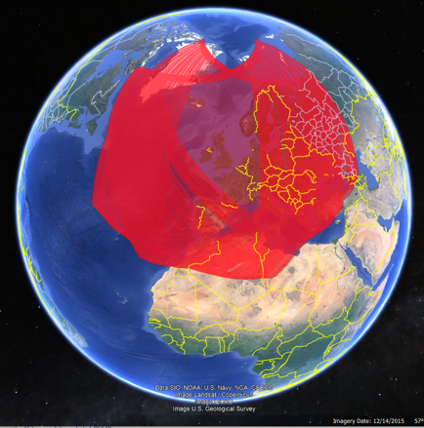
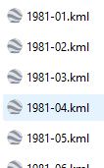
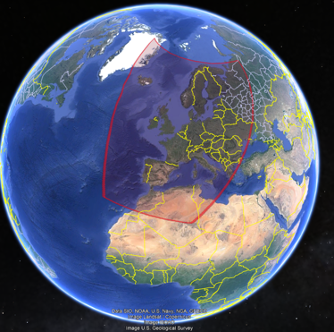
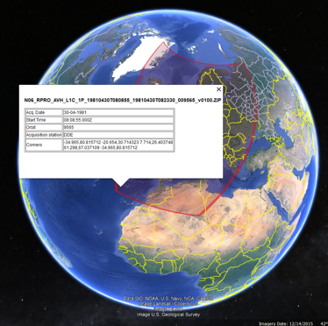
Europe - ESA Data spatial coverage
Metadata extracted from ESA L1C products
Built a KML file for each mission, year and month
Each pass can be selected with metadata

Slide 13


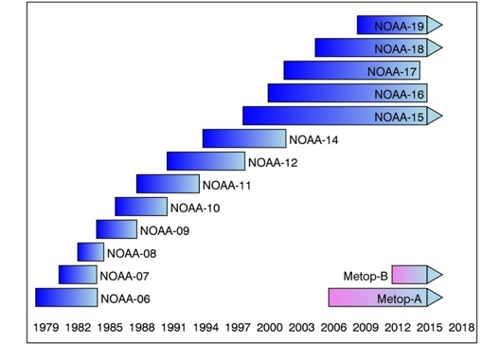



FDR for Advanced Very-High-Resolution Radiometer instrument (FDR4AVHRR)
  New project started in Q1 2024 at ESA:
  Reprocessing of European AVHRR LAC products series (NOAA & MetOp missions) to generate a L1C Fundamental Data Record (FDR);
    Reprocessed dataset based on new SW modules for improved geocoding / orthorectification, error propagation and accurate uncertainty estimates in the calibration module;
    FDRs for TIR and VNIR channels over Europe, cross-mission calibrated AVHRR FDR 1 km dataset for all channels;
    Extending European Data Set with data:
      over Europe from 2020 to 2025;
      over Greenland and northern areas;
      over selected regions across the world (Argentina, Kenya, South Africa, 1-KM Project, Brazil, Pacific/Atlantic/Africa).
    Completion by mid 2026
FDR4AVHRR
Presentation at WGISS#57 and #58

Slide 14
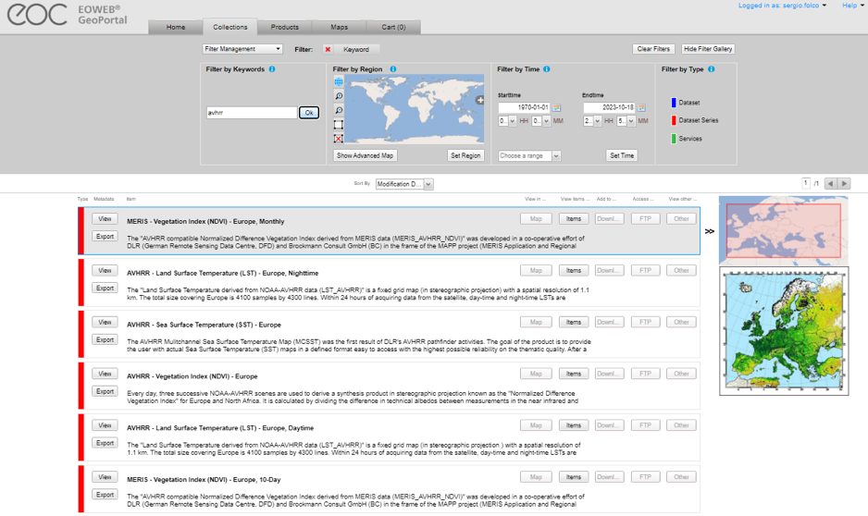
Europe – DLR
Four AVHRR datasets over Europe (N14,N16,N17,N18,N19) available in the DLR catalogue:
  AVHRR - Land Surface Temperature (LST) - Europe, Nighttime;
  AVHRR - Sea Surface Temperature (SST) - Europe;
  AVHRR - Vegetation Index (NDVI) - Europe;
  AVHRR - Land Surface Temperature (LST) - Europe, Daytime.
High redundancy with ESA dataset; not clear if L0 data available at DLR.
Presentation at WGISS#57

Slide 15
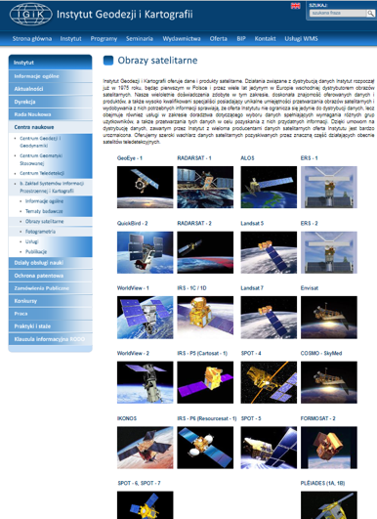
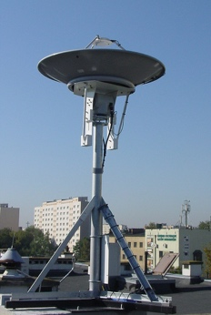
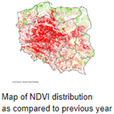
Europe – IGIK (Poland)
The Polish Institute of Geodesy and Cartography dept of Remote Sensing holds NOAA satellites data since 1996 and used for agriculture studies
The receiving station recorded data in HRPT, SeaWiFS (and other formats) from NOAA, Seastar, Metop and NPOESS polar-orbiting satellites.
AVHRR data are not accessible from the web site.
ESA received feedback from IGIK in Jan 2025. Two datasets available:
NOAA AVHRR Data from All Automatic Overpasses Over Poland Collected by the Dartcom System. Time range 2012-2018, volume 2.0 TB.
Dataset from NOAA-11 to NOAA-19 (1995-2014). Volume is 350 GB.
Next Steps: full processing into Level-1B and Level-1C, open access to users by 2026.
The datasets have been downloaded and stored in the ESA tape archive.

Slide 16
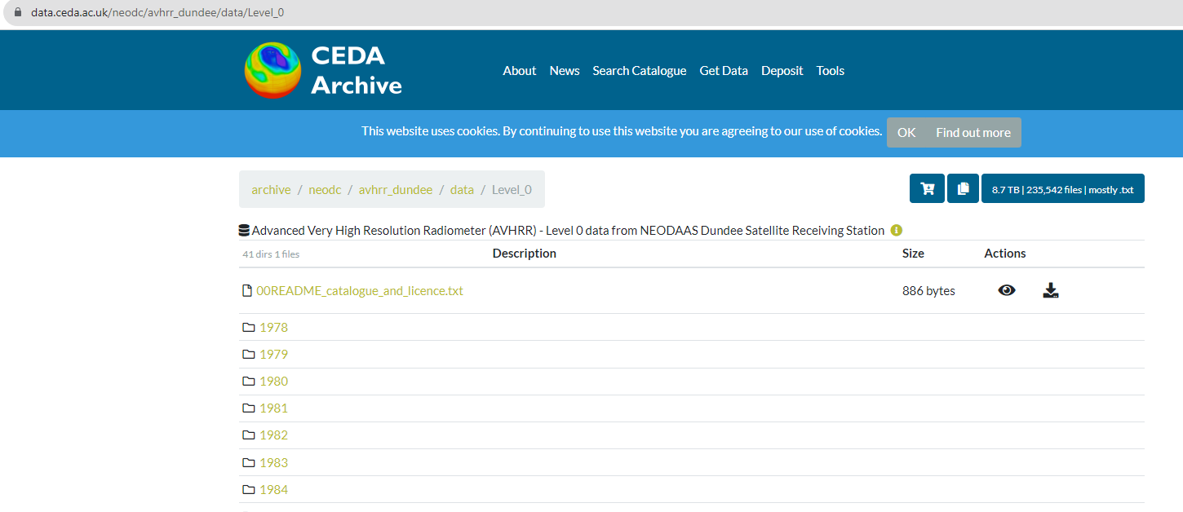
Europe – Dundee Station data archived at CEDA
1978 – 2018 AVHRR L0 data available with free and open access through CEDA (UK).
ESA has downloaded the full Dundee AVHRR L0 products (8.9TB, 235,541 L0 products).
Some data were reprocessed and included in the European dataset. Remaining products are now integrated to extend geographical coverage towards Greenland and in time back to 1978 (FDR4AVHRR ESA project).
Presentation at WGISS#56

Slide 17
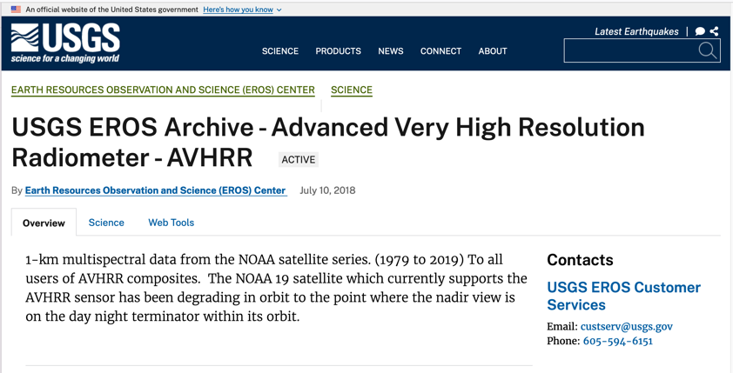
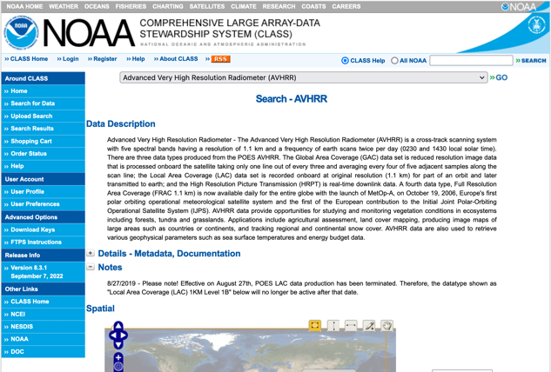
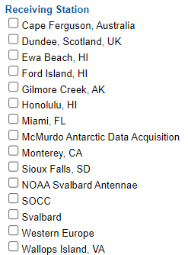
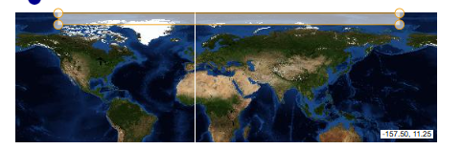
North America – NOAA & USGS
NOAA presentation at WGISS#55
Analysis by ESA over North America
Next Steps: USGS will be invited to make a presentation at WGISS#61

Slide 18
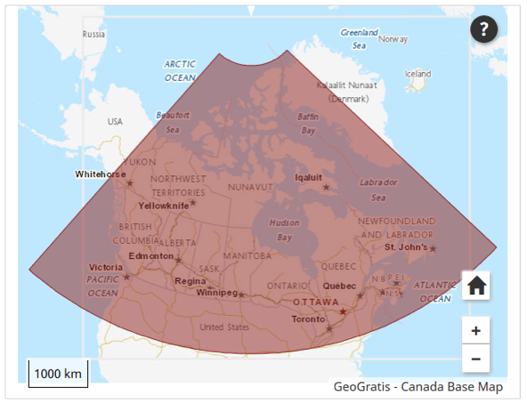
Canada – NRCan/CCMEO (1/2)
1981 – 2013 L1C data available at CCMEO (+ AVHRR L1B LAC/HRPT received after that date).
Open source data covered by WMO CGMS data distribution policy, they can be shared freely and without charge.
The Canadian sector is of high value to analyze changes of the environment.
The former developed pre-processing and retrieval of ECVs by A. Trishchenko and K.Klopenkov was of high quality and the standard for many other AVHRR processing chains.
Further development and processing was stopped some years ago but raw AVHRR data are available by NRCan.
https://open.canada.ca/data/en/dataset/9045136a-d6e7-a825-491d-ee5dc77a2620
.

Slide 19

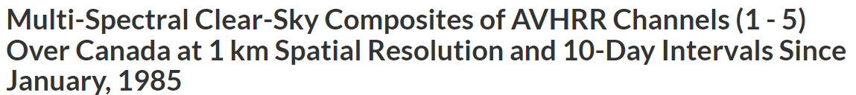
Canada – NRCan/CCMEO (2/2)
Next Steps: NRCan/CCMEO will be invited to make a presentation at WGISS#61

Slide 20
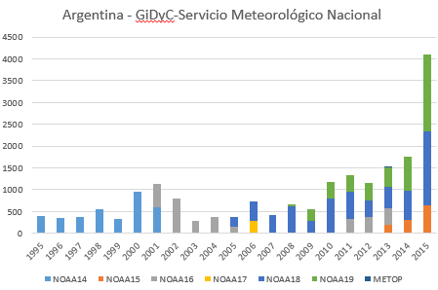
Argentina - GiDyC-Servicio Meteorológico Nacional
Initial products Metadata
Source: Jefa Departamento Teledetección Y Aplicaciones Ambientales, GiDyC-Servicio Meteorológico Nacional, Buenos Aires, Argentina
Number of products: 19360
Volume size: 740GB
Satellites: N14, N15, N16, N17, N18, MetopA/B
Time Period: 1995 – 2015
Extent: roughly Lat=[-30,15] Lon=[-60,-15]
Format: QUO (HRPT)
Downloaded products metadata*:
Number of products: 25504
Volume size: 1.02 TB
Time Period: 1995-2017
Format: .rar, .quo, .WI
Data transferring to ESA completed.
Full processing into Level-1B and Level-1C is completed (FDR4AVHRR ESA project).
Open access to users via ESA systems Q1 2026

Slide 21
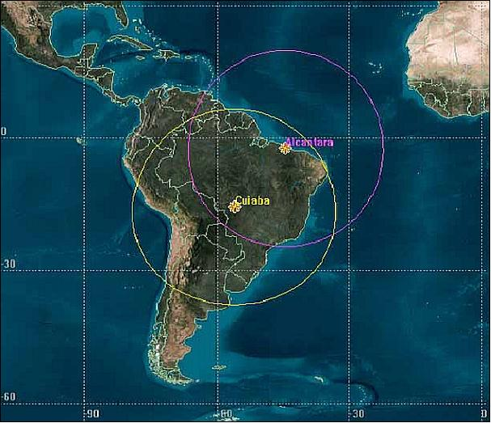
Brazil - INPE
Satellites: METOP-A, METOP-B, N12, N14, N15, N16, N17, N18, N19,
Number of L0/L1A : 287325
Volume size < 18TB
Time Period: 1998 - 2024
Extent: Brazil
Format: HRPT and others
METOP-B | May 2013-Ma-2024 | HRPT | 29237
METOP-C | Dec 2019-Mar 2024 | HRPT | 7924
NOAA_12 | Aug 1998-Aug 2007 | HRPT | 16333
NOAA_14 | Aug 1998-Jun 2007 | HRPT | 10976
NOAA_15 | Jul 2001-Aug 2019 | HRPT | 36816
NOAA_16 | Aug 2001-Dec 2014 | HRPT | 20692
NOAA_17 | Jan 2003 - Mar 2013 | HRPT | 24575
NOAA_18 | May 2005 – Mar 2024 | HRPT | 52626
NOAA_19 | Jan 2012 - Mar 2024 | HRPT | 39791
S1* | --- | Unknown | 48355
Data transfer to ESA completed.
Next Steps: full processing into Level-1B and Level-1C, open access to users via ESA systems (FDR4AVHRR ESA project).
* The S1* files are under investigation because they could be single data/calibration for channel.

Slide 22
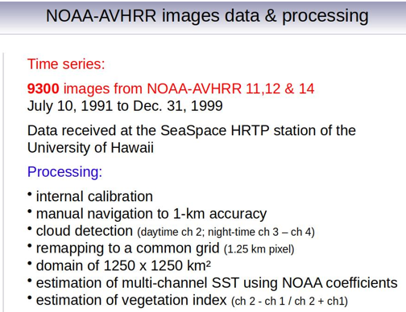
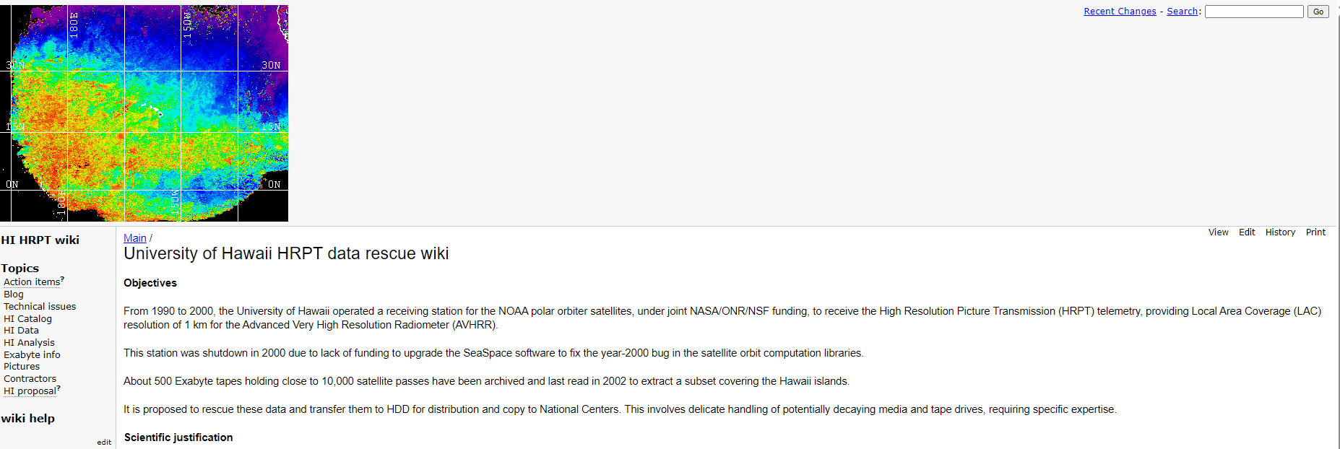
Pacific Ocean – University of Hawaii
An AVHRR dataset was acquired at the Hawaii University between 1990 and 2000. Data are still on Exabyte tapes, some were extracted covering the islands but accessibility not clear.
Exabyte tapes and hardware were shipped to ESA/ESRIN and transcription chain is being assembled.
The ESRIN laboratory has manufactured a special device to roll/unroll tapes at very slow speed and clean their surface from moisture before transcription. Test of this equipment is on-going.
Content extracted successfully from one tape.
Next steps: transcription of all tapes, full processing into Level-1B and Level-1C, open access to users via ESA systems.
Metadata from the website

Slide 23
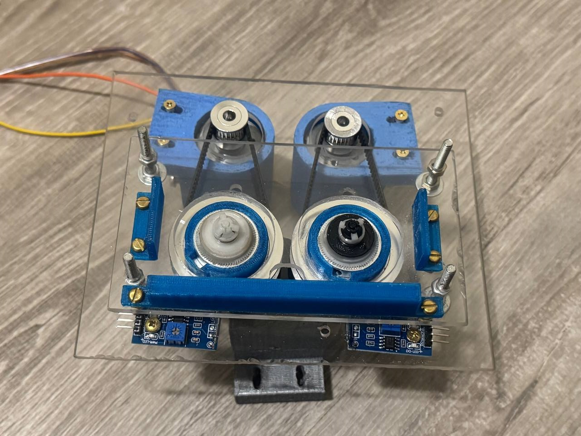
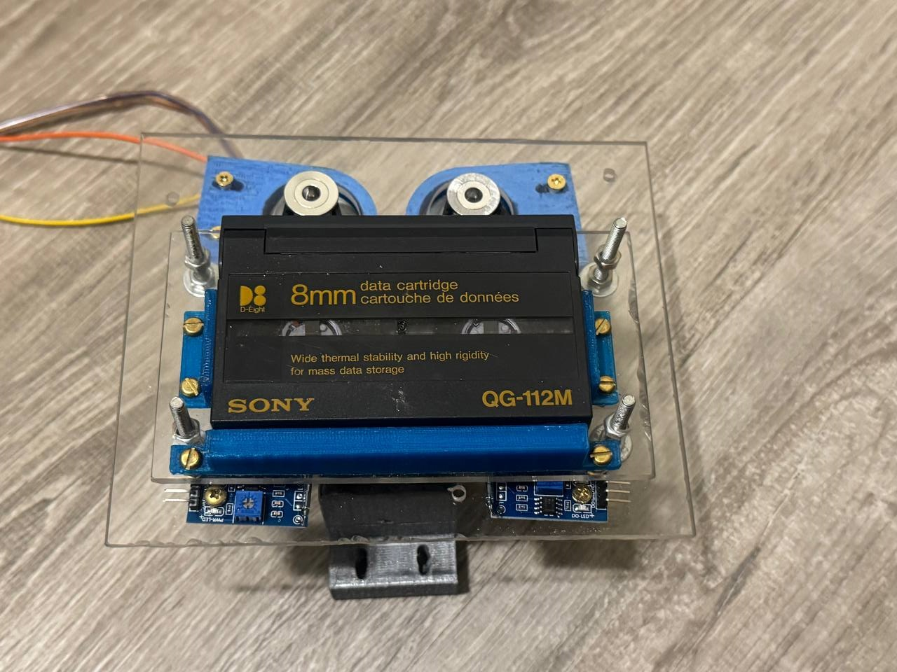
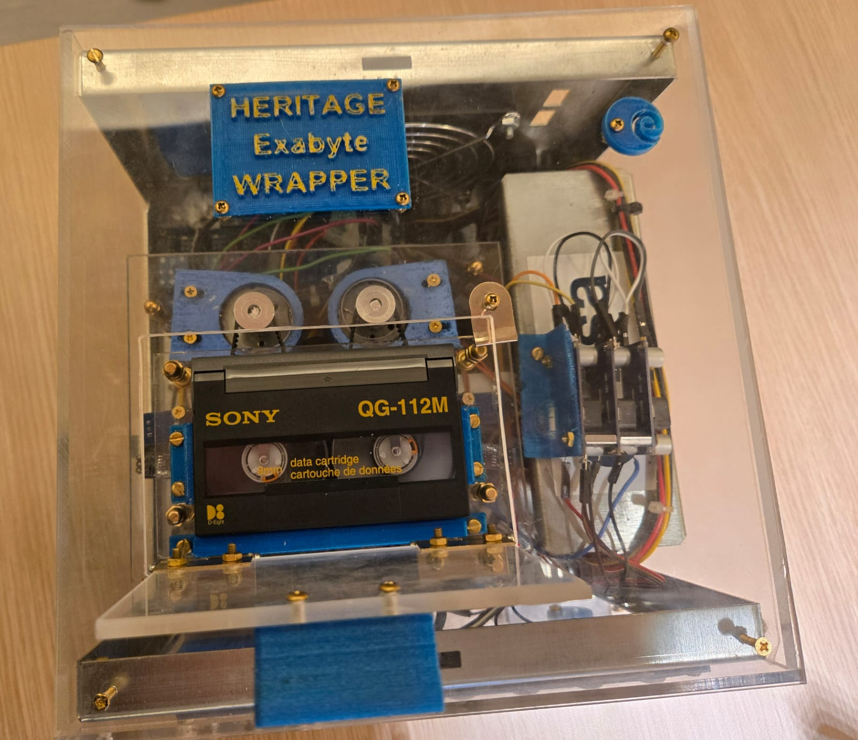
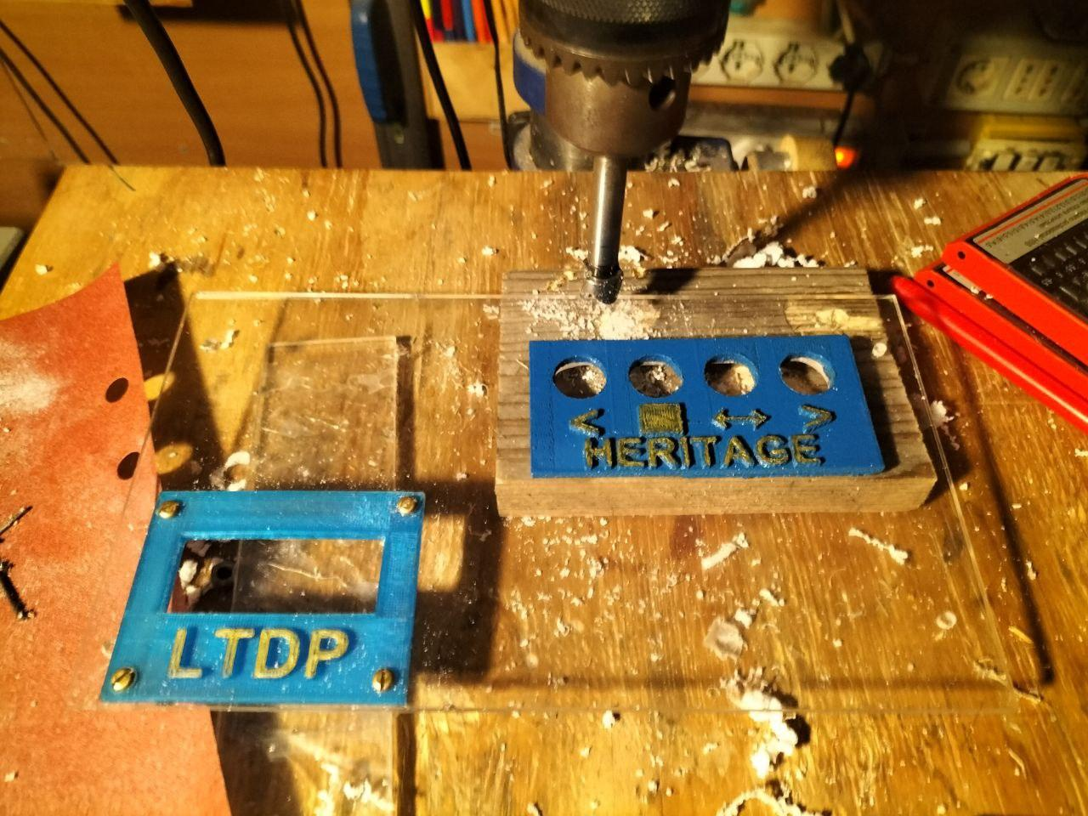
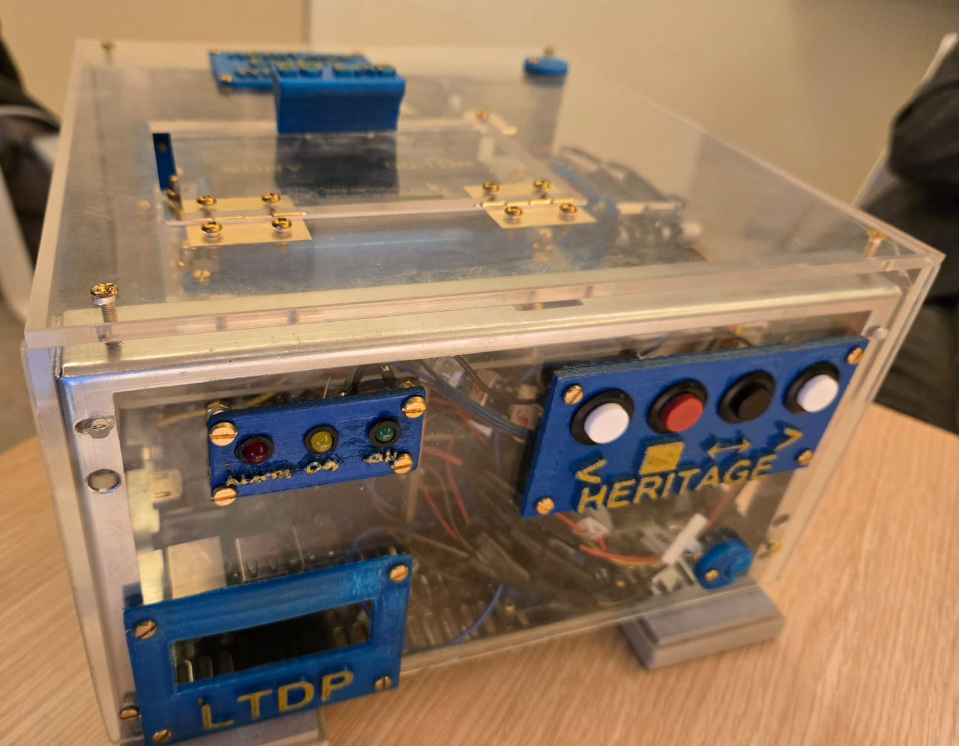
Heritage Exabyte tapes wrapper
Built at ESA ESRIN laboratory to clean and wrap exabyte tapes avoiding damaging both the cassette and the internal tape. Mandatory step for these old media before transcription.
Notes:
The 'heritage exabyte wrapper' is a device that is able to clean and wrap an exabyte tape avoiding damaging both the cassette and the internal tape. Older exabyte cassettes and tapes plastic becomes fragile after many years. Moreover, old tapes are often sticky and the original/nominal exabyte reader could damage the tape and the internal plastic. The 'heritage exabyte wrapper' uses on the shelf electronic components, 3d printed parts, aluminum as a material for the stressed components and dedicated algorithms to control the correctness of the wrapping. The main scope of the 'heritage exabyte wrapper' is to preserve the integrity of the tapes allowing its wrapping and its cleaning.

Slide 24
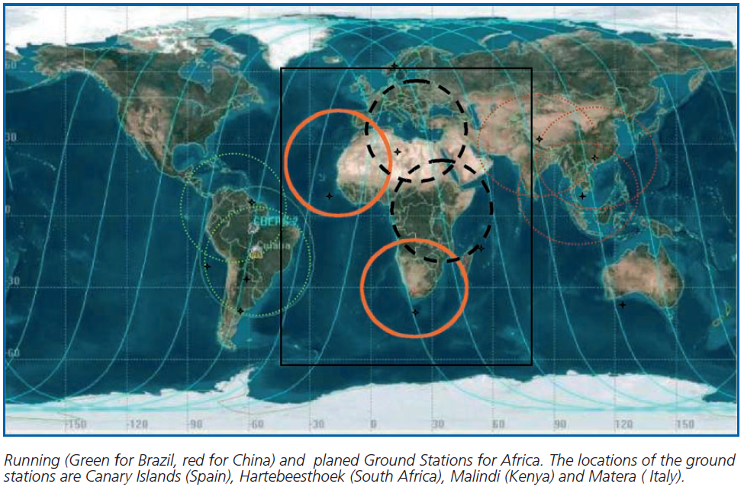
African Coverage
The combination of AVHRR data acquired in Maspalomas (Spain), Matera (Italy), Cairo (Egypt), Niamey (Niger), Hartebeesthoek (South Africa) and Malindi/Nairobi (Kenya) can provide full coverage of Africa;

Slide 25
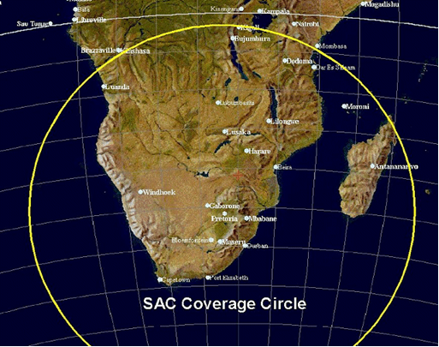
South Africa – SANSA
1km NOAA AVHRR data received at Hartebeesthoek, South Africa (25°53' S 027°42’ E) and maintained by SAC/SANSA – South African National Space Agency
NOAA 9 | 1985-1987
NOAA 11 | 1989-1993
NOAA 14 | 1995-2001
NOAA 16 | 2001-2005
NOAA 17 | 2005-2010
NOAA 18 | 2005-2009
Number of products: 7684
Volume size: 464GB
Data transfer to ESA completed.
Full processing into Level-1B and Level-1C is completed (FDR4AVHRR ESA project).
Open access to users via ESA systems Q1 2026

Slide 26
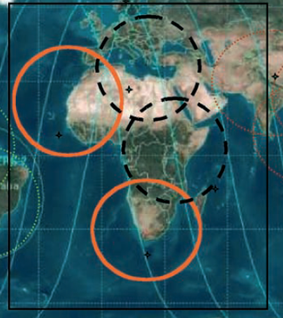
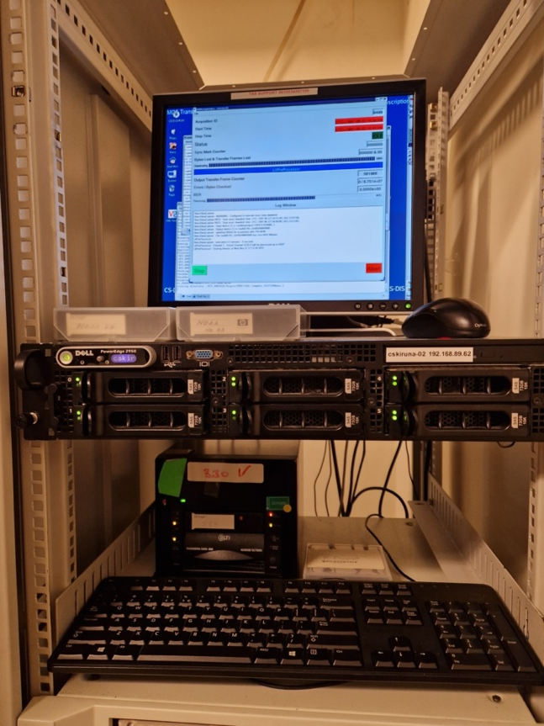
Central Africa (Kenya) - ASI/UniRoma
Data acquired at Malindi station in Kenya from 2001 to 2009 and stored on 44 DLT tapes. NOAA AVHRR data (Apr 2001 - Apr 2009) received:
At Malindi station, Agenzia Spaziali Italiana (2°56′18″S 40°12′45″E)
ESA transcribed the DLTs content successfully.
Full processing into Level-1B and Level-1C is completed (FDR4AVHRR ESA project).
Open access to users via ESA systems Q1 2026
Number of products: 8452
Volume size: 614 GB

Slide 27
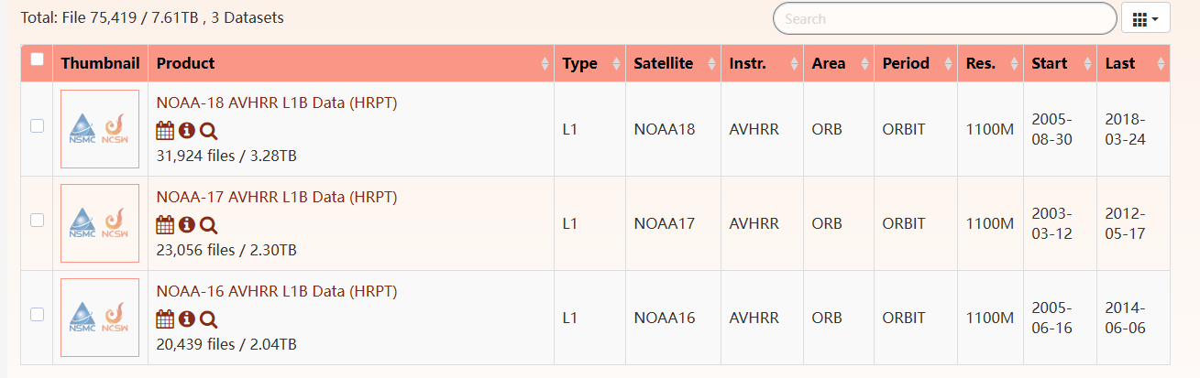
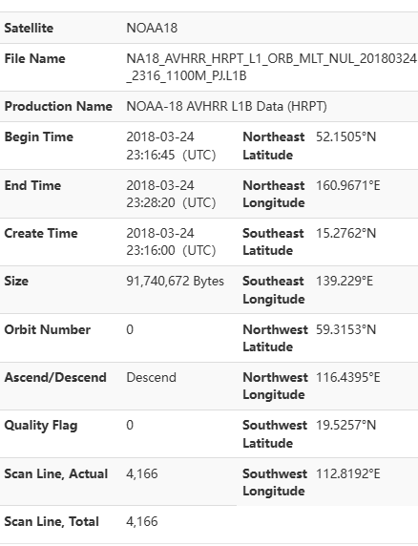
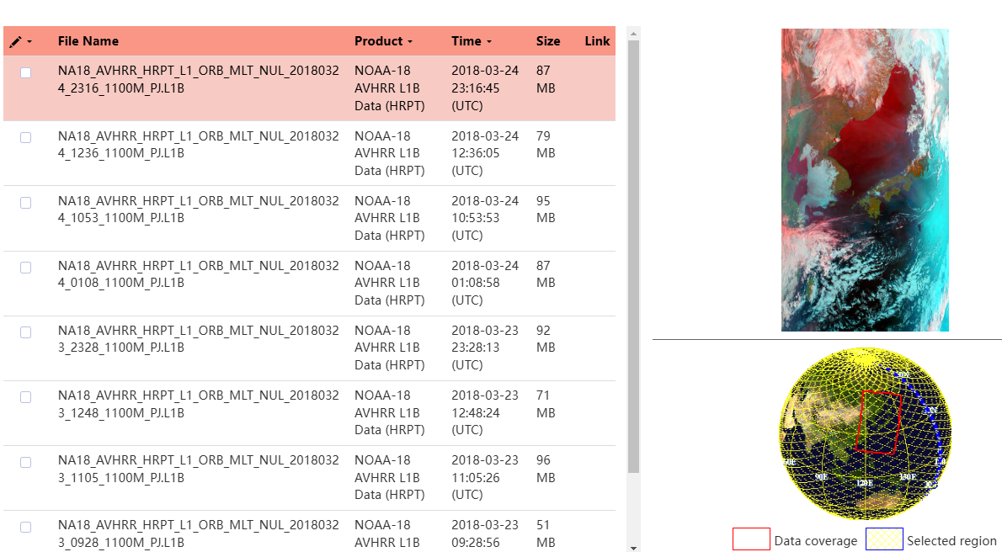
China – CMA/NSMC
AVHRR-receiving stations for global 1km land product (coordinated by USGS): Beijing, Urumqi, Guanzhou
AVHRR 1-km data covering Himalaya-Hindukush of the period 1981 – 1992 would be of exceptional value
Data after 2003 available at NSMC
http://satellite.nsmc.org.cn/DataPortal/en/data/dataset.html?dataCategoryCode=L1
Format is HRPT
No products downloading possible via machine-2-machine interface.
CMA/NSMC will be contacted and invited to make a presentation at WGISS-61.

Slide 28
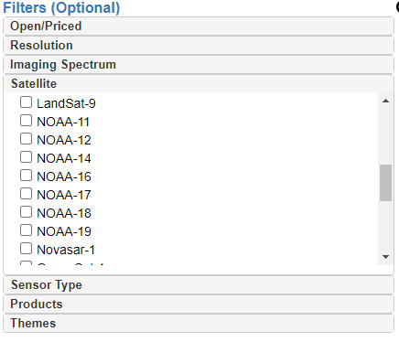
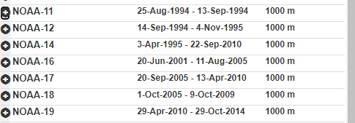


India - ISRO
https://bhoonidhi.nrsc.gov.in/bhoonidhi/index.html
Presentation at WGISS#57
Example over Hymalaya region
NOAA products are open-data and, after user registration, the products are downloadable.
No products number or volume can be extracted from the web site.
ISRO is processing AVHRR dataset holdings onto L1A products in house. L1B and L1C products will then be generated using the pyGAC software provided by ESA to ISRO.

Slide 29


Mongolia - Remote Sensing Department, Information and Research Institute of Meteorology, Hydrology and Environment
From UniBern
AVHRR UBM data
Source: Remote Sensing Department, Information and Research Institute of Meteorology, Hydrology and Environment, Ulaanbatar, Mongolia
Number of Scenes: 5.016
Satellites: N09, N11, N12, N14, N15
Time Period: 1993 – 1999
Extent: roughly Lat=[20,70] Lon=[80,120]
Format: hmf (origin: dat, grid, lut)
Further info:- UBMx station data were included in the Global Land 1km AVHRR Data Project
Browsing the NOAA data, the acquisitions are from 01/01/2017 up to now.
Downloadable data (raw,L1b,L1c) from 10/12/2023 (http://icc.mn/)
ESA established contacts with IRIMHE institute in Mar’25.
NOAA-15, NOAA-17 and NOAA-18 HRPT data is available and can be shared with ESA.
Data transferring on-going.

Slide 30

Thailand - GISTDA
GISTDA confirmed they keep data from last six months. No further action.

Slide 31


Australia – CSIRO
AVHRR reception based on 6 stations for continuous 1-km data set. Since the early 1990s CSIRO has been merging these separate local data sets to produce a stitched archive with national coverage. The assembly and consolidation of this data set continues within CSIRO today.
Data availability: 1981 (NOAA-7) onwards covering essentially the greater Australasian region and NZ.
Ian Grant, Bureau of Meteorology, Australia
CSIRO planning to reprocess all data into higher levels and provide access.
Coordination and cooperation with ESA ongoing (exchange of info and SW) to facilitate reprocessing and harmonization of datasets.
Presentations at WGISS#56/57/58
https://link.fsdf.org.au/dataset/avhrr-imagery

Slide 32
Additional AVHRR data available at ESA
Three HD with potentially unique AVHRR data made available to ESA from Prof. P.Cornillon (University of Rhode Island)
Per Region/Acquisition Station | Items
HRPT - Peru’ | 5055
East Pacific | 7530
HRPT – South Africa | 9721
Wallops Island | 109421
West Atlantic | 21744
West Pacific | 16809
Total | 170280
Data extraction from disks completed at ESA.
Next Steps: full processing into Level-1B and Level-1C, open access to users via ESA systems (FDR4AVHRR ESA project).

Slide 33
Other organizations
Inventory of existing national/regional HRPT and LAC data archives Version 3.2 has been produced in Q2 2025
List of Met offices and other organizations around the world who might have AVHRR LAC data being compiled at ESA
ESA will perform a worldwide AVHRR LAC data gap analysis extending the one done for Europe
ESA will contact additional organizations who might have AVHRR LAC data to investigate possibility to fill identified gaps

Slide 34
WGISS
Committee on Earth Observation Satellites
AVHRR Media Transcription

Slide 35




AVHRR 1 Km data on media
Several hundred heritage media (optical disks, DLTs, Exabytes) with potentially unique AVHRR LAC data identified:
  ESA (Optical Disks) 🡪 TRANSCRIPTION ONGOING
  University of Reading (Optical Disks) 🡪 TRANSCRIPTION ONGOING
  University of Rome / ASI (DLTs) 🡪 TRANSCRIPTION COMPLETED
  University of Hawaii (Exabytes) 🡪 TRANSCRIPTION ONGOING
DLT cassettes
LM 1200 optical Disk 2.4GB
Exabyte tapes

Slide 36



Optical Disks
Transcription of the full batch of available optical disks (around 522) contracted to a commercial company in the UK.
Sample L1B products successfully processed using the ESA processor from L) data extracted from disks .
Transcription of media ongoing.

Slide 37
DLT Tapes
DLT transcription chain set-up at ESA/ESRIN to transcribe tapes containing unique AVHRR / SPOT and ERS data.
Tapes received from ASI / University of Rome successfully transcribed and 8452 AVHRR products acquired in Malindi (Kenya) from 2001-2009 now safely archived on disks at ESA.

Slide 38


Exabyte Tapes
Exabyte transcription chain being set-up at ESA/ESRIN to transcribe tapes containing unique Hawaii AVHRR data.
The ESRIN laboratory is manufacturing a special device to roll/unroll the tapes at very slow speed and clean the tape surface from moisture.

Slide 39
WGISS
Committee on Earth Observation Satellites
AVHRR Data Processing and Access

Slide 40
Next Steps
WGISS members to continue ongoing transcription/reprocessing activities and projects
WGISS members to exchange information and SW to facilitate respective activities and pursue harmonization of respective datasets
ESA to contact additional organizations with potentially unique AVHRR LAC data
WGISS to check status of discoverability of AVHRR datasets worldwide and pursue common entry point through WGISS data discovery and access infrastructure
  AVHRR Session follow-on will be held at WGISS#61

