Slide 1
EUMETSAT data rescue activities and creation of F(C)DR
Jörg Schulz
Head of Climate and Data Analytics
EUMETSAT
Item 9.6
60th session of the CEOS Working Group on Information Systems and Services (WGISS)
13-17 October 2025, DLR, Germany

Slide 2
Introduction
Try to extend time series as further back as possible to support:
  global and regional reanalyses
  climate data records
  AI/ML, e.g. , for forecasting from weather to climate scales
Prepare data for use (quality control, renavigation if needed, recalibration where possible, format and meta data updates, etc.) inclusive of validation and assess improvements in application
Collaborate within CGMS particularly on geostationary ring radiance and Copernicus on other historical data.

Slide 3
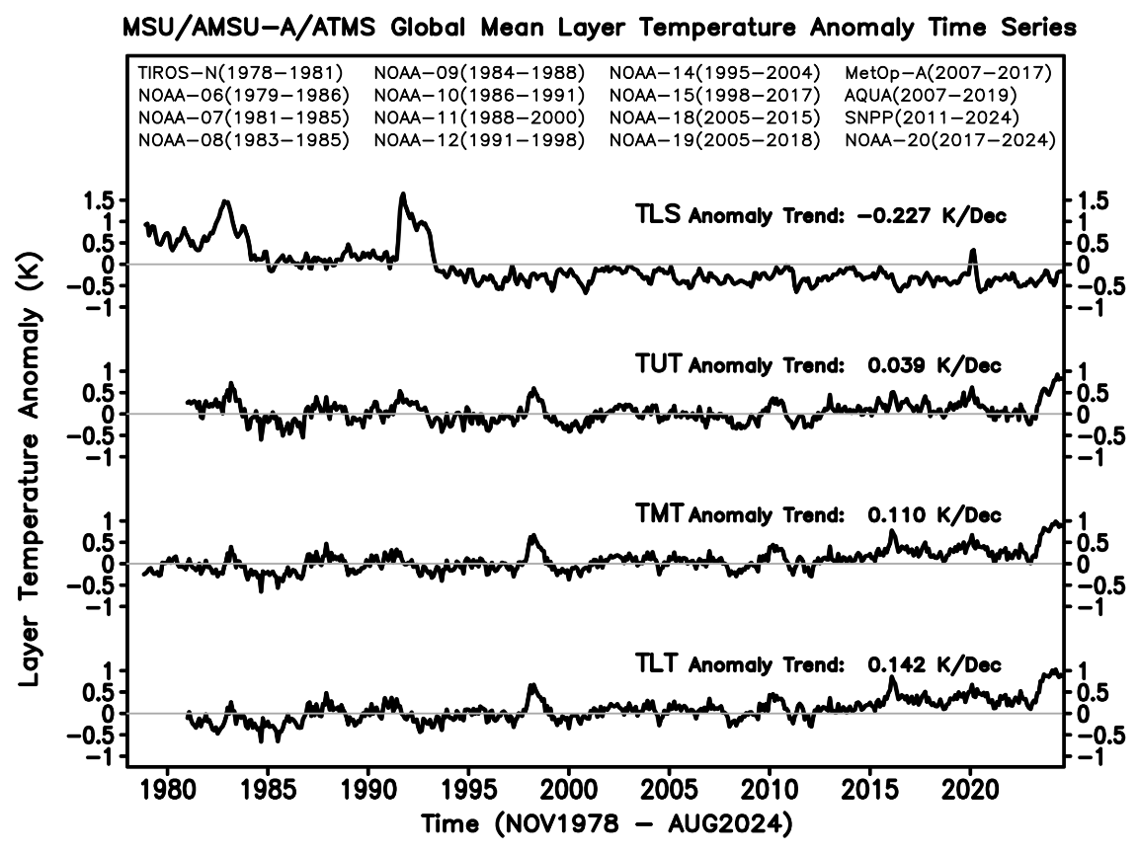
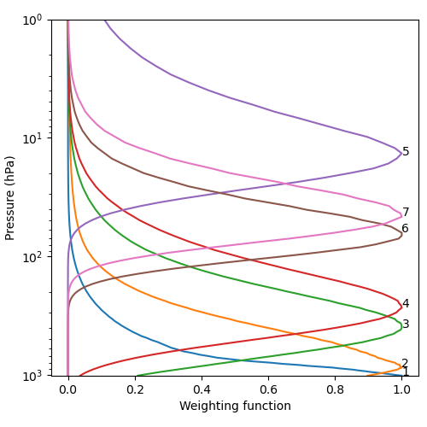
Microwave temperature sounding
MW temperature sounder data are used to monitor atmospheric temperature anomalies
MSU and AMSU-A measurements have been improved over the last decades
However, the calibration can be further improved, and measurement uncertainties can be estimated
SSM/T aboard of DMSP satellites operated parallel to MSU from 1991
SSM/T has more spectral channels providing more information of the higher atmosphere
SSM/T covering additional local equator crossing times

Slide 4
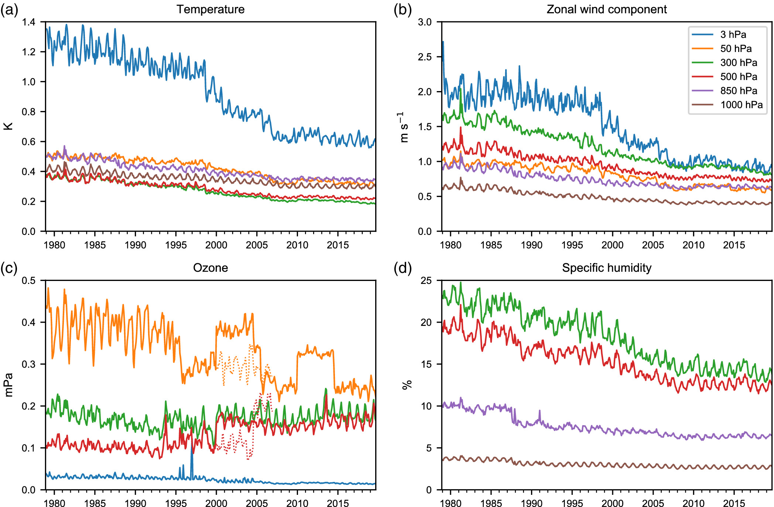
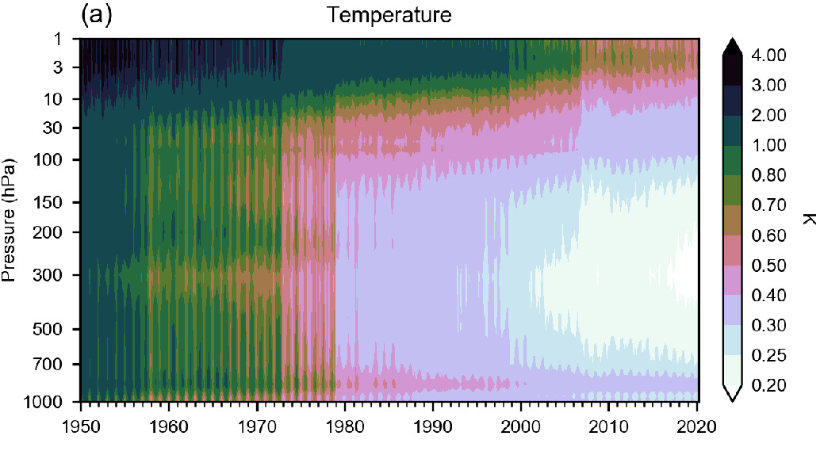
How does ERA5 temperature look like?
Ensemble data assimilation spread versus pressure and time for Temperature in ERA5
Bell, B., et al. (2021) The ERA5 global reanalysis: Preliminary extension to 1950
Hersbach, H., et al. (2020) The ERA5 global reanalysis

Slide 5
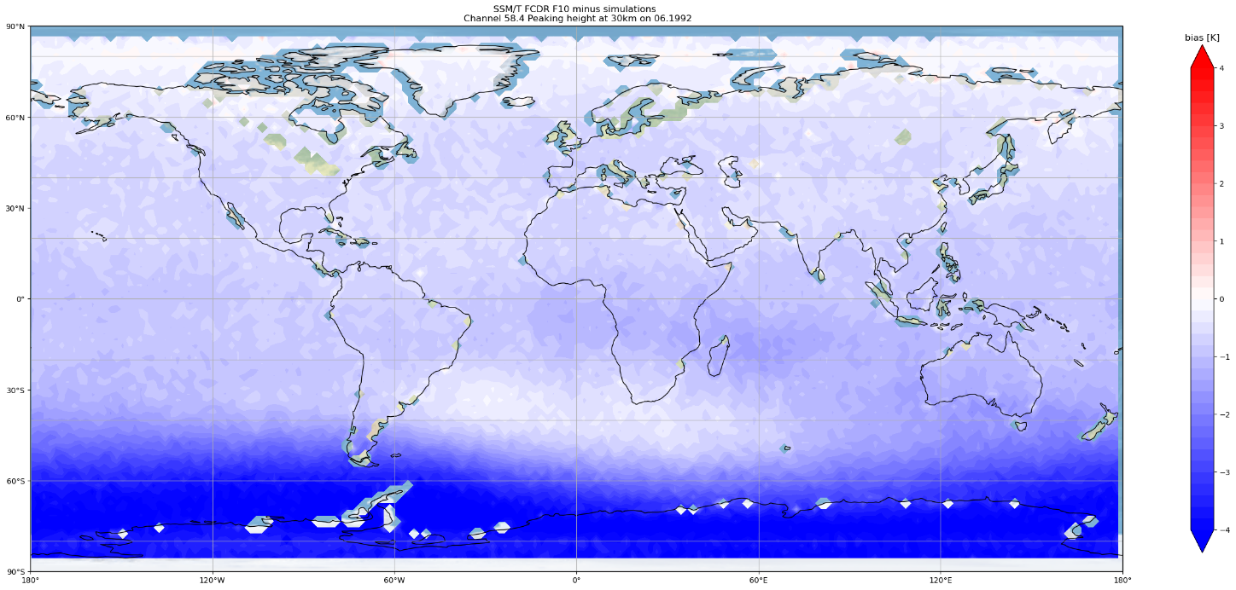
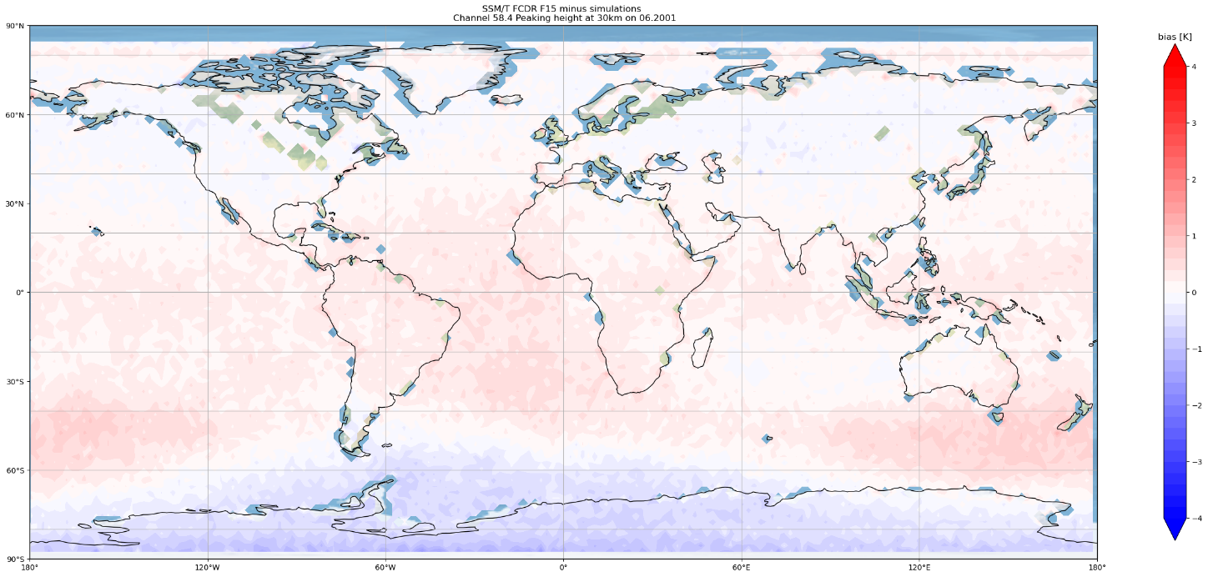
SSM/T vs. ERA-5
SSM/T channel 5@58.4 GHz peaking at 30km
F10 – June 1992 BIAS
F15 – June 2001 BIAS
+4K
+4K
-4K
-4K

Slide 6
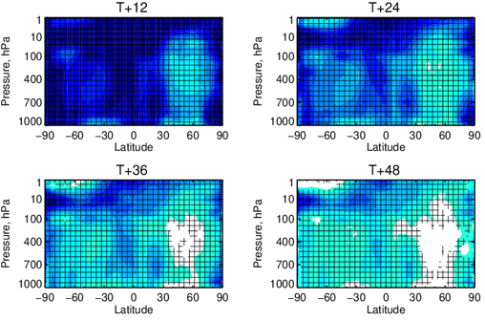
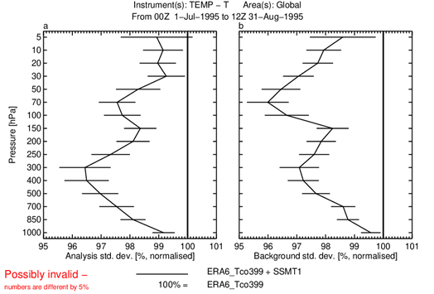
Support to Climate Services – Impact of rescued data in C3S ERA6
Provided SSM/T, SSM/T-2, SSH, SI-1, THIR AMVs data records to be assimilated into ERA6
None of this data has ever been used before in reanalyses
Example: SSM/T Assimilation Experiment
Temperature sounding – Troposphere and Stratosphere (1991-2005)
1st July – 31st August 1995: SSM/T data from DMSP F10, F12, and F13 satellites assimilated in addition to NOAA12 /14 MSU & HIRS and NOAA-14 SSU satellite data
Consistent signs of significant improvements for analysis-based verification with up to 0.5K reduction in stdv. of forecast error
Significantly better background fit to independent radiosonde observations with a few percent reduction in stdv.
Similar results were obtained for SSM/T-2 and SSH data
Change in stdv. of error in Temperature compared to control experiment (blue = reduction or error, hatched = significant)
Better fit to radiosonde data
Graphics courtesy of Bill Bell, ECMWF
Notes:
EUMETSAT has provided several rescued data to C3S for assimilating in ERA6. These data are mainly from Nimbus and DMSP satellites for the use in ERA6: THIR (only AMVs), SSH, SSM/T, and SSM/T2. These measurements were not used in previous reanalyses. The data were obtained from tapes or deep archives from the US and were decoded, cleaned up and converted into modern format (NetCDF4). They were then quality controlled and recalibrated. The data comes with uncertainty estimates when possible.
These data are currently being undergone assimilation tests to their impact on the ERA6 system. When a neutral or positive impact is found, they will be used in ERA6.
The slide shows the impact of such an assimilation test for SSM/T data. It is a temperature sounding instrument with channels in the 60 GHz oxygen band providing information on stratospheric and tropospheric temperatures and shown by the weighting functions.
The assimilation test was done for a period when 3 SSM/T instruments were operating: F10, F12, and F13. There are already other satellite temperature sounding data assimilated during this period from AMSU, SSU, and HIRS. Even then SSM/T data provided a large significant impact globally and all vertical levels as shown in the figures .

Slide 7
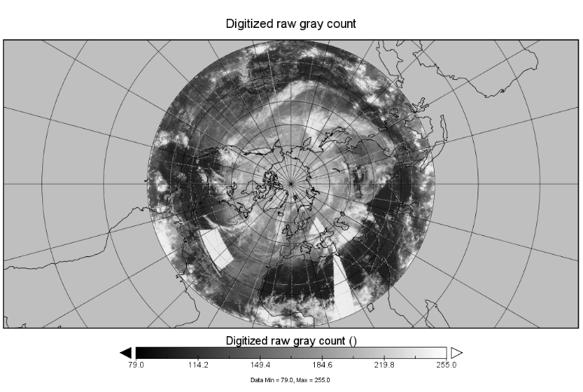

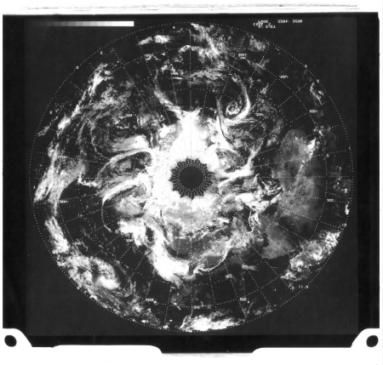
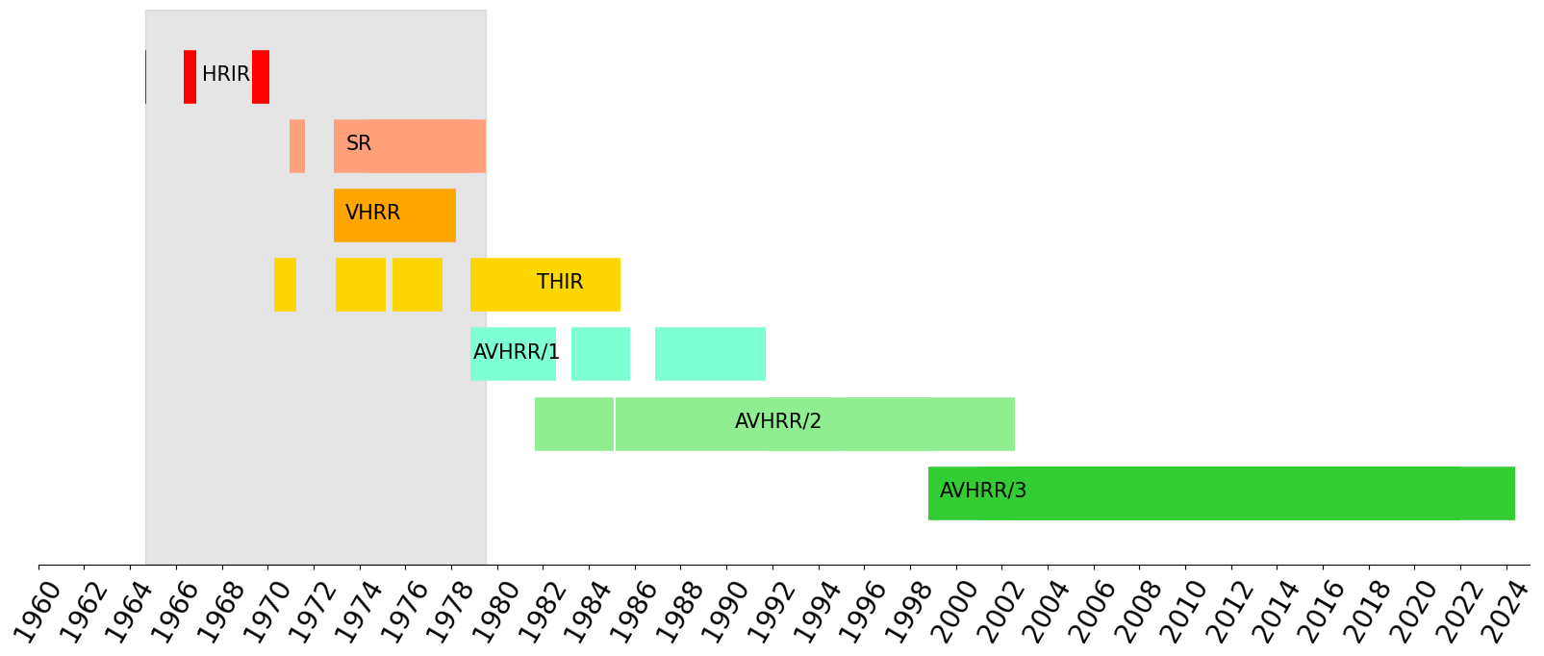
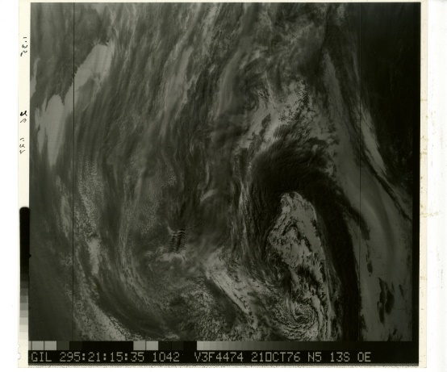
Early imager data for wind retrieval
Climate
Change
Found negatives of VHRR images in the USA. Míght be negatives containing VHRR imagery, from October 1974 through NOAA-5 end of life in 1979.
Instrument | HRIR | SR | VHRR
Satellite | Nimbus-1,-2, and -3 | TIROS-M + NOAA-1 to -5 | NOAA-2 to -5
Period | Aug 1964 – Jan 1970 | Jan 1970 – Jul 1979 | Nov 1972 – Mar 1978
IR channel | 3.4 – 4.2 µm | 10.5 – 12.5 µm | 10.5 – 12.5 µm
Pixel resolution at nadir | 7.5 x 7.5 km² | 7.2 x 7.2 km² | 0.9 x 0.9 km²
Swath width | ~4000 km | ~2500 km | 2580 km
Data available (digital) | Yes | No (only daily composites have been digitised) | No
AMV retrieval potentially possible | Yes: nighttime only | Yes, if orbit data can be localised | Yes, if data can be digitised

Slide 8
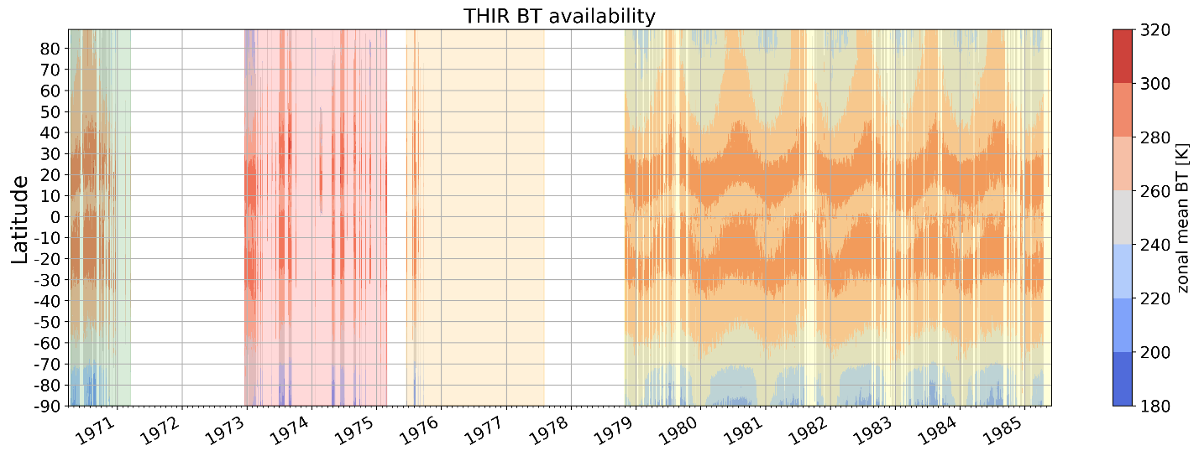
THIR instrument
THIR radiometer
from Hwang, NIMBUS 7 THIR data user’s guide, NASA/Goddard Space Flight Center, 1982.
Climate
Change
Nimbus 4
Nimbus 5
Nimbus 6
Nimbus 7
Satellite | Resolution at nadir | Start date | End date | Wavelength
Nimbus-4 | 22 km x 22 km 8 km x 8 km | 13/04/1970 | 02/04/1971 | 6.7 μm (WV) 11.5 μm (IR)
Nimbus-5 | 22 km x 22 km 8 km x 8 km | 19/12/1972 | 02/03/1975 | 6.7 μm (VW) 11.5 μm (IR)
Nimbus-6 | 22 km x 22 km 8 km x 8 km | 28/08/1975 | 12/08/1977 | 6.7 μm (VW) 11.5 μm (IR)
Nimbus-7 | 6.7 km x 6.7 km | 30/10/1978 | 14/05/1985 | 6.7 μm (WV) 11.5 μm (IR)
Notes:
Temperature-Humidity Infrared Radiometer (THIR) is a two channel high resolution scanning radiometer that was mounted onboard 4 Nimbus polar satellites from 1970 (Nimbus 4) until 1985 (Nimbus 7).
THIR was flying onboard 4 Nimbus polar satellites:
Satellite | Start date | End date
Nimbus 4 | 13 Apr 1970 |31 Mar 1971
Nimbus 5 | 19 Dec 1972 |1 Mar 1975
Nimbus 6 | 18 Jun 1975 | 11 Aug 1977
Nimbus 7 | 30 Oct 1978 |13 May 1985
The plots shown do not contain Nimbus-7 data as they are still in the making at University of Reading within our C3S2_314 sister project
THIR was operating day and night. Two channels are:
Water vapour 6.7 μm (6.5 μm — 7.0 μm) (we do not plan to use the WV for AMVs because of too few images available) – resolution 22 km ssp
Infrared: 11.5 μm (10.5 μm — 12.5 μm) – resolution 7 km ssp
A feasibility study is on going with C3S2.0 to be finished by June 2023 to analyse the THIR FDR (coming from the C3S2_314) project and decide if we can or not retrieve AMVs.
Those AMVs are potentially very important for the reanalysis as this is a unique source of global observations available at that time (prior to 1979).
The large swath of THIR instrument is potentially very as we could derive global AMVs using 2 successive polar orbits/images.

Slide 9
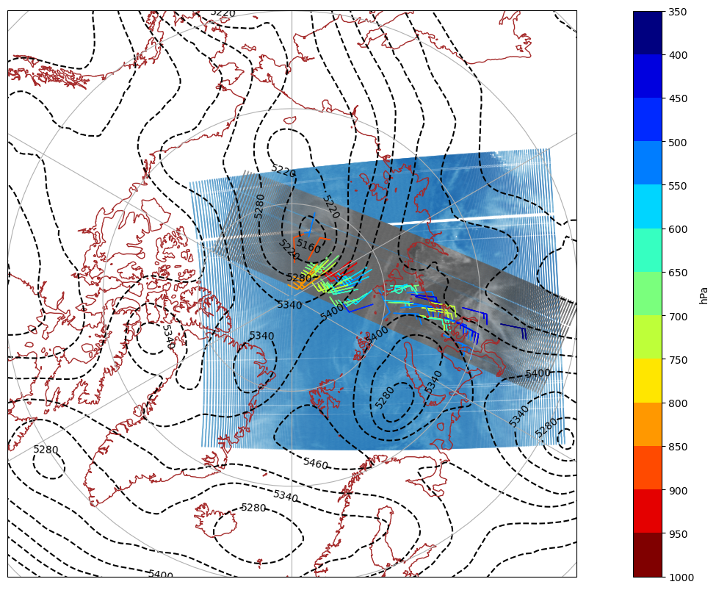
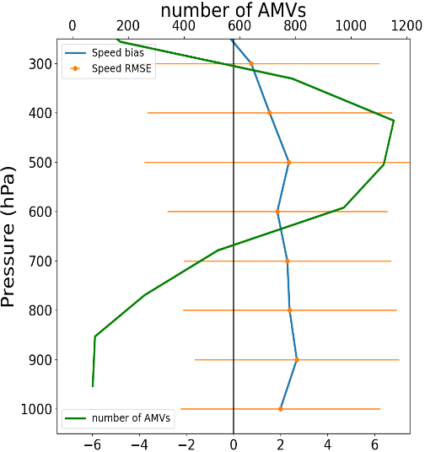
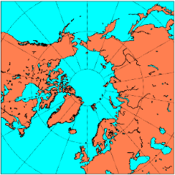
Atmospheric Motion Vectors in 1970
Six months of data quality analysis, e.g., analysing availability of consecutive orbits and algorithm improvements, e.g., search windows etc. led to a credible AMV estimate
Climate
Change
North Pole
April 1970 – December 1970
Comparison THIR – ERA5 (m/s)

Slide 10
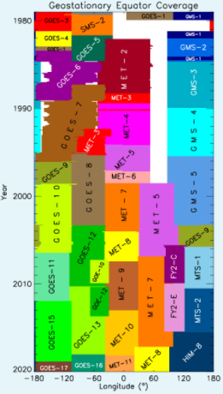
Why GEO-Ring?
Monitoring Earth from space and over the diurnal cycle is essential for studying atmospheric processes and impacts of these processes on Earth’s climate system as well as monitoring of the Earths’ surface
Large investments in establishing and improving the capabilities of the geostationary (GEO) meteorological satellite imagers forming the so-called GEO-Ring have been made and internationally coordinated resulting in more or less uniform capabilities
Exploitation has been pioneered by data sets such as ISCCP but these radiances offer enormous new potential for advancing both science and applications across wide sectors of the Earth science community and thus we consider this to be a resource for many applications
However, existing global data sets have only 3h temporal sampling and gaps exist over the Indian Ocean
Notes:
SMS/GOES 1-7 Data (1978-1996) Rescue – Progress
~2,800 Mode A images thought to be completely lost were recovered. (~60 days)
~8,100 images had corrections to at least 95% of their image lines. (~170 days)
~25,500 images had framing errors corrected that affected every visible scan in an image. (~530 days)
With removal of duplicate images, projected to reduce volume of GOES 1- 7 archive from ~115 TB to ~70TB
Process:
GOES 1-7 provided full disk every 30min
Lines deleted/added: caused by multiple bad/sync or ground station send errors
Bit slip: Bits inserted between sync and type blocks and/or data
Fixed type: IR(0) or VIS (1-8) incorrect, sometimes due to bit slip and/or multiple/bad sync
Fixed line number: line number was changed, caused by bit error
Framing error due to incorrect block size for IR data
GOES 8-15 - Data Stitching
Stitching together GOES domains for consistent 30 min “Full” Disk CDR
Unlike some of the other geostationary satellites, GOES 8-15 made observations in several domains to optimize temporal coverage over the USA
QC tools to detect and flag anomalies - complete for all Meteosat, Himawari, and GOES-8 onwards. Extending to rescued SMS, and GOES-1 to -7 data
Still apparent gap over Indian Ocean

Slide 11
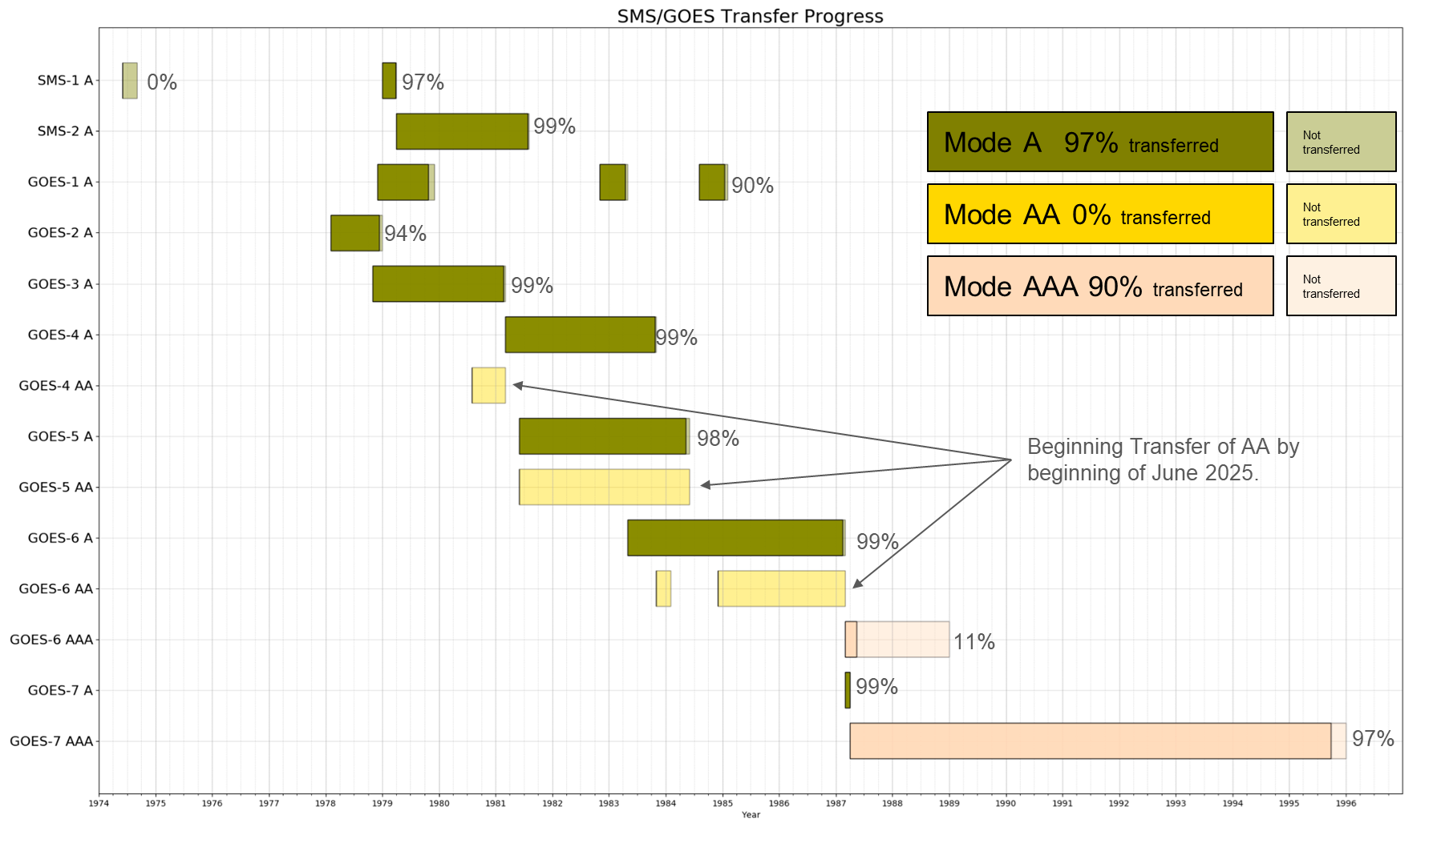
Data rescue of early US data at NOAA
Graphic courtesy of A. Heidinger, NOAA
1974
1976
1978
1980
1982
1984
1986
1988
1990
1992
1994
1996

Slide 12
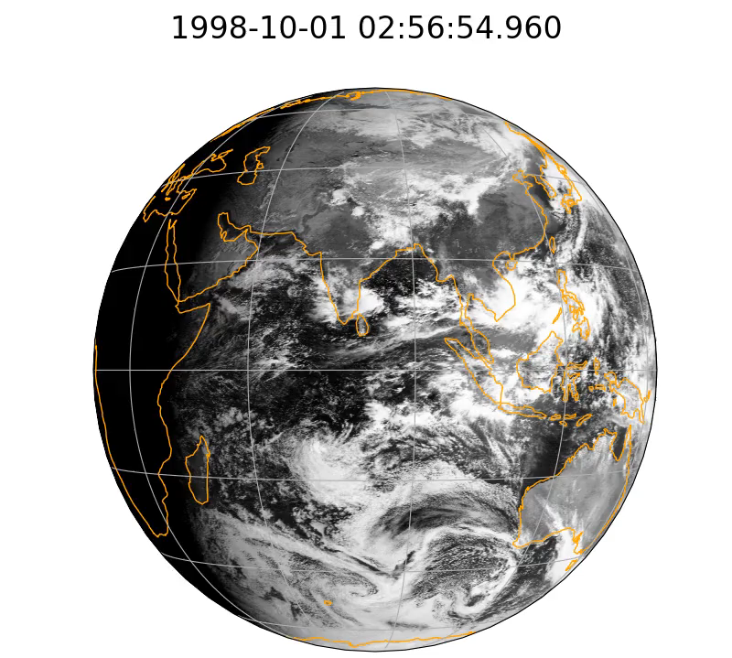
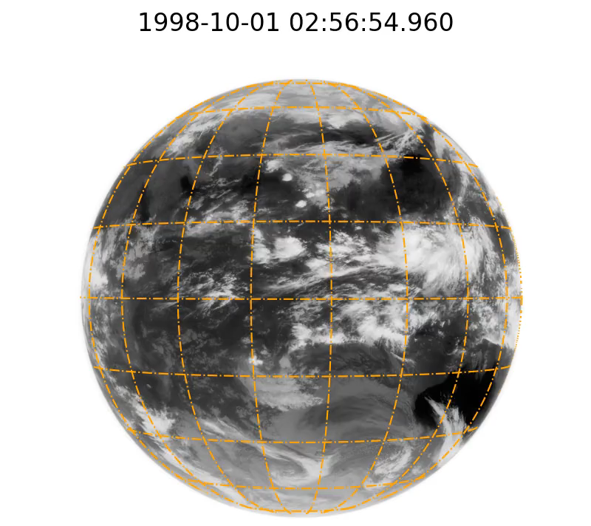
Filling gaps with INSAT
Received subsets of INSAT-1A (1987, 1988, and 1990), INSAT-1B (few files for 1984, 1985, 1992), INSAT-1D (1992, 1993, 1998 (time with Met-5 IODC)) from IMD
Quality analysis and feasible assessment of including to GEO-Ring is ongoing
Will improve completeness of GEO-Ring data (ISCCP used only 3 satellites in some years)
VIS channel, 2.75 km resolution
IR channel, 11 km resolution

Slide 13
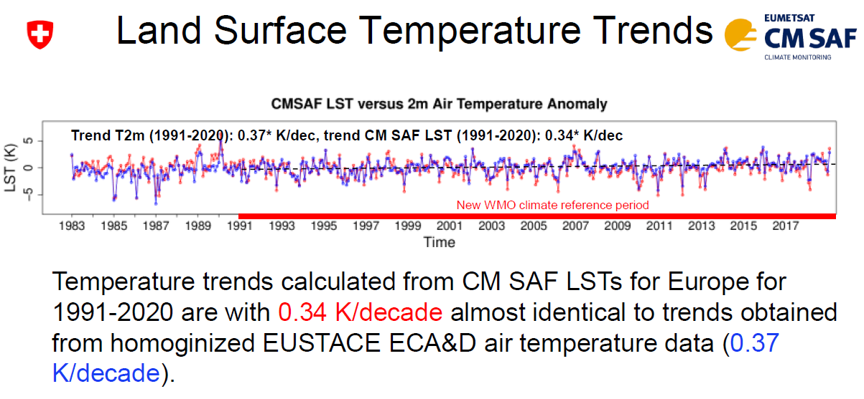
Quality evaluation – via Level 2 data
Slide from Anke Duguay-Tetzlaff@meteoswiss

Slide 14
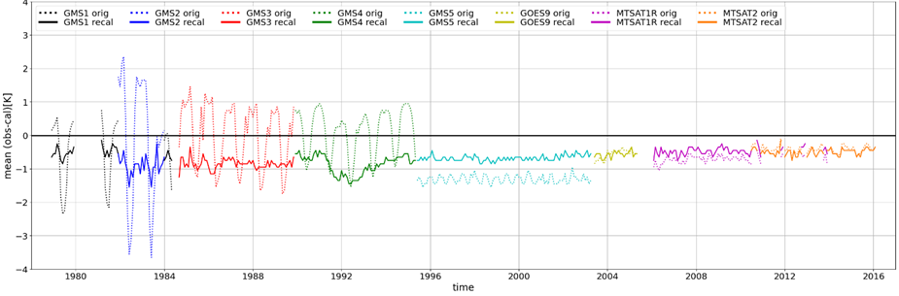
Quality evaluation – via L1 data simulations
Reference measurements are not easily available
Compare against simulated radiances from climate quality reanalysis
Observation – simulations using ERA5
Poli, P., R Roebeling, VO John, . Schulz et al. (2023) Radiance Simulations in Support of Climate Services, Earth and Space Science, 10, e2023EA002868. https://doi.org/10.1029/2023EA002868

Slide 15
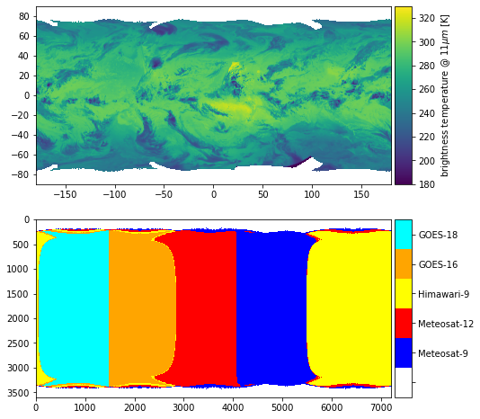
GEO-Ring L1g data
Static test data set will be available until the end of 2025:
    6 years: 2019 – 2024, HEALPix in NetCDF and Zarr, equal angle in NetCDF
    30 minutes and 5 km² sampling
    ABI, AHI, and SEVIRI – all channels
    Distribution on European Weather Cloud (EWC) and EUMETSAT Data Store, NOAA cloud is expected as well
    Use of data is free of charge, no redistribution, EWC can be accessed by EUM MS or European Research Projects
  A user workshop for feedback to test data set is planned for 2026 at EUMETSAT
  Full product planned for late 2027

Slide 16

Conclusion
Performed a few full cycles from rescue to impact in climate data records and reanalyses with very positive outcomes
AI/ML will be the next big user, e.g., DOP models
International cooperation is key to maintain historic data and make them useful in applications
Data are accessible in the EUM User Portal
and in the European Weather Cloud

